Slide 1
CS1010S
Tutorial 4: Higher Order Functions & ADT

Slide 2
Recap
Lambda Functions
Higher Order Functions
Abstract Data Types

Slide 3
Lambda Functions
def make_root(n):
def root(x):
return x**(1/n)
return root
make_root = lambda n: lambda x: x ** (1/n)
make_root(3)(27)
# 3.0

Slide 4
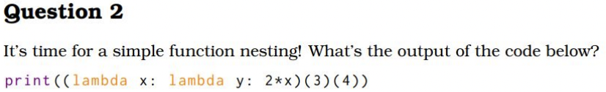
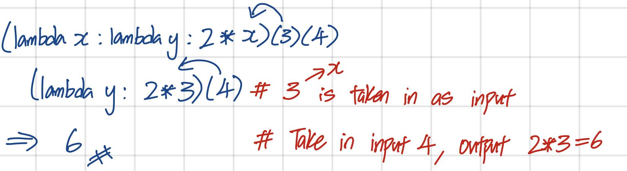

Slide 5
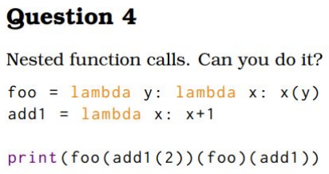
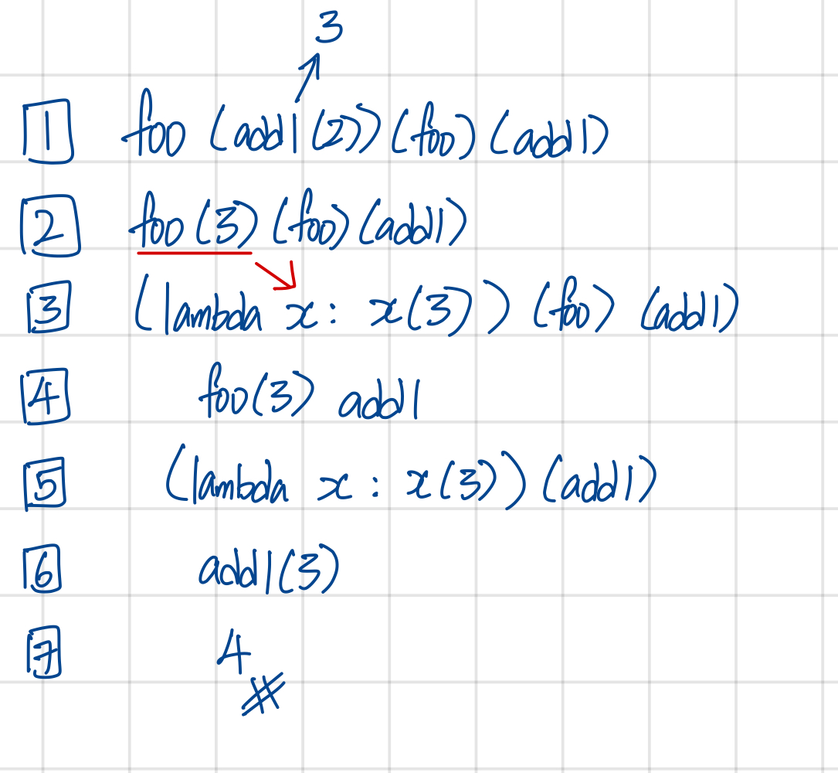
Hint:
foo(y)(x) = x(y)
add1(x) = x + 1

Slide 6
Higher Order Functions
Higher-order functions achieve data encapsulation.
Creating a function from another function
def compose(f, g):
return lambda x: f(g(x))
def thrice(f):
return compose(compose(f, f), f)

Slide 7
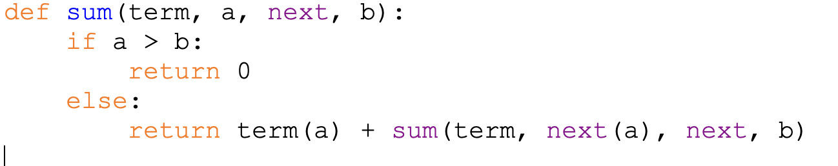
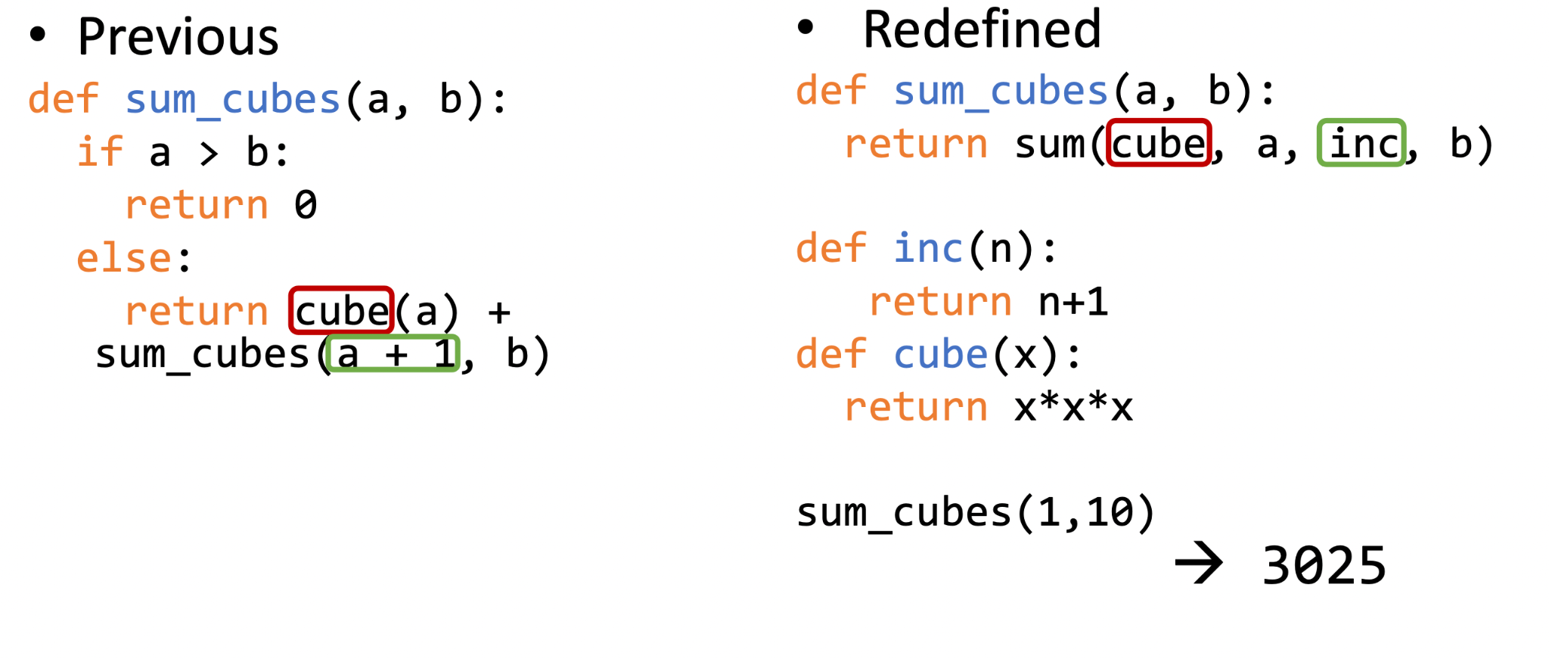
term = cube
inc = next

Slide 8
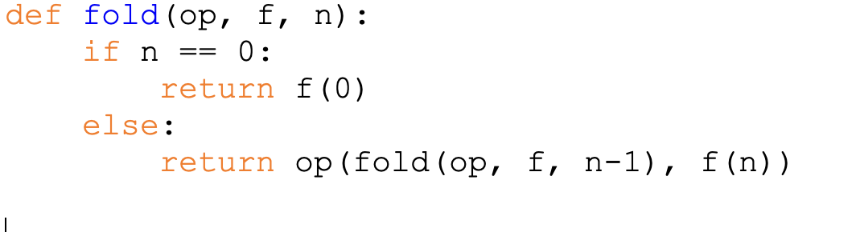
HOF (Fold)
Operation to do
Recursion to get n-1, n-2… values
Current value after applying the function
Add the binary operator on f(0) and f(1), then f(2) and the previous result… then f(n) with the previous result

Slide 9
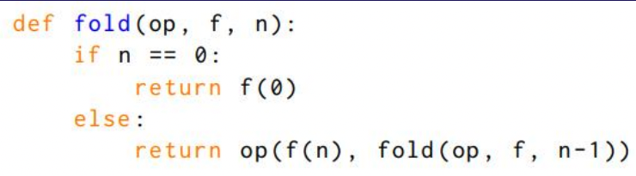
Another variation of Fold
f(n) ⊗ (f(n-1) ⊗ (f(n-2) ⊗ ... (f(1) ⊗ f(0)))...)

Slide 10
Example
fold(lambda x, y: x - y, lambda x: x**2, 4)
= (((0 - 1 **2) - 2**2) - 3 ** 2) - 4 ** 2
= -1 - 4 - 9 - 16
= -30

Slide 11
Example
fold(lambda x, y: x-y, lambda x: x**2, 4)
= 4 ** 2 - (3 **2 - (2 ** 2 - (1 ** 2 - 0))
= 16 - 9 + 4 - 1
= 10

Slide 12
Why did we attain different results?
The output depends on whether the operation being done is commutative
Changing the order of the operations doesn't affect the output
Commutative | Non-Commutative
Addition ( 1 + 2 == 2 + 1 ) Multiplication ( 5 * 4 == 4 * 5 ) | Subtraction ( 1 - 2 != 2 - 1 ) Division ( 5 / 4 != 4 / 5 )

Slide 13
Abstract Data Types
Internal implementation of the ADT is hidden from the user
User only needs to know the expected behaviour
make_point = lambda x, y: (x+y, 2 *x)
get_x = lambda p: p[1] / 2
get_y = lambda p: p[1] - p[0]
get_x(make_point(2, 9)) == 2
get_y(make_point(2, 9)) == 9

Slide 14
Abstract Data Types
Getters and Setters provide an interface to these data structures
We aren't supposed to know about how the data is being stored
Eg:
p = make_point(2, 9)
x = p[0] VS x = p.getX()
Which is correct?
Or is both fine?

Slide 15
Abstract Data Types
Getters and Setters provide an interface to these data structures
We aren't supposed to know about how the data is being stored
Eg:
p = make_point(2, 9)
x = p[0] VS x = p.getX()
Which is correct?
Or is both fine?
❌
✅
Breaking Abstraction!
Please don't do this!

Slide 16
Tutorial Questions

Slide 17
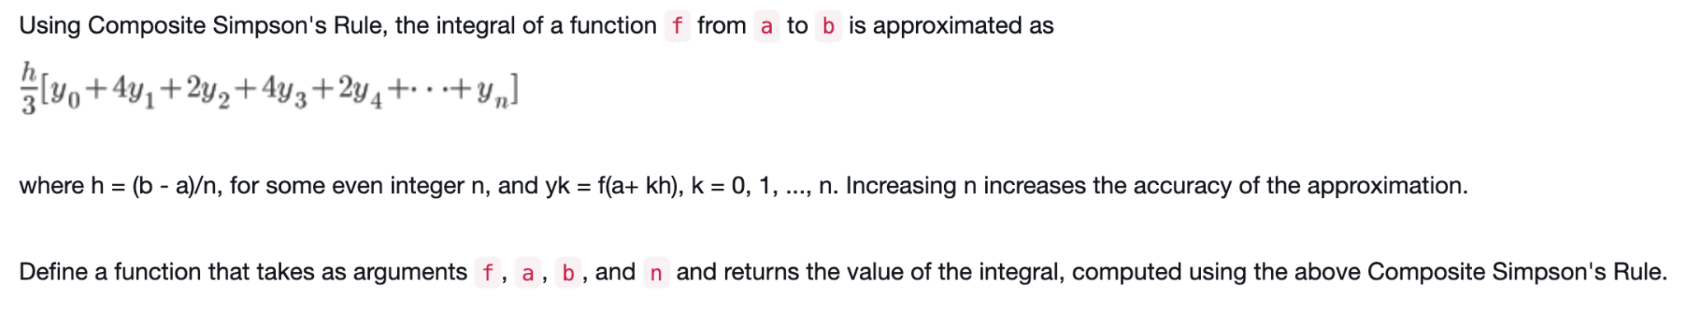
Question 1: Composite Simpson's Rule
Since we are learning about HOF, what does this pattern remind you of?

Slide 18
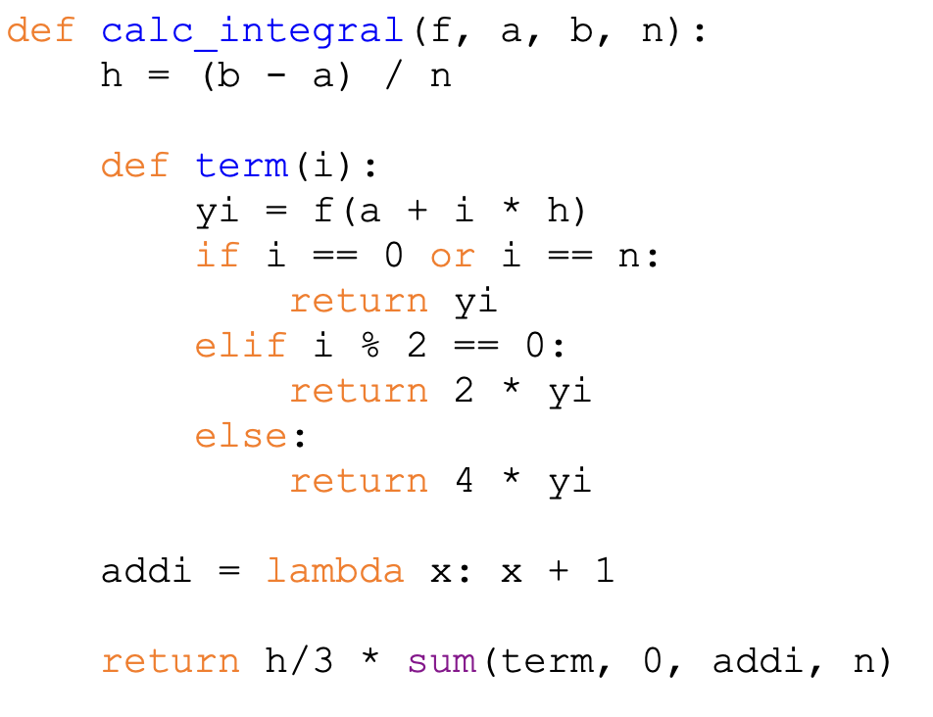
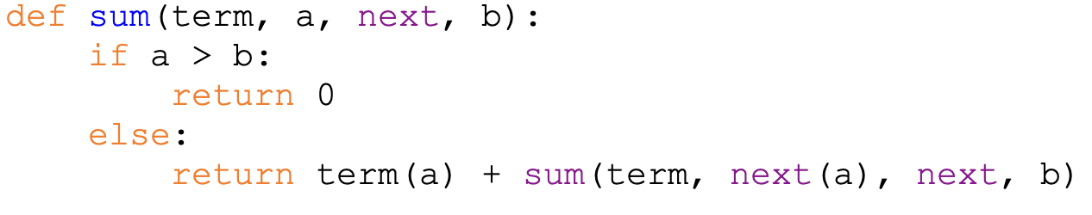

Slide 19
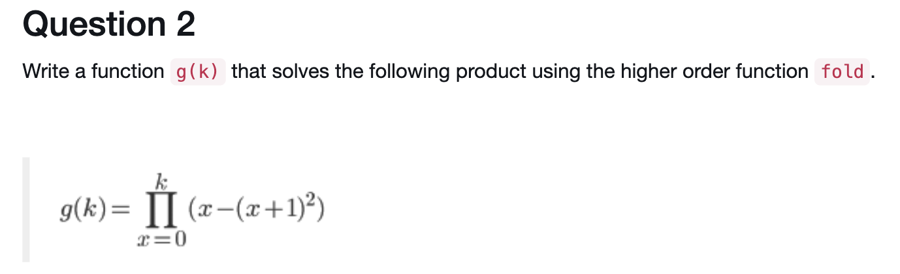
Question 2

Slide 20
What should we use as our parameters for fold?
op: Multiply (*)
f: (x - (x+1)**2)
n: k

Slide 21
term
n
op

Slide 22
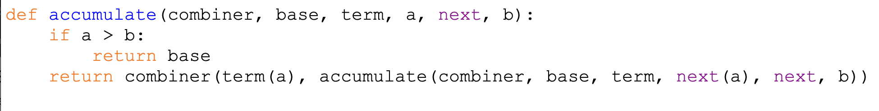
Base value
Tells us how to combine
Next term
Next value of a

Slide 23
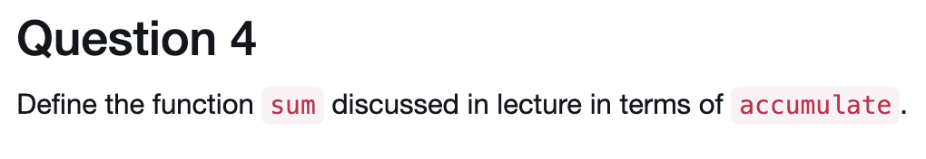
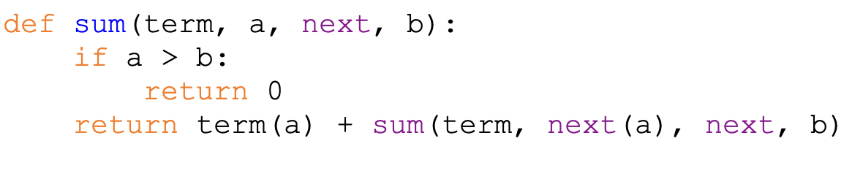
Need to see what accumulate needs
combiner -> how to combine terms (add things together)
base -> Should be 0
term -> current term
a -> lower bound
next -> how much to increment a
b -> upper bound

Slide 24
Put them together and you should get this!

Slide 25
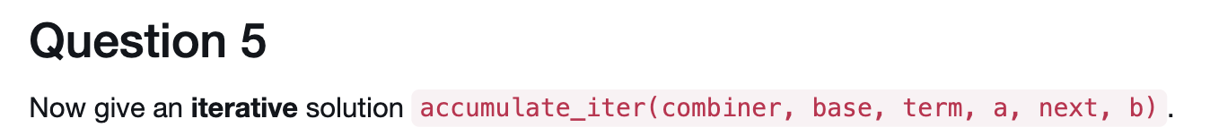
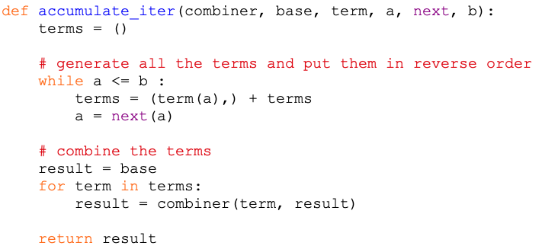

Slide 26
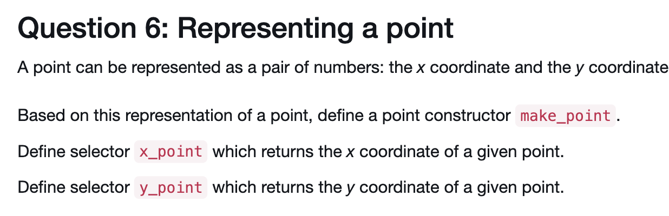
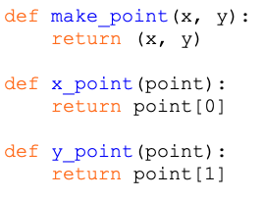

Slide 27
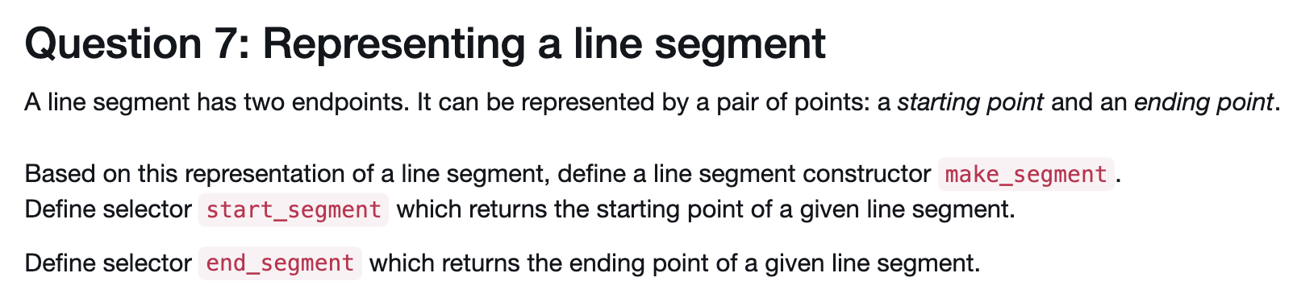
def make_segment(start, end):
Return (start, end)
def start_segment(seg):
Return seg[0]
def end_segment(seg):
Return seg[1]

Slide 28
Input: Segment
Output: Midpoint of the segment
What do we need to calculate?
Mid point value of x and y

Slide 29
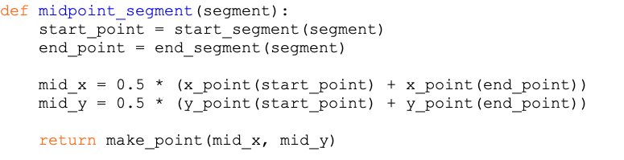
NO start_point[0]!!

Slide 30
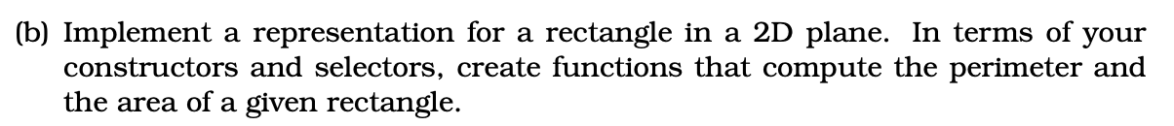
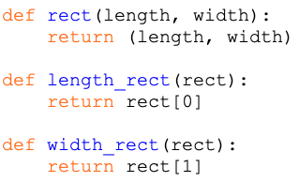

Slide 31
