Slide 1
Tutorial 5: Working with Sequences
Tutorial Group: 15A

Slide 2
Topics
Tuples
Equivalence (is vs ==)
Higher Order Functions (map, filter)

Slide 3
Tuples
Data type that is ordered and unchangeable (immutable)
Defined by using round brackets
How are they useful?
Tuples are immutable, so they can be used to prevent accidental addition, modification, or removal of data.
If we make want to store data, we don't want accidental changes to our records!
What makes difference between lists different from tuples then?
Immutability!

Slide 4
Creating Tuple Sequences
s = ()
for i in range(5):
s += (i,)
print(s) # (1, 2, 3, 4, 5)
Time Complexity: O(n^2)
Space Complexity: O(n)
# n is the size of the array

Slide 5
Creating Tuple Sequences
# Creating tuples from strings
tuple("1234") -> ("1", "2", "3", "4")
tuple("1, 2, 3, 4".split(" ")) -> ("1", "2", "3", "4")

Slide 6
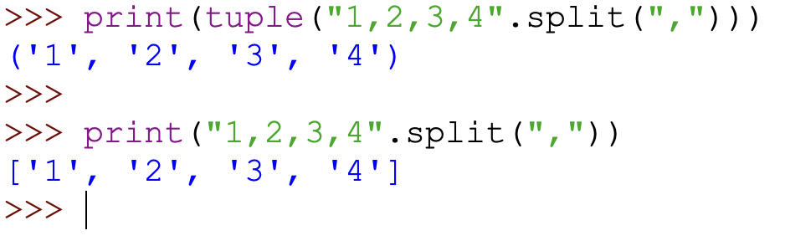
What's going on here?
Read more here: https://www.w3schools.com/python/ref_string_split.asp

Slide 7
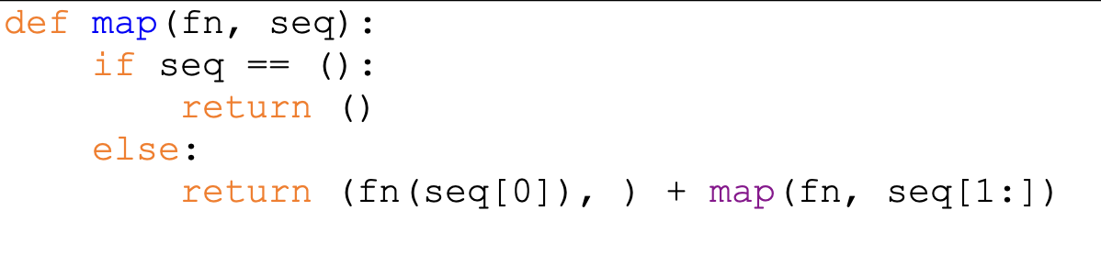
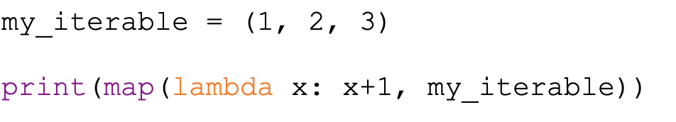
Higher Order Functions w/ Iterables
map
What does it take in?
Function to apply to each element
Iterable (tuple/list) to apply your function to the elements
Output: Iterable with all the elements being affected by the function
Output: (2, 3, 4)

Slide 8
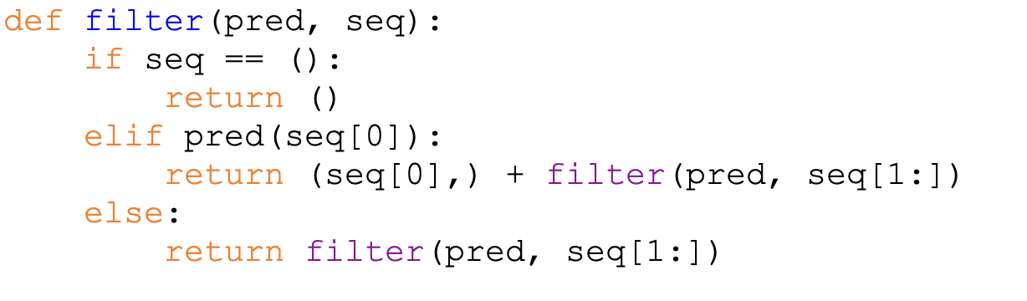
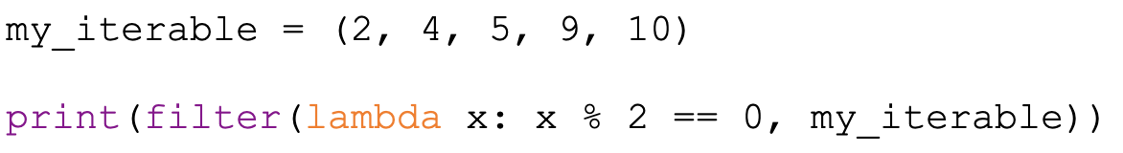
Higher Order Functions w/ Iterables
filter
What does it take in?
Filter condition to check each element
Iterable (tuple/list) to apply your function to the elements
Output: Iterable with all elements that passes our check
Output: (2, 4, 10)

Slide 9
Equivalence
There is a difference between is and ==
is (identity check) | == (equality check)
Checks whether the two variables points to the same object in memory | Checks whether the two variables have the same value

Slide 10
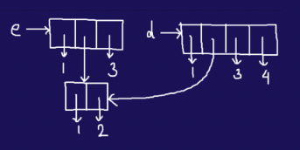
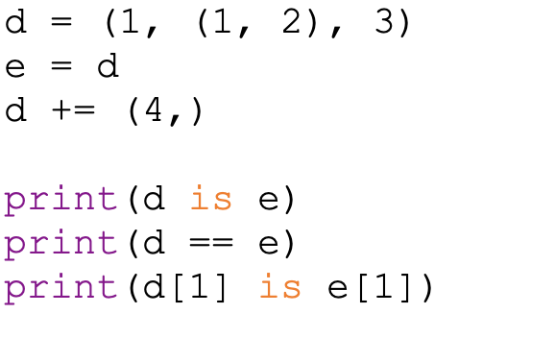
Equivalence
# False
# False
# True

Slide 11
Tutorial Questions

Slide 12
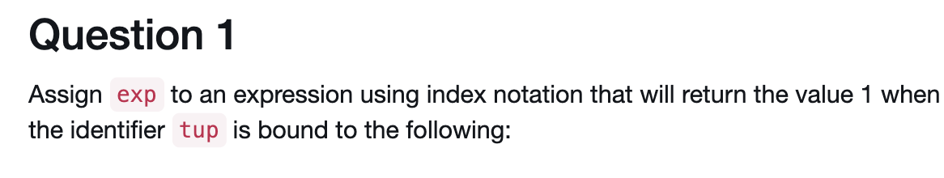
tup = (7, (6, 5, 4), 3, (2, 1))
What index should we use to get the value 1?
exp = tup[3][1]

Slide 13
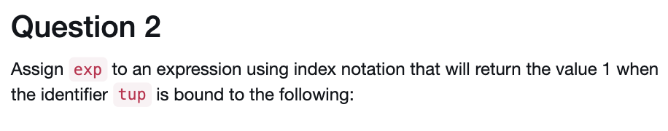
tup = ((7), (6, 5, 4), (3, 2), 1)
What index should we use to get the value 1?
exp = tup[3]

Slide 14
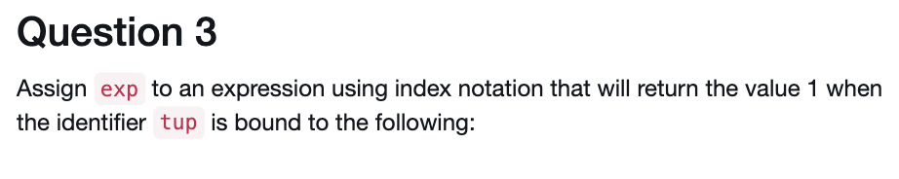
tup = (7, (6,), (5, (4,)), (3, (2, (1,))))
What index should we use to get the value 1?
exp = tup[3][1][1][0]

Slide 15
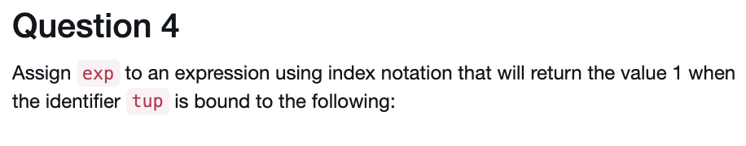
tup = (7, ((6, 5), (4,), 3, 2), ((1,),))
What index should we use to get the value 1?
exp = tup[2][0][0]

Slide 16
What is the question asking?
Output the elements that are are in the odd indexes of the tuple
my_tup = (1, 2, 3, 4, 5)
print(odd_indices(my_tup)) => (2, 4)

Slide 17
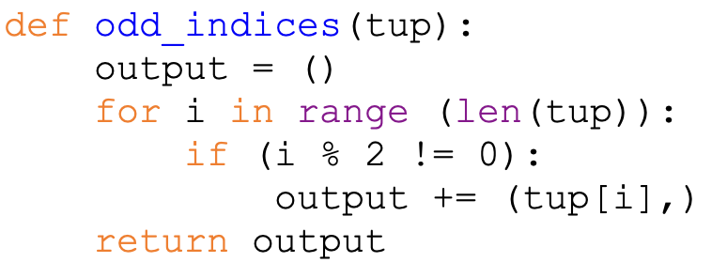

Slide 18
Is there another way to solve this?
What does this remind you off?
# Using Slicing!
def odd_indices(tup):
return tup[1:len(tup):2]

Slide 19
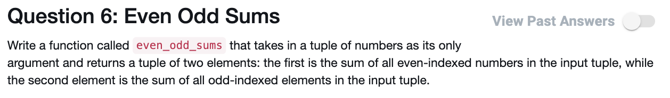
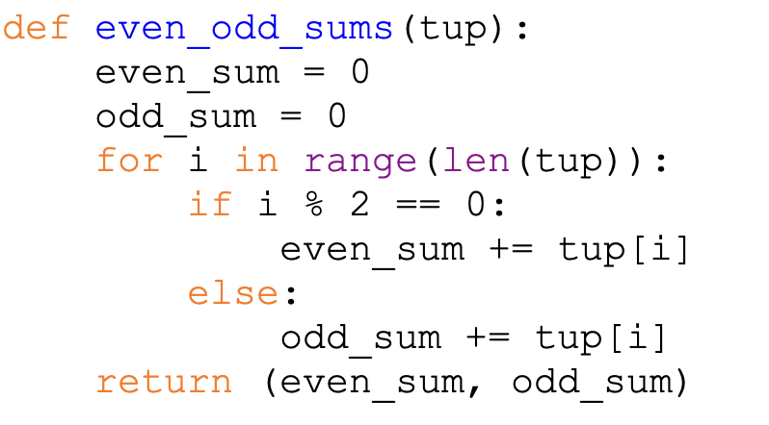
# Use a for loop
# Iterate and keep track of the sum for the even and odd-indexed elements
# return the sums in a tuple

Slide 20
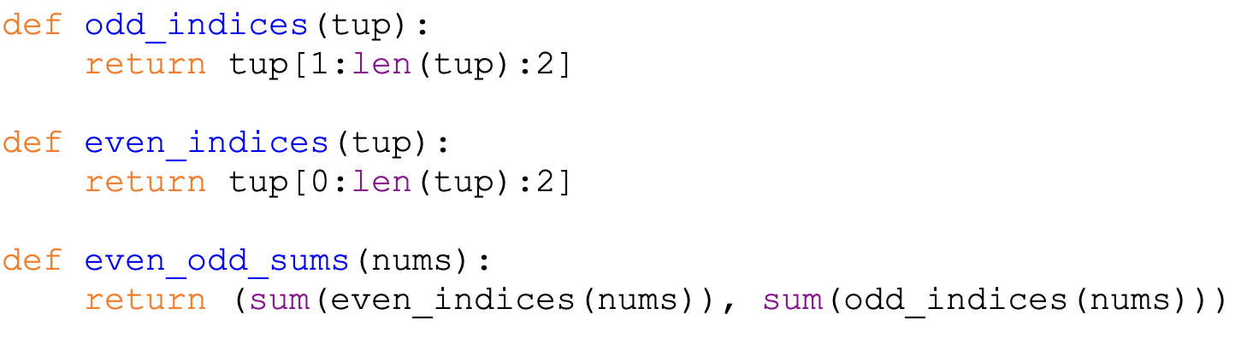
Using the idea of tuple slicing, how can we go about this question?
# Create a new tuple of the even-indexed elements
# Create a new tuple of the odd-indexed elements
# Use sum to add up the values of these tuples (iterable)

Slide 21
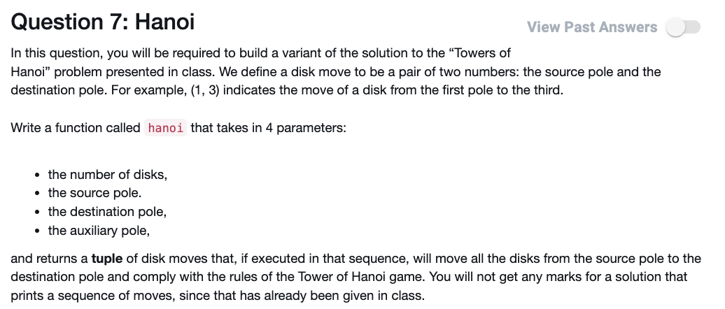
Tower of Hanoi
Input:
n — number of disks (iterating)
src — source pole
des — destination pole
mid — remaining/auxiilary pole
Output: print the steps (n, src, mid, des)

Slide 22
Tower of Hanoi
n = 1 (base case)
src -> des #(1, src, mid, des)
n =2
src -> mid #(1, src, des, mid)
src -> des #(1, src, mid, des)
mid -> des #(1, mid, src, des)

Slide 23
Tower of Hanoi
n = 3
src -> des
src -> mid
des -> mid
src -> dest
mid -> src
mid -> des
src -> des
#(2, src, des, mid)
#(1, src, mid, des)
#(2, mid, src, des)
Any Patterns?

Slide 24
n = 3
src -> des
src -> mid
des -> mid
src -> dest
mid -> src
mid -> des
src -> des
#(2, src, des, mid)
#(1, src, mid, des)
#(2, mid, src, des)
Any Patterns?

Slide 25
Tower of Hanoi
def hanoi(n, src, mid, des):
if n == 1:
print(f"{src} -> {des}")
else:
hanoi(n - 1, src, des, mid)
print(f"{src} -> {des}")
hanoi(n - 1, mid, src, des)
How to convert this into a tuple sequence of moves?

Slide 26
