Slide 1
Tutorial 7: List Processing & Data Structures

Slide 2
Content
Dictionaries
Common Data Structures
Queues
Stacks

Slide 3
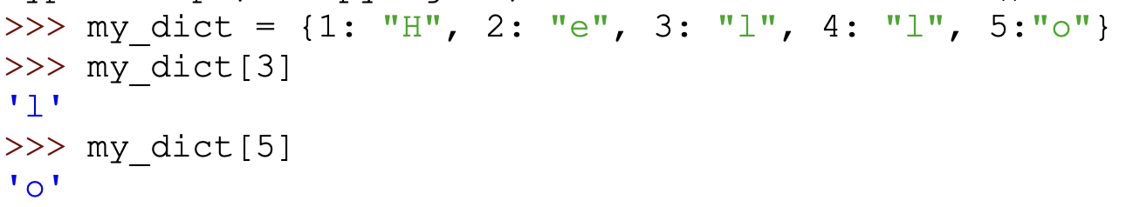
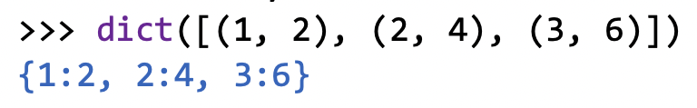
Dictionaries
What are dictionaries?
A data structure that store <Key, Value> pairs
Each key maps to a particular value

Slide 4
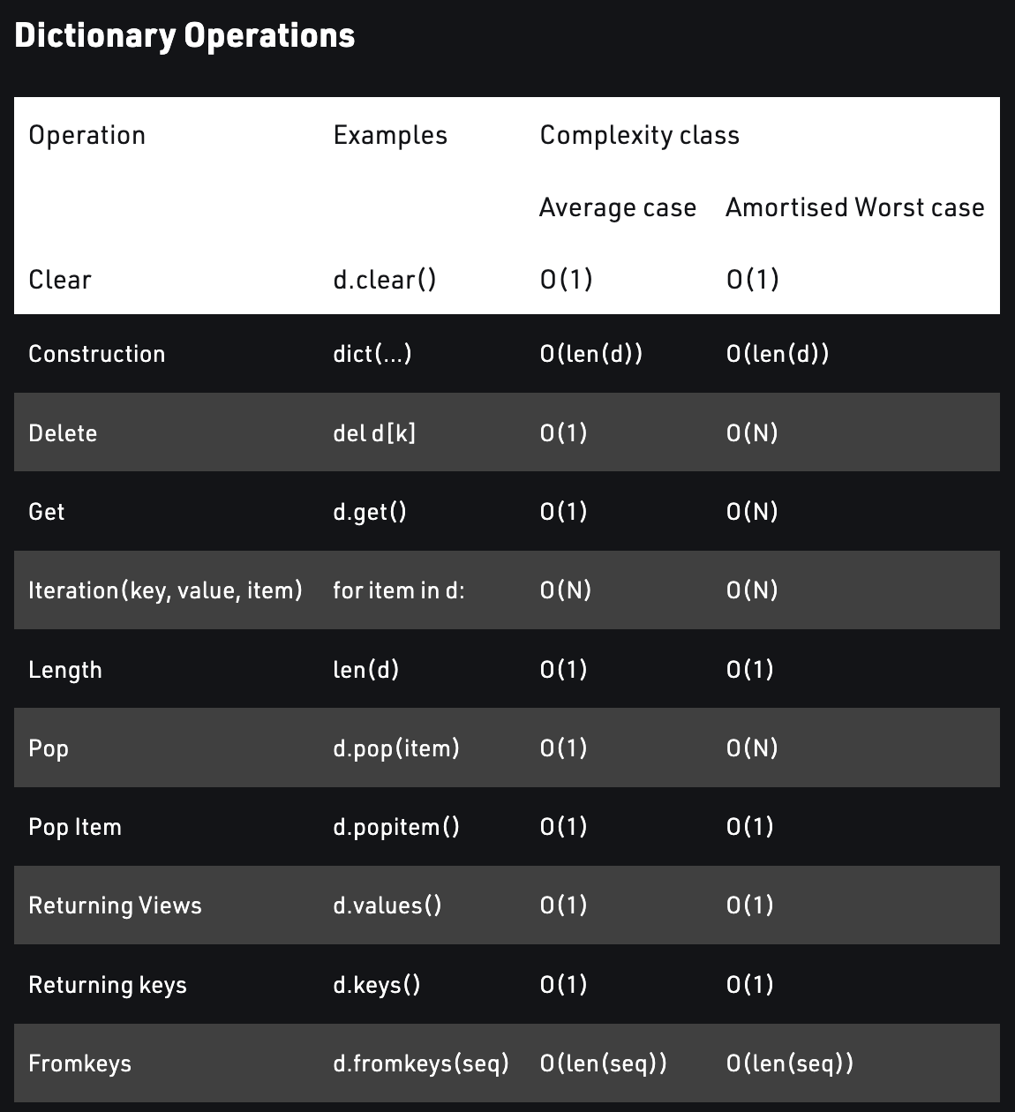
Dictionaries
Dictionaries are more efficient than lists in terms of getting values that you want
Get a key in O(1) time.

Slide 5
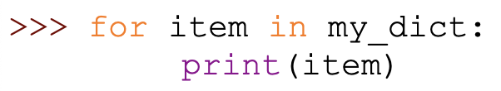



Looping with a dictionary
-> Prints the keys
-> Prints the values

Slide 6
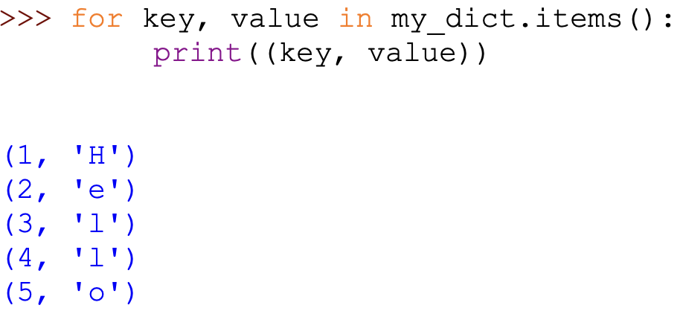
Looping with a dictionary

Slide 7
Dictionaries
Adding elements to the dictionary
Accessing the value using the key
weather['is nice'] => True
weather.get('is nice') => True
What would be a better way to get your value?

Slide 8
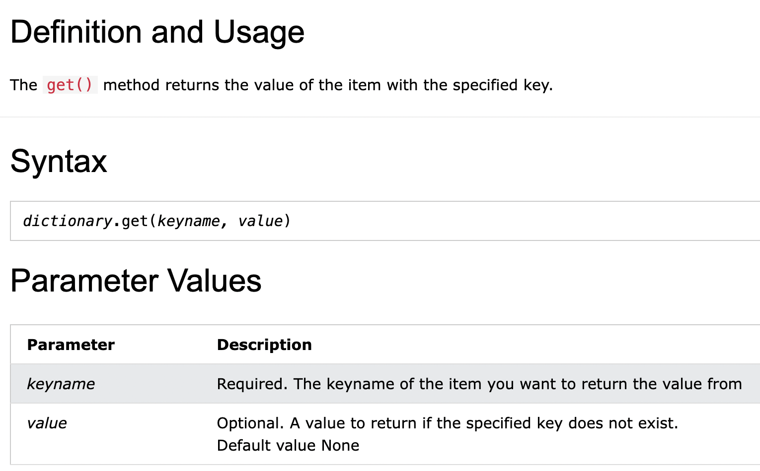
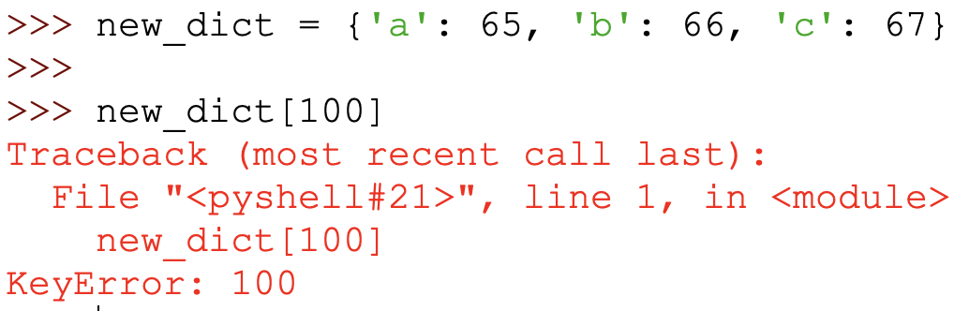
Dictionaries
What if the dictionary does not have that key?
-> A KeyError will be thrown

Slide 9
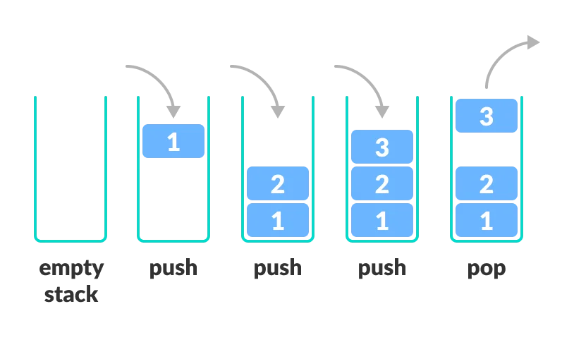
Stacks
First-In-Last-Out (FILO) data structure
Common Operations:
push(element)
Pushes the element on top the stack
pop()
Removes the element on top of the stack
How can we represent a Stack using the Data Structures we already know?
Examples: Lists & many more

Slide 10
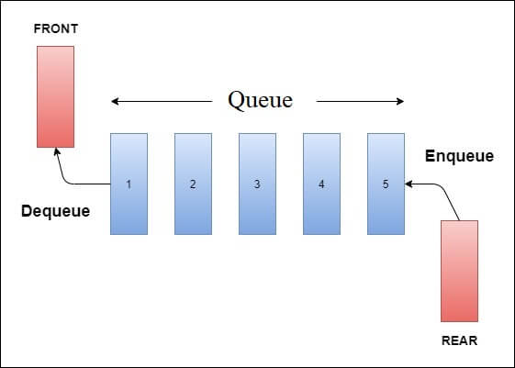
Queues
First-In-First-Out (FIFO) data structure
Common Operations:
push(element)
Pushes the element to the back of the queue
pop()
Removes the element at the front of the queue
How can we represent a Queue using the Data Structures we already know?
Examples: Lists & many more

Slide 11
Tutorial Questions

Slide 12
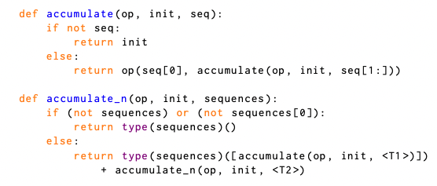
If given [[1, 2, 3], [4, 5, 6], [7, 8, 9], [10, 11, 12]],
accumulate_n(lambda x, y : x + y , 0, s) # [22, 26, 30]
What does accumulate_n do?
For each nested list, get the ith element, and apply accumulate on them.
Repeat for the other elements (i+1, i+2, … n)

Slide 13
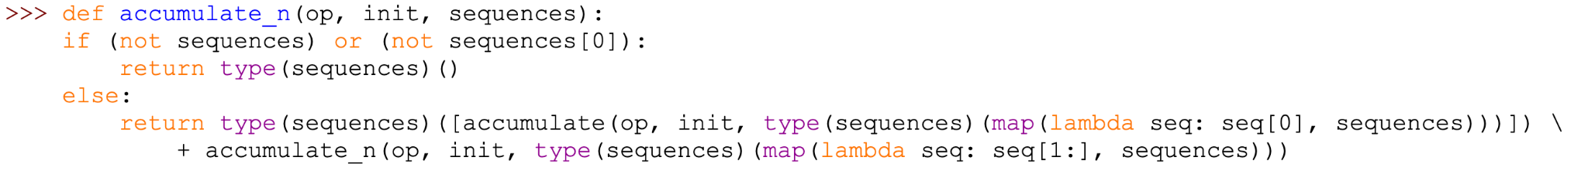
<T1>
<T2>
T1: gets all the first elements in the sequence
T2: Removes the current 0th position element in all the nested lists in the sequence

Slide 14
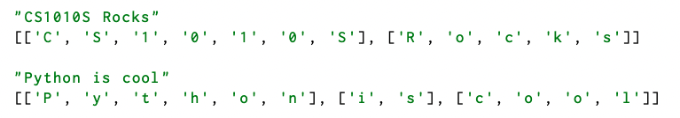
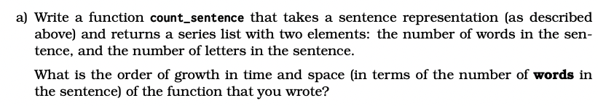
Words in sentence = Number of lists
Letters in sentence = Number of letters in each list + spaces

Slide 15
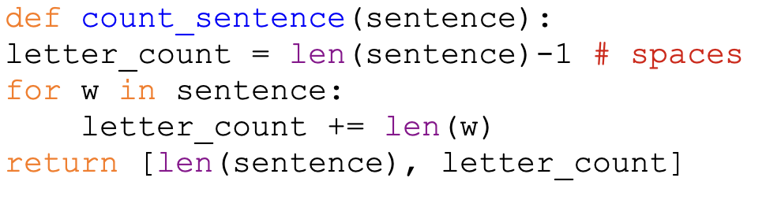
Time Complexity: O(n)
Space Complexity: O(1)

Slide 16
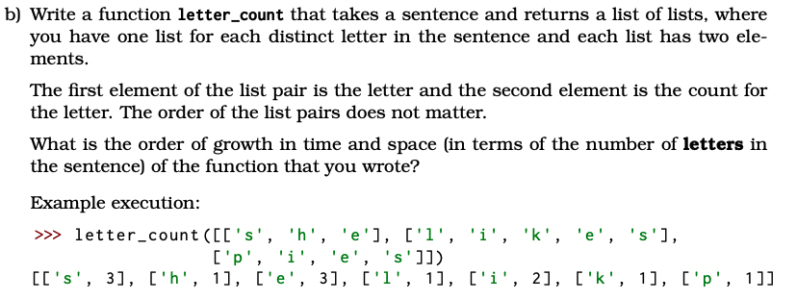
What data structure can we use to keep track of the count?
Maybe a dictionary?
Key Value Pairs are stored

Slide 17
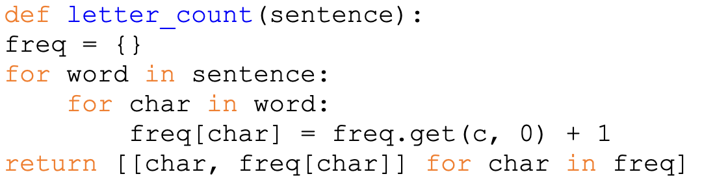
Time Complexity: O(n)
Space Complexity: O(n)

Slide 18
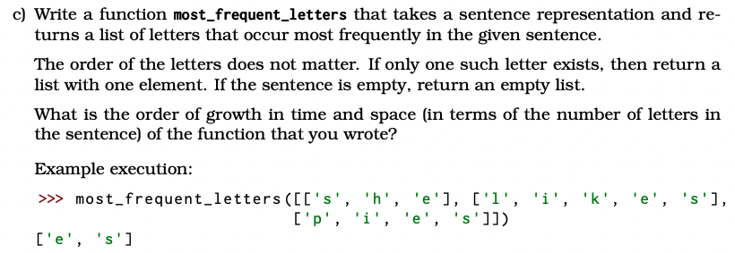

Slide 19
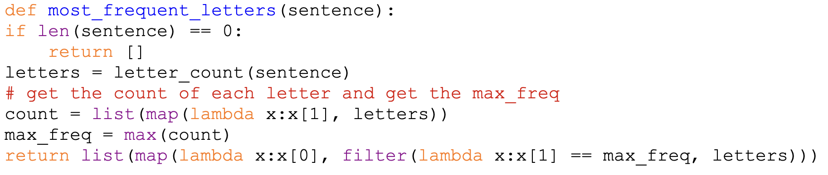
Time Complexity: O(n)
Space Complexity: O(n)

Slide 20
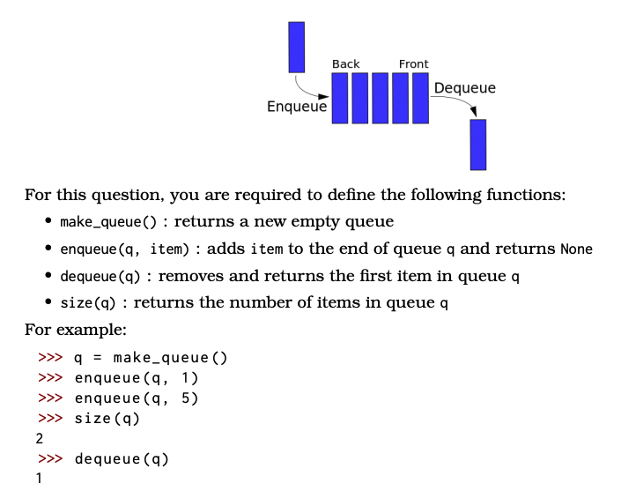
Using a List!

Slide 21
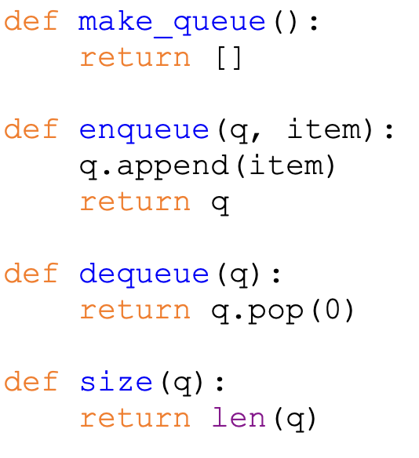

Slide 22
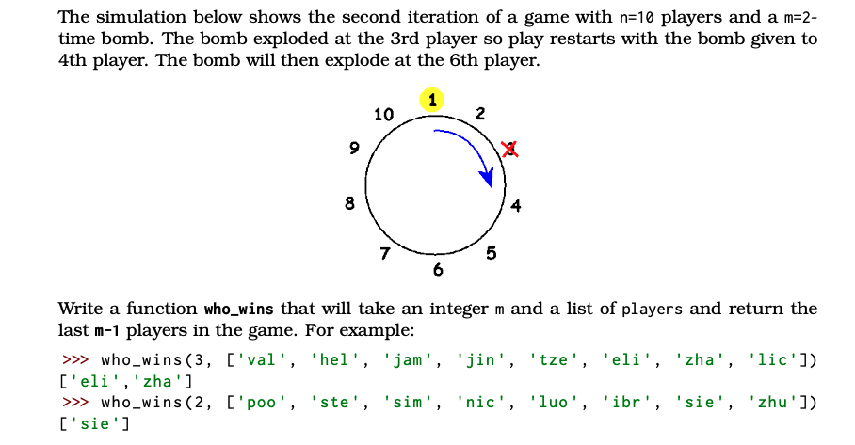
What do we need to keep track of?
-> Curr/Next player
What is the condition for a person to win?
-> Until m-1 players are left

Slide 23
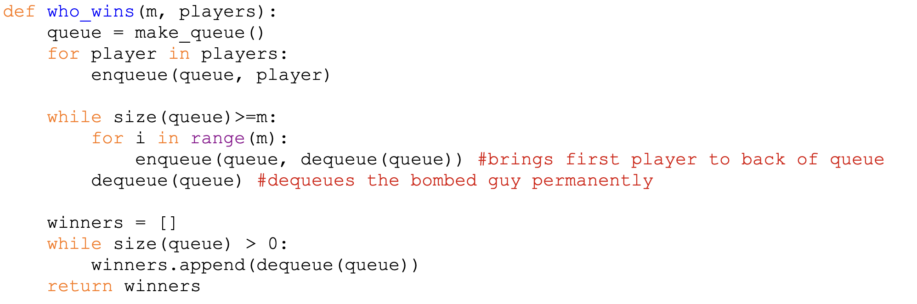
Psuedocode:
Create your queue and add everyone into it
Loop while there is still more than m players in game
Continuously enqueue and dequeue to loop through the players
Output the winners of the game

Slide 24
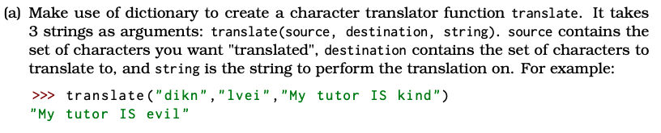
Each character in the source maps to a character in the destination
Use the mapping to translate the string!

Slide 25
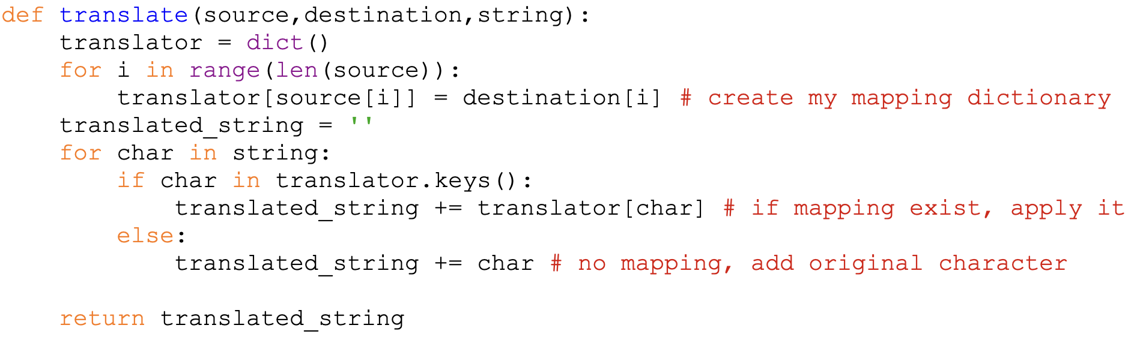

Slide 26
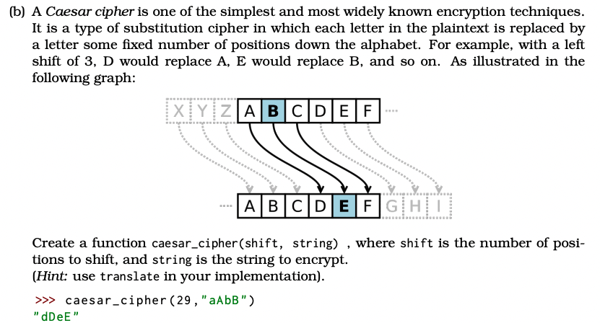
Shifts every character in the string by xx
Hint: Make use of ord() or chr()

Slide 27
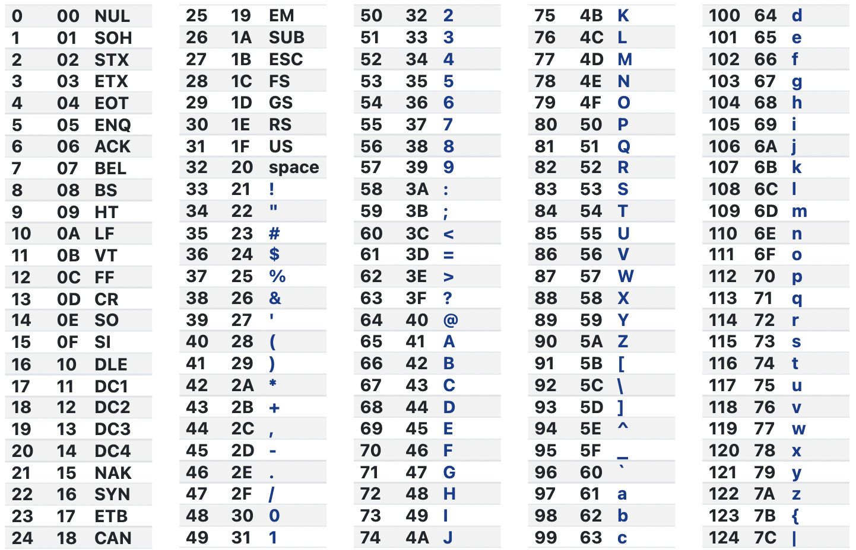
Characters are actually numbers if you think about it (in the computer)
We make use of the ASCII table to map the numbers into characters
ord()
The ord() function returns the number representing the unicode code of a specified character.
chr()
Python chr() function takes integer argument and return the string representing a character at that code point

Slide 28
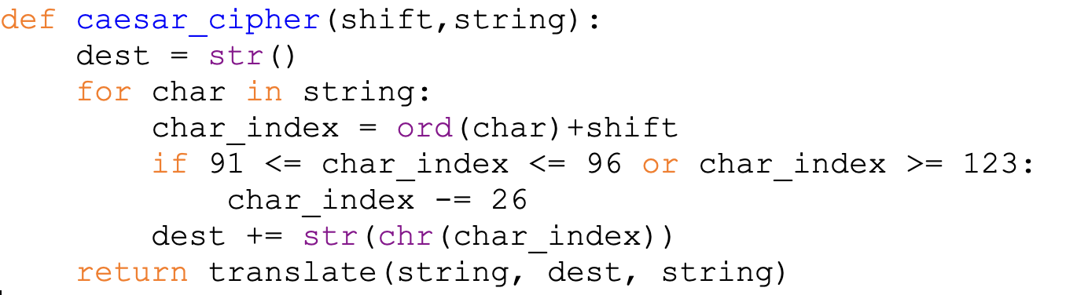
Why do we minus 26?
-> Wrap around when we exceed the range

