Slide 1
Tutorial 8:
Object-Oriented Programming

Slide 2
Topics
Object-Oriented Programming
Why is this important?
Data Abstraction
Inheritance
Polymorphism

Slide 3
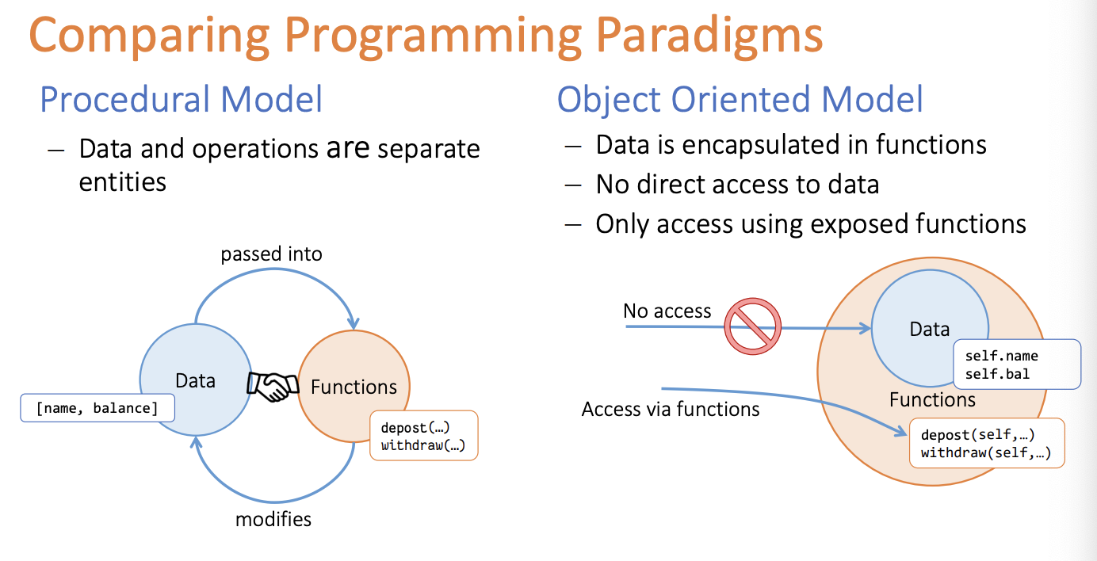

Slide 4
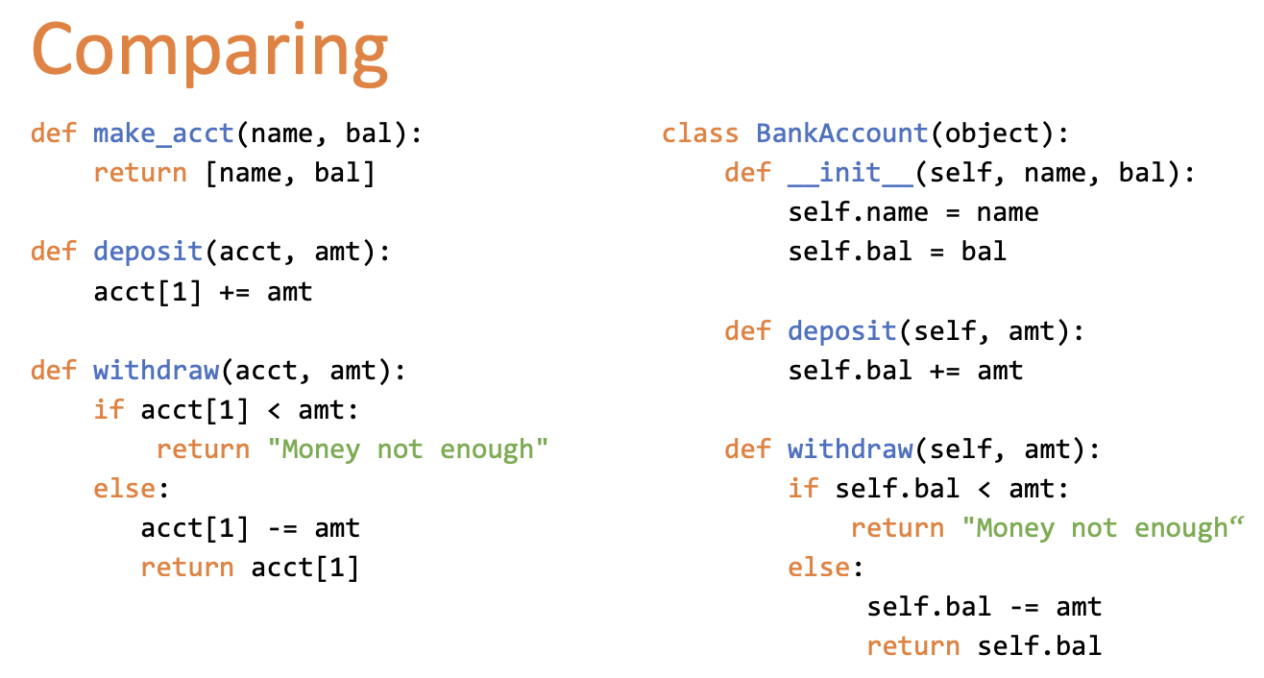
Use a function to affect our structure

Slide 5
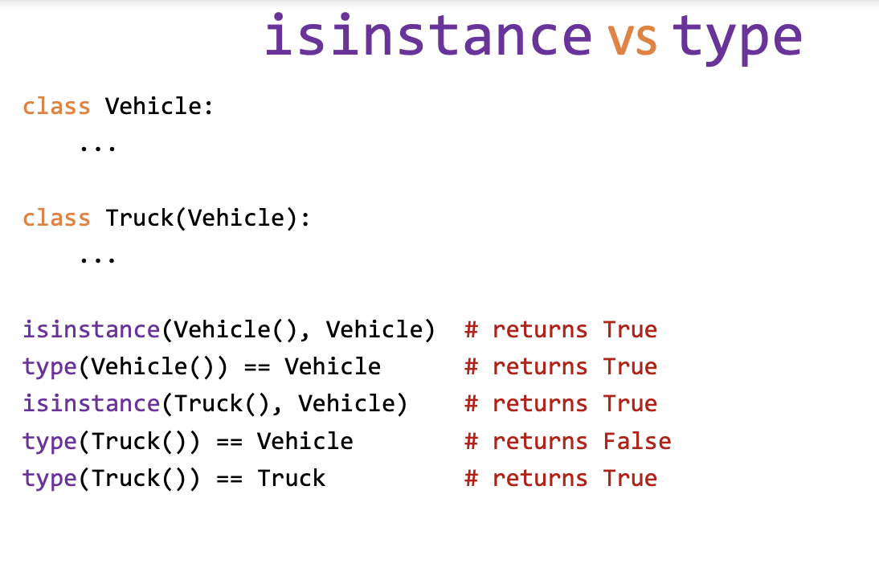
Class vs Instance
Class refers to the category of the object
Instance refers to a particular object of a class
A Textbook is a Book
Addition is an Operation

Slide 6
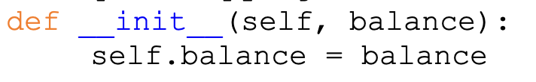
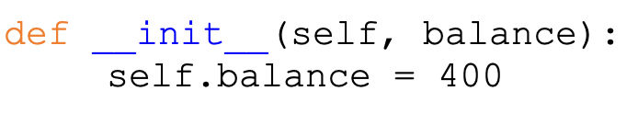
__init__ method
Basically this is like your constructor
Specifies what your object requires for you to instantiate it
Two underscores on each side!
What's the difference between these 2?
A: We use the balance variable to assign to the balance attribute
B: Just assign the balance attribute as 400

Slide 7
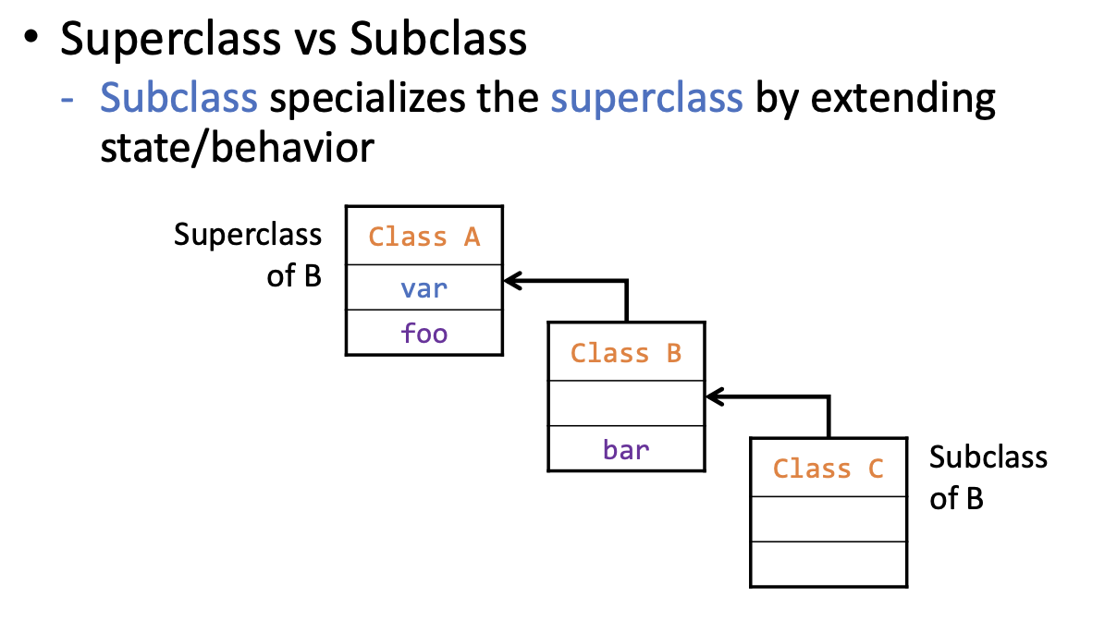
Inheritance
Note:
Classes has an "is a" relationship with their superclasses
Idea is that we can draw links between various Classes
Link them using inheritance

Slide 8
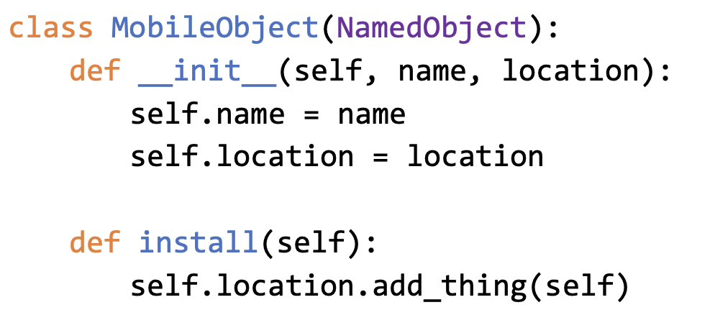
self
Basically is used to act as a reference to the instance of the class
Used within the class itself
Use self to use methods or get attributes you need relating to the instance

Slide 9
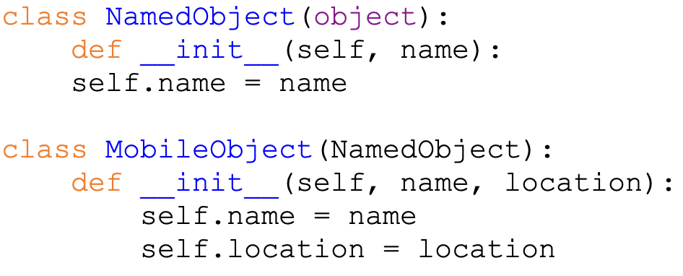
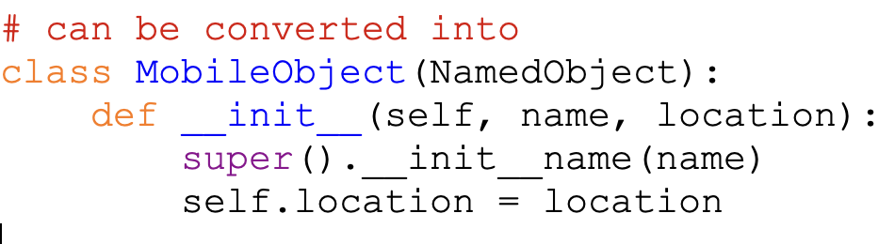
super() method
Need not necessarily only use in the init method
Think creatively!
Used to access methods in the superclass
Helps to reduce repeated code
May need the superclass's definition
of the method to get what you need

Slide 10
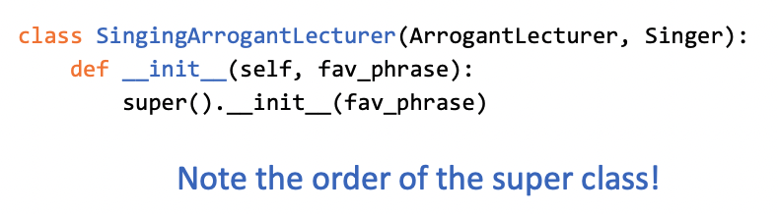
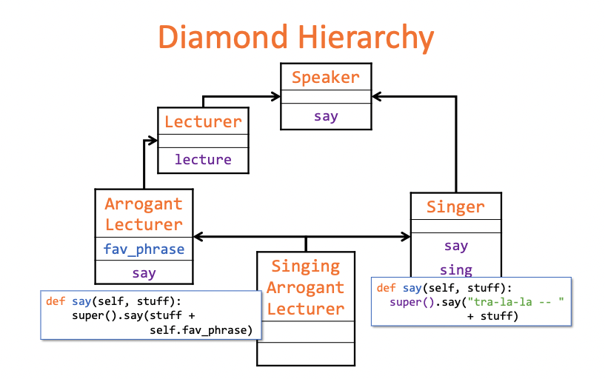

Polymorphism [Multiple Inheritance]
A Class may inherit from multiple classes at the same time
So what will happen if I call a method with the same name in both classes?
Output:
"Tra-la-la - -
Python is cool
How cool is that?"

Slide 11
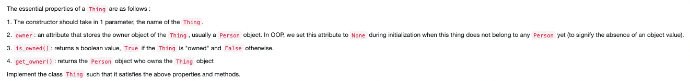
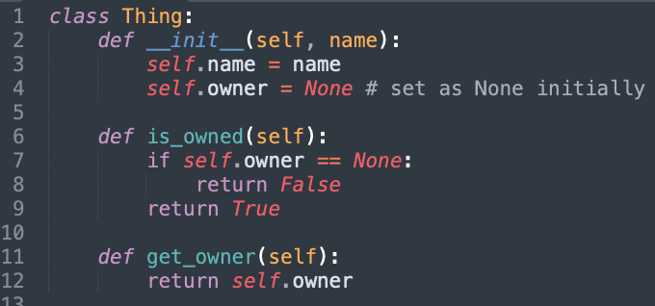
Question 1

Slide 12
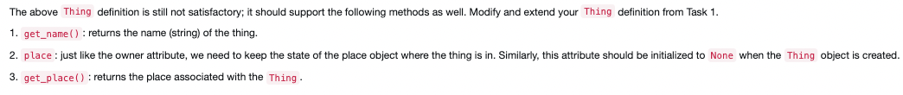
Question 2

Slide 13
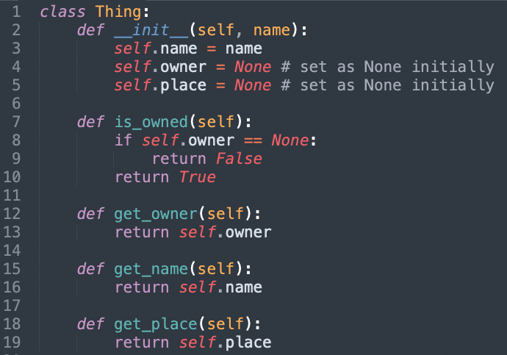
Question 3

Slide 14

Question 3
What's wrong with initialising the attributes as such?
What if there was a specific naming convention for all Mobile Objects?
Would be better for us to invoke the super().__init__(name) method of MobileObject

Slide 15


Question 4
How can we verify that beng is the owner of the ice_cream?

Slide 16

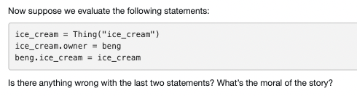


Question 5
Nope!
2nd Statement: Assigning beng as the owner of the ice cream
3rd Statement: Assigning the ice_cream attribute of beng as ice_cream

Slide 17
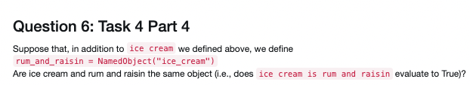
When we instantiate an instance of a Class
Separate instances are separate Objects
Hence an identity check will always evaluate to False!

Slide 18
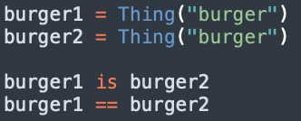
Question 7
# False
# False
What if you wanted to compare if 2 burgers are the same if they had the same ingredients for example?
Need another way of comparing
What method can we use to accomplish this?

Slide 19
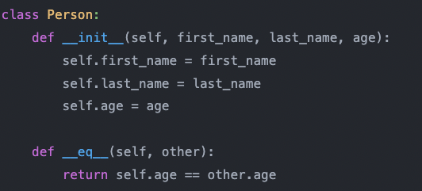
Could make use of the __eq__(self) method!
Default implementation for __eq__ is the identity operator
Define your own version!

