Slide 1
Tutorial 9: Dynamic Programming, Memoization & Exceptions

Slide 2
Scope
Memoization
Dynamic Programming
Exception Handling
Side Note:
Dynamic Programming and Memoization will not be tested!

Slide 3
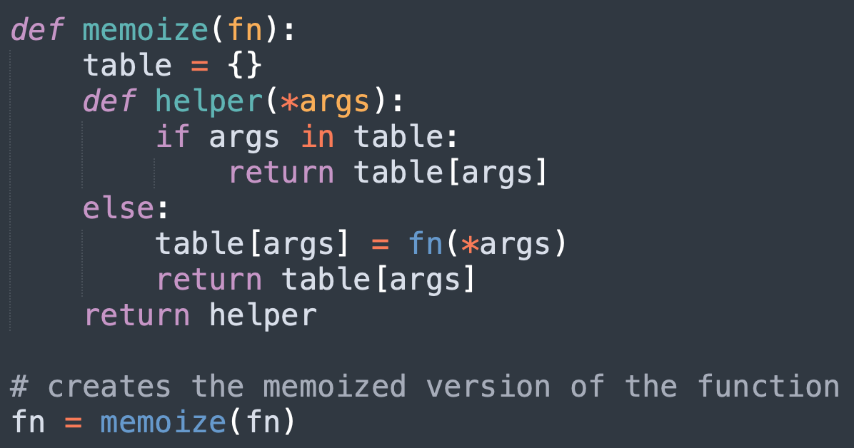
Memoization
What is memoization?
Memoization is a method used to store the results of previous function calls to speed up future calculations
Using the memoized function is called check the table if the value exists:
If not, we calculate the value and store it in the table for access later
Why is *args being used here?
Various functions may take in varying number of parameters
*args is used to make the memoize(fn) function generic (applicable to all functions)

Slide 4
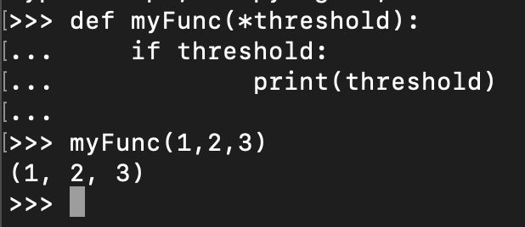
*args and **kwargs
Used for optional arguments
Represented as a tuple of values
Can unpack using a for-loop, or indexing etc
https://www.geeksforgeeks.org/args-kwargs-python/

Slide 5
Dynamic Programming
Dynamic Programming is mainly an optimization over plain recursion.
Wherever we see a recursive solution that has repeated calls for same inputs, we can optimize it using Dynamic Programming. The idea is to simply store the results of subproblems, so that we do not have to re-compute them when needed later.
https://www.geeksforgeeks.org/dynamic-programming/#:~:text=Dynamic%20Programming%20is%20mainly%20an,compute%20them%20when%20needed%20later.

Slide 6
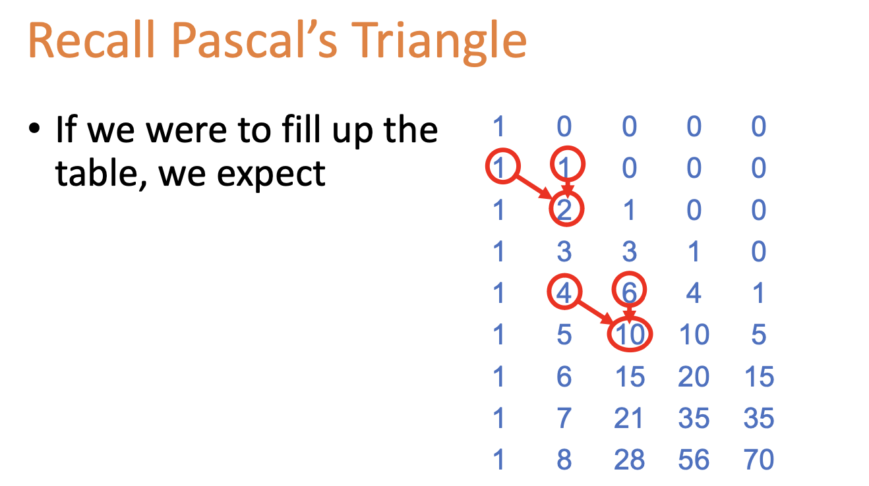
Example: DP Choose
We can see that the value at n is dependent on the values computed before
Dynamic Programming can perhaps be used!

Slide 7
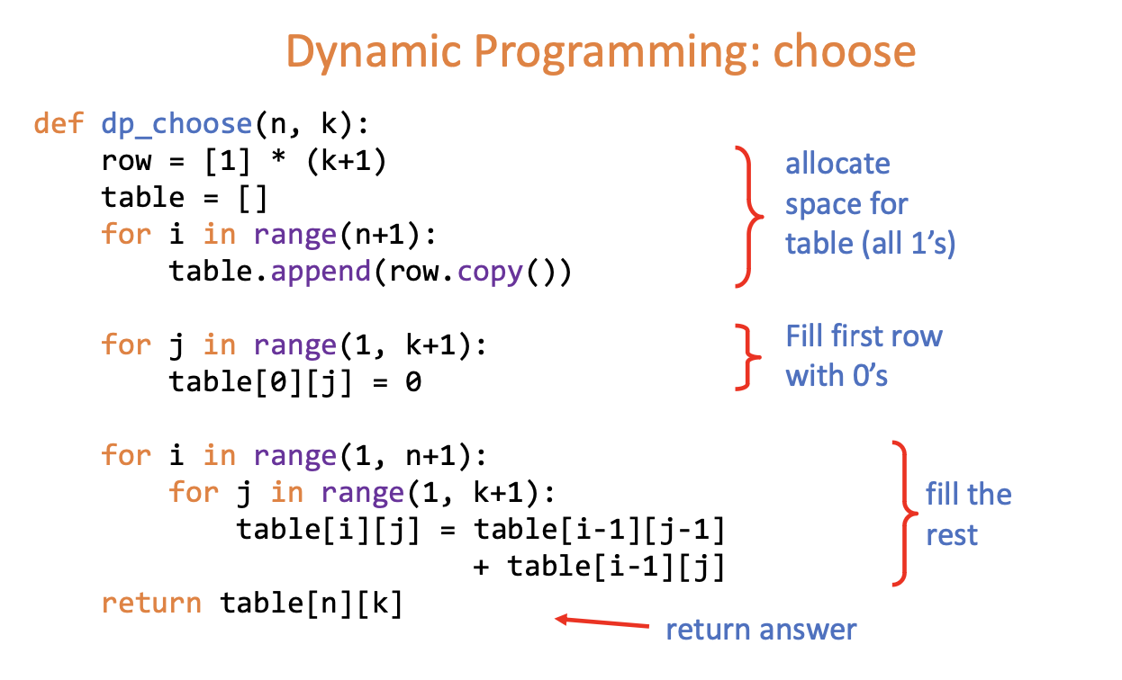
Dynamic Programming
Generally:
Initialise the table of values
Calculate the values when needed
Return the value stored in the table

Slide 8
Exception Handling
Way for you to handle exceptions in your program to avoid the program or system crashing
What if you are trying to read in a file using readcsv() and you encounter an error?
You can kind of expect the error to occur (common with reading files)
React to it by doing something in response

Slide 9
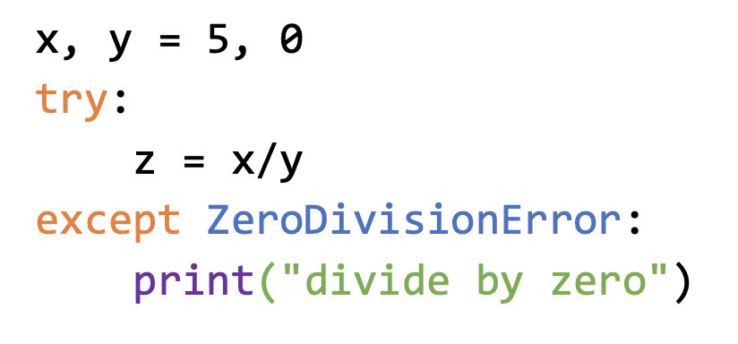
Exception Handling
Typically done using try-except
try: "try to do a set of operations"
except: will occur when an Exception is being thrown
Can specify what type of Exception to handle
finally: will always be executed regardless of whether an exception has occurred

Slide 10
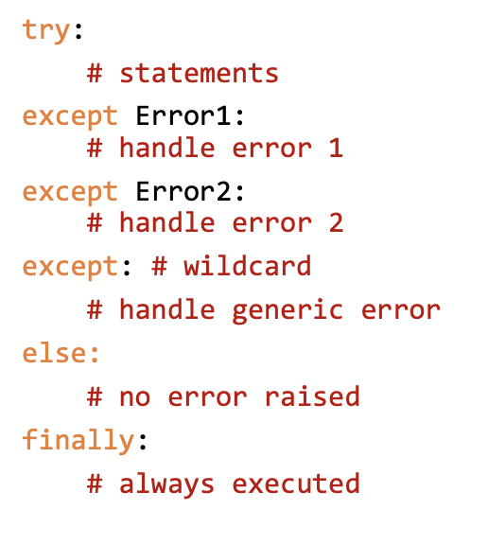
Exception Handling

Slide 11
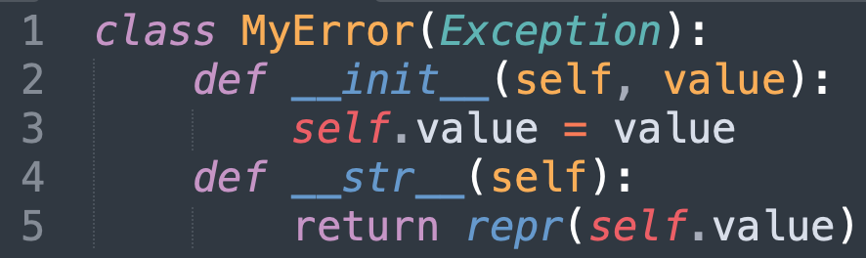
Custom Exceptions
Our custom Exception always extends Exception
def __str__(self):
Special method of a Class (Like __init__, __eq__)
Defines the string representation of the Class
repr() gets the string representation of self.value

Slide 12
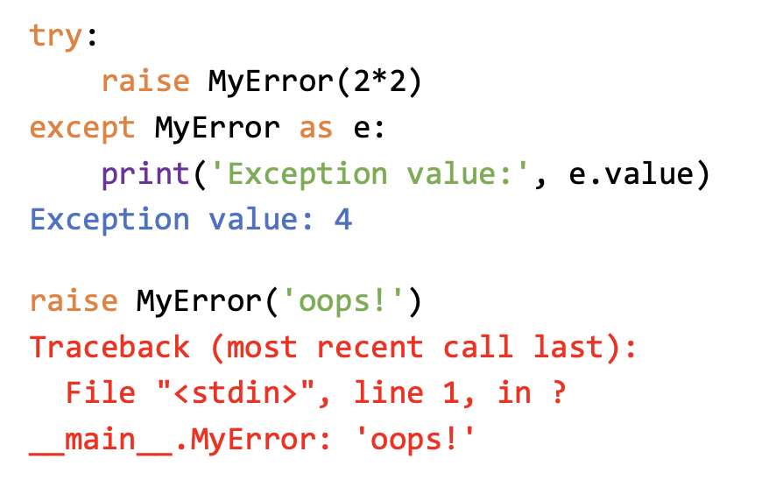
Custom Exceptions

Slide 13
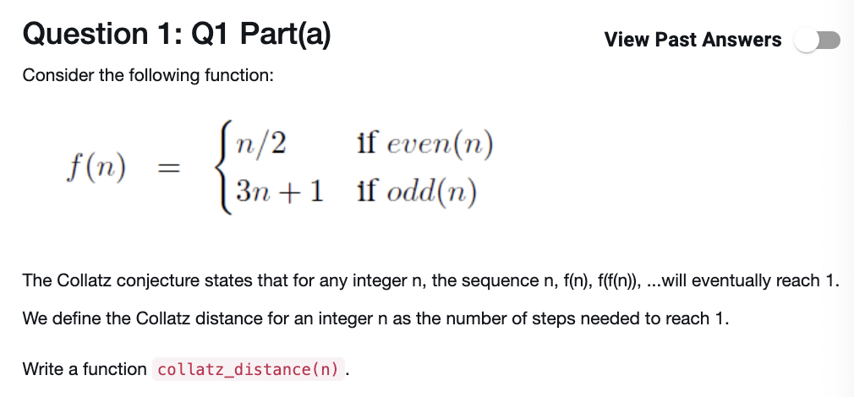
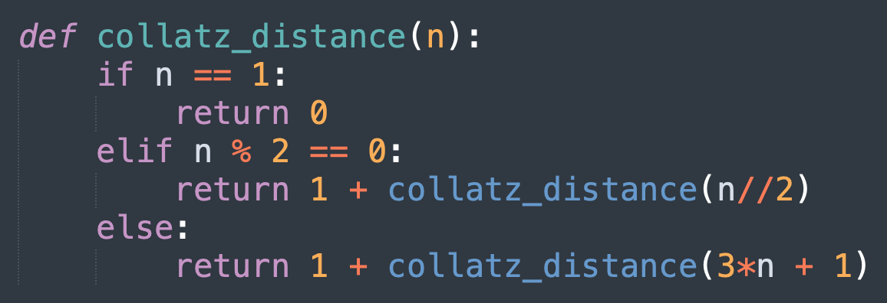
Recursive Solution

Slide 14
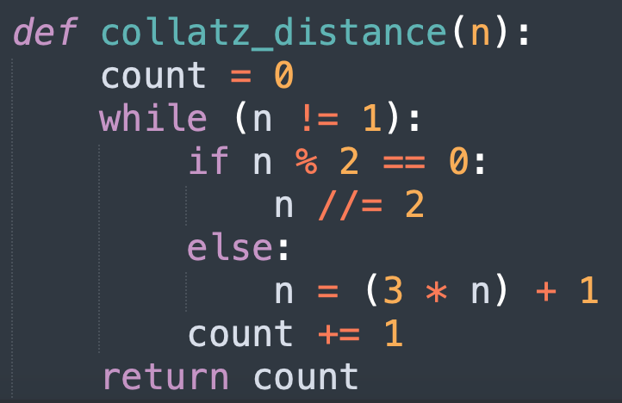
Iterative Solution

Slide 15
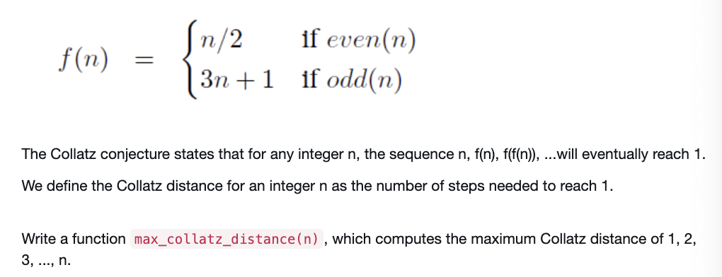
Now we have to calculate the collatz_distance for values [1, n]
Can simply use a list to store the collatz_distance(1 to n)
Get the max of the values

Slide 16
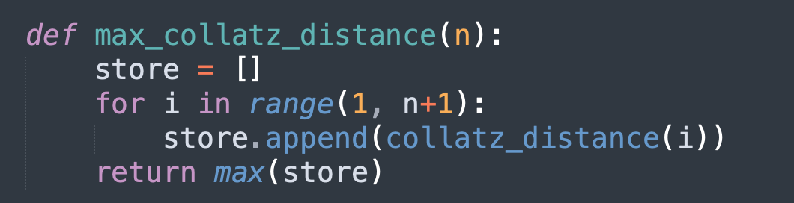
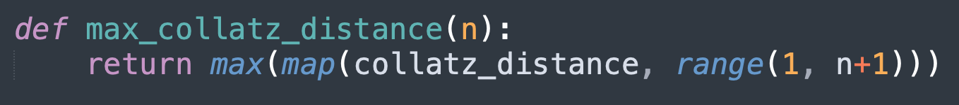

Slide 17
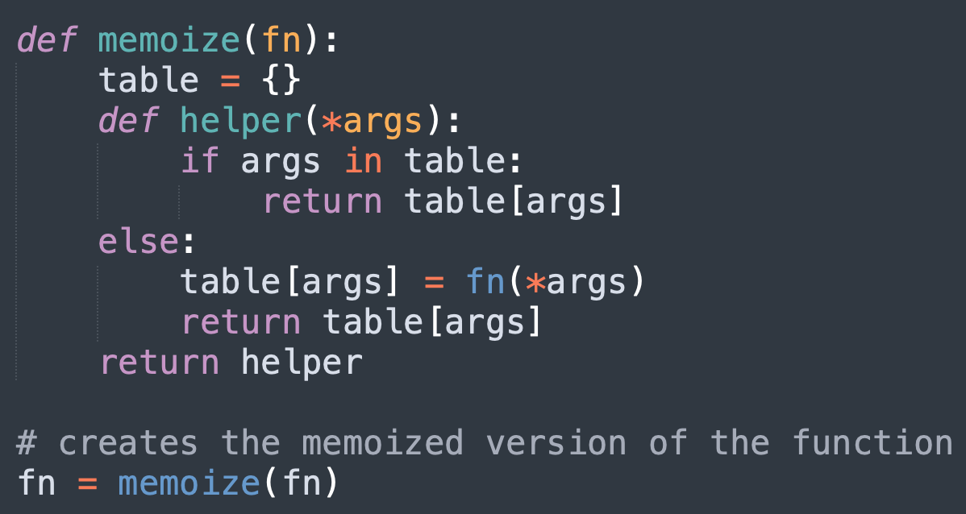
Basically what you have to do is transform your original collatz_distance to the memoized version
Make use of that inside your max_collatz_distance function

Slide 18
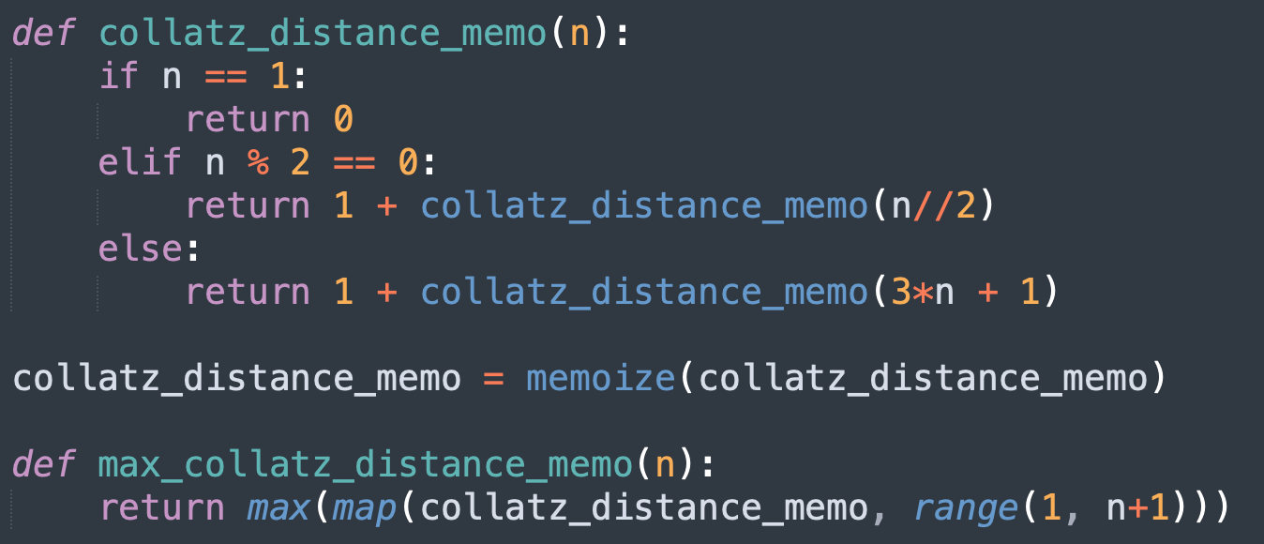

Slide 19
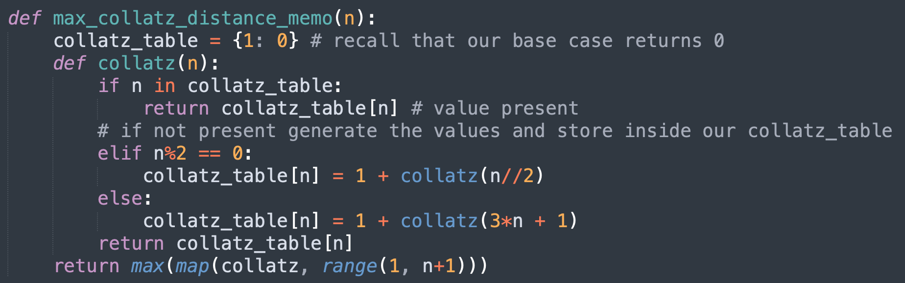

Slide 20
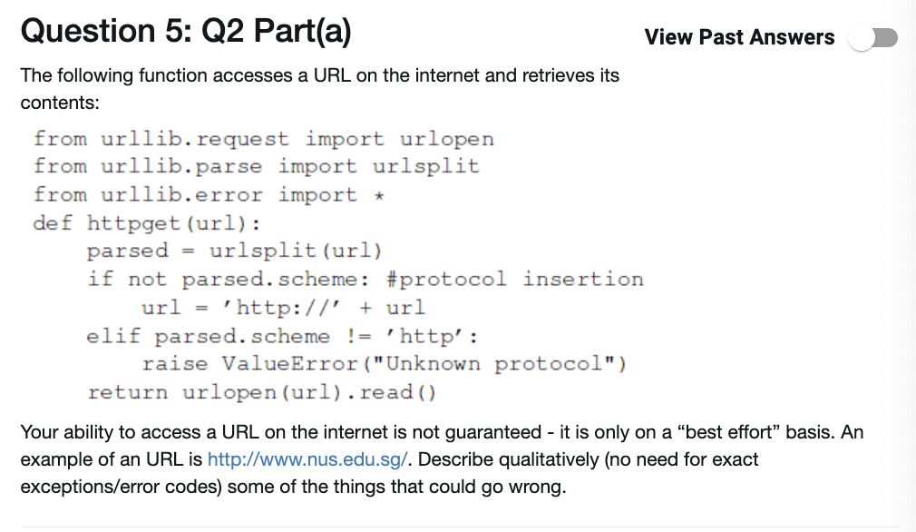
What could possibly go wrong?
Error: 404
URL does not exists
etccc

Slide 21
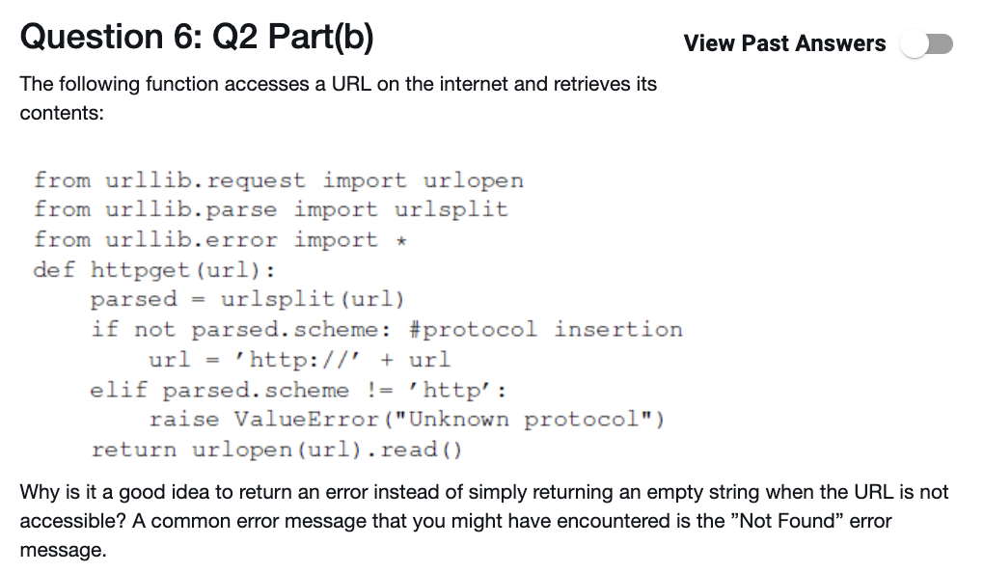
Gives the user a meaningful message of what's the error
Can do something about it
It is possible that an empty string is an actual response from a server. So we are unable to differentiate
if the URL is not accessible or if it is the response from a server.

Slide 22
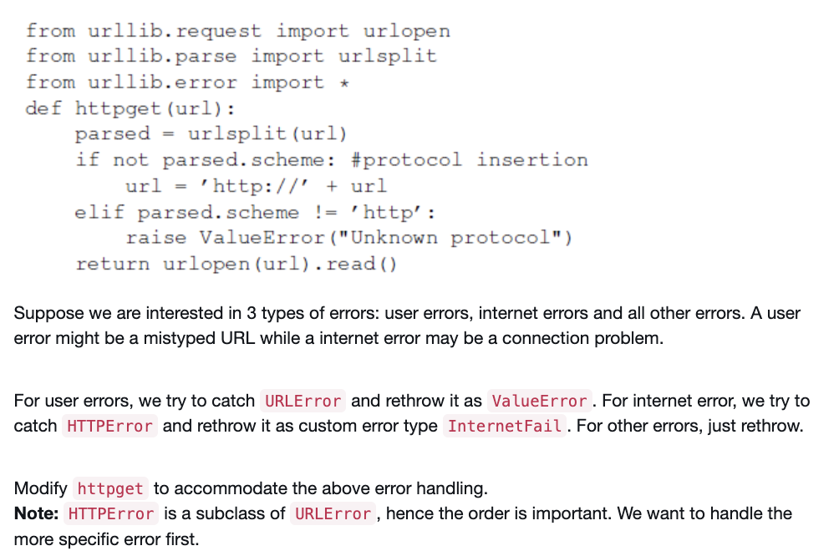
Should handle exceptions in order of the lowest scope first
If we handle the parent class Exception
We miss the granularity and ability to pinpoint the specific type of error

Slide 23
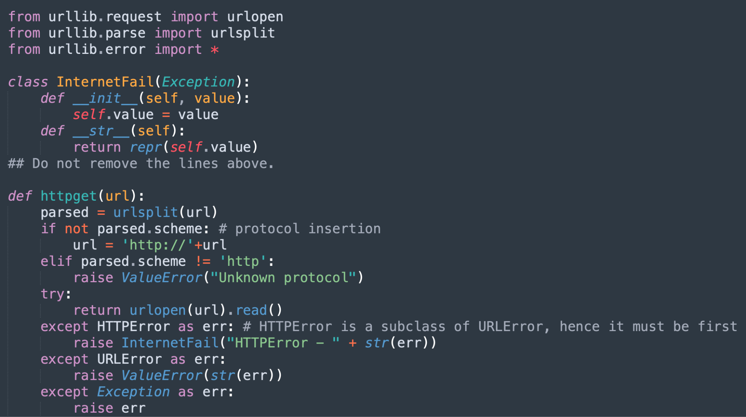

Slide 24
