Slide 1

SAMSUNG PRISM
GENERATIVE AI HACKATHON · 3RD EDITION · 2026–27
Streaming
Live RAG
Retrieve before the user finishes speaking.
A latency-aware, multi-intent, session-refining RAG pipeline for conversational AI.
Theme 04 · Streaming Live RAG
Team Cracked Code · VIT Vellore
Pallavi Yadav · Merril Baiju · Abdur Rahuman · Gowdham B
73 tests passing · 100% Recall@10 · 0% fabricated citations

Slide 2
01 · THE PROBLEM
Conversation is continuous. Retrieval is not.
A real user speaks one natural request, not a tidy query. Details arrive mid-flow and every answer must stay grounded.
ORDINARY RAG
user speaking
user speaking
retrieve
generate + answer
OUR SYSTEM
user speaking
answer
retrieving while speaking
Illustrative timeline. Speculative retrieval fires once intent is stable (7.9 ms in a logged run), so synthesis starts the moment speech ends.
1
2
3
4
High latency
Compound intents
Late constraints
Grounding
Search, ranking and generation all begin only after the user stops speaking.
Venue, cancellation and catering in one breath; a single query flattens them.
"Actually, the trip was international": refine the answer or restart?
Every claim needs a corpus citation or an explicit uncertainty flag.
SAMSUNG PRISM GenAI Hackathon · Theme 04 Streaming Live RAG · Team Cracked Code
2

Slide 3
02 · EXISTING SOLUTIONS & GAPS
Where today's approaches break, and our answer
Each gap maps to a concrete mechanism in the pipeline.
EXISTING APPROACH
WHERE IT BREAKS
OUR ANSWER
Batch, turn-based RAG
Waits for end of speech: seconds of dead air
Controller: Wait / Retrieve / Suppress on partial transcripts
Single-query retrieval
Implied intents are diluted or dropped
Multi-intent decomposer + parallel retrieval + RRF fusion
Restart on clarification
Late detail discards context and doubles latency
Delta retrieval; ledger supersedes only affected claims
Trusted citations
Fabricated or irrelevant doc IDs slip through
Fail-closed verifier; 0% fabricated citations measured
Heavy agent stacks
High cost and latency per turn
Lean pipeline, ~$0.006 modelled cost per turn
SAMSUNG PRISM GenAI Hackathon · Theme 04 Streaming Live RAG · Team Cracked Code
3

Slide 4
03 · THE INSIGHT
Turn the utterance into a retrieval stream
We treat partial speech as progressively useful evidence, not as an incomplete query to ignore.
ORDINARY RAG
OUR APPROACH
Wait → Retrieve → Answer
Listen → Prefetch → Refine → Answer
  One query after the utterance ends
  Compound intent is flattened
  No useful work happens during speech
  Late detail triggers a fresh search
  Controller decides WAIT / RETRIEVE / SUPPRESS
  Speculative retrieval starts before utterance end
  Multi-intent queries decomposed and fused
  Late details refine the existing answer state
POST-UTTERANCE
WHILE USER IS STILL SPEAKING
SAMSUNG PRISM GenAI Hackathon · Theme 04 Streaming Live RAG · Team Cracked Code
4

Slide 5
04 · SOLUTION & ARCHITECTURE
A controller-driven Streaming Live RAG pipeline
Do useful work early, but commit only after verification.
0.0 s · chunk 1
0.5 s · chunk 2
1.2 s · chunk 3
2.0 s · end of utterance
1
2
3
4
Retrieval Controller
Multi-Intent Decomposer
Retrieve · Fuse · Rerank
Generate · Verify
Intent-stability check. WAIT · RETRIEVE · SUPPRESS. Skips reformat-only turns.
Orthogonal sub-queries, entity protection, over-fragmentation guardrail.
Parallel sub-query search, RRF fusion, reranker, contradiction screen.
Claims cited to chunk IDs; compound claims split; fabricated or unsupported rejected.
Answer Ledger session-scoped, ephemeral memory: versioned claims, evidence and supersession
Late detail → delta retrieval only → supersede affected claims → answer v1 → v2, never a restart
Output streamed answer + grounded citations + telemetry (timestamps, triggers, versions, tokens, cost)
SAMSUNG PRISM GenAI Hackathon · Theme 04 Streaming Live RAG · Team Cracked Code
5

Slide 6
05 · WHAT MAKES IT STREAMING
The moment the judge should watch
A partial transcript becomes useful before the user has finished speaking.
0.0 s
0.5 s
1.2 s
2.0 s
"I need to cancel"
"a corporate event"
"booked for next week"
"...because of a force majeure closure."
WAIT
WAIT
RETRIEVE
SYNTHESIZE
Intent unstable: 1 stable entity (threshold 4). 0 LLM calls, 0 ms retrieval.
3 stable entities. Still below threshold.
6 ≥ 4 stable entities: provisional retrieval, 10 chunks in 7.9 ms. Generator not invoked, ledger untouched.
End of utterance: cache hit reuses 10 pre-warmed chunks, then fuse, ground, answer.
KEY DIFFERENCE Retrieval starts before utterance completion; synthesis waits for a stable, verified state. Timings are from a logged run of the demo scenario.
SAMSUNG PRISM GenAI Hackathon · Theme 04 Streaming Live RAG · Team Cracked Code
6

Slide 7
06 · TECHNICAL DEPTH
An engineered RAG system, not a prompt wrapper
Explicit control, retrieval, verification, state and telemetry layers.
CONTROL
REASONING
RETRIEVAL
Intent-stability policy over the partial transcript: WAIT until enough stable entities, RETRIEVE provisionally, SUPPRESS when the turn only asks to reformat (zero retrieval calls).
Multi-intent decomposer splits compound speech into search-ready sub-queries. Entity protection keeps names like capitalized pairs intact; a guardrail rejects prepositional fragments.
Dense + sparse candidates per sub-query, RRF fusion, then reranker. Reranker corrects distractors ranked above the true answer.
GROUNDING
SESSION
EVALUATION
Claims decomposed to atomic form, each checked against the chunks it cites. Unknown chunk IDs are treated as fabricated; contradictions surface both sides.
Answer ledger keeps versioned claims and evidence. Refinements dedupe already-cited chunks and supersede only the affected claims.
Pytest suite (73 tests), scenario benchmark across 5 categories, structured JSONL telemetry with stage timing, tokens and cost.
SAMSUNG PRISM GenAI Hackathon · Theme 04 Streaming Live RAG · Team Cracked Code
7

Slide 8
07 · SESSION REFINEMENT
Refine, don't restart
The answer ledger lets a late detail change only what it must.
1
Turn 1
2
Late detail
3
Contradiction?
4
Turn 2
Answer v1
›
Delta retrieval
›
Screen
›
Answer v2
Claims c1, c2, c3 verified and cited to chunks.
Only new chunks are fetched; already-cited chunks are skipped.
Conflicting claim is superseded, not silently overwritten.
Unaffected claims kept; changed claims replaced; version recorded.
Test-backed behaviours
Why it matters
Dedup skips already-cited chunks; multiple claims sharing a new chunk are consolidated; supersession retires a conflicted claim; empty new chunks are a no-op.
A user who says "actually, the trip was international" gets an updated answer in place, with the version trail visible in telemetry, instead of a full cold start.
SAMSUNG PRISM GenAI Hackathon · Theme 04 Streaming Live RAG · Team Cracked Code
8

Slide 9
08 · FAILURE-SAFE DESIGN
Grounded answers, not confident hallucinations
Explicit defenses for unsupported, contradictory and insufficient evidence.
1
Retrieve
2
Fuse + Rerank
3
Verify claims
4
Render
Candidate evidence from the corpus.
Merge evidence across sub-queries.
Check each claim against cited chunks.
Only supported state is surfaced.
Unsupported claim
Fabricated citation
Verifier failure
Rejected; marked as insufficient evidence.
Invalid chunk IDs never pass verification.
Parse errors, API exceptions or wrong-schema JSON never default to "supported".
Contradictory evidence
Coverage gap
Reformat / suppress turns
Both sides surfaced and flagged unresolved; no cherry-picking.
Returns insufficient evidence with zero generator calls.
Zero unnecessary retrieval calls.
SAMSUNG PRISM GenAI Hackathon · Theme 04 Streaming Live RAG · Team Cracked Code
9

Slide 10
09 · LIVE DEMO
A chatbot on the surface, a live retrieval debugger underneath
You type partial speech chunk by chunk; the audience watches each pipeline stage react.
Streaming Live RAG
● LIVE
LIVE RAG PIPELINE
0.0 s
"I need to cancel"
1
Transcript
WAIT
chunks streaming
0.5 s
"a corporate event"
2
Controller
WAIT
WAIT → RETRIEVE
1.2 s
"booked for next week"
3
Speculative retrieval
PRE-FETCH
10 chunks · 7.9 ms
2.0 s
"...because of a force majeure closure."
4
Multi-intent split
END
sub-queries in parallel
5
Fusion
Assistant · answer v1 Synthesized from pre-fetched evidence (cache hit, 10 chunks). Every claim cited to a corpus chunk ID such as DOC_04 §1.
RRF + rerank, cache reused
6
Grounding check
claims verified vs corpus
Type partial speech…
Send Chunk
End Utterance
7
Final answer
version 1 · citations
SAMSUNG PRISM GenAI Hackathon · Theme 04 Streaming Live RAG · Team Cracked Code
10

Slide 11
10 · DEMO SCRIPT
Manually driven, deterministic, no smoke and mirrors
No microphone dependency; the UI reads real pipeline state, never scripted results.
Chunk 1
"I need to plan"
WAIT · intent unstable · no retrieval, no answer
1
Chunk 2
"a customer workshop in Pune for 30 people"
Speculative retrieval fires while user is still speaking
2
Chunk 3
"and I need the cancellation policy"
Second intent detected; delta retrieval, prior evidence reused
3
Chunk 4
"and catering options"
Multi-intent decomposition: venue · cancellation · catering
4
End Utterance
Reuse cache → fuse → ground → verified answer with citations
5
Controls: Send Chunk · End Utterance · Reset · Demo Scenario (prefills next chunk; you still press Send). Live indicator: ordinary RAG retrieves after speech; ours is already retrieving.
SAMSUNG PRISM GenAI Hackathon · Theme 04 Streaming Live RAG · Team Cracked Code
11

Slide 12
11 · TOOLS & TECH STACK
What it is built with
Streamlit live demo · manual chunk-by-chunk control · pipeline inspector
Interface
Controller · Decomposer · RRF fusion · Reranker · Generator · Grounding verifier · Answer ledger
Pipeline modules
Indexed policy corpus · parallel sub-query retrieval · contradiction screen [add embedding model / vector store]
Retrieval
OpenAI-compatible client factory · token-counting wrapper · context-budget guard · Groq-hosted API
LLM layer
JSONL event logs: timestamps, retrieval triggers, source maps, version transitions, tokens, cost
Observability
Python 3.11 · pytest, 73 passing · eval.benchmark: 13 scenarios, 15 turns · Docker [confirm]
Quality
SAMSUNG PRISM GenAI Hackathon · Theme 04 Streaming Live RAG · Team Cracked Code
12

Slide 13
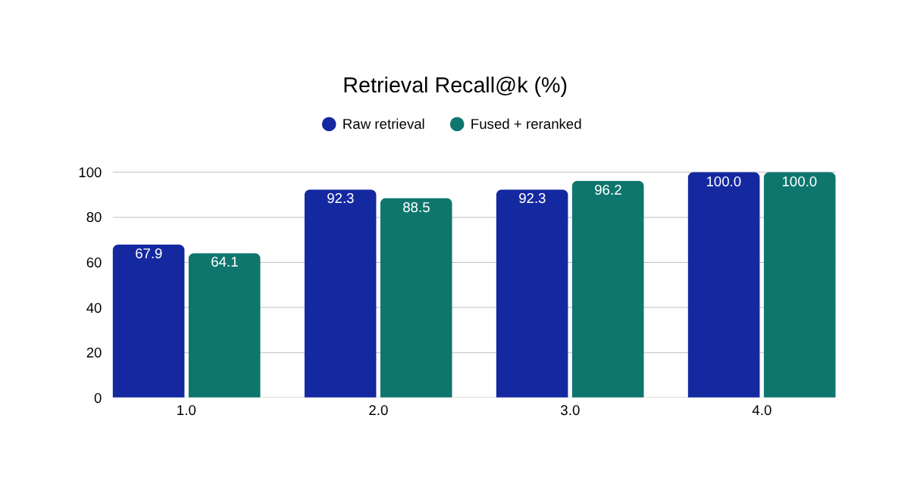
12 · RESULTS
What we measured
13 scenarios / 15 turns, run after the 73-test suite passed (2 tests deselected).
73 / 73
100%
100%
0%
Automated tests passed
Raw Recall@10
Controller accuracy
Fabricated citations
2 deselected
answerable turns
all evaluated turns
100% citation validity
Latency breakdown (mean)
Retrieval
9 ms
Generator
3.09 s
Verifier
9.40 s
Response proxy
3.10 s
Cost / 15 turns
$0.0848
SAMSUNG PRISM GenAI Hackathon · Theme 04 Streaming Live RAG · Team Cracked Code
13

Slide 14
13 · CATEGORY BREAKDOWN & HONEST LIMITATIONS
Where we are strong, and where we are improving
Category | Turns | Controller | Fused R@10 | Grounded
single_intent | 6 | 100% | 100% | 58.3%
multi_intent | 2 | 100% | 100% | 100%
refinement | 4 | 100% | 100% | 0.0%
unanswerable | 2 | 100% | N/A | 50.0%
contradiction | 1 | 100% | 100% | 100%
HONEST LIMITATIONS
  Groundedness (claims citing the expected chunks) is 50% overall and 0% on refinement turns, below our 85% gate. Refinement citations are the top fix.
  The pipeline runs synchronously (stream=False), so true streaming TTFT is not yet measured. Mean turn latency of 80.5 s is dominated by LLM API calls and rate limits, not retrieval.
  Small in-house evaluation set: results are indicative, not a held-out benchmark.
  Fabricated citations stay at 0%: failures are lack of relevance, never invention.
50%
0%
Citation groundedness
Refinement grounded
overall; gate is 85%
top fix priority
SAMSUNG PRISM GenAI Hackathon · Theme 04 Streaming Live RAG · Team Cracked Code
14

Slide 15
14 · IMPACT & USE CASES
A better interaction model for conversational assistants
The architecture generalizes to any assistant that needs fast, grounded answers over a large knowledge base.
1
2
3
Voice assistants
Enterprise policy support
Support and travel desks
Answers begin forming while the user is still speaking: lower perceived latency on-device.
Travel reimbursement, event booking, vendor terms and cancellation rules in one question.
Compound customer requests resolved in one grounded answer with sources.
~9 ms
0%
~$0.006
5
Scenario categories
Retrieval stage
Fabricated citations
Modelled cost / turn
single · multi · refine · gap · conflict
mean latency
valid corpus IDs only
$0.0848 over 15 turns
Corpus-grounded by design: no external web, no cross-session profile, session-scoped memory only.
SAMSUNG PRISM GenAI Hackathon · Theme 04 Streaming Live RAG · Team Cracked Code
15

Slide 16
15 · WHAT SETS US APART
Six differentiators
1
Speculative pre-fetch
2
Fail-closed verifier
3
No cherry-picking
Cache warms while the user speaks; zero LLM calls until speech ends.
Parse errors, API failures or bad schema never default to "supported".
Contradicting sources are both surfaced and flagged unresolved.
Ordinary RAG: starts after the turn ends
Ordinary RAG: unverified claims pass
Ordinary RAG: silently picks one
4
Refine, don't restart
5
Suppress presentation turns
6
Judge-drivable demo
Ledger supersedes only affected claims, answer v1 → v2.
"Repeat in two bullets" makes zero retrieval calls.
Type chunks live and watch controller, retrieval and grounding react.
Ordinary RAG: discards context, re-runs
Ordinary RAG: wastes tokens, risks drift
Ordinary RAG: opaque black box
SAMSUNG PRISM GenAI Hackathon · Theme 04 Streaming Live RAG · Team Cracked Code
16

Slide 17
16 · WHAT'S NEXT
From working prototype to production-grade streaming RAG
Each step targets a measured gap, not complexity for its own sake.
1
2
3
4
5
PHASE 1
PHASE 2
PHASE 3
PHASE 4
PHASE 5
True token streaming
Faster verification
Refinement citations
Real speech input
Scale + worklet
stream=True to report real time-to-first-token.
Batch and parallel claim checks; lighter verifier to cut the 9.4 s stage.
Lift refinement groundedness to the 85% gate.
Streaming STT plugged into the existing chunk interface.
Larger corpus, held-out streaming sets, Samsung mentor worklet.
North star: production-grade streaming retrieval for Samsung voice experiences that feels instantaneous without compromising evidence.
SAMSUNG PRISM GenAI Hackathon · Theme 04 Streaming Live RAG · Team Cracked Code
17

Slide 18
Thank you
Retrieve while the user is still speaking.
Team Cracked Code · VIT Vellore
Pallavi Yadav · Merril Baiju · Abdur Rahuman · Gowdham B
Built for the Samsung PRISM Generative AI Hackathon, 3rd Edition 2026–27, organised by Samsung R&D Institute India.

