Slide 1
Introduction of Spark and RDD
Mei Canhua
2016.06.02

Slide 2
Agenda
What’s Spark
Spark Architecture and Components
Spark RDD
RDD Programming Model
Glance at the implementation for RDD
Comparison between Spark and Hadoop
Q&A

Slide 3
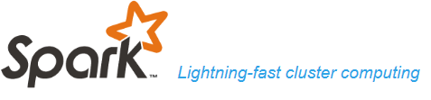
What’s spark
Apache Spark is a
lightning-fast in-memory cluster-computing system.
Provide high-level APIs in Java, Scala, Phtyon and R, and an optimized engine that supports general execution graphs.
Support a rich set of higher-level tools including Spark SQL , MLLib, GraphX and Spark Streaming.
The largest 100% open source project in data processing.
the largest open source community in big data, with over 1000 contributors from 250+ organizations.
processing x PB data over 8,000 nodes adopted by enterprises like Netflix, Yahoo, eBay
Notes:
Reference: https://databricks.com/spark/about

Slide 4
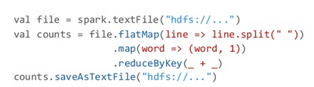
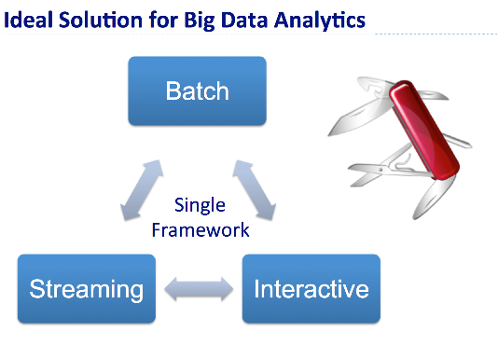
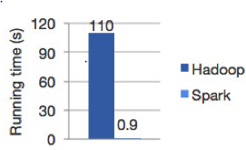
Feature
Lightning Speed
Hadoop :100 in Memory, 10x on disk
In memory computing, cache, query optimizations
Ease of Use
20+ operations in spark
VS 2 in hadoop
Interactive shell:
Scala, python, R shell
API: java, scala, python R
Runs Everywhere
Mesos
Yarn
Standalone
Cloud： EC2
Unified Stack Solution
Generality: Combine SQL, streaming, and complex analytics.
Notes:
Reference:
https://dzone.com/refcardz/apache-spark

Slide 5




Spark Architecture
Resource Management
Local
Standalone
Yarn
Mesos
Spark Ecosystems
Spark SQL
MLib
Spark Graph
Spark Streaming
Spark DataFrames
Spark Datasets
Spark RDD
Spark Core

Slide 6
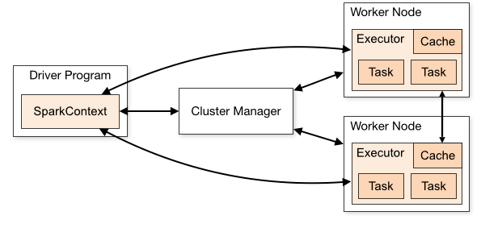
Spark Components
Driver Program (jvm process) | SparkContext | Executor (jvm process) | Worker Node (host)
Application | Job (action) | Stage | Task
Cluster Manager | Application jar | Deploy mode
Notes:
Reference:http://spark.apache.org/docs/latest/cluster-overview.html
Application User program built on spark. Consists of a driver program and executors on the cluster.
Application jar A jar containing the user's Spark application. In some cases users will want to create an "uber jar" containing their application along with its dependencies. The user's jar should never include Hadoop or Spark libraries, however, these will be added at runtime.
Driver program The process running the main() function of the application and creating the SparkContext
Cluster manager An external service for acquiring resources on the cluster (e.g. standalone manager, Mesos, YARN)
Deploy mode Distinguishes where the driver process runs. In "cluster" mode, the framework launches the driver inside of the cluster. In "client" mode, the submitter launches the driver outside of the cluster.
Worker node Any node that can run application code in the cluster
Executor A process launched for an application on a worker node, that runs tasks and keeps data in memory or disk storage across them. Each application has its own executors.
Task A unit of work that will be sent to one executor
Job A parallel computation consisting of multiple tasks that gets spawned in response to a Spark action (e.g. save, collect); you'll see this term used in the driver's logs.
Stage Each job gets divided into smaller sets of tasks called stages that depend on each other (similar to the map and reduce stages in MapReduce); you'll see this term used in the driver's logs.

Slide 7
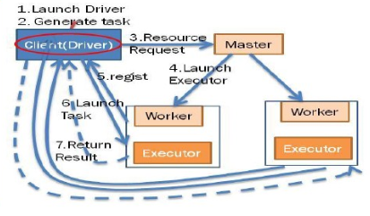
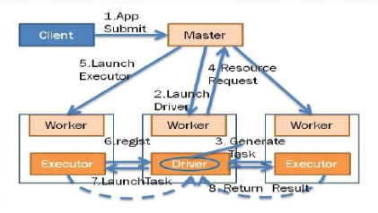
Work Flow
Driver Program on remote Client
Driver Program on worker node in cluster

Slide 8


The soul of Spark: RDD
Resilient Distributed Dataset: A Fault-Tolerant Abstraction for In-Memory Cluster Computing
A distributed collection of objects
Read-only collection of objects partitioned in the cluster (Partitioning can be controlled by user)
Fault-tolerant: can be rebuilt if a partition is lost
Can be persistent in memory/disk(cache), Reusability
Can apply to parallel operations(transformations and actions) on RDDs
2 ways of create RDD
Parallelizing an existing collection in Driver Program
Referencing a dataset in an external storage system
(a shared filesystem, HDFS, Hbase or others offering a Hadoop InputFormat)
Notes:
http://www-bcf.usc.edu/~minlanyu/teach/csci599-fall12/papers/nsdi_spark.pdf

Slide 9
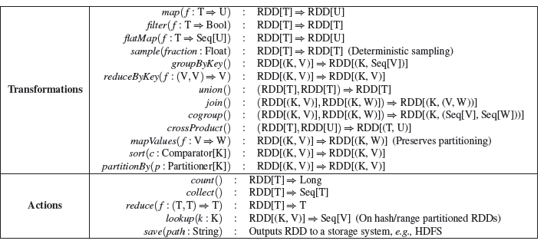
RDD: Distributed Programming Model

Slide 10
The internal Implementations of RDD
Questions:
How many tasks?
How the tasks are assigned to different worker nodes?
How to do computing in each task?
How to do fault-tolerant?
Methods | Description
getPartitions() | return the set of partitions in this RDD
iterator()/compute() | compute a given partition.
getPreferredLocations() | specify placement preferences for a given partition
getDependencies() | return how this RDD depends on parent RDDs

Slide 11
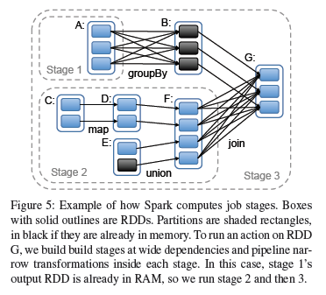
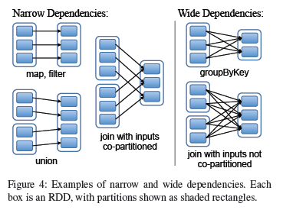
Narrow/Wide Dependencies
Fault-tolerant
ND: recompute
WD:
Recompute (cost)
add checkpoint (or long lineage)
DAG Scheduling

Slide 12
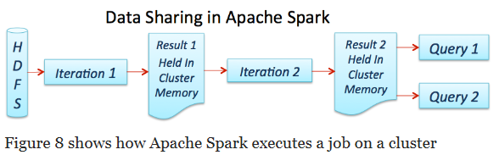
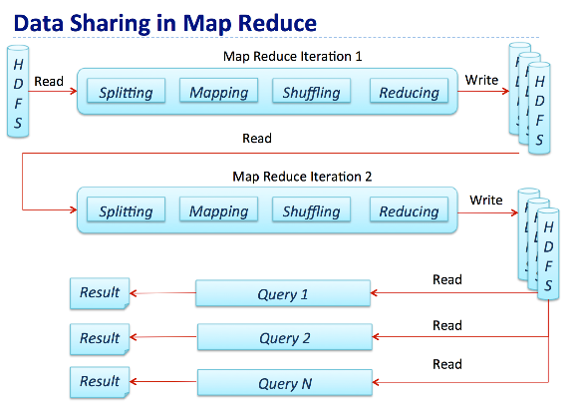
Comparison between Spark and Hadoop

Slide 13
Q&A THANKS
Life is short, we need spark!!!
Notes:
http://wenku.baidu.com/view/02acb4f1af1ffc4fff47ac2a.html

