Slide 1
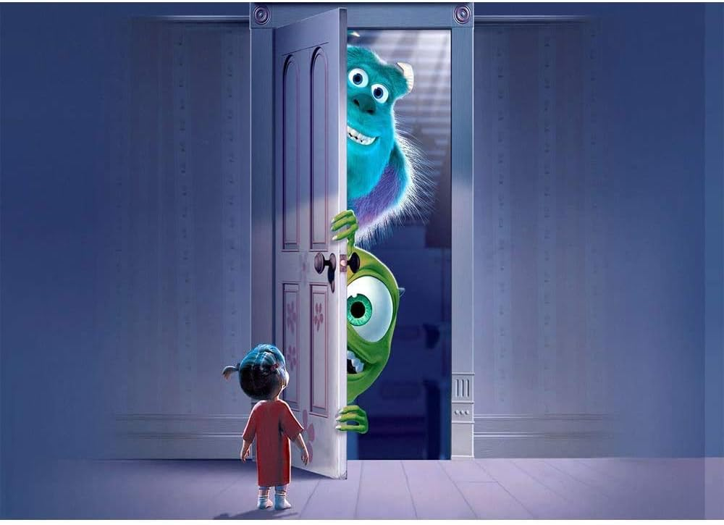
Welcome to the
Escape Room
Try your best!

Slide 2
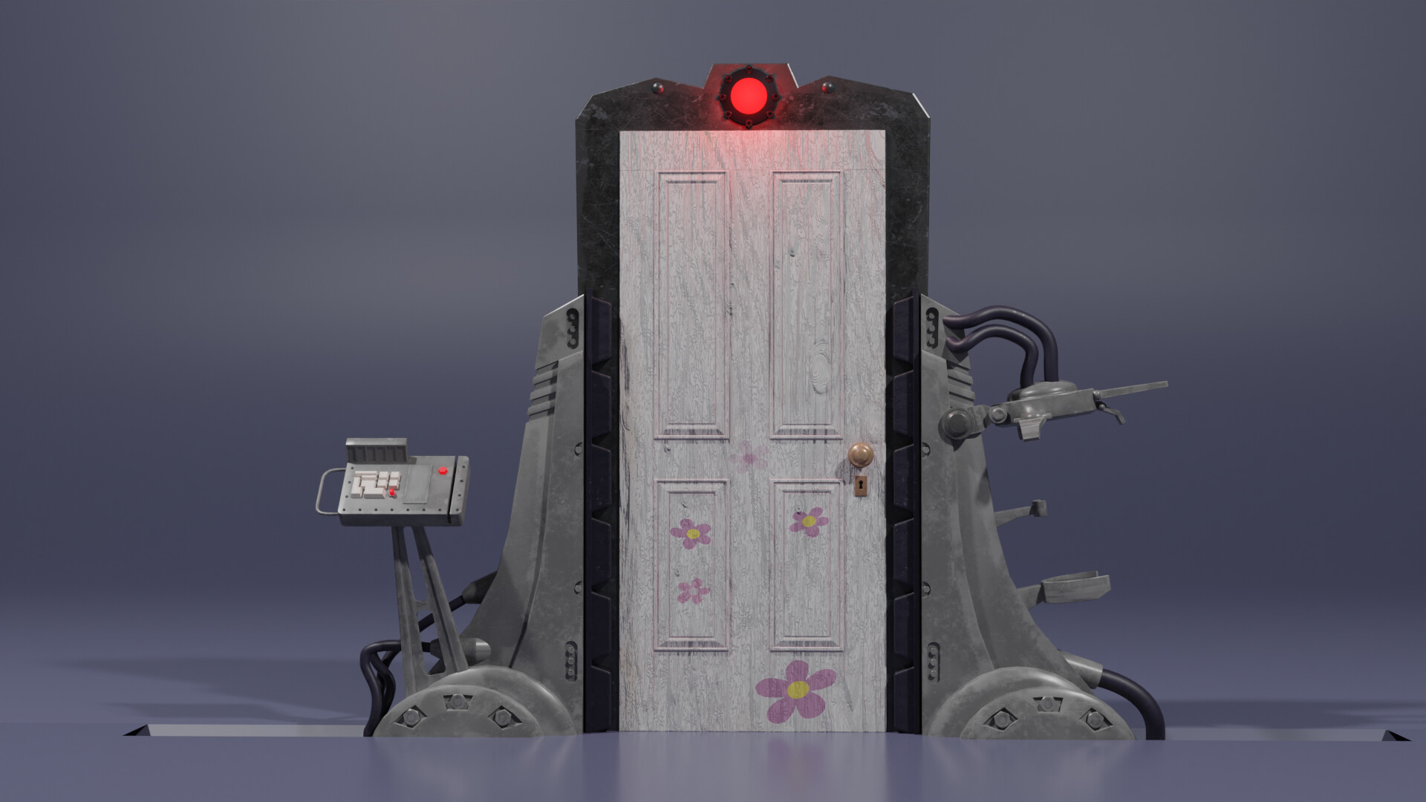
Structure of the Game
Objects Definition: Objects such as furniture, doors, keys, and rooms are defined as dictionaries.
Room and Object Relationships: Dictionaries that define which items or rooms are related to each other.
Functions: Startgame, play_room, explore_room etc., that we imported from gamefunctions.
Features: We added images and gifs.

Slide 3

Challenges
State Management Complexity: Tracking player location, items, unlocked doors, and win/lose conditions grows intricate as the game progresses.
Object Interactions: Handling item collection, door unlocking, and puzzle-solving demands meticulous implementation.
User Input Management: Juggling diverse player commands poses challenges in ensuring smooth gameplay.
Enhanced Navigation: Simplifying decision-making by enabling letter input (e.g., x for explore, i for inspect).

Slide 4

More Challenges
Catching and Fixing Mistakes:The most important or difficult challenge was to spot the bugs and then fixing them without changing too much of the code.
User Input Handling: Managing user input can be challenging, especially when dealing with various commands and actions the player can take.

Slide 5

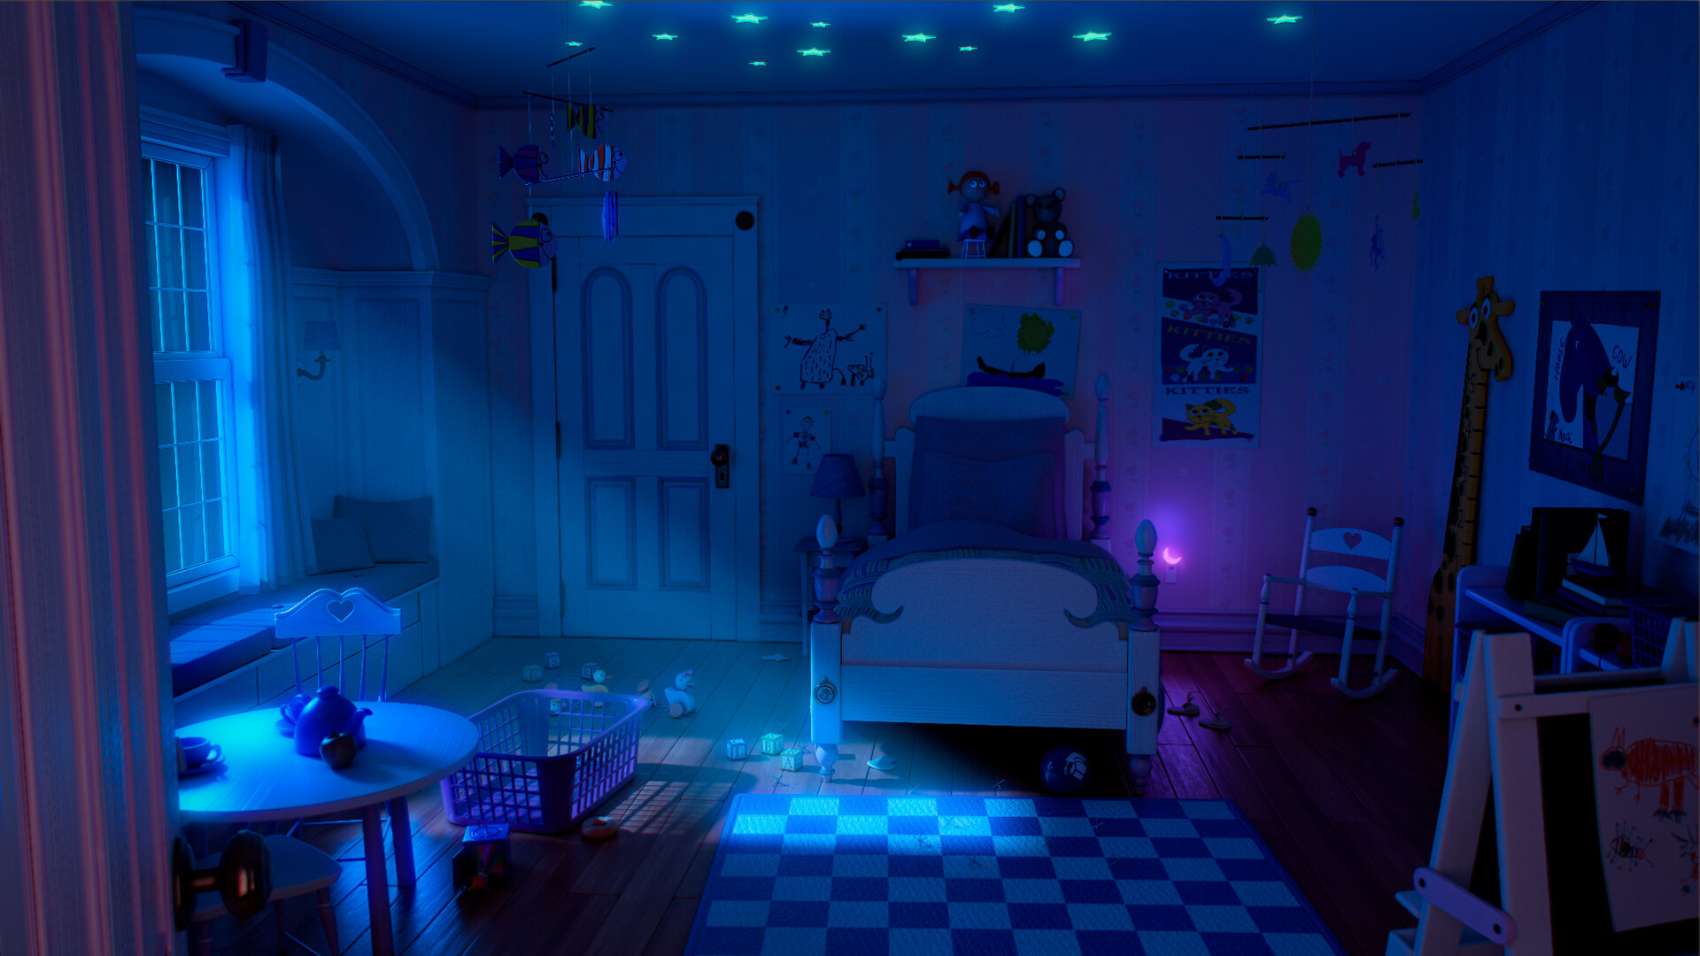
Biggest Mistake
Erased a piece of code and couldn’t trace back when it went all wrong. Better understanding of the tools (software used) in order to better handle the history path.
Time management
Learnings
Better understanding of the software (VS, Jupiter, Github)
Working on the code simultaneously
Editing the code without having to replace everything
Points for development

Slide 6

LET’S PLAY :
DEMO

Slide 7
Thank You
Madison Wells
Mateo Mariaca
Olsi Mosha

