Slide 1
Learn IT Yourself
Lernziele spieleriesch selbst erreichen
Jonas hilpp, angelika sudheimer, mert gündüz, jannik adam

Slide 2
Agenda
Business
Quality
Technical Ability

Slide 3
Business
Vision
Use Cases
Project management
RUP
Time estimation

Slide 4
Our Vision
Blow up your motivation levels for reaching your goals!
Turn mundane tasks such as studying into a game!

Slide 5
Vision – Structured Learning
Make progress of learning digital and competitive
Stay as motivated as you were in the beginning
Split your learning goal into various tasks
Notes:
Mit linker Hand Zeugs erledigen
Statur behalten
1

Slide 6
Vision - Motivation
Competitive
Self-reflection
Points for completing tasks
Highscore system
Group statistics
Individual rating of (completed) tasks
Reward system outside groups
Spend points on personal rewards
Notes:
Highscore system to help you compare yourself with others and track your own improvements.
Statistics provide who is first and who is last.
Push notifications if you’re last to make sure you step up your game.
reflect upon him/herself by giving an individual rating after finishing a task. This way you will keep track on the parts you have mastered well, but also areas where you still could need some polishing.
You’ll be able to individualize the amount of points rewarded for each task. In addition to this, you can define your own personal rewards, such as eating a Snickers.
1

Slide 7
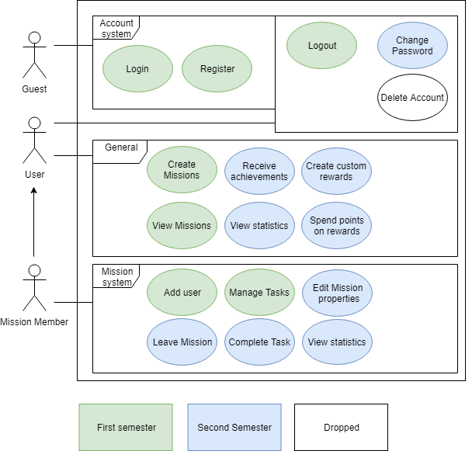
Scope – Usecases
Important Use-Cases:
* Create Mission
* Manage Tasks
* Rewards
* Achievements
* Statistics
Dropped
* Delete Account

Slide 8
Project Management
SCRUMMING with project management tool „YouTrack“
Every week new sprint planning
Gives an overview of:
Spent time
Tasks ToDo/ in Progress/ Done
Work history

Slide 9
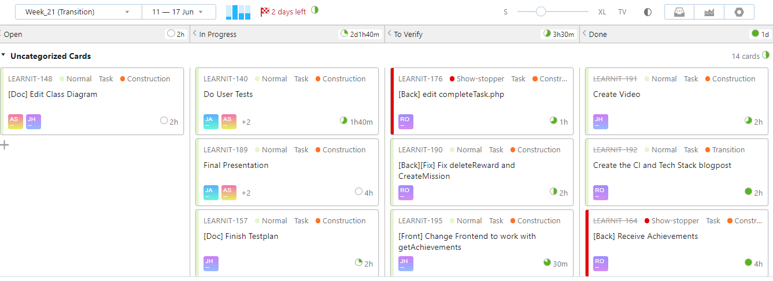
Youtrack

Slide 10
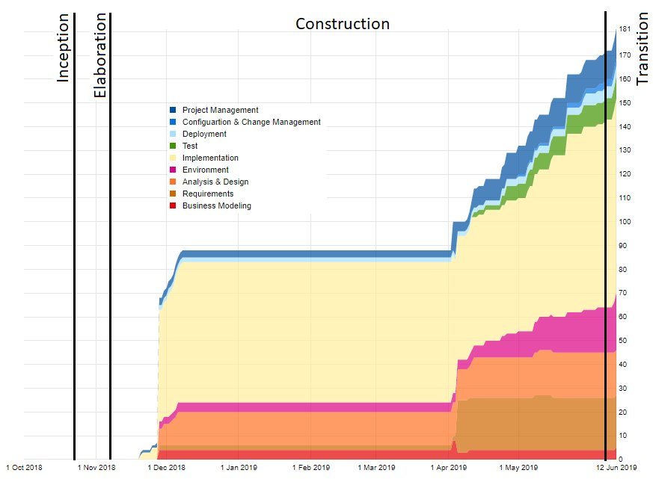
RUP
Notes:
Wie sie sehen können, sehen sie nichts -> Fehler eingestehen, im Final wird es besser aussehen
<number>

Slide 11
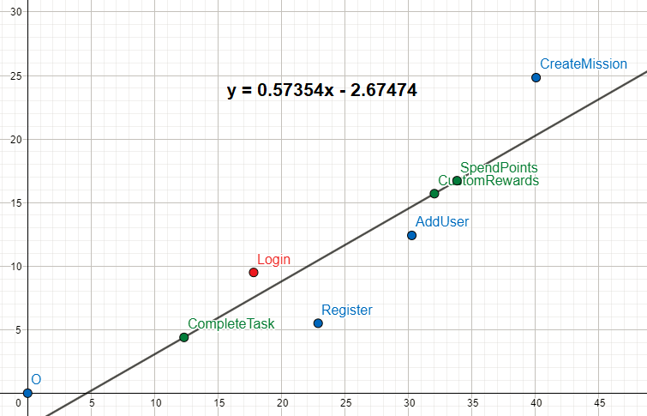
FP Time Estimation

Slide 12
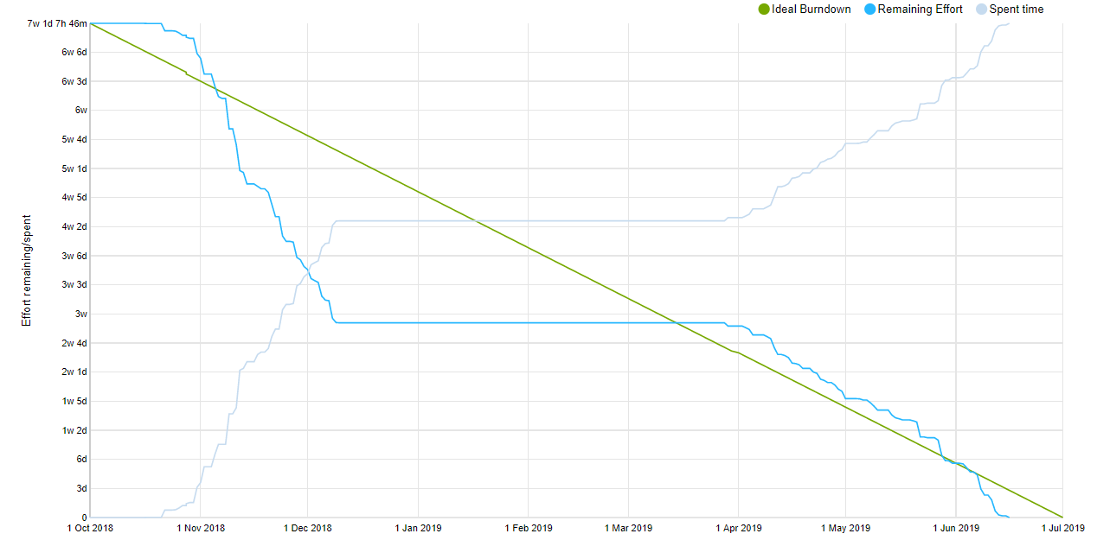
Burndown

Slide 13
Quality
Testing
Automation
RISK Management
Architecture
Patterns
Metrics

Slide 14


Testing
Unit Testing
Functional Testing
Testing the functionality of individual functions
Testing a complete functionality of the application
User Testing
Testing the usability

Slide 15






Continuous Integration
Development
Version Control
Continuous Integration
Trigger
Build and Test
Feedback

Slide 16
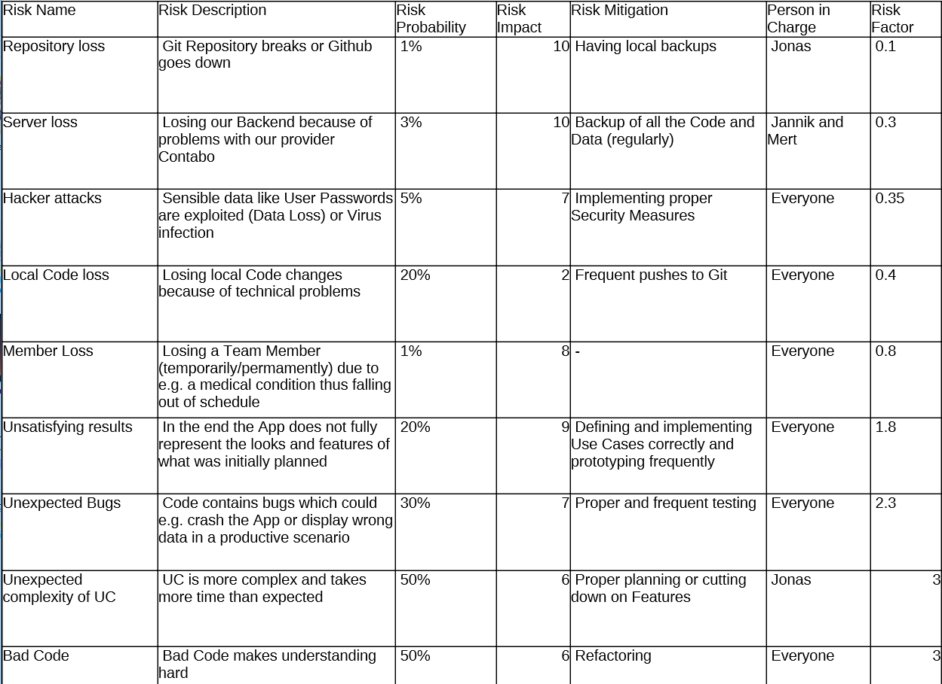
Risk Management

Slide 17
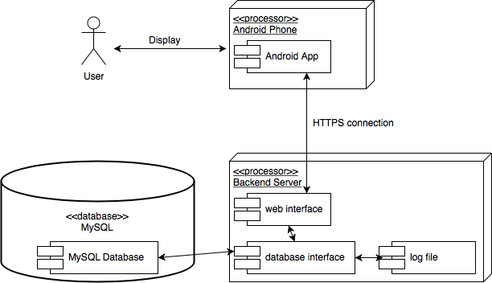
Architecture

Slide 18
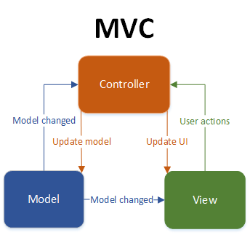
Architecture II

Slide 19
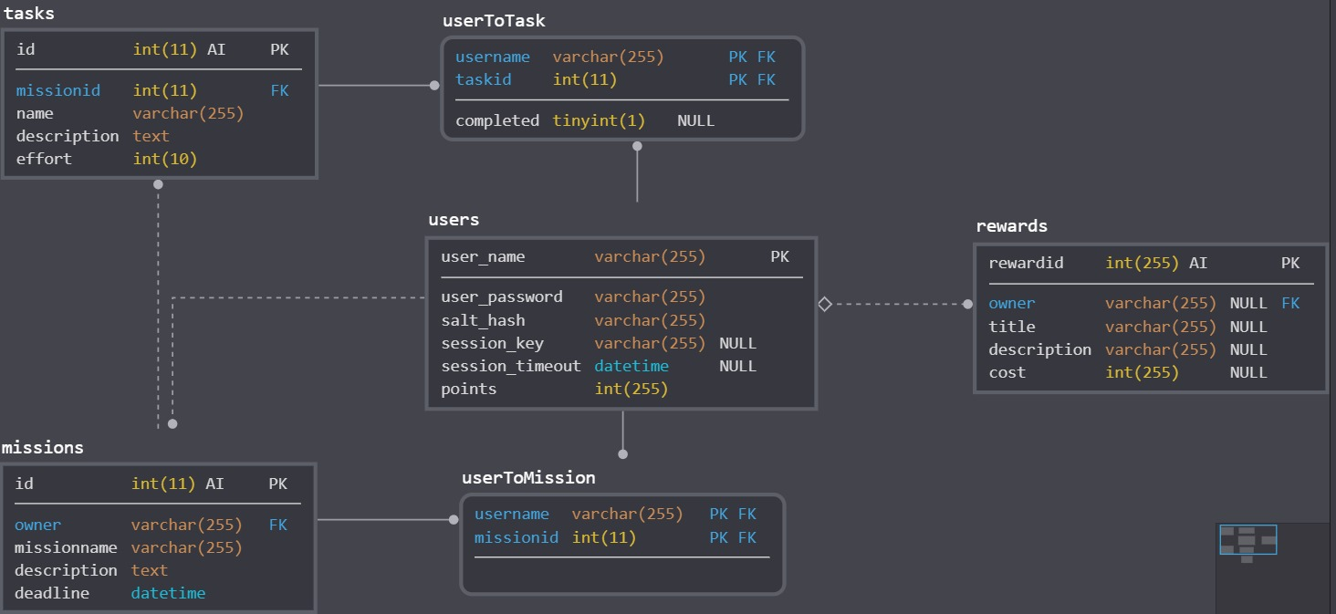
Architecture III

Slide 20
Design Patterns
Factory Method Pattern
Idea: Disguise the construction of a model with another class, the factory
In our case: Static methods to create new model objects
-> filled with data, then returned

Slide 21
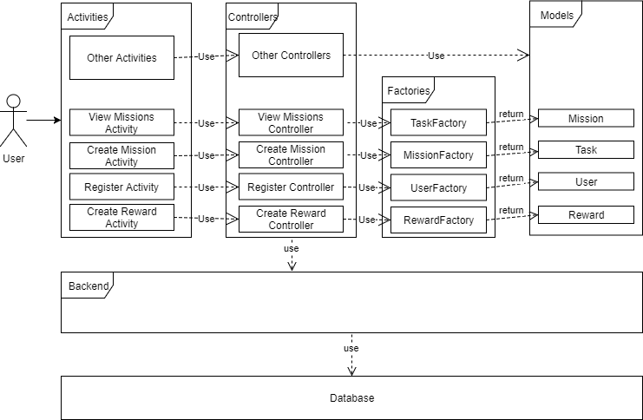
Design Patterns II

Slide 22
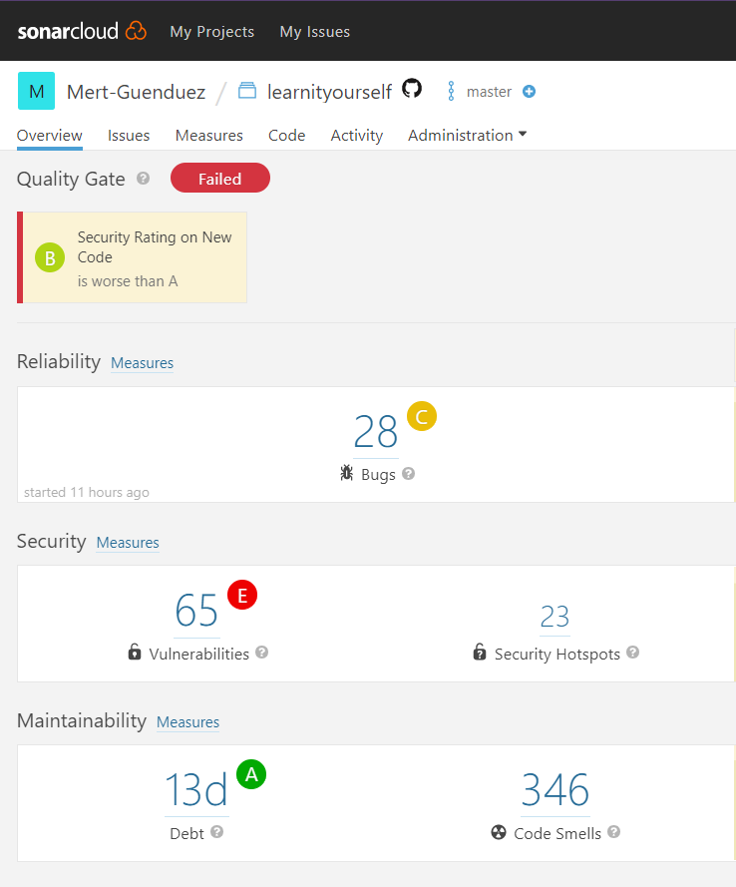
Metrics

Slide 23
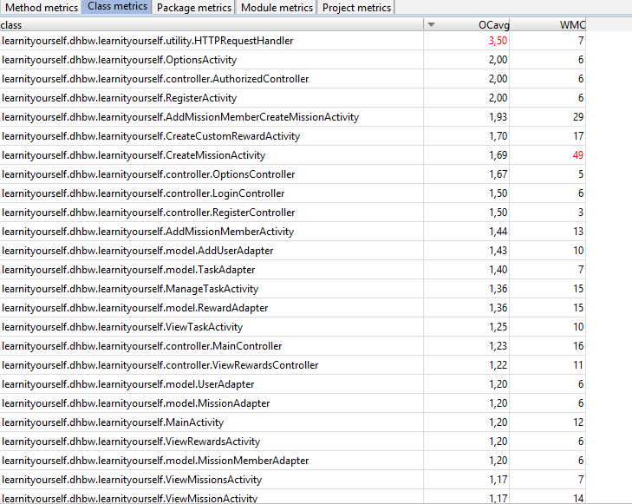

Metrics II

Slide 24
Automation
Tests, DIE, git, YouTrack SHOW Integration
Automated testing is important, why is it important. Are you mentioning that in your talk, are you explaining how it is integrated into your project. what does this mean for the client? Present proof that yours are executed. So - not only are you implementing it technically, but you are also arguing in your presentation how it is integrated into your project management and software engineering process and methodology of running your project. You dont need to mention it 4 times, but for me I need to see whether you cover all aspects of the testing during your talk.

Slide 25
Technology
Class diagram
Technical Ability
live demo

Slide 26
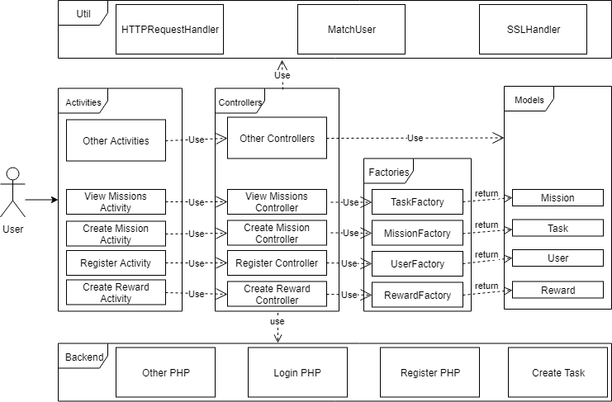

Slide 27
Technical Ability
Account
CRUD Missions
CRUD Tasks
CRUD Rewards
Statistics
Achievements

Slide 28
Demo

