Slide 1
Learn It Yourself
Lernziele spieleriesch selbst erreichen
Jonas hilpp, angelika sudheimer, mert gündüz, jannik adam

Slide 2
Business
Vision, Use-Case, PM, RUP

Slide 3
Vision
Turn mundane tasks such as studying into a game!
Applying the concepts of gamification to your studies and tasks in a way no one ever has!
Get points for the completion of tasks and spend them on personal rewards

Slide 4
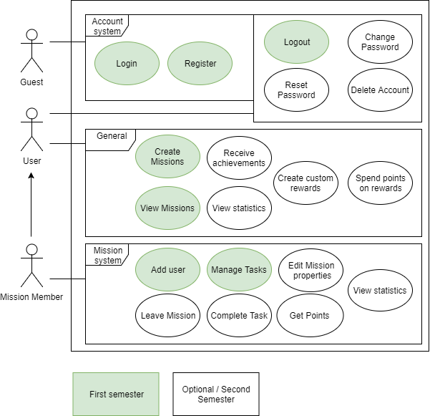
Scope: Use-Case Diagram
Account system ☺
Create/View Mission
Add user
Manage Tasks
Gamification coming next semester!

Slide 5
Project management
SCRUMMING with YouTrack
Dont assume that the people you present to know what scrum is.
So you can explain why you pick this method and how it affects the client.

Slide 6
SRS

Slide 7
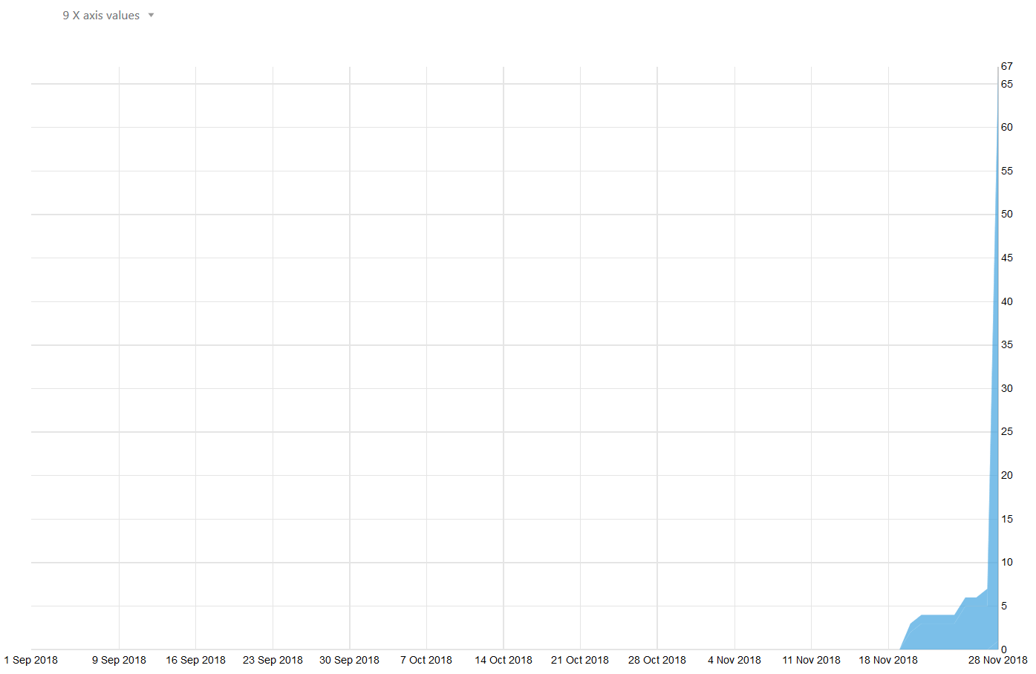
RUP
Notes:
Wie sie sehen können, sehen sie nichts -> Fehler eingestehen, im Final wird es besser aussehen

Slide 8
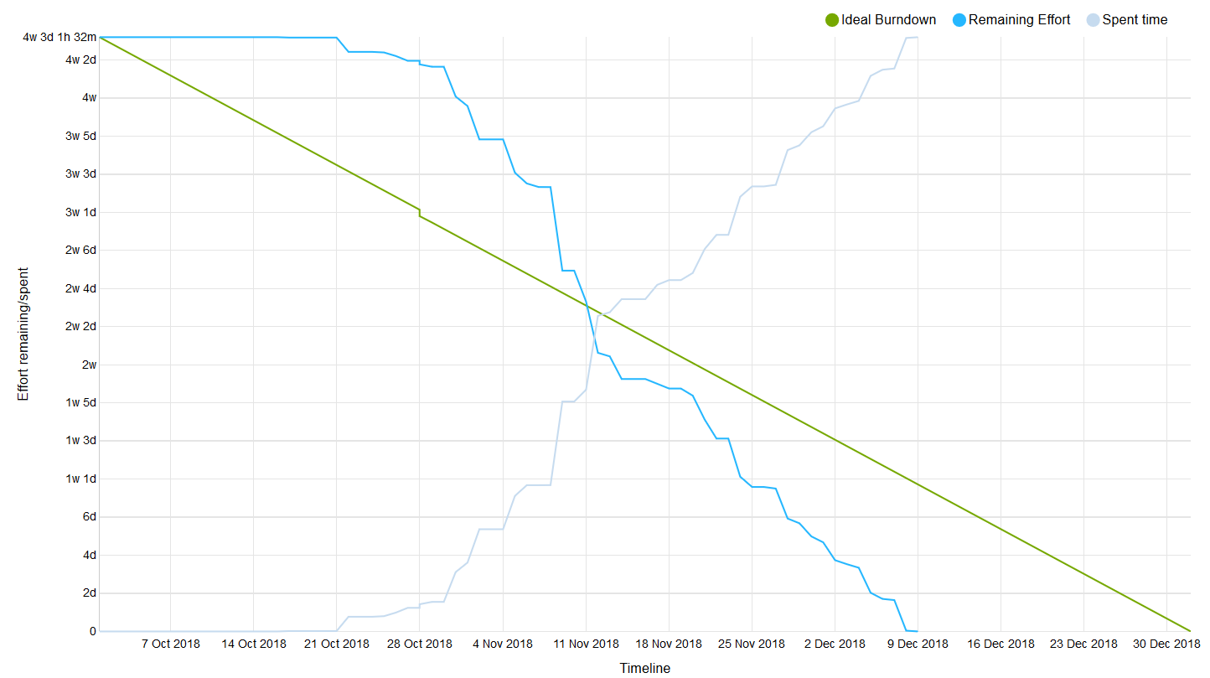
Burndown

Slide 9
Technology
Class diagram, live demo

Slide 10
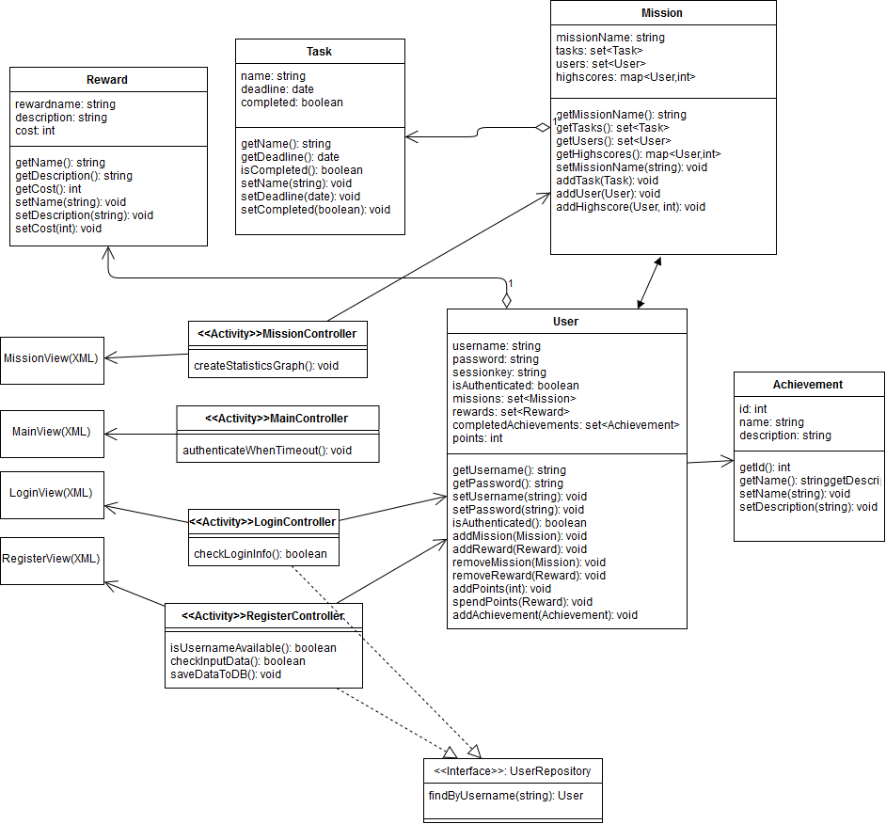
OUT TO DATE: MIT NEUEM KLASSEN DIAGRAMM ERSETZEN !!!

Slide 11
Demo
How far have we come?

Slide 12
Quality
Tools, Architecture, Automation

Slide 13
Werkzeuge & Frameworks
YouTrack (Projektmanagement)
Github (Version control)
Android Studio & PhpStorm (IDE)
WordPress (Blog Documentation)
Gradle (Build system)
Apache & MySQL (Server and database)

Slide 14
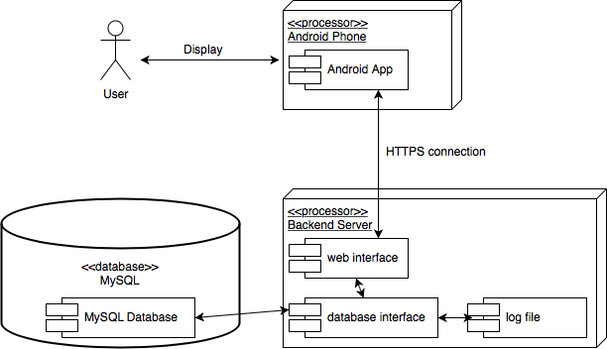
Architecture

Slide 15
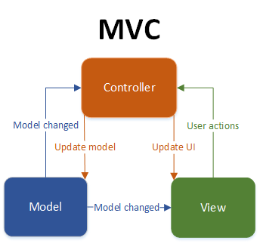
Architecture II

Slide 16
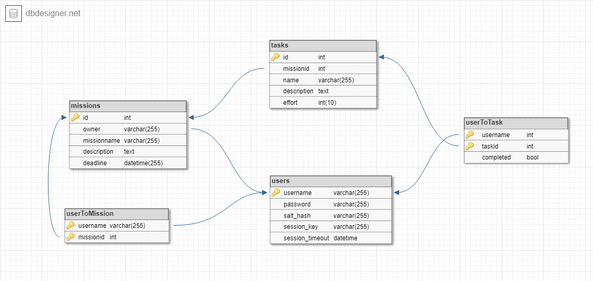
Architecture III

Slide 17
Configuration
No clue

Slide 18
Automation
Tests, DIE, git, YouTrack SHOW Integration
Automated testing is important, why is it important. Are you mentioning that in your talk, are you explaining how it is integrated into your project. what does this mean for the client? Present proof that yours are executed. So - not only are you implementing it technically, but you are also arguing in your presentation how it is integrated into your project management and software engineering process and methodology of running your project. You dont need to mention it 4 times, but for me I need to see whether you cover all aspects of the testing during your talk.

