Slide 1
Learn IT Yourself
Lernziele spieleriesch selbst erreichen
Jonas hilpp, angelika sudheimer, mert gündüz, jannik adam

Slide 2
Agenda
Business
Quality
Technical Ability

Slide 3
Business
Vision
Scope/ SRS
Project management
RUP
Time estimation

Slide 4
Our Vision
Blow up your motivation levels for reaching your goals!
Turn mundane tasks such as studying into a game!

Slide 5
Vision - Motivation
Competitive
Self-reflection
Points for completing tasks
Highscore system
Group statistics
Individual rating of (completed) tasks
Reward system outside groups
Spend points on personal rewards
Notes:
Highscore system to help you compare yourself with others and track your own improvements.
Statistics provide who is first and who is last.
Push notifications if you’re last to make sure you step up your game.
reflect upon him/herself by giving an individual rating after finishing a task. This way you will keep track on the parts you have mastered well, but also areas where you still could need some polishing.
You’ll be able to individualize the amount of points rewarded for each task. In addition to this, you can define your own personal rewards, such as eating a Snickers.
5

Slide 6
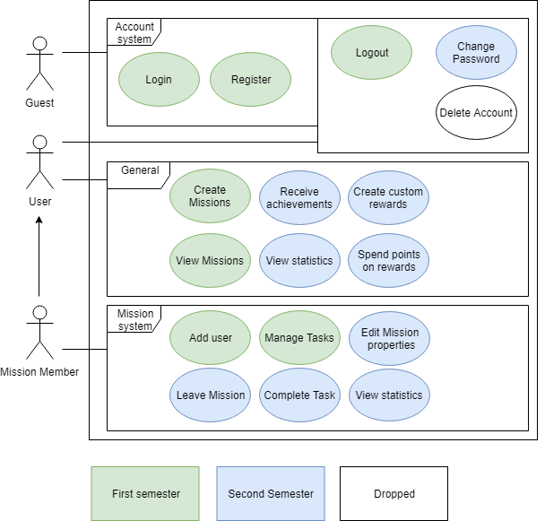
Scope – Usecases
Important Use-Cases:
* Create Mission
* Manage Tasks
* Rewards
* Achievements
* Statistics
Dropped
* Delete Account

Slide 7
Project Management
SCRUMMING with project management tool „YouTrack“
Every week new sprint planning
Gives an overview of:
Spent time
Tasks ToDo/ in Progress/ Done
Work history

Slide 8
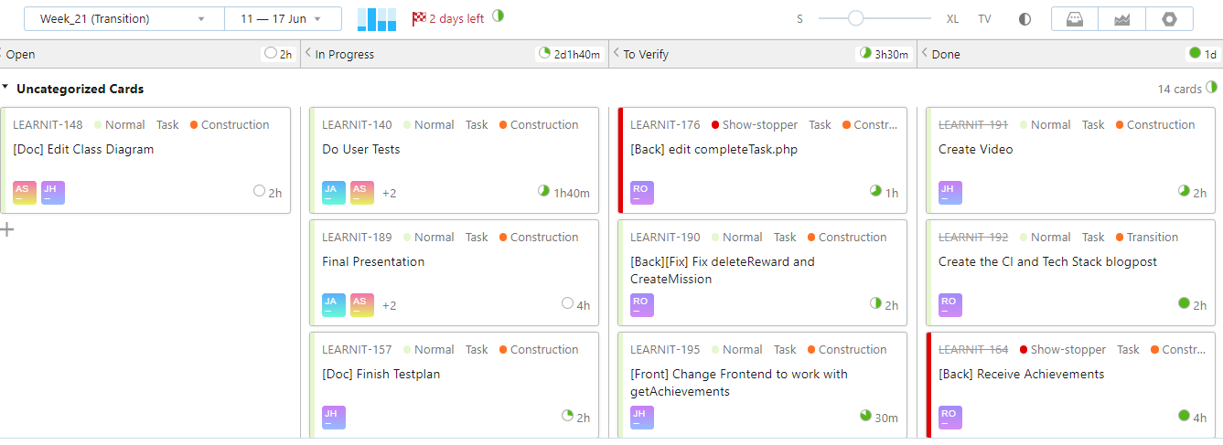
Youtrack

Slide 9
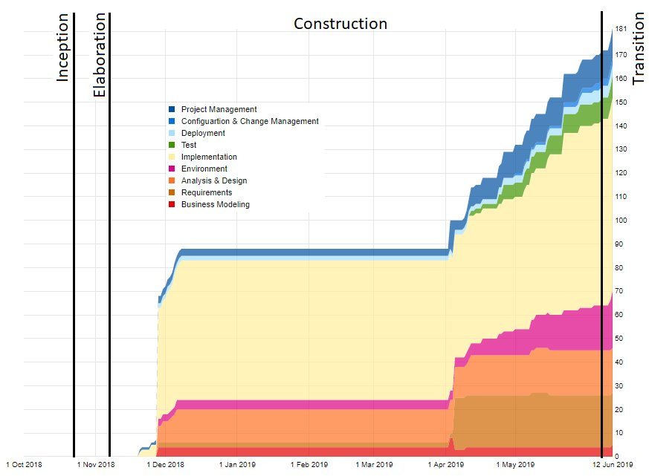
RUP
Notes:
Wie sie sehen können, sehen sie nichts -> Fehler eingestehen, im Final wird es besser aussehen
9

Slide 10
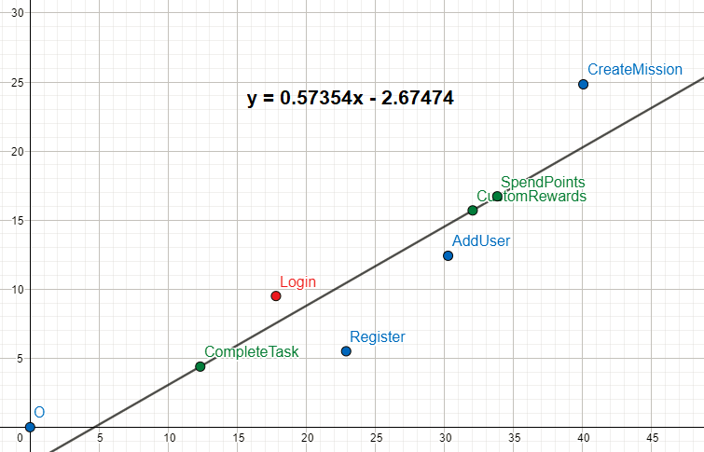
FP Time Estimation

Slide 11
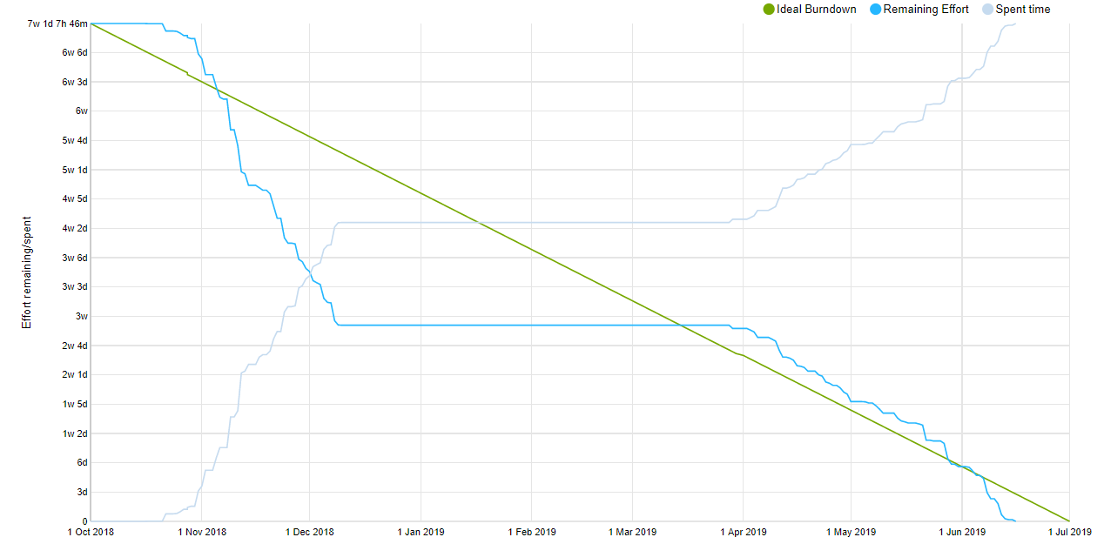
Burndown

Slide 12
Quality
Testing
Automation
RISK Management
Architecture
Patterns
Metrics

Slide 13


Testing
Unit Testing
Functional Testing
Testing the functionality of individual functions
Testing a complete functionality of the application
User Testing
Testing the usability

Slide 14






Continuous Integration
Development
Version Control
Continuous Integration
Trigger
Build and Test
Feedback

Slide 15
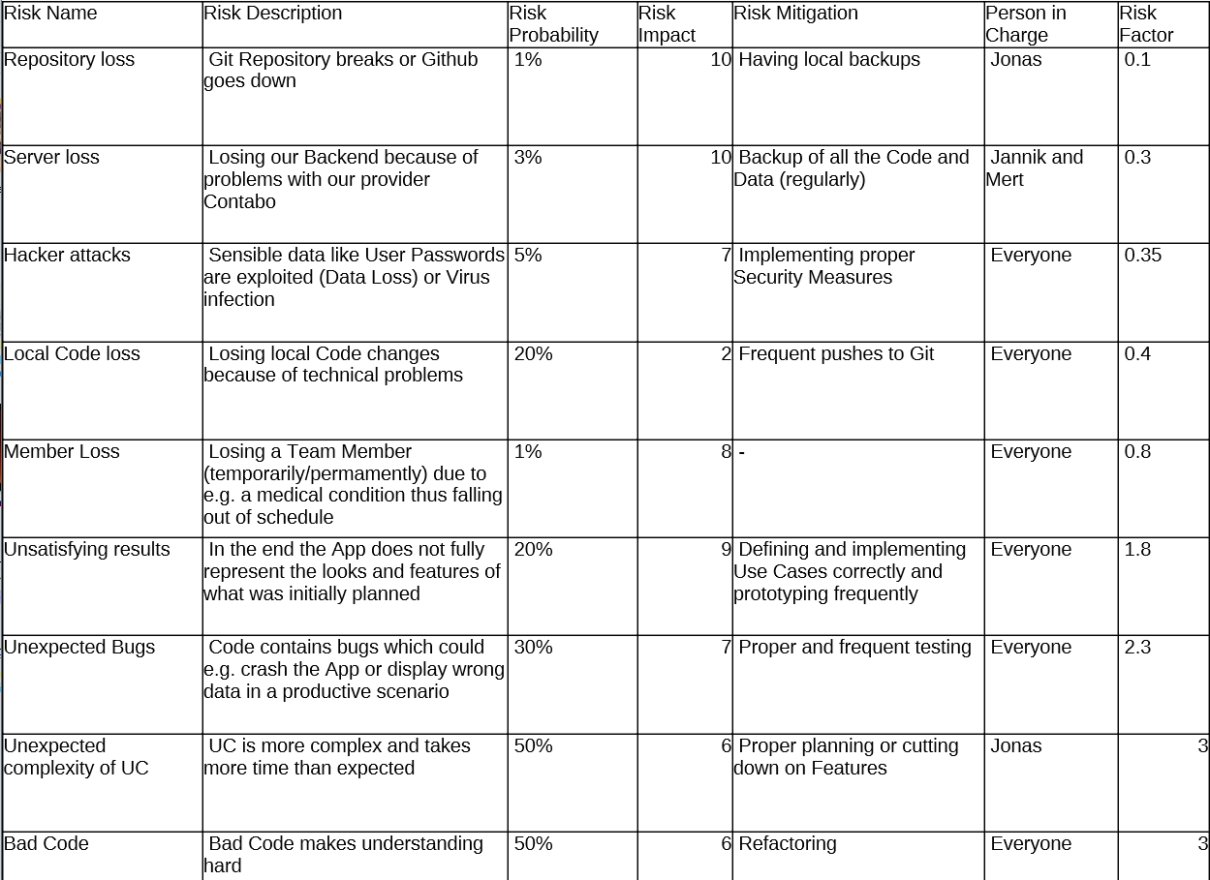
Risk Management

Slide 16
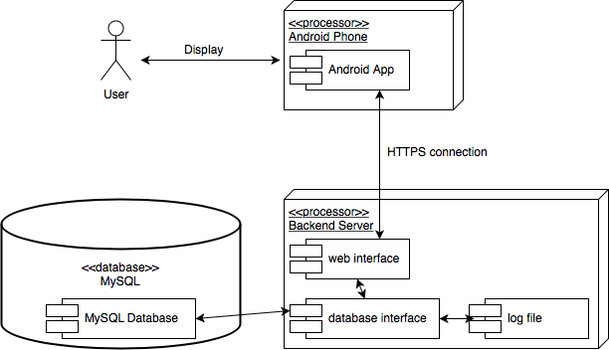
Architecture

Slide 17
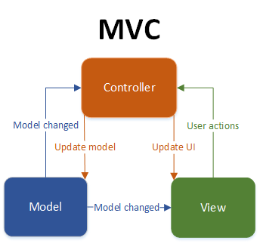
Architecture II

Slide 18
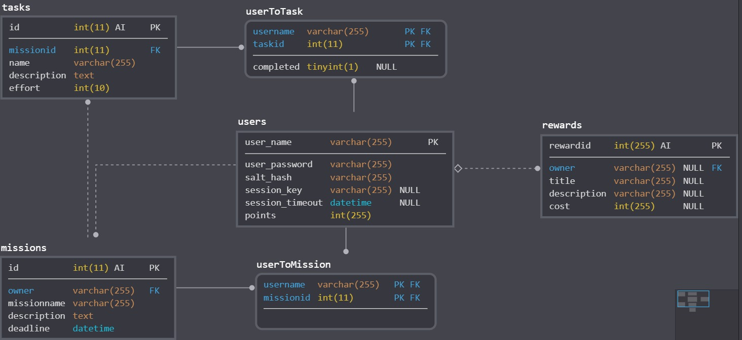
Architecture III

Slide 19
Design Patterns
Factory Method Pattern
Idea: Disguise the construction of a model with another class, the factory
In our case: Static methods to create new model objects
-> filled with data, then returned

Slide 20
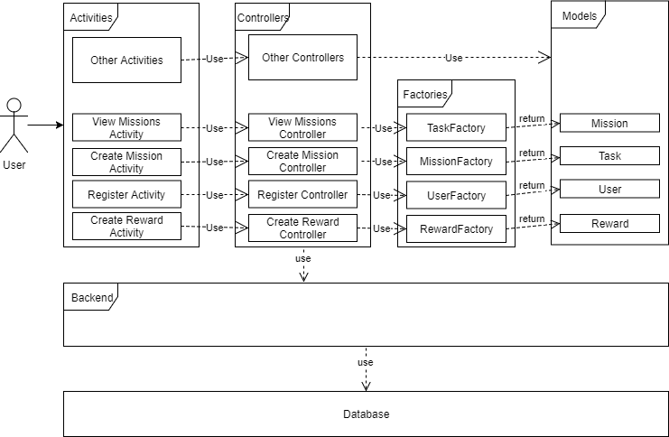
Design Patterns II

Slide 21
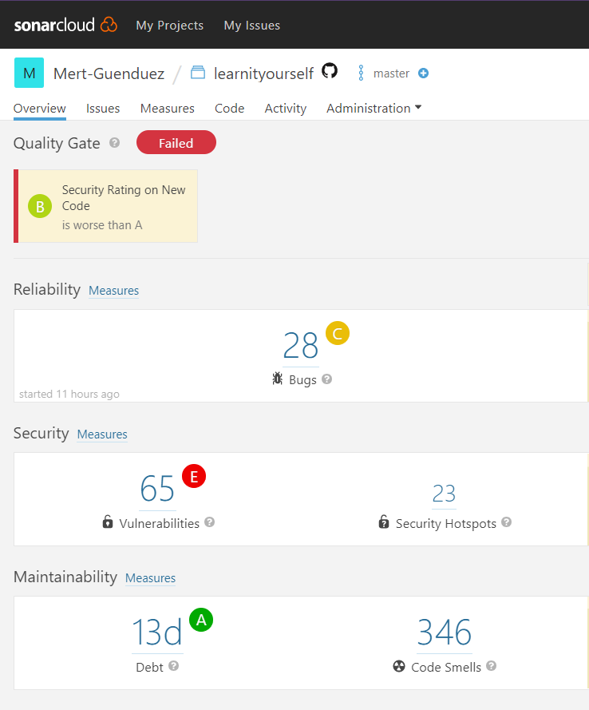
Metrics

Slide 22
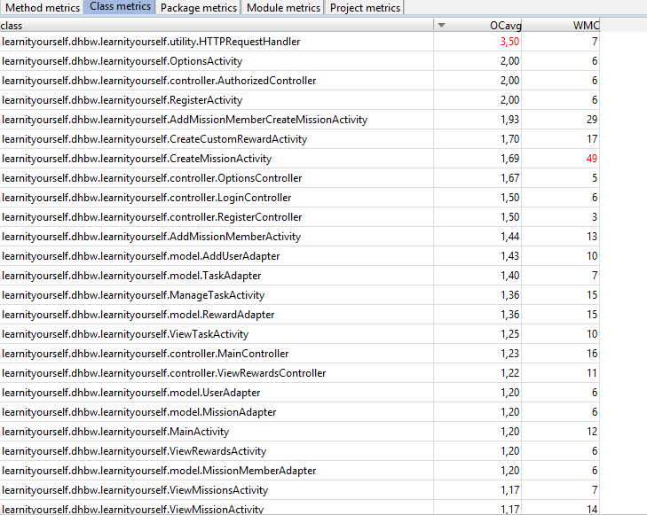

Metrics II

Slide 23
Technology
Class diagram
Technical Ability
live demo

Slide 24
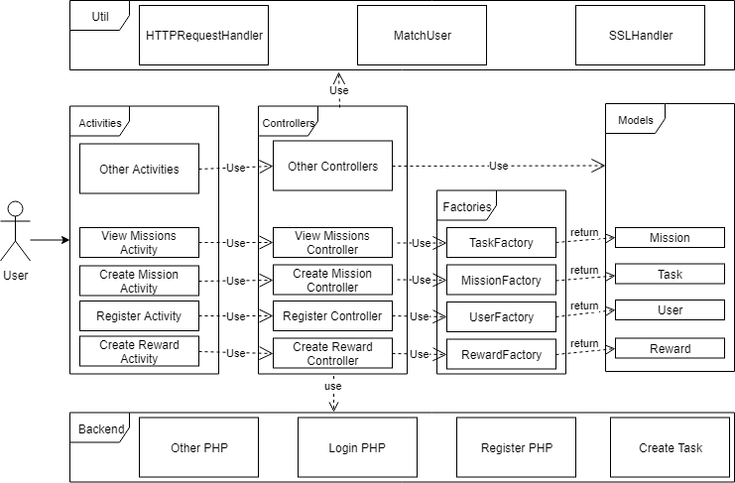

Slide 25
Technical Ability
Account
CRUD Missions
CRUD Tasks
CRUD Rewards
Statistics
Achievements

Slide 26
Demo

