Slide 1
Environments of z~0.2 Star Forming Galaxies: Building on the Citizen Science Discovery of the Green Peas
Carie Cardamone
Wheelock College
with Meredith Powell, Nico Cappelluti & Meg Urry @ Yale
With thanks to the Galaxy Zoo Team and over 200,000 volunteers including: Elisabeth Baeten, Gemma Coughlin, Dan Goldstein, Brian Legg, Mark McCallum, Christian Manteuffel, Richard Nowell, Richard Proctor, Alice Sheppard, and Hanny van Arkel
Notes:
http://www.theskyscrapers.org/astroassembly
Today not trad sci talk (introduce the problem of understanding how galaxies form and evolve and showing you how my work contributes towards that understanding), Rather going to take opportunity to introduce Citizen Science (specifically Galaxy Zoo, project I’m involved in) and use some of my research to show how CitSci can enable new and exciting research results.
Why Now? It’s a loaded term among academics, and often not understood what it is, Hot topic in funding agencies (and highlighted in decadal review – but! Incorrectly!)
Decadal Review: Astro2010 p101The internet plays a pervasive role for public astronomy, attracting world-wide audiences on websites such as Galaxy Zoo (www.galaxyzoo.org, last accessed July 6, 2010) and on others that feature astronomical events, such as NASA missions. - although they mislabeled a Vorverpe a Green Pea (emission line cloud!!!! Vs a galaxy)
Green Peas & Galaxy Evolution: Discoveries of Citizen Science
Abstract: I will introduce the Galaxy Zoo Citizen Science project and discuss some new discoveries being made through collaborations with Citizen Scientists. I will present a class of rapidly growing emission line galaxies, known as ‘Green Peas’, first noted by volunteers in the Galaxy Zoo project because of their peculiar bright green colour and small size. Their appearance is due to very strong optical emission lines, namely [OIII] λ5007 Å, with an unusually large equivalent width of up to ∼1000 Å. The Peas have some of the highest specific star formation rates seen in the local Universe, yielding doubling times for their stellar mass of hundreds of Myr. Due to their similarity in size, mass, luminosity to high-redshift ultraviolet-luminous galaxies, e.g. Lyman-break galaxies and Lyα emitters, studying these starbursting galaxies can help us to understand the build up of stellar mass in the Universe.

Slide 2
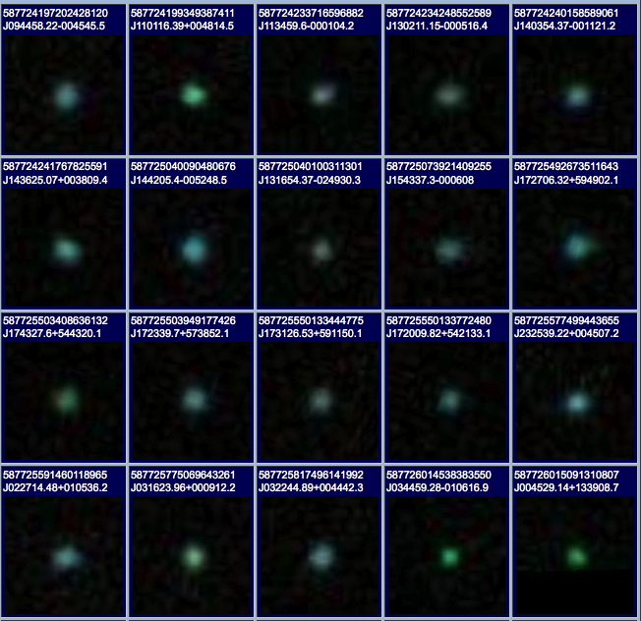
Galaxy Zoo Green Peas: discovery of a class of compact extremely
star-forming galaxies
Cardamone et al. 2009
Notes:
In particular – the unintended consequences (my research!) Story to tell you today.
~200 were found by eye by the ‘Peas Brigade’ - a group of volunteers dedicated to finding these.
The task fell to me: How do these objects fit into our picture of galaxy evolution? Most importantly what can they tell us about how galaxies form?
----
If we start with the assumption that morphology tells us something of the galaxies properties.
So how do we fit these objects into our picture of galaxy evolution - what can they tell us about it?
But
Most peas turned out to be Starburst galaxies,
This was surprising to me, I expected to see AGN.
of lower metalicity (by their location on the BPT plot)
Further looking into their gas phase metalicity revealed numbers near 0.5 solar to nearly solar in some cases.
E(B-V) from the balmer decrement so you can believe

Slide 3
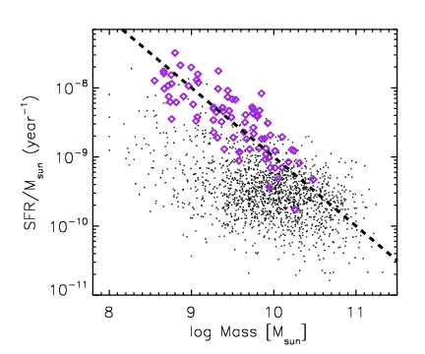
Specific Star Formation Rate
Galaxies from the early Universe
Lyman Break
Galaxies
Lyman-a Emitters
(Gawiser et al. 2006)
Peas
SFR = 10 M_{sun}yr⁻¹
Galaxy Zoo Mergers
after Castro Cerón et al. 2006
Cardamone et al. 2009
Notes:
Specific star formation rates indicating doubling times of order 1 Gyr or less.

Slide 4
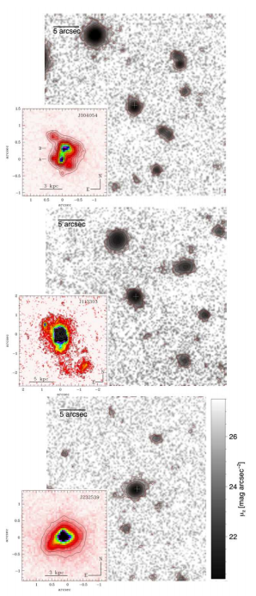
Follow-up Studies
GTC-OSIRIS z’-band
Short / Extreme phase of SF
Recent massive inflow of gas
Feedback (Wolf Rayet *s?)
Metal poor (1/5th solar)
High N/O ratios
Very young ages (≤10 Myrs)
Up to 20 % of current mass
Existing old stellar components
Low HI column density
High escape fraction for ionizing radiation
What is their galactic environment?
HST WFPC2 F606 (R)
Amorin et al. 2010, Amorin et al. 2011, Izotov et al. 2011, Amorin et al. 2012, Hawley 2012, Pilyugin et al. 2012, Chakraborti et al. 2012, Henry et al. 2015, Rutkowski et al. 2017, Greis et al. 2017
Amorin et al. 2012
Notes:
Follow-up studies of the Green Peas and other compact, low-redshift, star forming galaxies have found them to be authentically metal-poor galaxies, with lower oxygen abundances than other star forming galaxies of a similar mass (Amorin et al. 2010, 2011). Several studies have looked in great detail at the abundances of various elements in the Green Peas, something that cannot be done in their high redshift analogs. This has resulted in a variety of interesting results, including the importance of Wolf-Rayet stars in the ionization of the gas in the Green Peas (Hawley 2012, Amorin et al. 2012). They have also been shown to have energetic outflows of gas (Amorin et al. 2012) and have been used to understand the astrophysics regulating the production of Lyman-alpha emission lines (Henry et al. 2015). Their morphologies have been confirmed to be clumpy by HST imaging (Overzier et al. 2010) and results have suggested that star formation in the peas occurs in several separate knots throughout the galaxy (Amorin et al. 2012). Additionally, underlying older stellar populations have been revealed through low-luminosity emission (Amorin et al. 2012a). Their radio emission suggests they have strong magnetic fields, larger than that of the Milky Way (Chakraborti et al. 2012).

Slide 5
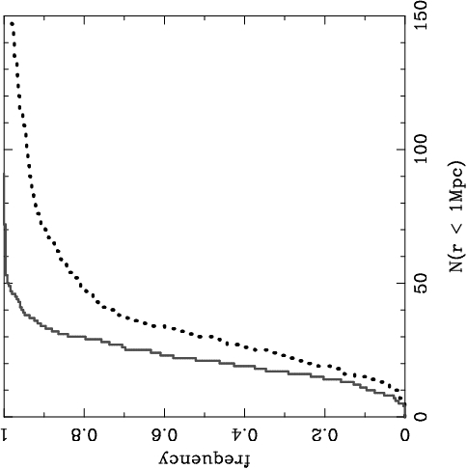
Peas may live in under-dense regions
Cumulative Distribution
Peas
comparison
galaxies
Correlation functions provide a better measure of the 3D environment
Fewer projected neighbors
# of neighbors within 1 Mpc
Cardamone et al. 2009
Notes:
., the median environmental density around peas is less than two-thirds that around normal galaxies, etc. 95% of peas live in environments less dense than those inhabited by at least 33.5% of normal galaxies. Alternatively, at least one-third of normal galaxies live in environments denser than those in which 95% of peas are found.
1 Mpc = 3 Million Light Years

Slide 6
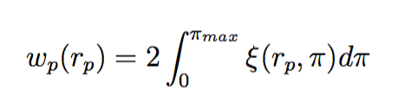
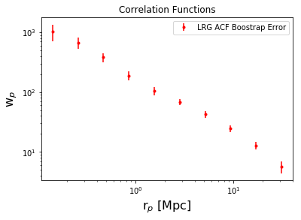

Correlation Function
Pair Counting: a pair of galaxies are a distance r
Manodeep Sinha’s CorrFunct
https://github.com/manodeep/Corrfunc
Notes:
The quantitative measure of clustering is the 2-pt correlation function, which measures the excess probability that a pair of objects is a given distance from each other, over a random distribution.
There are two terms in the correlation function that are dominant on different scales

Slide 7
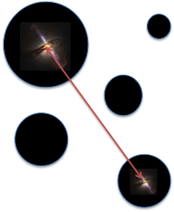
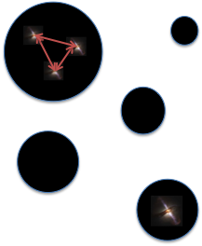
Correlation Function
Luminous Red Galaxies
Notes:
Homogenous well studied sample
Successfully constrained cosmological parameters (e.g., Tegmark et a. 2004)
HOD models are good fit (Zehavi et al. 2005, Reid & Spergel 2009, White et al. 2011)
The quantitative measure of clustering is the 2-pt correlation function, which measures the excess probability that a pair of objects is a given distance from each other, over a random distribution.
There are two terms in the correlation function that are dominant on different scales

Slide 8
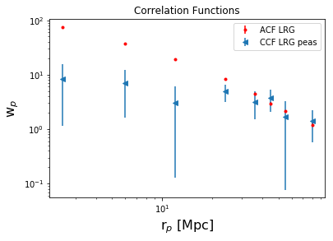
Cross-Correlation Function (r > 1 Mpc)
Notes:
Sample galaxy_DR12v5 LOWZ (N & S) files, limit 0.112<z<0.36, 287751galaxies
Randoms sample (random0_DR12v5_LOWZ: 14,144,530 galaxies,

Slide 9
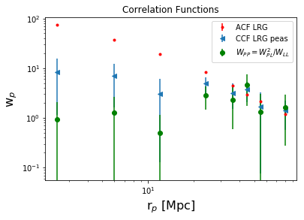
Cross-Correlation Function
Cross-Correlation Function (r > 1 Mpc)
Few Neighbors
Notes:
Sample galaxy_DR12v5 LOWZ (N & S) files, limit 0.112<z<0.36, 287751galaxies
Randoms sample (random0_DR12v5_LOWZ: 14,144,530 galaxies,

Slide 10
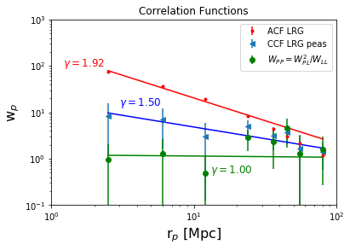
Cross-Correlation Function
Cross-Correlation Function (r > 1 Mpc)
Notes:
Sample galaxy_DR12v5 LOWZ (N & S) files, limit 0.112<z<0.36, 287751galaxies
Randoms sample (random0_DR12v5_LOWZ: 14,144,530 galaxies,

Slide 11
Conclusions
Peas do not trace dark matter distributions.
Peas live in under dense regions compared to Luminous Red Galaxies.
Small bias value (< 0.5)
Next Step: Use dark matter model to characterize bias

Slide 12
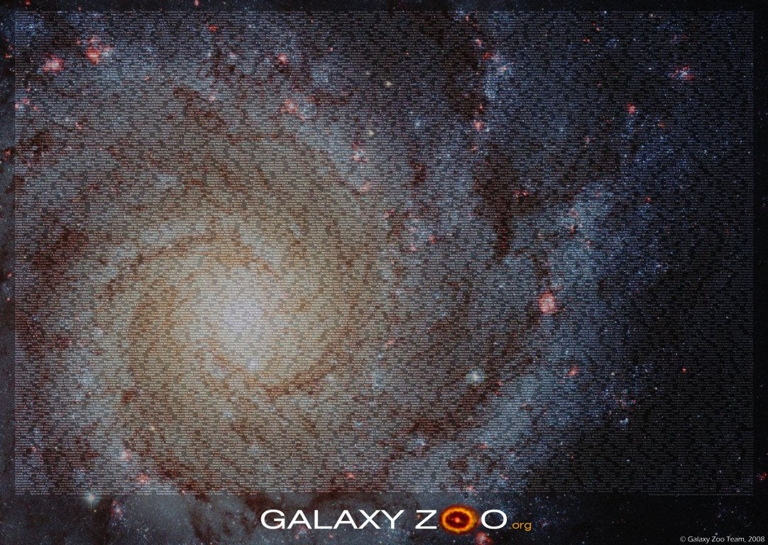

Slide 13
Comparison to Higher Redshift
 | LBG / LαE | The Peas
Redshift | z ~ 3.0 | z ~ 0.2
Low Reddening | E(B-V)~0.05-0.2 (Verhamme et al. 2008) | E(B-V) ≤ 0.2
Compact Morphology | compact/disturbed (Giavalisco et al. 1996, Bremer et al. 2004) | compact/disturbed (HST)
High Specific Star Formation Rate | ~10s Msun/yr (Carilli et al. 2008; Coppin et al. 2007; Lehmer et al. 2005; Barmby et al. 2004) | ~ 0.3 - 30 Msun/yr
Lower Metalicity | 10-50% solar | ~50% solar
Environment | dense regions (Giavalisco 2002) | under-dense regions
Notes:
Key observation came from galex counterparts - UV luminosities are similar to lyman break galaxies

Slide 14
Comparison to Higher Redshift
 | LBG / LαE | The Peas
Redshift | z ~ 3.0 | z ~ 0.2
Low Reddening | E(B-V)~0.05-0.2 | E(B-V) ≤ 0.2
Compact Morphology | compact/disturbed | compact/disturbed (HST)
High Specific Star Formation Rate | ~10s Msun/yr | ~ 0.3 - 30 Msun/yr
Lower Metalicity | 10-50% solar | ~50% solar
Environment | dense regions | under-dense regions
Notes:
Key observation came from galex counterparts - UV luminosities are similar to lyman break galaxies

Slide 15
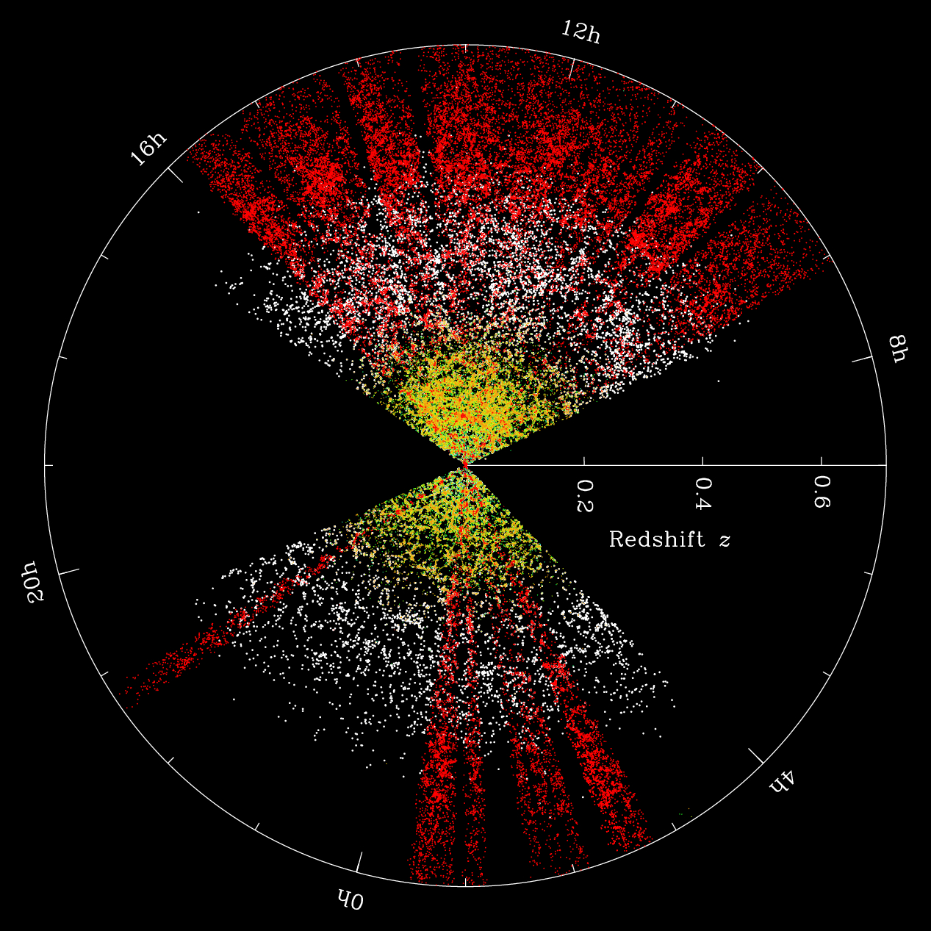
Cross-Correlation Function
Luminous Red Galaxies
SDSS
Lowz LRGs
Homogenous well studied sample
Successfully constrained cosmological parameters (e.g., Tegmark et a. 2004)
HOD models are good fit (Zehavi et al. 2005, Reid & Spergel 2009, White et al. 2011)
http://wwwmpa.mpa-garching.mpg.de/mpa/research/current_research/hl2012-1/hl2012-1-en-print.html
Notes:
Match spatial & redshift distributions of data and reproduce completeness, redshift failures, close pair separations
The quantitative measure of clustering is the 2-pt correlation function, which measures the excess probability that a pair of objects is a given distance from each other, over a random distribution.
There are two terms in the correlation function that are dominant on different scales

Slide 16
Luminous Red Galaxy Auto-Correlation Function (sample provided by N Padmanabhan, BOSS)
w_{p}(r_{p}) = w_{1-halo}(r_{p}) +w_{2-halo}(r_{p})
Two halo term: at large scale all pairs come from different halos
Notes:
Sample galaxy_DR12v5 LOWZ (N & S) files, limit 0.112<z<0.36, 287751galaxies
Randoms sample (random0_DR12v5_LOWZ: 14,144,530 galaxies,

Slide 17
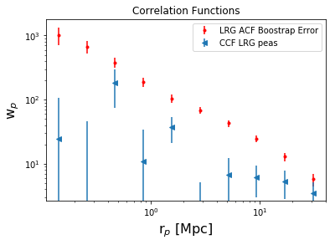
Luminous Red Galaxy Auto-Correlation Function (sample provided by N Padmanabhan, BOSS)
w_{p}(r_{p}) = w_{1-halo}(r_{p}) +w_{2-halo}(r_{p})
Two halo term: at large scale all pairs come from different halos
Notes:
Sample galaxy_DR12v5 LOWZ (N & S) files, limit 0.112<z<0.36, 287751galaxies
Randoms sample (random0_DR12v5_LOWZ: 14,144,530 galaxies,

