Slide 1
Urry Group Weekly Update
June 28th 2017

Slide 2
Last Week
Generated smoothed random of peas distribution (assuming even sky +/-1 degree of peas location
Downloaded Luminous Red Galaxies from Nikhil & it’s associated random catalog.
Ran cross-correlation & autocorrelation with new sample

Slide 3
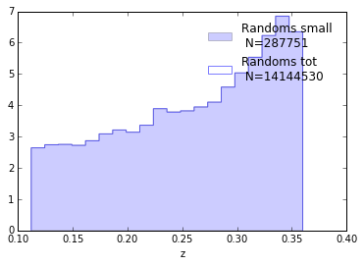
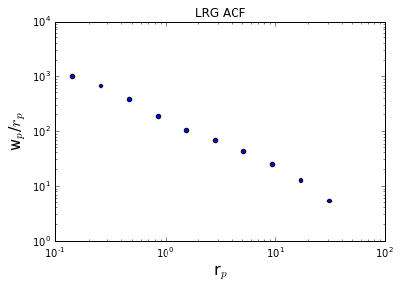
AUTO Correlation function from the LRGs:
Sample galaxy_DR12v5 LOWZ (N & S) files, limit 0.112<z<0.36: 287751galaxies
Randoms sample (random0_DR12v5_LOWZ: 14,144,530 galaxies,
randomly sampled to 707226

Slide 4
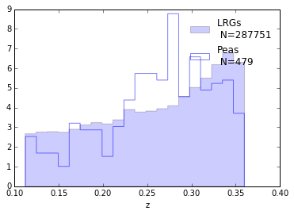
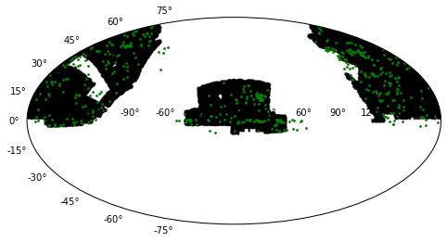
This sample of LRG’s are well matched in redshift space to the peas.
Not as good a match in RA/Dec

Slide 5
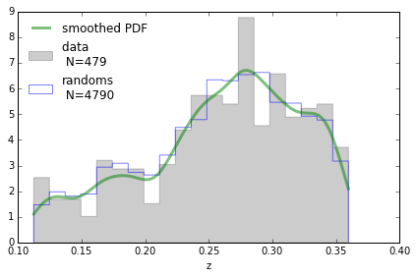
Created Random catalog for peas (using Merry’s KDE smoothed code)

Slide 6
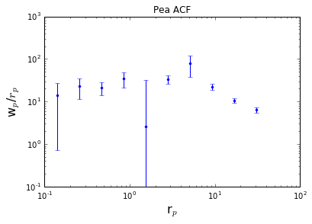
ACF 479 peas: Errors are jacknifed over whole sky (need to find a sensible way to fix this)

Slide 7
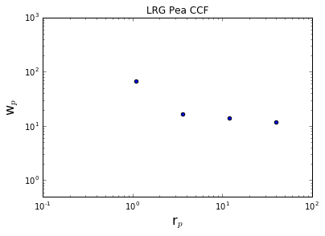
A quick cross correlation function (no errors) to see what we’d get . . .
array([ -7.70946594, 67.23458255, 16.85047569, 14.00175222, 11.76177076])

Slide 8
Next Steps
Questions:
Peas/ LRG miss-match in RA/Dec, should I limit the regions and throw out some peas?
Jackknife for errors (computing across the full sky, need to find a way to account for non-full sky nature of survey).
Run cross-correlation w/ errors
Should peas ‘randomns’ be uniform
Update ‘memo’ document notes
Slides for GZ10
Anything we’d like to do with new GZ datasets?

Slide 9
HST Search - PEAS
63 of the 1346 ‘new’ BOSS peas are in HST imaging + 11 of the 24 original peas not in BOSS search result
Trying to get actual data now….
Recent proposals:
Lyman alpha escape in Green Pea galaxies (give peas a chance)
Green Pea Galaxies: Extreme, Optically-Thin Starbursts?
UV Spectroscopy of Lyman Break Galaxy Analogs: A Local Window on the Early Universe
Origin of double peaks in Lyman-alpha spectra: diffuse halos or Lyman continuum leakage?
Unveiling the Dark Baryons II: the First Sample of OVI Emission Imaging
UV Snapshot of Low-redshift Massive Star-forming Galaxies: Searching for the Analogs of High-redshift Clumpy Galaxies

Slide 10
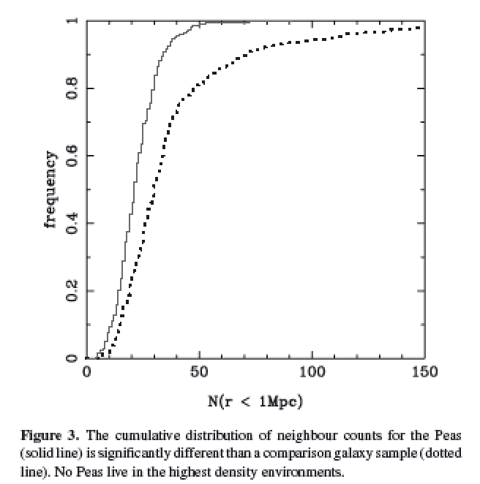
Cardamone et al. 2009
Projected density around Peas vs. sample matched in luminosity and redshift
Looked within projected 1Mpc, and imag > -20.5
Notes:
Projected density around Peas vs. sample matched in luminosity and redshift
Looked within 1Mpc, and imag > -20.5
Peas lie in lower density regions than typical gal at same i-band luminosity
KS test 8 sigma
Median environmental density less than 2/3rds normal galaxies

Slide 11
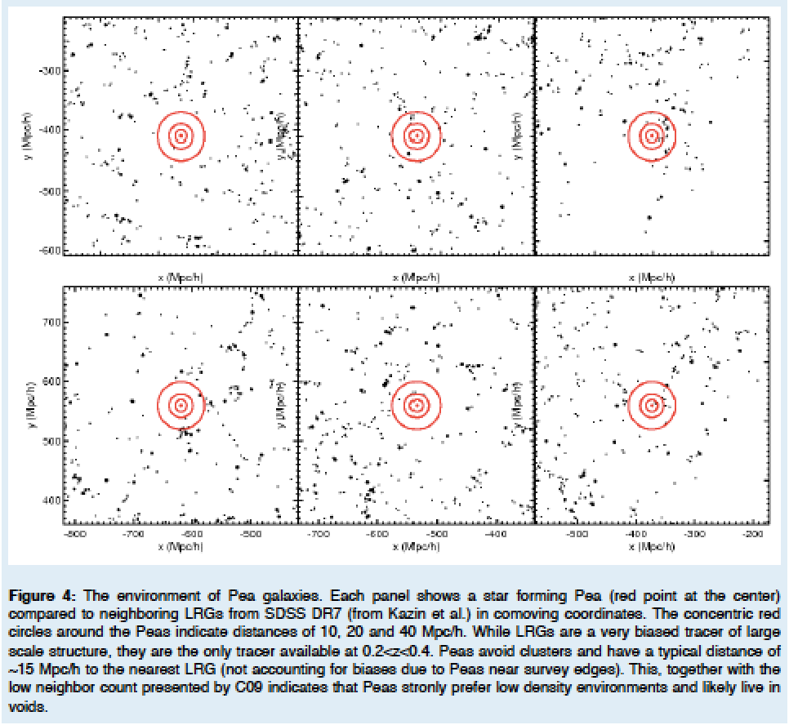
Kevin’s HST SNAP proposal / ~15 Mpc/h to nearest DR7 LRGs
Notes:
(10,20 & 40 Mpc/h) – red circles
Strongly prefer low density environments. . . .

Slide 12
Mapping Environment of Green Peas
Original idea – match peas to a Mock Universe
Looking at abundance matching
e.g., distance to 5th nearest neighbor (W/in Mstar)
e.g., distribution of Neighbors within 1/5 Mpc

Slide 13
Searching for Pea Neighbors
Starting with the original sample of 80 peas, looking within 50 Mpc projected
Neighbors found with specz 427
Neighbors in photometric catalog 120595
Neighbors found with photo redshift est 20743
Neighbors found w/ photoz in 1sig of pea z 9844
+ -> photo error class 1 3560
*** only a handful (35) remain if looking within 5 Mpc… ***

Slide 14
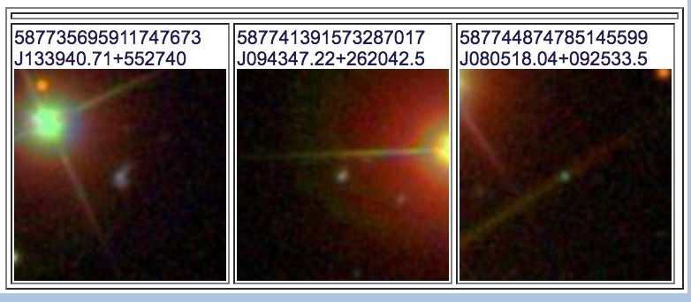
8 from Original 80 not recovered
3 BAD photometry – near bright objects….
2 not in Portsmouth Catalog
3 had EW < 0.5
15 Not classified as ‘Star Forming’ in BPT
(Seyfert, Composite, LINER)

