Slide 1
Urry Group Weekly Update
July 17th 2017

Slide 2
Last Week
Looked at random peas distribution (assuming even sky +/-1 degree of peas location or exact location – no influence on corr funct).
Ran cross-correlation & autocorrelation of Peas / LRGs
Met with Nikil
Presented at GZ10

Slide 3
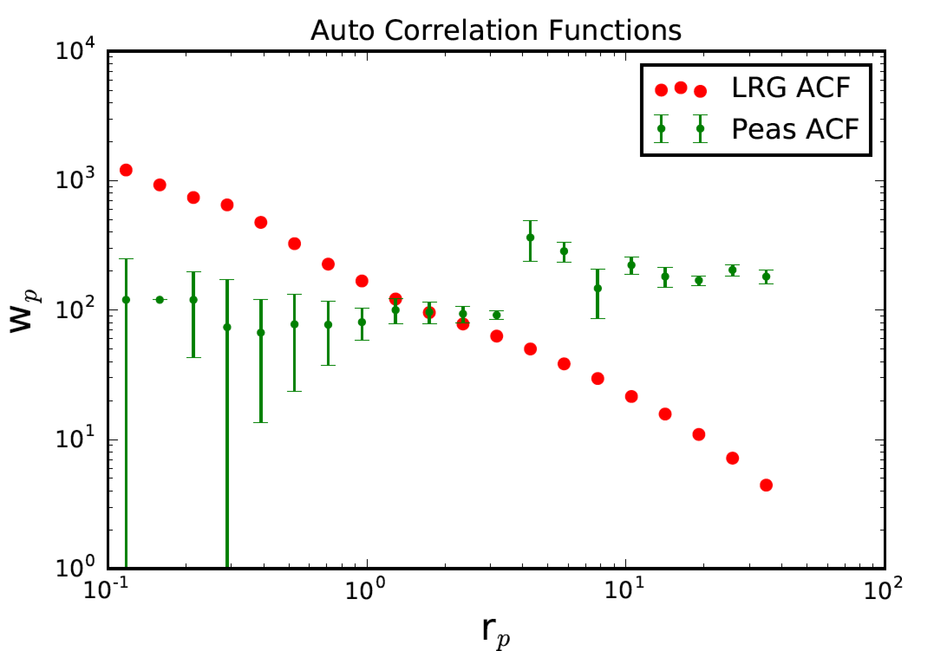
AUTO Correlation function from the LRGs
(sample provided by N Padmanabhan, BOSS)
Smaller amplitude, less clustered?
w_{p,1h}
w_{p,2h}
Notes:
Sample galaxy_DR12v5 LOWZ (N & S) files, limit 0.112<z<0.36, 287751galaxies
Randoms sample (random0_DR12v5_LOWZ: 14,144,530 galaxies,

Slide 4
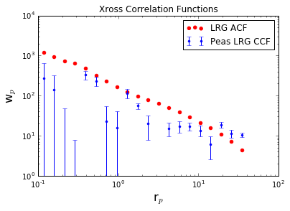
There is something wrong with this cross correlation function ?????

Slide 5
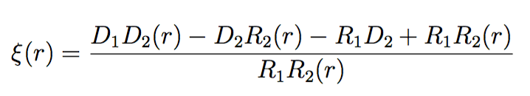
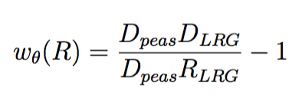
Next Steps
In process:
Errors (Jackknife -> Bootstrap), not worry about division of sky regions with uneven detection across them.
Move from Landy-Szalay to Padamabhan 2009
Revisit ‘peas’ selection – want larger sample, but still ‘pure’
Update ‘memo’ document notes & start paper draft
Landy-Szalay (1993) estimator
Padamanabhan (2009) estimator:
No R_peas needed!

