Slide 1
Urry Group Weekly Update
July 24th 2017

Slide 2
Last Week
Used Peebles 1976 instead of Landy-Szalay as estimator (that’s Padamabhan 2009)
Read Davis & Peebles 1983 (also, skimmed Padamanabhan 2009, Alam 2015 (DR12), Zehavi 2002 & 2004, Reid 2016)
> Errors (Jackknife -> Bootstrap), not worry about division of sky regions with uneven detection across them. IN PROGRESS
> Revisit ‘peas’ selection – want larger sample, but still ‘pure’ IN PROGRESS

Slide 3
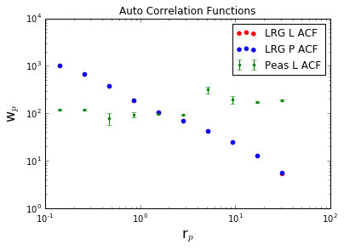
AUTO Correlation function from the LRGs
(sample provided by N Padmanabhan, BOSS)
w_{p,1h}
w_{p,2h}
Notes:
Sample galaxy_DR12v5 LOWZ (N & S) files, limit 0.112<z<0.36, 287751galaxies
Randoms sample (random0_DR12v5_LOWZ: 14,144,530 galaxies,

Slide 4
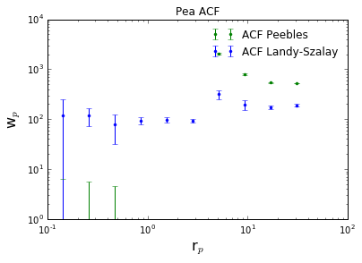
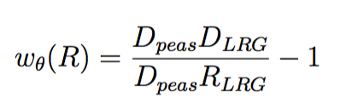
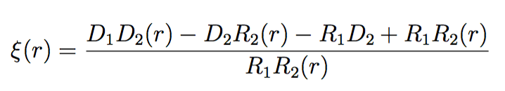
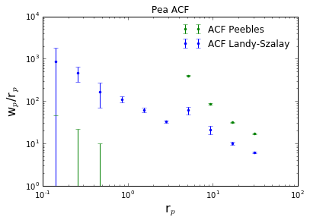
Small scales
w_p (peebles) < 0

Slide 5
Next Steps
In process:
Errors (Jackknife -> Bootstrap), not worry about division of sky regions with uneven detection across them.
Cross correlation w/ Peebles
Update ‘memo’ document notes & start paper draft
Run Panoptes project with full color-sel sample
Landy-Szalay (1993) estimator
Padamanabhan (2009) estimator:
No R_peas needed!

