Slide 1
Urry Group Weekly Update
October 10th 2017

Slide 2
Last Month
> Errors (Jackknife -> Bootstrap), not worry about division of sky regions with uneven detection across them. DONE
>Write AAS Abstract DONE
> Use current wps & PL fits to r_p > 1 Mpc
> Start write up IN PROGRESS
> Revisit ‘peas’ selection – want larger sample, but still ‘pure’ IN PROGRESS

Slide 3
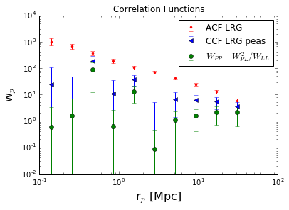
w_{p,1h}
-2.4
w_{p,2h}
Notes:
Sample galaxy_DR12v5 LOWZ (N & S) files, limit 0.112<z<0.36, 287751galaxies
Randoms sample (random0_DR12v5_LOWZ: 14,144,530 galaxies,

Slide 4
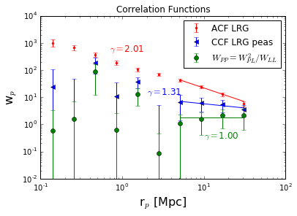
w_{p,1h}
w_{p,2h}
Running for r>6 Mpc
(avoid point @ 3Mpc)
Notes:
Sample galaxy_DR12v5 LOWZ (N & S) files, limit 0.112<z<0.36, 287751galaxies
Randoms sample (random0_DR12v5_LOWZ: 14,144,530 galaxies,

Slide 5
Next Steps
> Fit full covariance, w/ better technique then powerlaw This afternoon w/ Merry
> Why “-” CCR
Try different sample of ‘peas’
Bin rp differently
> Revisit ‘peas’ selection – larger sample, but still ‘pure’
Panoptes project with full color-sel sample ??
Keep all non-Seyferts
> Start write up
Apply for jobs ????

