Slide 1
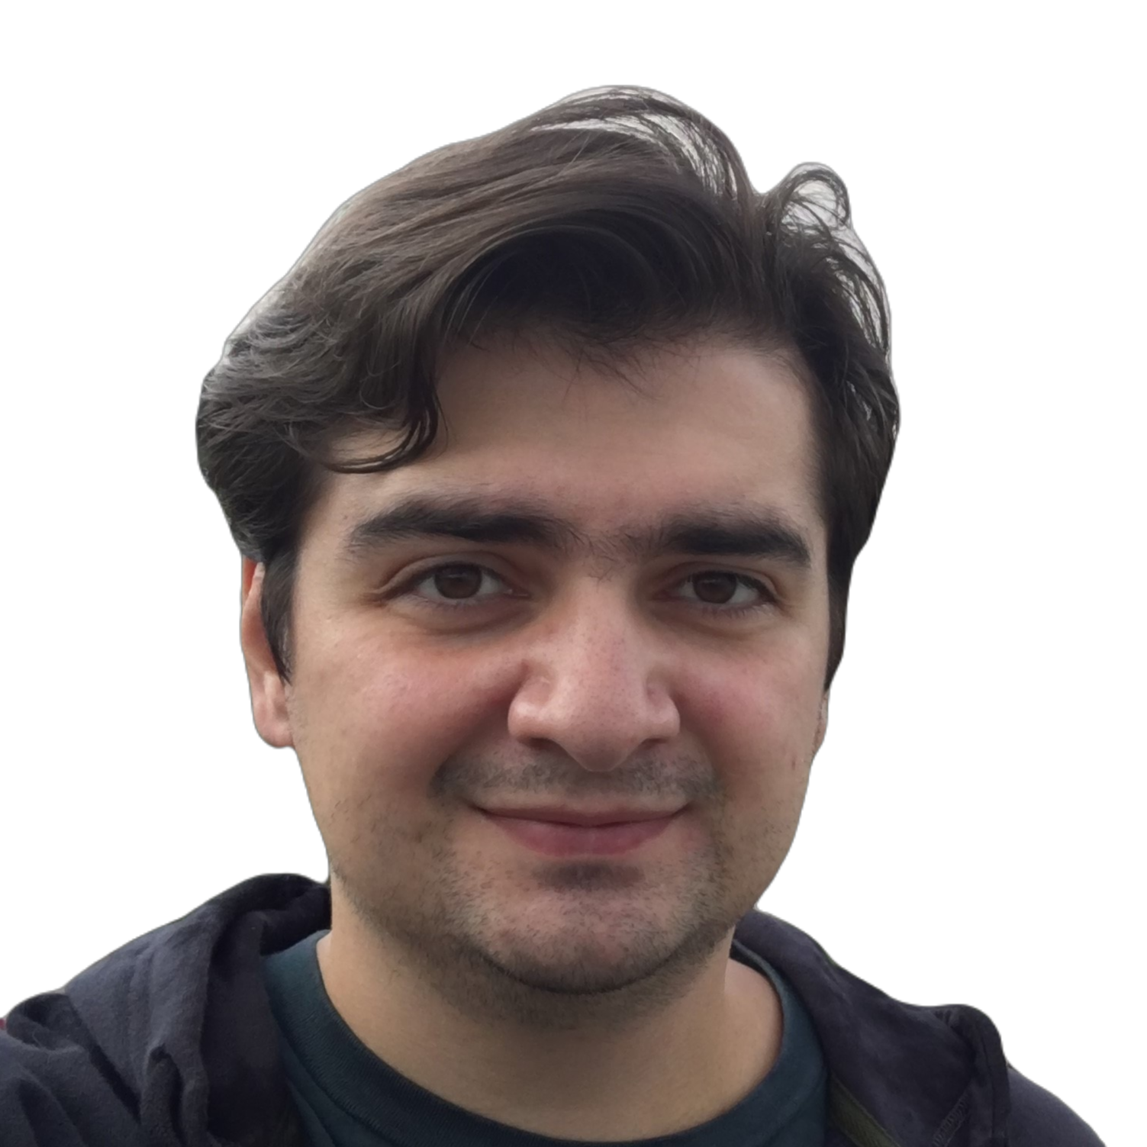






Mert Aygün
mertaygun97@gmail.com
+90 (541) 552 22 51
Yalova, TURKEY
EDUCATION
SKILLS & COMPETENCES
09.2016 - 09.2023
Teamwork
Computer Engineering
Dumlupınar University - Kütahya
Coordination
ABOUT
Project Management
Analysing & Reporting
I'm in my senior year of computer engineering. Currently I’m working on my 3D and 2D unity projects. After that i plan to develop mobile apps for Android.
Presentation Skills
Communication
Analytic Thinking
MY PROJECTS
LANGUAGES
Stock market website (HTML-CSS)
Language school database with Java Swing UI (group project, i worked on database with MS SQL)
Unity 2D Top down shooter game
Unity 3D Action Rpg game (currently in development)
Unity 2D educational game for primary school students (currently in development)
Online retailer database with Oracle (currently in development)
Turkish
English

