Slide 1
ANALYSIS OF MOVEMENT TRAJECTORY VIA KINECT SENSORS
Advisors:
Asst. Prof. Dr. Mehmet Türkan
Asst. Prof. Dr. Şermin Tükel
Students:
Çağatay Kırmızıay
Mert Canatan
Mert Asım Karaoğlu
Özer Çevikaslan

Slide 2
Content
Microsoft Kinect and the Marker-Based Gold Standard Devices
Literature Analysis
Discussion
References

Slide 3
Microsoft Kinect
 | Kinect V1 | Kinect V2 | Advantage of the Kinect V2
Viewing Angle | 43° vertical, 57° horizontal | 60° vertical, 70° horizontal | wider angle of view
RGB Resolution | 640 x 480 | 1920 x 1080 | higher resolution
Depth Resolution | 320 x 240 | 512 x 424 | higher resolution
Streaming Frame Rate | 30 Hz (fluctuates according to the light intensity and computational power) | 30 Hz (fluctuates according to the light intensity and computational power) | -
Number of Skeletons and tracked Joints | 2 skeletons and 20 skeleton joints per each (bir makale de 21 joints yazıyor?) | 6 skeletons and 25 skeleton joints per each | higher number of joints brings more variables for better accuracy in analysis algorithms
Measurement range | 0.8-4 m | 0.5-4.5 m | enhanced usable range

Slide 4
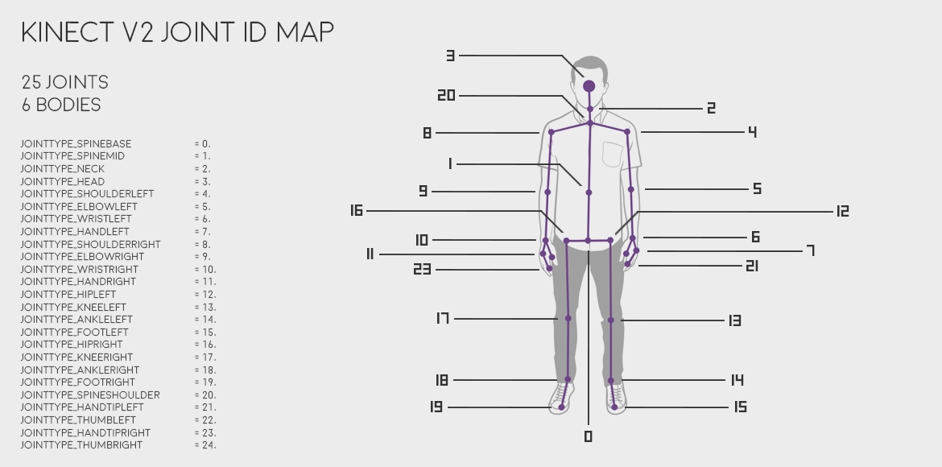

Slide 5
Marker-Based Gold Standard Devices
VICON
Optotrak
Optitrack
Qualysis

Slide 6
Genel bir conclusion ve result kısımlarından alınan bazı istatistiklerle neden Kinect V2 tercih edildi
Motion analysis ile neurologic disorderlara sahip insanlar analiz edilebilir.

Slide 7
References
[1] Alexandra Pfister, Alexandre M. West, Shaw Bronner & Jack Adam Noah, 2014, Comparative
abilities of Microsoft Kinect and Vicon 3D motion capture for gait analysis, Journal of Medical
Engineering & Technology, 38:5, 274-280
[2] S. Lee, Y. Lee, J. Kim, 2017, Automated Evaluation of Upper – limb Motor Function
Impairment using Fugl – Meyer Assessment, IEEE Transactions on Neural Systems and
Rehabilitation Engineering
[3] R. J. Adams, M. D. Lichter, E. T. Krepkovich, A. Ellington, M. White, P. T. Diamond, 2015,
Assessing Upper Extremity Motor Function in Practice of Virtual Activities of Daily Living, IEEE
Transactions on Neural System and Rehabilitation Engineering, Vol. 23, No. 2
[4] R.A. Clark, Y. Pua, K. Fortin, C. Ritchie, K. E. Webster, L. Denehy, A. L. Bryant, 2012,
Validity of Microsoft Kinect for assessment of postural control, Gait & Posture 36, 372 – 377
[5] B. Galna, G. Barry, D. Jackson, D. Mhiripiri, P. Olievier, L. Rochester, 2014, Accuracy of the
Microsoft’s Kinect sensor for measuring movement in people with Parkinson’s disease, Gait &
Posture 39, 1062 – 1068
[6] Geerse DJ, Coolen BH, Roerdink M.,2015 Kinematic Validation of a Multi-Kinect v2
Instrumented 0-Meter Walkway for Quantitative Gait Assessments. PLoS ONE 10(10): e0139913.
doi:10.1371/journal.pone.0139913
[7] A. Fernández-Baena, A. Susín and X.Lligadas, 2012, Biomechanical Validation of Upper-
body and Lower-body Joint Movements of Kinect Motion Capture Data for Rehabilitation
Treatment. 2012 Fourth International Conference on Intelligent Networking and Collaborative
Systems 978-0-7695-4808-1/12
[8] D. Córdova – Esparza, J.R. Terven, H. Jiménez – Hernández, A. Vázquez – Cervantes, A.
Herrera – Navarro, A. Ramírez – Pedraza, 2016. Multiple Kinect V2 Calibration, Automatika,
Vol: 57, No. 3.
[9] M. Kowalski, J. Narunier, 2015 Livescan 3D: A Fast and Inexpensive 3D Data Acquisition
System for Multiple Kinect V2 Sensors, 3D Vision (3DV), 2015 International Conference
[10] http://bdml.stanford.edu/twiki/pub/Haptics/MotionDisplayKAUST/ViconHardwareReference.pdf,
12.12.2017
[11] https://msdn.microsoft.com/en-us/library/jj131033.aspx, 17.12.2017
[12] https://developer.microsoft.com/en-us/windows/kinect/hardware, 18.12.2017
[13] https://vvvv.org/documentation/Kinect,

