Slide 1


IoT Presentation Automation of notes with Trello via IFTTT Project group 4: Orhan Dursun, Ersin Barut, Mert Haybat, Yunus Yücel Modul „Internet of Things“ SS2020, 30.06.2020

Slide 2
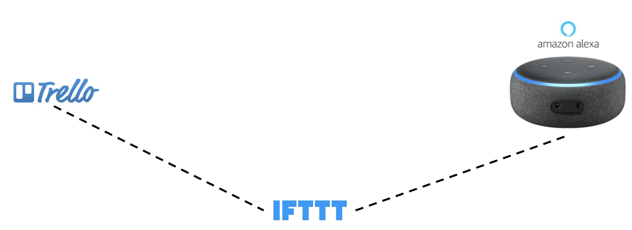
Service architecture
IoT Praxisprojekt 2020

Slide 3
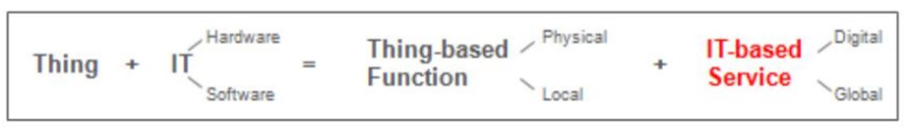
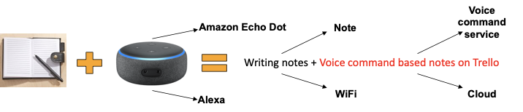
Disappearence of media breaks
IoT Praxisprojekt 2020
Value driver: Record everything important from the lecture!
Media breaks: Manual recording of important notes is no longer necessary due to automated creation of cards on trello by voice command
Notes:
Notes + Amazon Alexa = Writing notes + Voice command based notes on Trello
Value driver: Record everything important from the lecture!

Slide 4
Benefits and outlook
IoT Praxisprojekt 2020
Benefits:
No distraction while taking notes, focus on lecture
No notes on paper, which could be lost
Notifications on mobile app
Easy notes by voice command
Outlook:
Take pictures on phone and upload it on Trello
Share notes with others

Slide 5
Any questions?

