Slide 1


VISION AND PERCEPTION PROJECT
CONTINUAL LEARNING
Mert YILDIZ
1951070
Irene Amerini
Paolo Russo
Notes:
1

Slide 2
CONTENT
Introduction
Continual Learning
Dataset
Model and Setup
Models Comparison
Conclusion

Slide 3
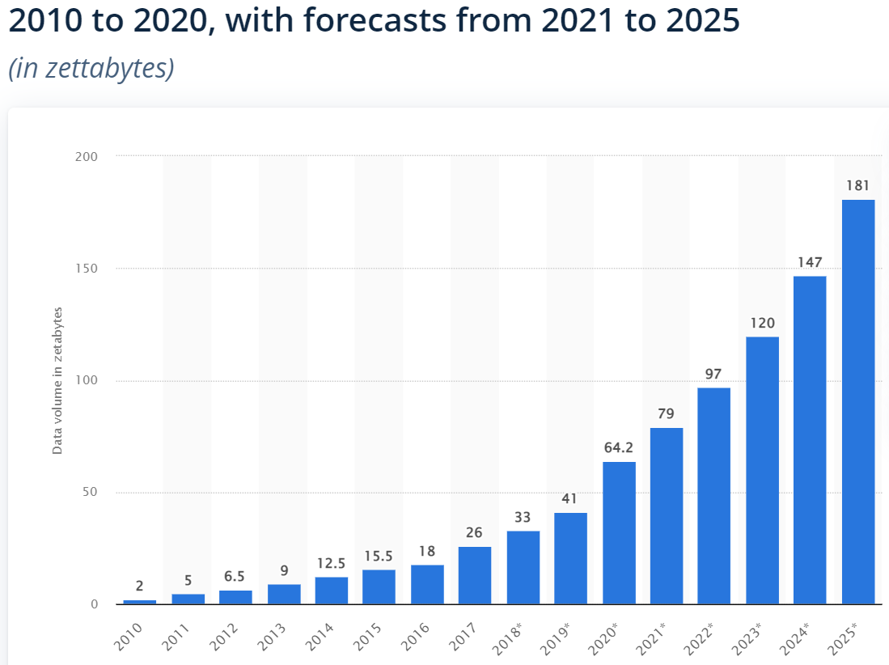
Introduction
Do we need to retrain the model each and every time we receive new data?
How can we overcome catastrophic forgetting in Neural Networks?

Slide 4
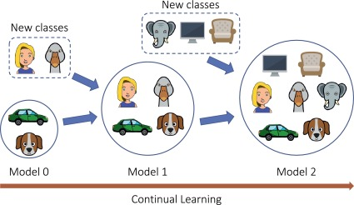
Continual Learning
Ability of to learn continually from a stream of data
Mimic humans ability to continually acquire, fine-tune, and transfer knowledge and skills throughout their lifespan
*Michieli, U., Toldo, M., & Zanuttigh, P. (2022). Domain adaptation and continual learning in semantic segmentation. Advanced Methods and Deep Learning in Computer Vision, 275-303. https://doi.org/10.1016/B978-0-12-822109-9.00017-5

Slide 5

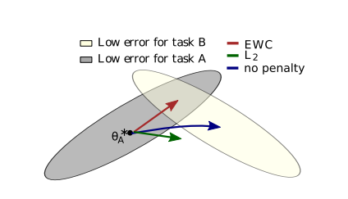
Continual Learning
L2
Elastic Weight Consolidation (EWC)
*Kirkpatrick, J. et. al. (2017, January 25). Overcoming catastrophic forgetting in neural networks

Slide 6
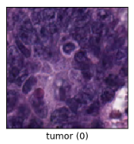
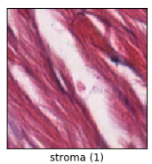
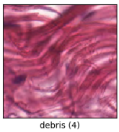
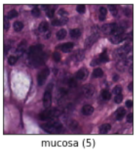
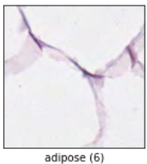
Dataset
Tensorflow Dataset
Classification of textures in colorectal cancer histology.
Each example is a 150 x 150 x 3 RGB image.
6500 Images
Train : 5000
Validation: 750
Test set: 750
8 classes
['Tumor', 'Stroma', 'Complex', 'Lympho', 'Debris', 'Mucosa', 'Adipose', 'Empty']

Slide 7
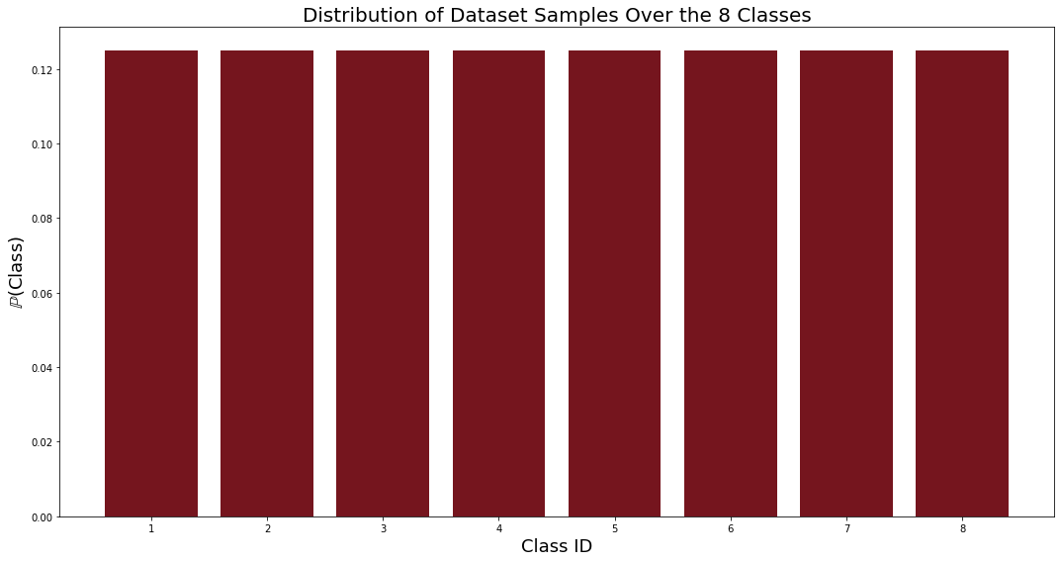
Dataset

Slide 8
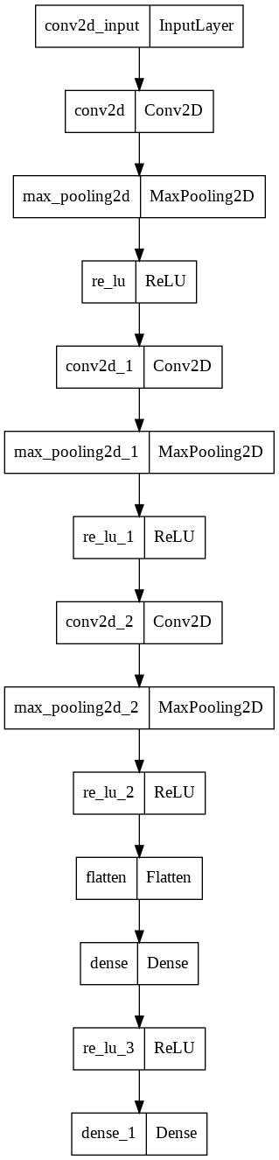
Model and Setup
Convolution with 128 filters + Max Pooling + Relu
Convolution with 512 filters + Max Pooling + Relu
Convolution with 512 filters + Max Pooling + Relu
Fully Connected with 512 nodes + Relu
Output layer with Softmax activation with 8 nodes

Slide 9
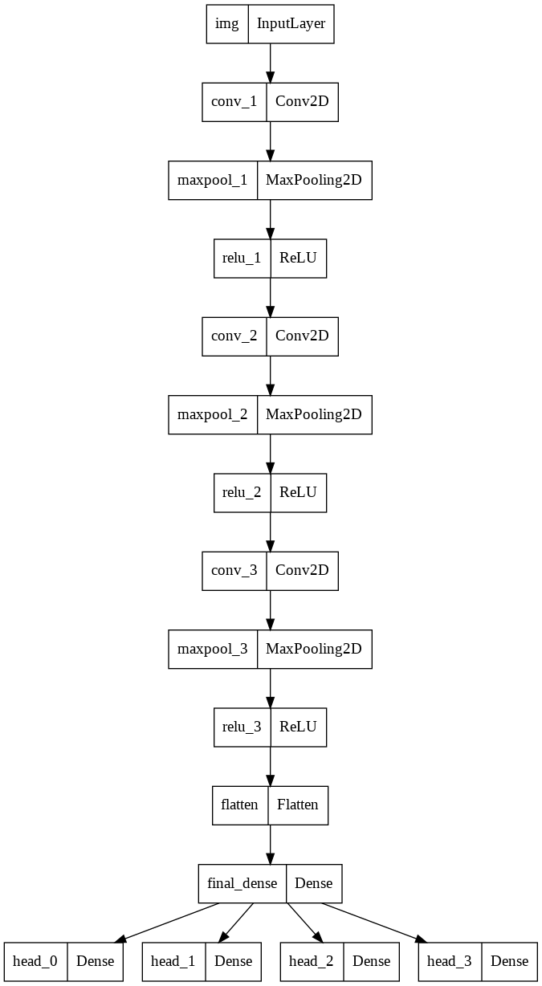
Model and Setup
Convolution with 128 filters + Max Pooling + Relu
Convolution with 128 filters + Max Pooling + Relu
Convolution with 128 filters + Max Pooling + Relu
Fully Connected with 128 nodes + Relu
Task_0 output layer with Softmax activation with 2 nodes
Task_1 output layer with Softmax activation with 2 nodes
Task_2 output layer with Softmax activation with 2 nodes
Task_3 output layer with Softmax activation with 2 nodes

Slide 10
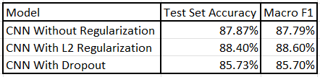
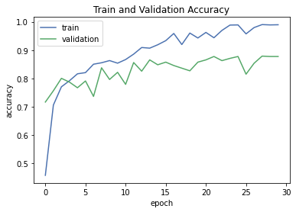
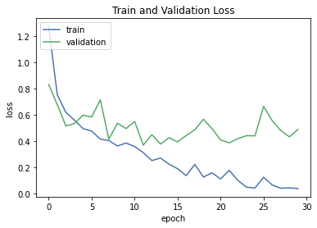
Models Comparison
Accuracy & Loss of the Model Without Regularization

Slide 11
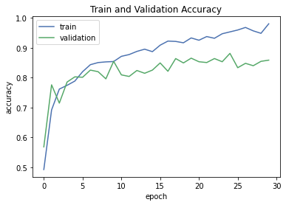
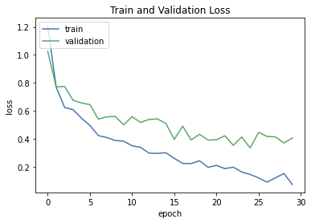
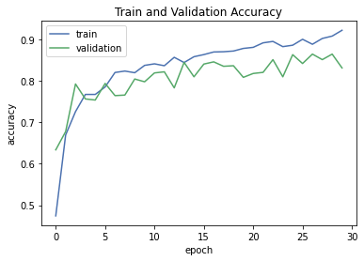
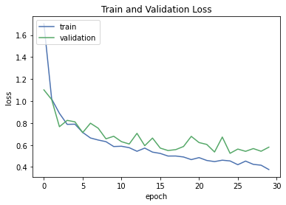
Accuracy & Loss of the Model With Dropout as Regularization
Accuracy & Loss of the Model With L2 Regularization

Slide 12
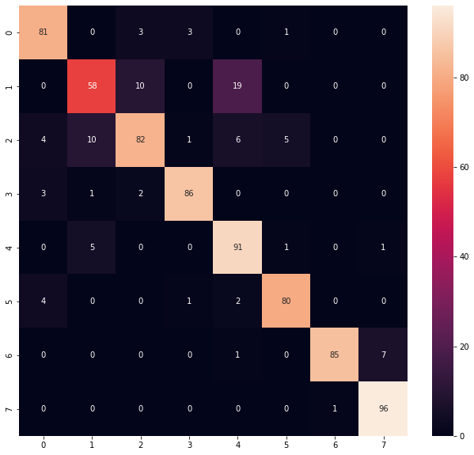
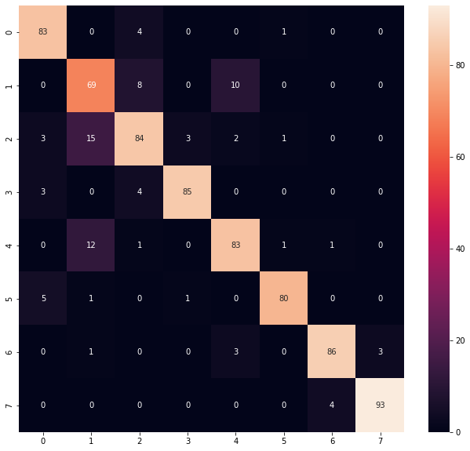
Confusion Matrix as Heatmap
CNN withhout Regularization
CNN with Dropout

Slide 13
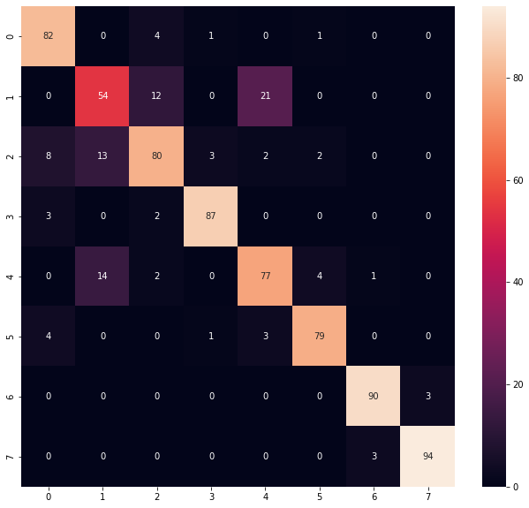
Confusion Matrix as Heatmap
CNN with L2 Regularization

Slide 14
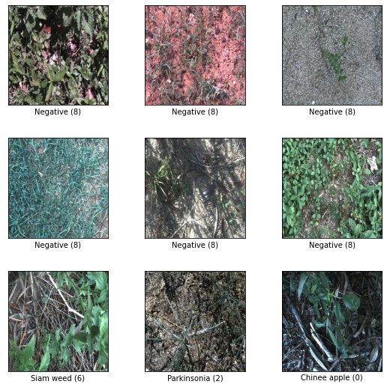
Unbalanced Data
Tensorflow Deep Weed Dataset

Slide 15
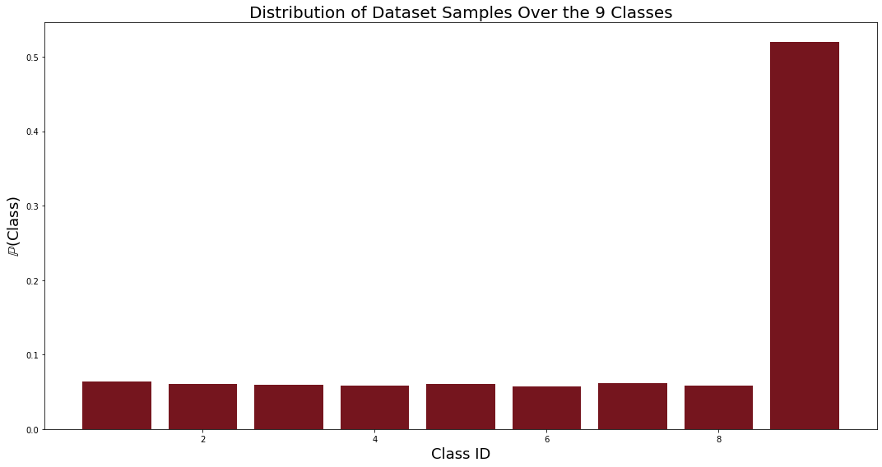
Unbalanced Data

Slide 16
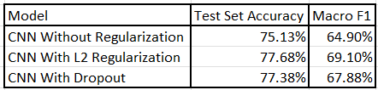
Unbalanced Data

Slide 17
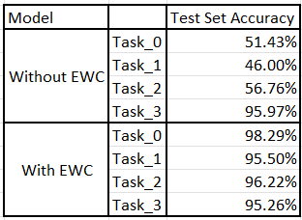
Continual Learning Models Comparison

Slide 18
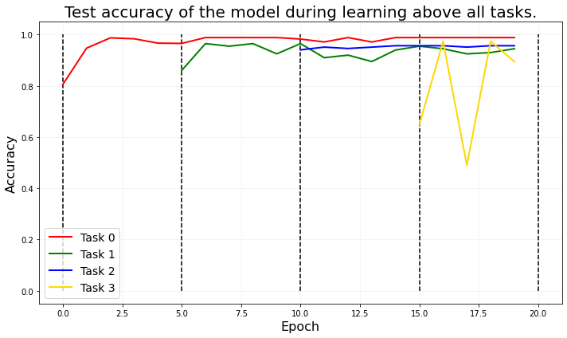
Intra-Task Learning Plot

Slide 19
Conclusion
Importance of regularization in ML.
Because of balanced data CNN withhout regularization is over performing the CNN with L2 Regularization but in unbalanced data the opposite has been proven.
Retraining model each and every time is not feasible.
EWC is the best regularization for continually learning so far.

Slide 20
References
Michieli, U., Toldo, M., & Zanuttigh, P. (2022). Domain adaptation and continual learning in semantic segmentation. Advanced Methods and Deep Learning in Computer Vision, 275-303. https://doi.org/10.1016/B978-0-12-822109-9.00017-5
Moriarty, S. (2020) “Continual Learning with Elastic Weight Consolidation in TensorFlow 2.” Available at: https://seanmoriarity.com/2020/10/18/continual-learning-with-ewc/
Kirkpatrick, J. et. al. (2017, January 25). Overcoming catastrophic forgetting in neural networks. Retrieved from https://arxiv.org/pdf/1612.00796.pdf.
Total data volume worldwide 2010-2025. (2021, June 7). Statista. https://www.statista.com/statistics/871513/worldwide-data-created/

Slide 21


