Slide 1
COMP4102
Fall 2019

Slide 2
Send and receive objects through sockets (sendreceiveobjects)
Datagram socket
System tray
email

Slide 3
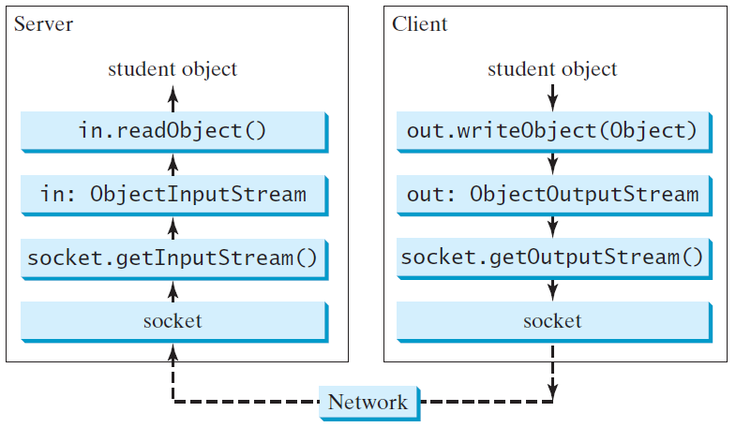
Example: Passing Objects in Network Programs
Modify your client server app such that:
Add Student class with name and id fields, make it Serializable
Client: creates Student instances and sends to the server
Server: receives student instances and prints.
Very well structured, quite similar to file IO.
Instead of
InputStream / OutputStream
Use
ObjectInputStream/ObjectOutputStream→ requires the objects to implement the
Serializable interface.

Slide 4
Stream Socket vs. Datagram Socket
Stream socket
Datagram socket
A dedicated point-to-point channel between a client and server.
Use TCP (Transmission Control Protocol) for data transmission.
Lossless and reliable.
Sent and received in the same order.
No dedicated point-to-point channel between a client and server.
Use UDP (User Datagram Protocol) for data transmission.
May lose data and not 100% reliable.
Data may not received in the same order as sent.

Slide 5
DatagramSocket
DatagramSocket
Create a server DatagramSocket
Create a client DatagramSocket
The DatagramSocket class represents a socket for sending and receiving datagram packets. A datagram socket is the sending or receiving point for a packet delivery service. Each packet sent or received on a datagram socket is individually addressed and routed. Multiple packets sent from one machine to another may be routed differently, and may arrive in any order.
To create a server DatagramSocket, use the constructor DatagramSocket(int port), which binds the socket with the specified port on the local host machine.
To create a client DatagramSocket, use the constructor DatagramSocket(), which binds the socket with any available port on the local host machine.

Slide 6
Sending and Receiving a DatagramSocket
Sending
Receiving
To send data, you need to create a packet, fill in the contents, specify the Internet address and port number for the receiver, and invoke the send(packet) method on a DatagramSocket.
To receive data, create an empty packet and invoke the receive(packet) method on a DatagramSocket.

Slide 7
Datagram Programming
Datagram programming is different from stream socket programming in the sense that there is no concept of a ServerSocket for datagrams. Both client and server use DatagramSocket to send and receive packets.
Designate one a server

Slide 8
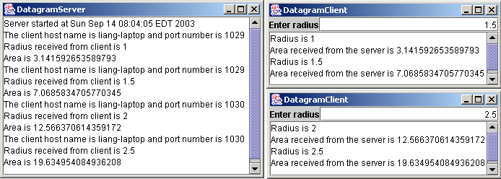
Example: A Client/Server Example
The client sends radius to a server. The server receives the data, uses them to find the area, and then sends the area to the client. Rewrite the program using datagram sockets.
Note: Start the server, then the client.

Slide 9
System Tray Application
In order to add an application to the System tray:
//returns current system tray
SystemTray tray = SystemTray.getSystemTray();
//returns an image to be added to tray, whose pixel data is read from given file name
Toolkit toolkit = Toolkit.getDefaultToolkit();
Image image = toolkit.getImage("getFile.jpg");
//creates tray icon with previously defined pop up menu
TrayIcon icon = new TrayIcon(image, "SystemTray Demo",menu);
//add this icon into the tray
try {
tray.add(icon);
}
catch (AWTException e) {
System.err.println("Could not add tray icon to system tray");
}
The complete example is attached to this document.
SystemTrayDemo.java
Unfortunately, JavaFX doesn’t support tray apps.

Slide 10
Multithreading
A thread is a unit of program execution that runs independently from other threads.
Multiple threads behave as if they were running on independent CPUs,
The java.lang.Runnable interface defines a run( ) method that serves as the block of code a thread executes.
The java.lang.Thread class represents a thread; it defines methods for setting and querying thread properties and for starting the execution of a thread.
The synchronized statement and modifier can be used to write blocks of code or entire methods that require a thread to obtain a lock before executing the block or the method. This mechanism ensures that two threads can't run the block or method at the same time.
The wait( ) and notify( ) methods of java.lang.Object can be used to suspend threads and wake them up again.

Slide 11
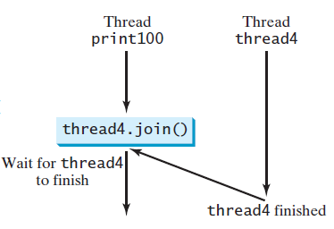
TaskThreadDemo.java
run(): the thread body is defined here
start(); starts a thread instance
Thread.yield(); prevents starvation. Each thread politely offers the other threads a chance to run.
Thread.sleep(long millis) method puts the thread to sleep for the specified time in milliseconds to allow other threads to execute
join() method to force the thread instance to wait for another thread to finish

Slide 12
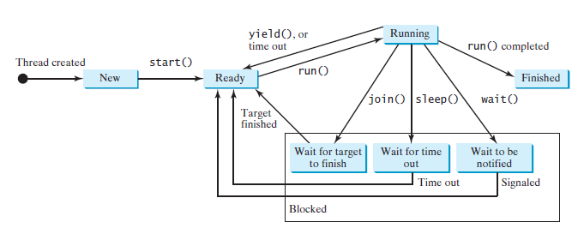
Thread states

Slide 13
Thread Safety
In other words, multiple threads are modifying the same resource. And the order of execution cannot be predicted.
AccountWithoutSync.java
ExecutorService ex = Executors.newCachedThreadPool();
is a thread pool that can be used to execute tasks efficiently.
ex.execute() takes a Thread instance, and starts execution.
ex.shutdown() : no new task can be accepted, but any existing tasks will continue to finish.
Check the results:
This is a common problem, known as a race condition, in multithreaded programs.
A class is said to be thread-safe if an object of the class does not cause a race condition in the presence of multiple threads.
Account class is not thread-safe.

Slide 14
Avoiding Race Conditions
more than one thread must be prevented from simultaneously entering certain part of the program, known as critical region. So, find the critical region first. Solutions:
use the synchronized keyword to synchronize the method containing critical region so that only one thread can access the method at a time.
public synchronized void deposit(double amount)
If it is an instance method, acquires the lock on the instance. If it is available, locks the instance. When finishing the method, instance is unlocked.
If it is a static method, locks the class.
Use synchronized keyword to acquire a lock on any object, not only “this”.
synchronized(account){ account.deposit(1);}
3. Explicitly lock/unlock objects
Lock lock = new ReentrantLock():
lock.lock(); lock.unlock();

Slide 15
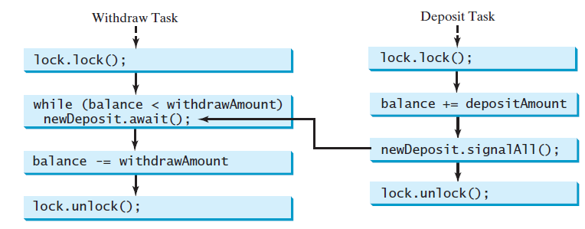
Thread Cooperation
Conditions on locks can be used to coordinate thread interactions.
ThreadCooperation.java (since I commented all print statements in lecture , we have seen nothing!)

Slide 16
E-mail
Download javax.mail.jar, and unzip
Add it into your project’s Library folder

Slide 17
Properties props = new Properties();
props.put("mail.smtp.host", "my-mail-server");
props.put("mail.from", "me@example.com");
Session session = Session.getInstance(props, null);
try {
MimeMessage msg = new MimeMessage(session);
msg.setFrom();
msg.setRecipients(Message.RecipientType.TO,"you@example.com");
msg.setSubject("JavaMail hello world example");
msg.setSentDate(new Date());
msg.setText("Hello, world!\n");
Transport.send(msg);
} catch (MessagingException mex) {
System.out.println("send, exception: " + mex);
}

Slide 18
Properties
implements a hash table, which maps keys to values. Any non-null object can be used as a key or as a value.
Some keys required by the javax.mail:
[for the rest (and complete descriptions) see JavaMail API]

Slide 19
Key | Type | Description
mail.debug | boolean | The initial debug mode. Default is false.
mail.from | String | The return email address of the current user,
mail.protocol.class |  | Specifies the fully qualified class name of the provider for the specified protocol. Used in cases where more than one provider for a given protocol exists; this property can be used to specify which provider to use by default. The provider must still be listed in a configuration file.
mail.protocol.host | String | The host name of the mail server for the specified protocol.
mail.protocol.port | int | The port number of the mail server for the specified protocol. If not specified the protocol's default port number is used.
mail.protocol.user | String | The user name to use when connecting to mail servers using the specified protocol.
Now lets go back to the code

Slide 20
E-mail protocols
POP3 :Post Office Protocol version 3 (POP3) is a standard mail protocol used to receive emails from a remote server to a local email client. Allows you to download email messages on your local computer and read them even when you are offline.
IMAP: The Internet Message Access Protocol (IMAP) is a mail protocol used for accessing email on a remote web server from a local client. IMAP and POP3 are the two most commonly used Internet mail protocols for retrieving emails. Both protocols are supported by all modern email clients and web servers.
IMAP vs. POP3: The POP3 protocol assumes that there is only one client connected to the mailbox. In contrast, the IMAP protocol allows simultaneous access by multiple clients. IMAP is suitable for you if your mailbox is about to be managed by multiple users.
SMTP: Simple Mail Transfer Protocol (SMTP) is the standard protocol for sending emails across the Internet.

Slide 21
Port Numbers
 | POP3 | IMAP | SMTP
Default | 110 | 143 | 25-2525
Secure | 995 | 993 | 465
host | To send (SMTP) | To receive
gmail | 465 | 993 (requires imap permission, check gmail settings)

Slide 22
Preparation
Properties props = new Properties();
props.put("mail.smtp.host", "my-mail-server");→this should be: props.put("mail.smtp.host", “smtp.gmail.com");
props.put("mail.from", "me@example.com");→this should be:
props.put("mail.from", “cse460ekin@gmail.com");
Session session = Session.getInstance(props, null);
try {
MimeMessage msg = new MimeMessage(session);
msg.setFrom();
msg.setRecipients(Message.RecipientType.TO,"you@example.com");
msg.setSubject("JavaMail hello world example");
msg.setSentDate(new Date());
msg.setText("Hello, world!\n");
Transport.send(msg);
} catch (MessagingException mex) {
System.out.println("send failed, exception: " + mex);
}

Slide 23
Session
represents a mail session and is not subclassed.
collects together properties and defaults used by the mail API's. A single default session can be shared by multiple applications on the desktop. Unshared sessions can also be created.
The Session class provides access to the protocol providers that implement the Store, Transport, and related classes.

Slide 24
Method Summary
Return type | Method and Description
static Session | getInstance(Properties props) Get a new Session object.
static Session | getInstance(Properties props, Authenticator authenticator) Get a new Session object.
PasswordAuthentication | getPasswordAuthentication(URLName url) Return any saved PasswordAuthentication for this (store or transport) URLName.
Store | Several, overloaded. Get a Store object that implements this user's desired Store protocol.
Transport | Several, overloaded. Get a Transport object that implements this user's desired Transport protocol.
Now lets go back to the code

Slide 25
Preparation
Properties props = new Properties();
props.put("mail.smtp.host", “smtp.gmail.com");
props.put("mail.from", “cse460ekin@gmail.com");
Session session = Session.getInstance(props, null); //we set the properties, and no authenticator.
try {
MimeMessage msg = new MimeMessage(session);
msg.setFrom();
msg.setRecipients(Message.RecipientType.TO,"you@example.com");
msg.setSubject("JavaMail hello world example");
msg.setSentDate(new Date());
msg.setText("Hello, world!\n");
Transport.send(msg);
} catch (MessagingException mex) {
System.out.println("send failed, exception: " + mex);
}

Slide 26
MimeMessage
Multipurpose Internet Mail Extensions (MIME) is an Internet standard that extends the format of email to support:
Text in character sets other than ASCII
Non-text attachments
Message bodies with multiple parts
Header information in non-ASCII character sets
Although MIME was designed mainly for SMTP protocol, its use today has grown beyond describing the content of email and now often includes descriptions of content type in general, including for the web (see Internet media type) and as a storage for rich content in some commercial products
Virtually all human-written Internet email and a fairly large proportion of automated email is transmitted via SMTP in MIME format. Internet email is so closely associated with the SMTP and MIME standards that it is sometimes called SMTP/MIME email.
The content types defined by MIME standards are also of importance outside of email, such as in communication protocols like HTTP for the World Wide Web. HTTP requires that data be transmitted in the context of email-like messages, although the data most often is not actually email.
[Wikipedia]

Slide 27
This class represents a MIME style email message. It implements the Message abstract class and the MimePart interface.
Clients wanting to create new MIME style messages will instantiate an empty MimeMessage object and then fill it with appropriate attributes and content.

Slide 28
Method Summary
Return type | Decsription
void | addFrom(Address[] addresses) Add the specified addresses to the existing "From" field.
void | addHeader(String name, String value) Add this value to the existing values for this header_name.
void | addRecipients(Message.RecipientType type, Address[] addresses) Add the given addresses to the specified recipient type.
void | addRecipients(Message.RecipientType type, String addresses) Add the given addresses to the specified recipient type.
Message | reply(boolean replyToAll) Get a new Message suitable for a reply to this message.
void | setContent(Multipart mp) This method sets the Message's content to a Multipart object.
void | setContent(Object o, String type) A convenience method for setting this Message's content.
Now lets go back to the code

Slide 29
Preparation
Properties props = new Properties();
props.put("mail.smtp.host", “smtp.gmail.com");
props.put("mail.from", “cse460ekin@gmail.com");
Session session = Session.getInstance(props, null); //we set the properties, and no authenticator.
try {
MimeMessage msg = new MimeMessage(session);
msg.setFrom(); //from is empty
msg.setRecipients(Message.RecipientType.TO,"you@example.com"); → to whom it will be sent, change as following
msg.setRecipients(Message.RecipientType.TO,“emine.ekin@gmail.com")
msg.setSubject("JavaMail hello world example");
msg.setSentDate(new Date());
msg.setText("Hello, world!\n");
Transport.send(msg);
} catch (MessagingException mex) {
System.out.println("send failed, exception: " + mex);
}

Slide 30
Transport
An abstract class that models a message transport. Subclasses provide actual implementations.
Note that Transport extends the Service class, which provides many common methods for naming transports, connecting to transports, and listening to connection events.

Slide 31
Method Summary
Return type | Decsription
static void | send(Message msg) Send a message.
static void | send(Message msg, Address[] addresses) Send the message to the specified addresses, ignoring any recipients specified in the message itself.
Now lets go back to the code

Slide 32
Properties props = new Properties();
props.put("mail.smtp.host", “smtp.gmail.com");
props.put("mail.from", “cse460ekin@gmail.com");
Session session = Session.getInstance(props, null);
try {
MimeMessage msg = new MimeMessage(session);
msg.setFrom(); msg.setRecipients(Message.RecipientType.TO,“emine.ekin@gmail.com")
msg.setSubject("JavaMail hello world example");
msg.setSentDate(new Date());
msg.setText("Hello, world!\n");
Transport.send(msg);
} catch (MessagingException mex) {
System.out.println("send failed, exception: " + mex);
}

Slide 33
send failed, exception: javax.mail.MessagingException: Could not connect to SMTP host: smtp.gmail.com, port: 25;
So: we cannot use default port for gmail.
nested exception is:
java.net.ConnectException: connect: Address is invalid on local machine, or port is not valid on remote machine
Result of previous exception

Slide 34
Try the following
props.put("mail.smtp.port", "465"); //google uses port number 465, but 465 is a secure port, therefore you have to add the followings as well
props.put("mail.smtp.socketFactory.port", "465");
props.put("mail.smtp.socketFactory.class", "javax.net.ssl.SSLSocketFactory"); //and because this secure socket, we have to mention authentication, lets say no authentication is required
props.put("mail.smtp.auth", “false");
See the exception

Slide 35
So: instead of null in
Session session = Session.getInstance(props, null);
We have to specify the authenticator
Authenticator a = new Authenticator() ;
//when you write this, IDE will complain that it is an abstract class cannot be instantiated in this way.

Slide 36
Authenticator
public abstract class Authenticator extends Object
represents an object that knows how to obtain authentication for a network connection.
Applications use this class by creating a subclass, and registering an instance of that subclass with the session when it is created.
When authentication is required, the system will invoke a method on the subclass (like getPasswordAuthentication). The subclass's method can query about the authentication being requested with a number of inherited methods (getRequestingXXX()), and form an appropriate message for the user.

Slide 37
At the end
Following the instructions, change the Session definition as:
Authenticator a = new Authenticator() {
@Override
protected PasswordAuthentication getPasswordAuthentication() {
return new PasswordAuthentication("cse460ekin@gmail.com","vlkvlkwnaw");
}} ;
Session session = Session.getDefaultInstance(props,a);

Slide 38
public class Send1 {
public static void main(String[] argv){
Properties props = new Properties();
props.put("mail.smtp.host", "smtp.gmail.com"); //smtp.isikun.edu.tr
props.put("mail.smtp.port", "465");
props.put("mail.smtp.socketFactory.port", "465");
props.put("mail.smtp.socketFactory.class", "javax.net.ssl.SSLSocketFactory");
props.put("mail.from", “cse482atisik@gmail.com");//isikun address
props.put("mail.smtp.auth", "true");
Authenticator a = new Authenticator() {
@Override
protected PasswordAuthentication getPasswordAuthentication() {
return new PasswordAuthentication("cse482atisik@gmail.com ",“EmineEkin"); //isikun address and password
}
} ;
Session session = Session.getDefaultInstance(props,a);
try {
MimeMessage msg = new MimeMessage(session);
msg.setFrom();
msg.setRecipients(Message.RecipientType.TO,"emine.ekin@gmail.com");
msg.setSubject("JavaMail hello world example");
msg.setSentDate(new Date());
msg.setText("Hello, world!\n");
Transport.send(msg);
}
catch (MessagingException mex) {
System.out.println("send failed, exception: " + mex);
} } }
Exchange server seems not to like well known pop3, imaps, and smtp.
Only if the admin configured the server, you may use smtp.

Slide 39
Reading e-mail
Steps:
Define Protocol
Get a session instance to read email
Access emails through store class
Read Inbox

Slide 40
Sending Attachment
Open Send1.java from COL
We’ll modify the following part
try {
MimeMessage msg = new MimeMessage(session);
msg.setFrom(); msg.setRecipients(Message.RecipientType.TO,"emine.ekin@gmail.com");
msg.setSubject("JavaMail hello world example");
msg.setSentDate(new Date());
msg.setText("Hello, world!\n");
Transport.send(msg);
}
We have to take a deeper look into MimeMessage

Slide 41
MimeMessage msg = new MimeMessage(session);
If you are sending plain text
msg.setText("Hello, world!\n");
Otherwise
Multipart mp = new Multipart();
msg.setContent(mp );
Multipart is an abstract class, direct known subclass is MimeMultipart.
So:
Multipart mp = new Multipart();
is not correct.
Multipart mp = new MimeMultipart();

Slide 42
Now we have:
Multipart mp = new MimeMultipart();
msg.setContent(mp );
Lets add some content.
As the name implies, MimeMultiPart contains a number of parts. Parts are added by following method
addBodyPart(BodyPart part): Adds a Part to the multipart.
Now, we go through BodyPart class.

Slide 43
Multipart mp = new MimeMultipart();
//Before setting the content, we have to prepare it.
msg.setContent(mp);
BodyPart: abstract class, direct known subclass is MimeBodyPart.
BodyPart bp = new MimeBodyPart():
The part to be placed in message is ready. Lets add the content. For example, write some text.
bp.setText(“Hellö”);
And, add this part to the Multipart instance.
Mp.add(bp);

Slide 44
Altogether:
try {
MimeMessage msg = new MimeMessage(session);
msg.setFrom(); msg.setRecipients(Message.RecipientType.TO,"emine.ekin@gmail.com");
msg.setSubject("JavaMail hello world example");
msg.setSentDate(new Date());
Multipart mp = new MimeMultipart();
BodyPart bp = new MimeBodyPart():
bp.setText(“Hellö”);
mp.addBodyPart(bp);
msg.setContent(mp );
Transport.send(msg);
}

Slide 45
Lets add another part for the attachment:
partForAtt = new MimeBodyPart();
String filename = "getFile.jpg";
DataSource source = new FileDataSource(filename);
partForAtt.setDataHandler(new DataHandler(source));
partForAtt.setFileName(filename); mp.addBodyPart(partForAtt);
That’s all… Ready to run.

Slide 46
Receiving e-mails with attachment
Open Receive.java from COL
Find the line we have fetched the multipart instance.
Multipart mp = (Multipart) msg.getContent();
The point is not just to extract the parts, but also to understand whether or not any part contains file.

Slide 47
Example from RFC 2183, where the header is defined
Content-Disposition: attachment; filename=genome.jpeg;
So we will be using this issue to check if there is an attachment.
Multipart mp = (Multipart) msg.getContent();
int partCount = mp.getCount;
for(int i=0;i<partCount;i++){
MimeBodyPart bp =(MimeBodyPart) mp.getBodyPart(i); //get the body part
if(Part.ATTACHMENT.equalsIgnoreCase(bp.getDisposition() ){
//so we have a file in this part
bp.saveFile(bp.getFileName());
}
}
Says that this part should be presented as an attachment.

Slide 48
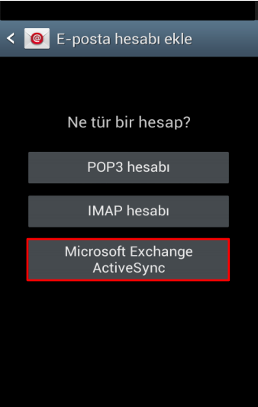
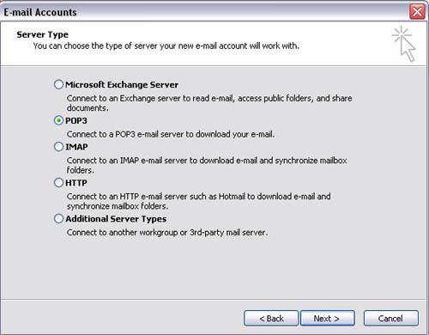
isik/isikun domain options to receive emails

Slide 49
Accessing exchange server with JavaMail
Seems not possible
Microsoft released an open sourced API for connecting to Exchange Web Service
https://github.com/OfficeDev/ews-java-api
We aren’t going to deal with it.

Slide 50
Java Collection Framework hierarchy
A collection is a container object that holds a group of objects, often referred to as elements.
The Java Collections Framework supports three types of collections, named lists, sets, and maps.

Slide 51
Collections Framework
All collections frameworks contain the following:
Interfaces: abstract data types that represent collections. Allow collections to be manipulated independently of the details of their representation.
Implementations: concrete implementations of the collection interfaces. In essence, they are reusable data structures.
Algorithms: These are the methods that perform useful computations, such as searching and sorting, on objects that implement collection interfaces. The algorithms are said to be polymorphic: that is, the same method can be used on many different implementations of the appropriate collection interface. In essence, algorithms are reusable functionality.

Slide 52
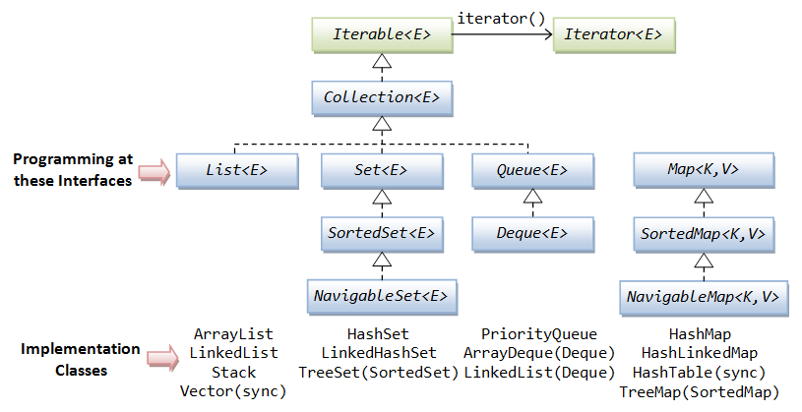
<Key,Value> pairs

Slide 53
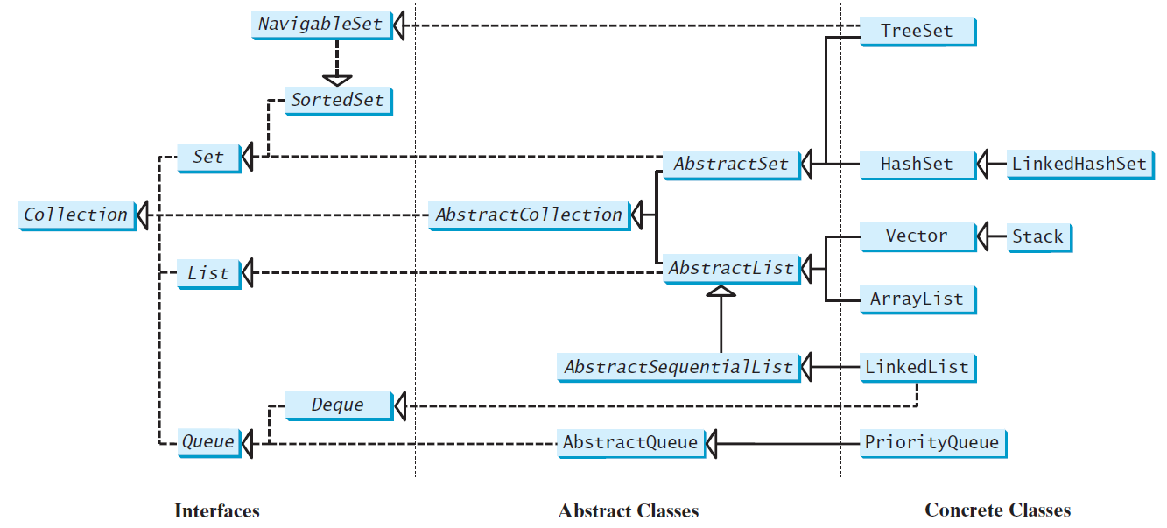
Java Collection Framework hierarchy, yet another view:
Set and List are subinterfaces of Collection.

Slide 54
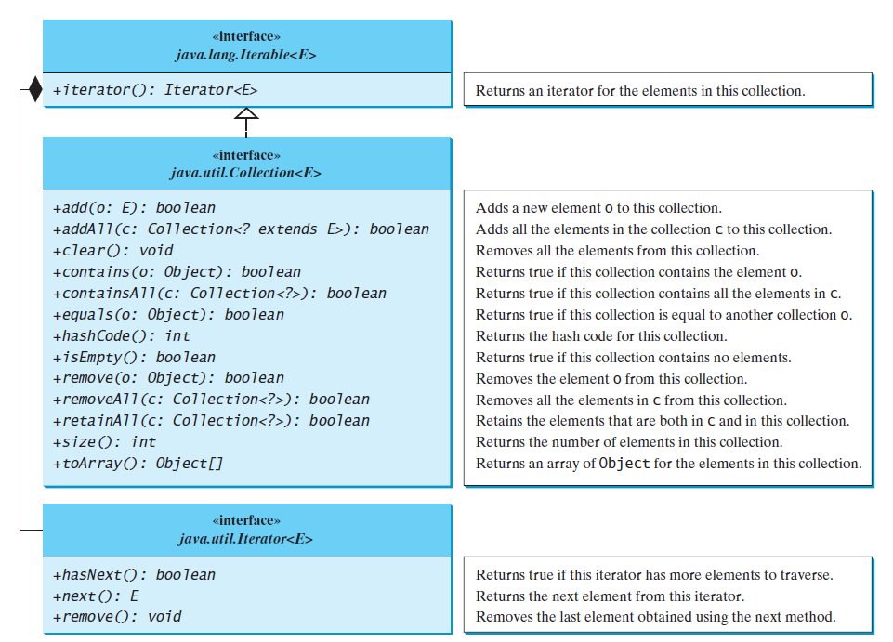

Slide 55
Iterator
Each collection has an Iterator object that can be used to traverse all the elements in the collection.
Iterator is a classic design pattern for walking through a data structure without having to expose the details of how data is stored in the data structure.
The Collection interface extends the Iterable interface.
provides a uniform way for traversing elements in various types of collections.
The iterator method in the Collection interface returns an instance of the Iterator interface, which provides sequential access to the elements in the collection using the next() method.
You can also use the hasNext() method to check whether there are more elements in the iterator, and the remove() method to remove the last element returned by the iterator.

Slide 56
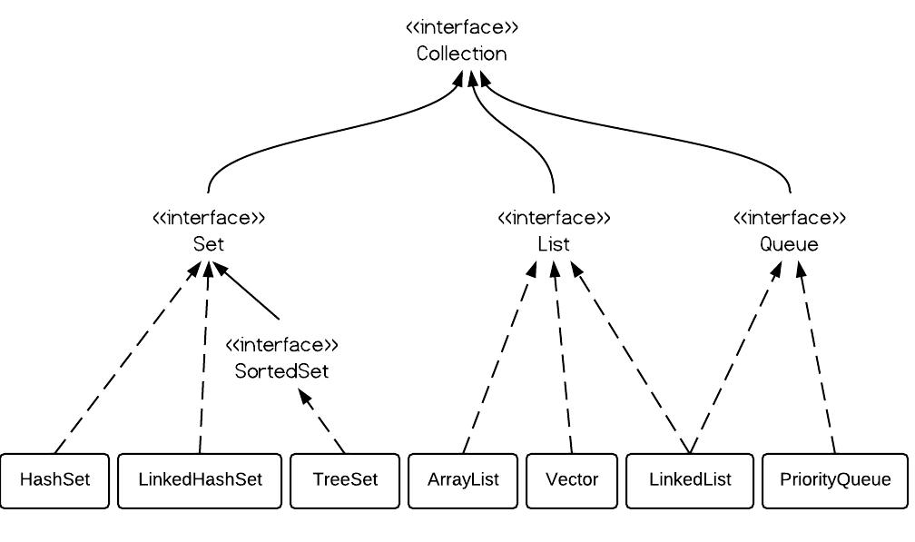
extends
Stack
implements

Slide 57
The Set Interface
extends the Collection interface.
does not introduce new methods or constants,
an instance of Set contains no duplicate elements.
Concrete Classes implementing Set<>
HashSet
LinkedHashSet→extends HashSet,
TreeSet→implements SortedSet interface

Slide 58
HashSet→AbstractSet
used to store duplicate-free elements. For efficiency, objects added to a hash set need to implement the hashCode() in a manner that properly disperses the hash code.
No particular ordering of the elements
capacity: 16, loadFactor=0.75 [Defaults]
As is always, tradeoff between time and space.
TestHashSet.java

Slide 59
LinkedHashSet→HashSet→ AbstractSet
LinkedHashSet extends HashSet
linked-list implementation
supports an ordering of the elements in the set.
the elements in a LinkedHashSet can be retrieved in the order in which they were inserted into the set.
TestHashSet.java

Slide 60
TreeSet→SortedSet TreeSet→AbstractSet
guarantees that the elements in the set are sorted.
You can use an iterator to traverse the elements in the sorted order. The elements can be sorted in two ways. (Consider TreeSet<E>)
E must implement Comparable interface
to specify a comparator for the elements in the set if E does not implement the Comparable interface, or you don’t want to use the compareTo() of E. This approach is referred to as order by comparator, i.e., Comparator interface.

