Slide 1
What is Computer Enginnering?
Sample Course Module Name Author: Süleyman Mert ALMALI

Slide 2
Job Description (Computer Engineering)

Slide 3
Fall semester, 2022-2023
Download DOC, SLIDE, PPTX

Slide 4
What is Computer Engineering
Based on Computer Science theory, computers anything that can help and make our life easier. hardware, software, networks, security components, databases, etc. systems with answers science produces.

Slide 5
What Does a Computer Engineer Do?

Slide 6

Computer engineer from unmanned aerial vehicles to banking applications, from social media to mobile environments, surgeon robots to the vehicles that can park themselves with the innovations it produces. It changes our lives in every way.
w:300 h:300px

Slide 7
w:300 h:300px w:300 h:300px

Slide 8
Requirements to Become a Successful Computer Engineer
Mathematical acumen and problem solving ability
Creativity
Predisposition to Teamwork
Communicate Effectively and Take Responsibility

Slide 9
Which Can Work in Institutions
Information for defense industry and military institutions
Hospital information system automation
Finance and banking systems
Sectors such as automotive, white goods, textile computer aided manufacturing systems
Entertainment industry
Universities and research centers
…
bg right:40% h:280px

Slide 10
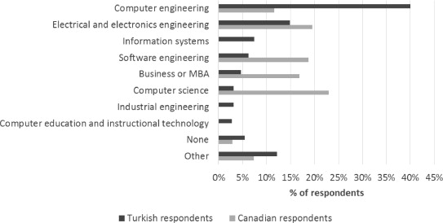
What Job Title Do They Work in?
Canada and Turkey Comparative Table Compared to Canada, we see more people working as computer engineers in Turkey. This shows that it would be more beneficial to develop in the field of computer engineering for those who want to work in Turkey.
bg left:50% w:600px h:300px

Slide 11
References
http://www.cs.bilkent.edu.tr/data/bilgisayartanitim.pdf
https://www.sciencedirect.com/science/article/abs/pii/S0164121215001314
https://www.etu.edu.tr/tr/bolum/bilgisayar-muhendisligi?pgNb=9

