Slide 1
ENSE 374, Milestone 4
Consilium
Gurinder Brar, Xia Hua, Tim Pasion, Jonathan Vargas
December 2, 2019

Slide 2

CONSILIUM
Plan. One task at a time
Notes:
SPEAKER: JON
So who here has gone through problems of procrastination. (I should see more hands up because I know most of you have said you procrastinated in milestones 1 and 2) but I digress. Procrastination is a problem that everyone has been through and that is why we’re here to help with. CONSILIUM, Plan. One task at a time.

Slide 3
Project Vision
The golden circle:
Why-Everyone goes through Procrastination. Its a problem that can spiral.
How- focus on smaller manageable tasks. With way to keep oneself accountable
What- daily planner that is task orientated
The Gap:
Overwhelmed feelings. Where to start.
Project rationale:
To get a clue on what needs to be done through the use of visual aids
Vision:
A digital tool to break down important project/events/due dates to smaller more manageable tasks
Notes:
Speaker: jon
Procrastination, Its a form of self sabotage that is soothing until the end. Its mentally taxing. Its prevalent in any area. And it's completely preventable. We want to make a tool that can help prevent this.
How are we going to do this. A basic story of procrastination goes along the lines of. You are given a project at this due date. You start thinking that there’s other stuff going on. this project seems pretty big. you start feeling overwhelmed then proceed to watch 10 episodes of stranger things on netflix. A way that we found to help with procrastination is to break down the problem in smaller more manageable tasks. And keeping yourself accountable on said tasks
And that is what aim to do with our daily planner that is focused on To-Do items.
We see consilium as a digital tool that one can use to organize important dates and make small plans to achieve their goals

Slide 4
The “deep dive”
Potential Stakeholders:
Universities
Event planners
Project managers
Assumptions:
Access to user data
To store into database
Cross platform
Available in different platforms
Constraints:
database storage
Limited storage
app size
Keep app small enough to distribute
Optimize performance
User experience is a priority
Notes:
SPEAKER: JON
Some stakeholders that we see are:
Universities that would like to distribute this as a service to aide students
Event planners that would like to keep track of moving parts in their schedules
Project managers that would like to aide fellow group mates
Some assumptions that we have about this app are:
Access to user Data so We can display their data in any device
[This app has to be compatible on multiple platforms like apple and android] with desktop support in the future
The constraints we see are:
[Limited database storage] space based on Firebase plan.
Keeping the app small. our goal is to keep it 30 mb
Optimizing performance to make the user experience a great one

Slide 5
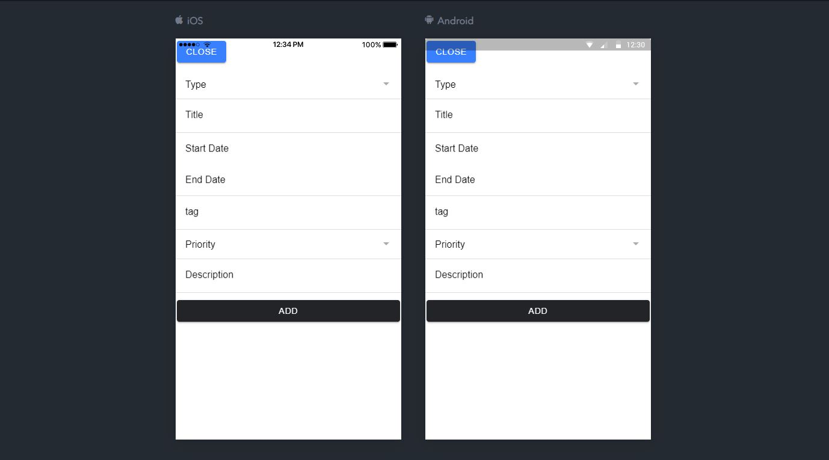
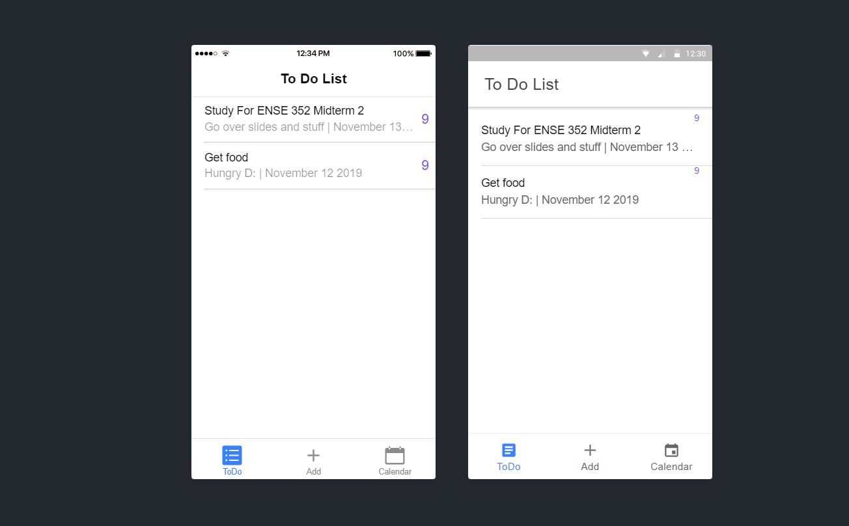
Screen Shots and Demo
Notes:
MVP 2 DEMO: Tim

Slide 6
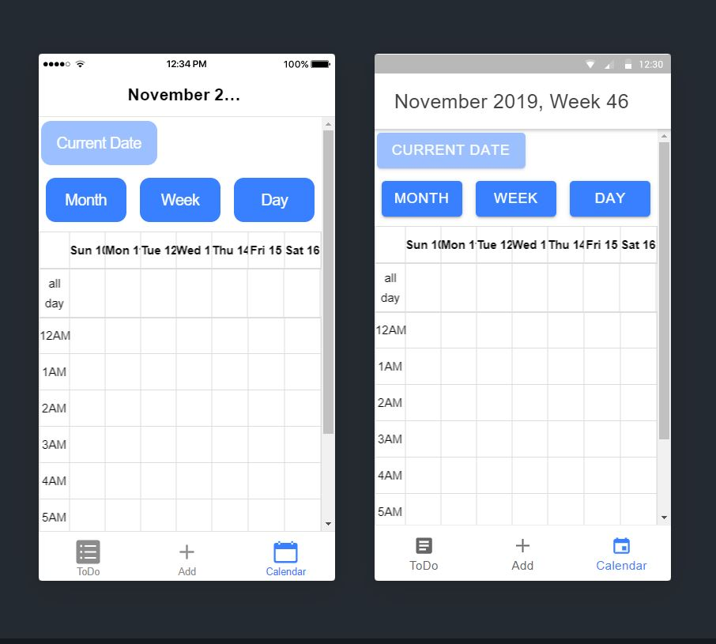
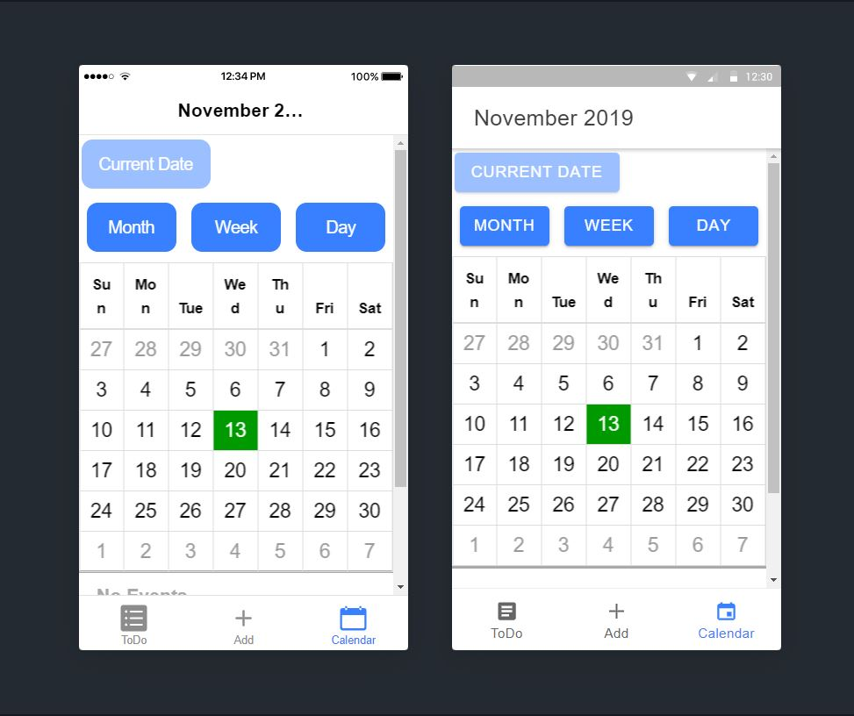
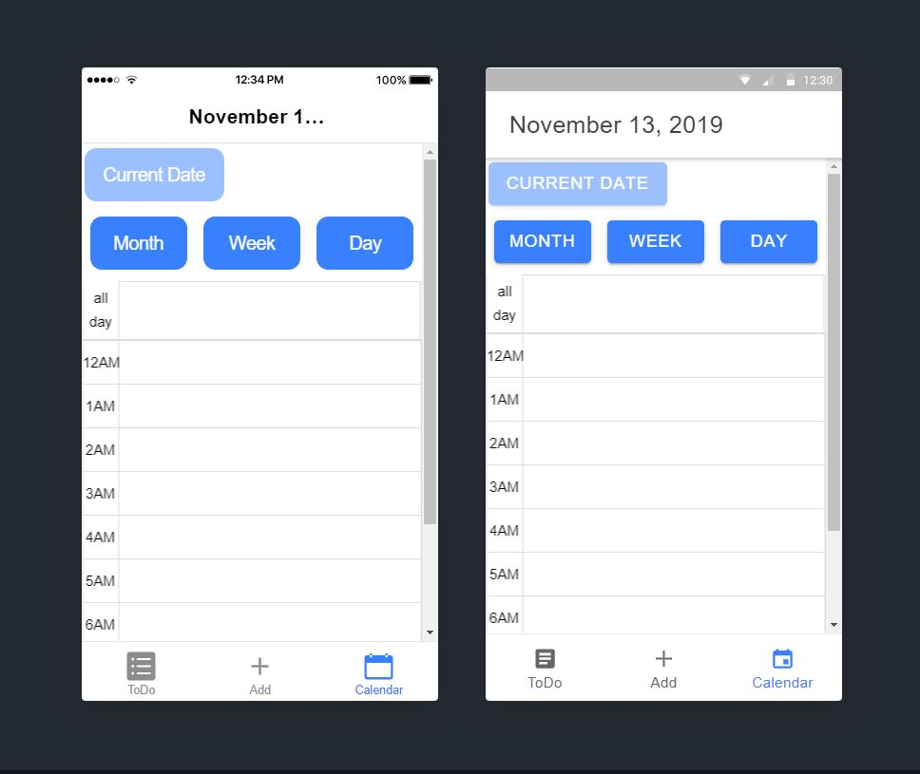
Screen Shots

Slide 7
About MVP 2
Were we successful?
Not really. ~70% done
Focused on bare minimum (adding and viewing events)
Things not completed: Notifications,Details,List of completed tasks
CRUD:(Create, Read ,Update ,Delete)
Able to Create,read and delete.
Notes:
We were not able to complete the MVP, we are missing local notifications, expanded details page per toDo , and a list of completed tasks
Completed tasks were implementing the Users method to sign up,login,and logout , side menu , and read from database into calendar. Queried some of the data to seperate toDo’s from events.

Slide 8
Teamwork/responsibilities
Jonathan Vargas-The Scrum leader
Delegating Tasks
Leading Meetings
Timothy Pasion-The Coding Head
Lead Coder
Software Consultant
Xia Hua-The Architecture Design Lead
System Designs
Gurinder Brar-The Documentation Lead
Organize Documentation
Notes:
Our workflow consists of delegating tasks and completing our work on our own and meeting up to collaborate and reflect on our work
We assigned roles based on suggestions and expertise.

Slide 9
Feeling,Future MVPs & GitHub
Feelings
Highlight:
-a useful product ,design process, exchange ideas
Better-ifs:
-more time,more people focus on coding,more accurate
Shift:
-away from U of R, simpler
-clean code
Potential Next MVPs
-change themes, view completed todos, reminder, link UOFR events, link location and holidays
GitHub
https://github.com/Mertric/ENSE-374Project
Notes:
SPEAKER: XIA

Slide 10
Reflection
How did you feel about this project? What did you like about it? What did you dislike?
liked how work was broken in smaller parts
good presentation practice, develop project on time.
Time constraints
Disliked working on FRD
What did you learn about yourself as you collaborated and worked through this milestone?
Improvement on Communication and planning.
More collaboration
How will we use what we have learned going forward?
Practice of giving presentations.
Teamwork cooperation.
Using Github and clean code.
What “stuff & things” related to this project would you want help with? -Could have been better?
Help with FRD.
A clear definition on MVPs.

Slide 11
Thank you
Any questions?

