Slide 1
ENSE 374, Milestone 3
Consilium
Gurinder Brar, Xia Hua, Tim Pasion, Jonathan Vargas
November 13, 2019

Slide 2
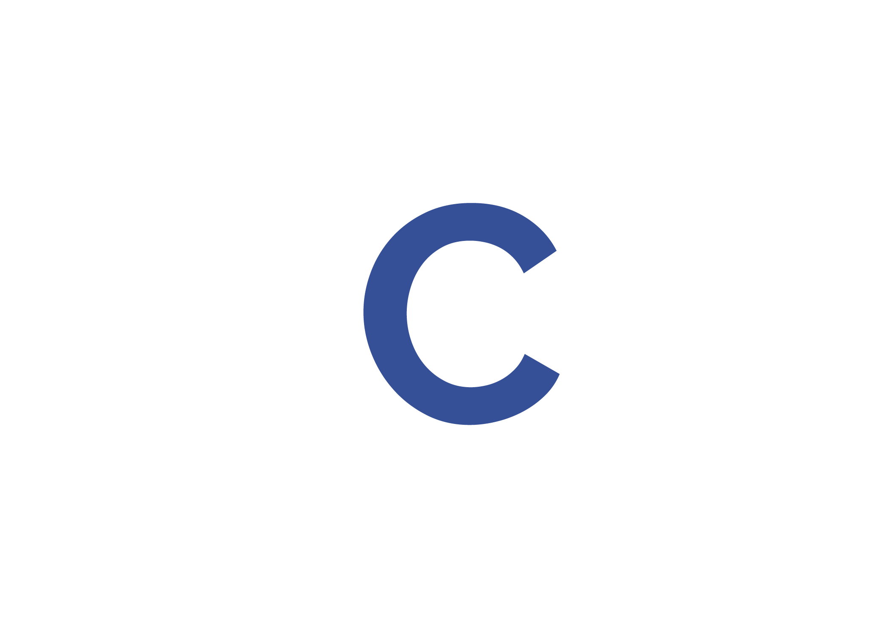
CONSILIUM
To plan your tasks
This application will increase productivity levels, and reduce procrastination.
Notes:
SPEAKER: TIM

Slide 3
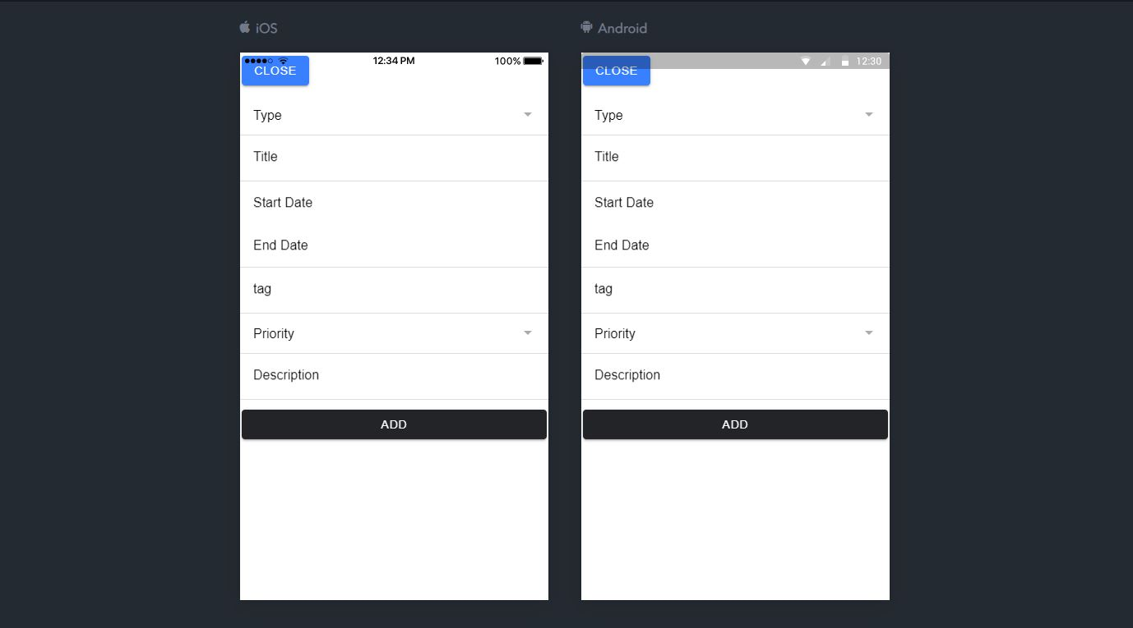
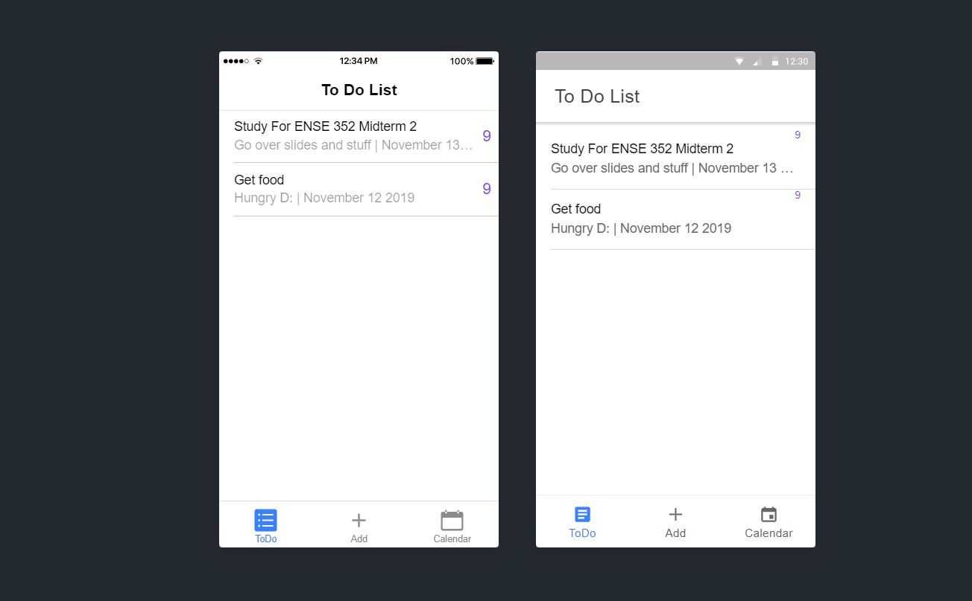
Screen Shots and Demo

Slide 4
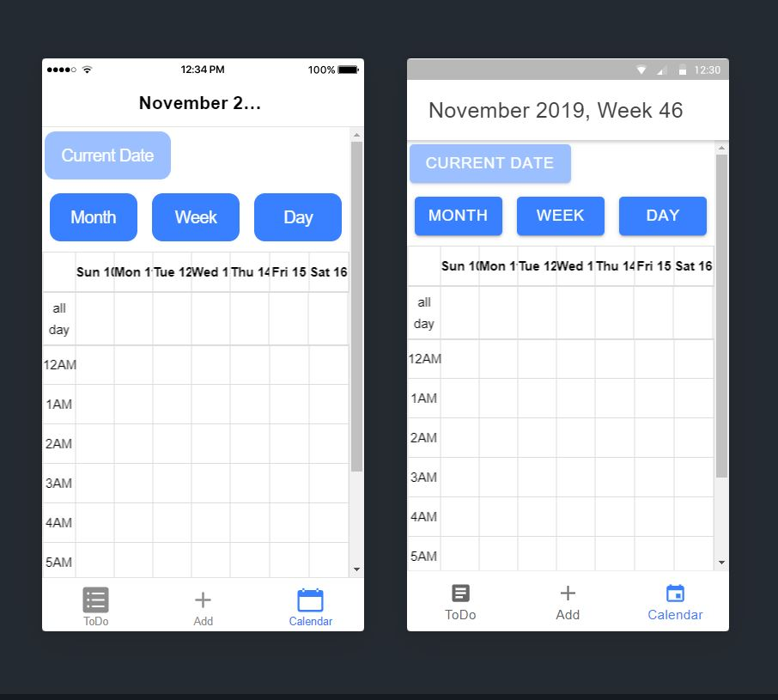
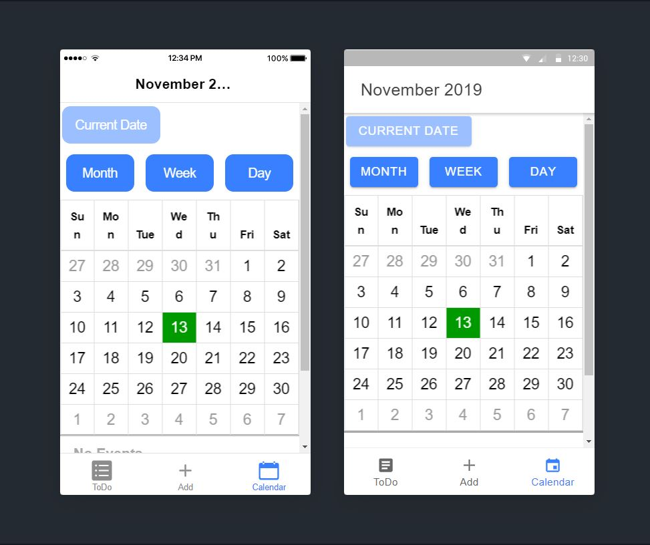
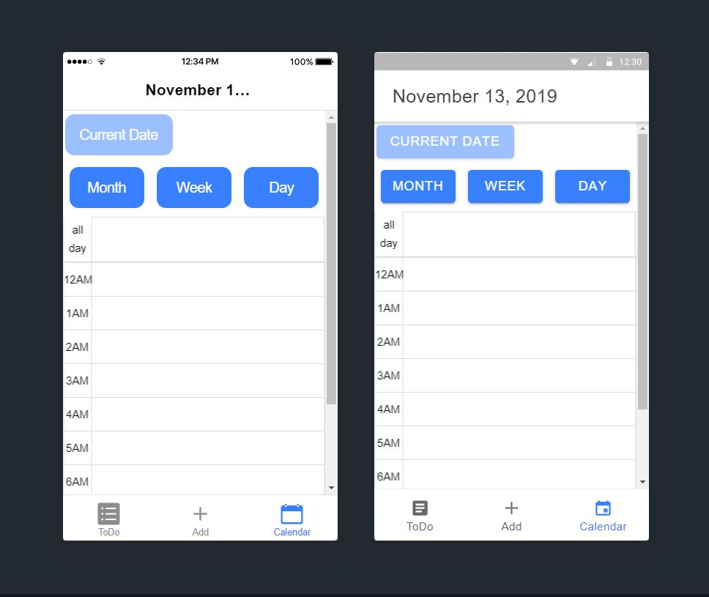
Screen Shots

Slide 5
About MVP 1
Were we successful?
Somewhat. Some functionalities were lost as we got carried away with adding too many bells and whistles
Focused on bare minimum (adding and viewing events)

Slide 6
Construction & development changes
1
Changes in our methodology

Slide 7
Clean Code and Our FRD
yes, we think our code is clean because we made sure all our group members and other people understands code properly.
The variables had meaningful names and were declared close to its usage.
Its low coupling, each function does not rely on each other.
All variables were camel case for eg. iPhone,eBay etc.
Notes:
SPEAKER: gurindeer

Slide 8
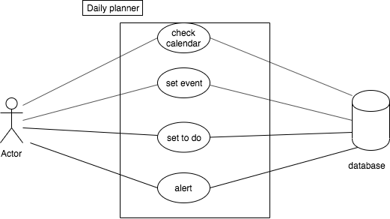
Domain Driven Design
Notes:
SPEAKER: XIA

Slide 9
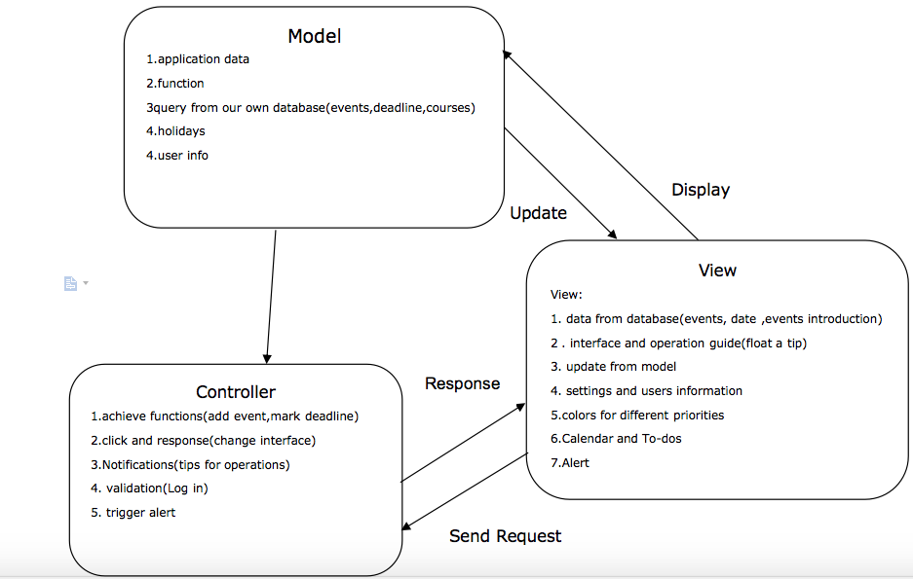
MVC Diagram
Notes:
Respons misspelled. (response)-fixed

Slide 10
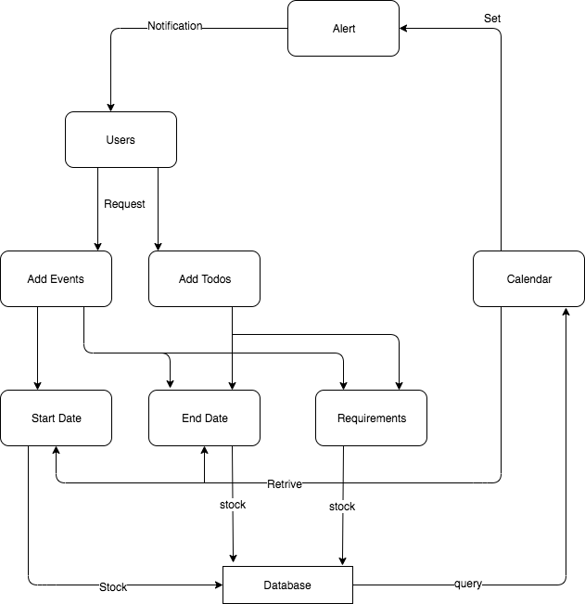
Data Flow Diagram
Notes:
Requirments, misspelled. (requirements-fixed

Slide 11
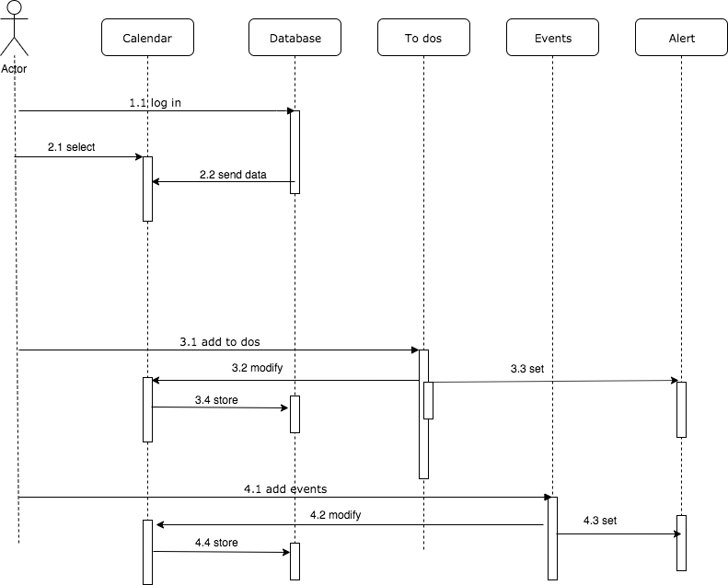
Sequence Diagram

Slide 12
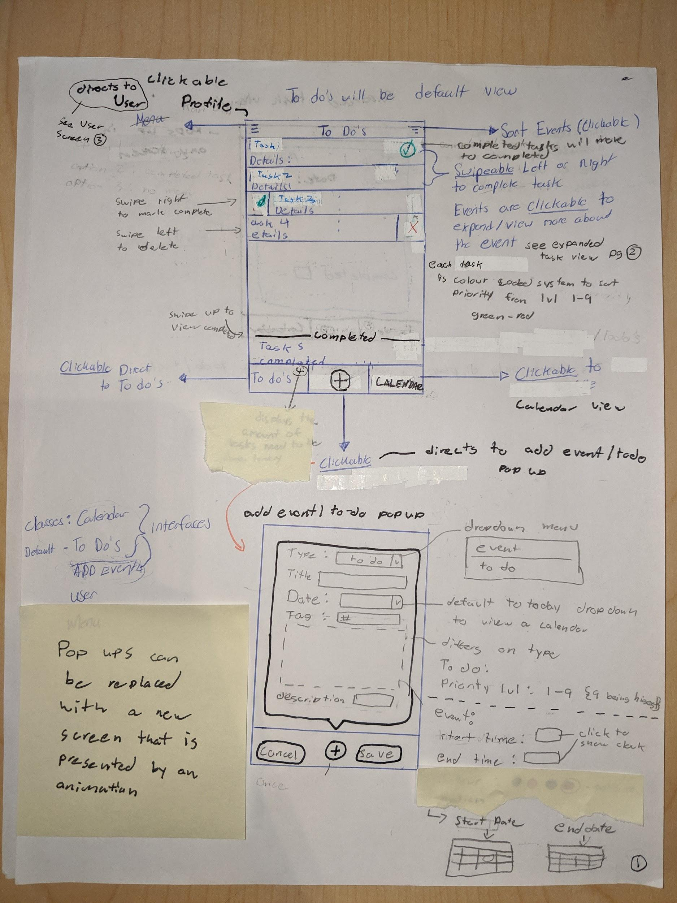
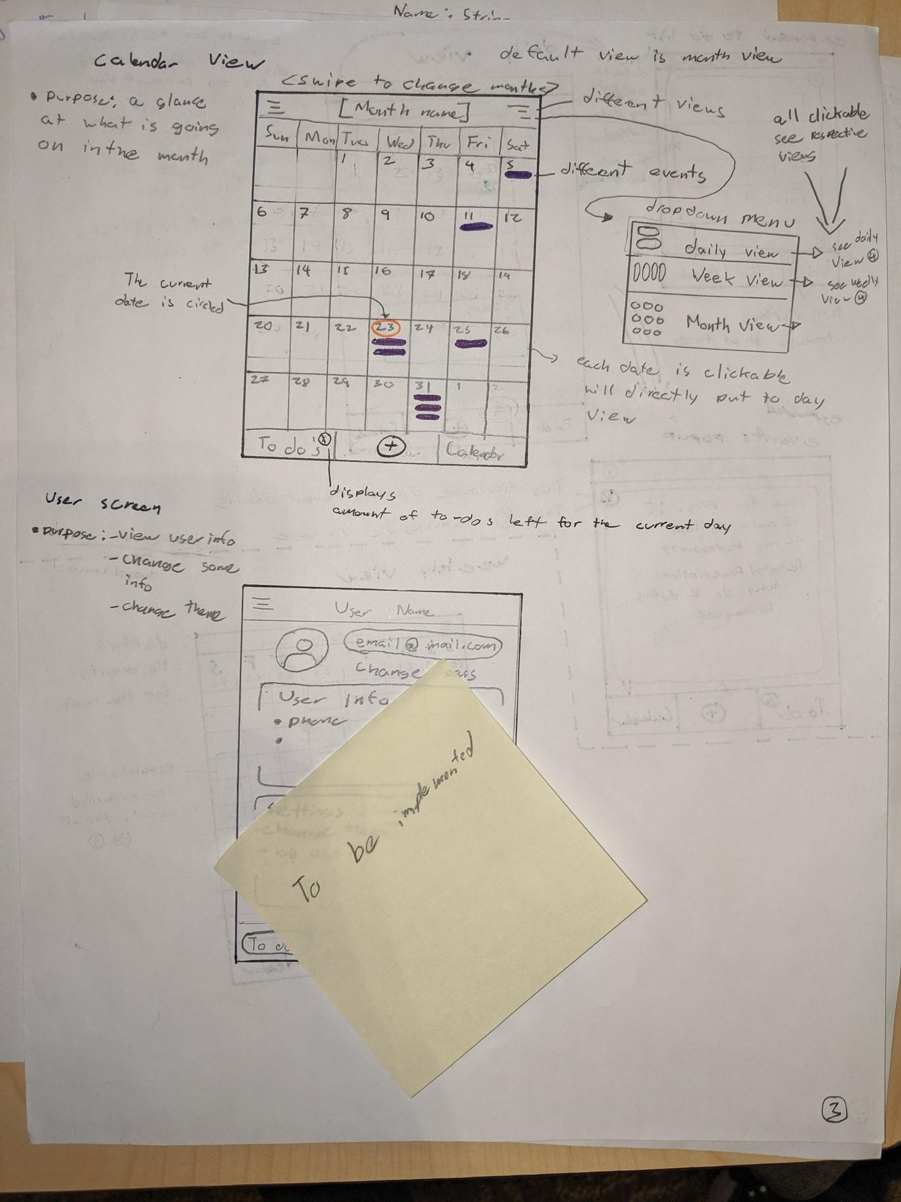
Updated lo-fidelity

Slide 13
MVP-2
New features(user,alert , holidays,style choose)
User:user account.
Alert:a reminder.How often?When?What style?
Holidays:set a plan for holidays.
Style:change favor style of interface.
Doable?
Barriers to success? Set alert template
Notes:
speaker:Xia

Slide 14

GitHub and kanban board
Needed interactivity with the kanban board
Implemented issues and milestones
Naming convention for documentation
https://github.com/Mertric/ENSE-374Project

Slide 15
Reflection
How did you feel about this milestone? What did you like about it? What did you dislike?
This milestone was an important one, as this is the milestone in which we felt like we are closer to develop our application by the deadline. We did a lot of coding. We liked the knowledge we gained from clean code as it will help us in future in writing code.
What did you learn about yourself as you collaborated and worked through this milestone?
Plan and brainstorm ideas before starting the work, so that the overall changes later on can be minimize.
How will you use what you have learned going forward?
Plan things out before actually executing the ideas behind them. Changes become more costly as the project progresses.

Slide 16
Thank you
Any questions?

