Slide 1
ENSE 374, milestone 2
Consilium
Gurinder Brar, Xia Hua, Tim Pasion, Jonathan Vargas
October 23, 2019

Slide 2
Consilium
A task orientated planner
We are working on this consilium mobile planner application that will help users to stay up to date with the daily reminders on the activities that needs to be done.
Gives important notifications
Helps to finish work on time

Slide 3
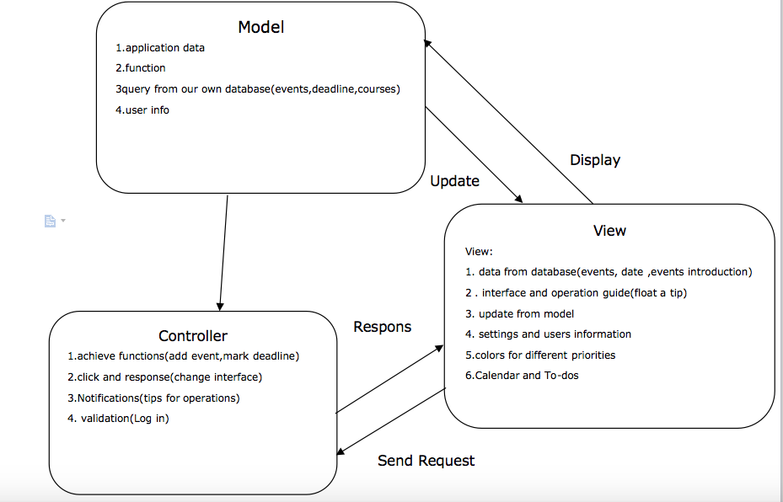
MVC

Slide 4
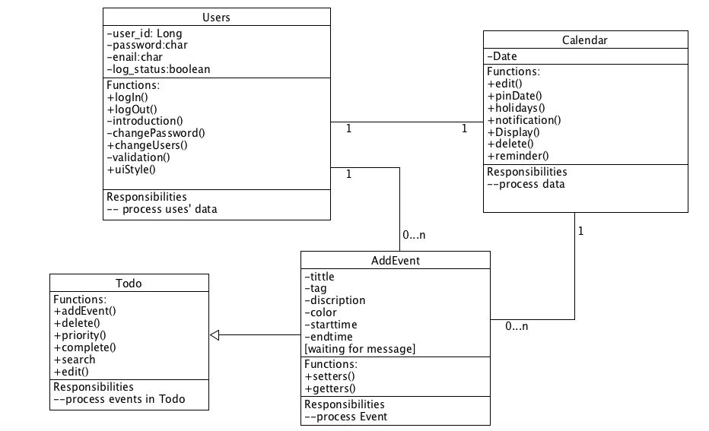
UML MVP-1

Slide 5
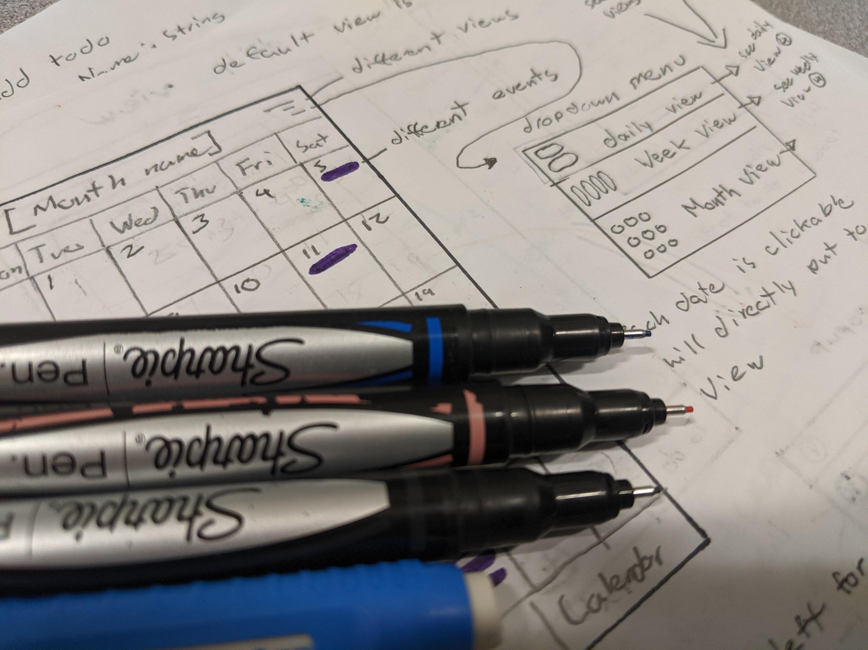
Low-fidelity prototype
Key activities
Add and view events/tasks
Static elements
Pop-ups

Slide 6
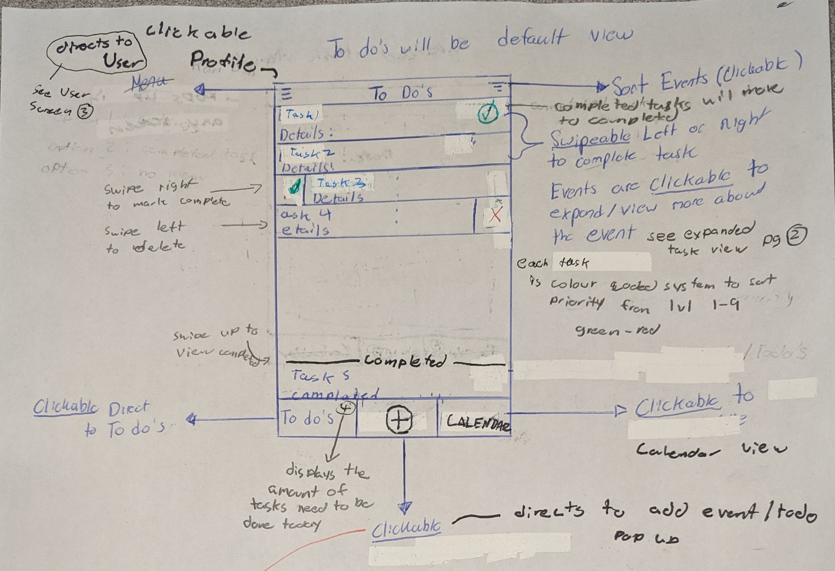
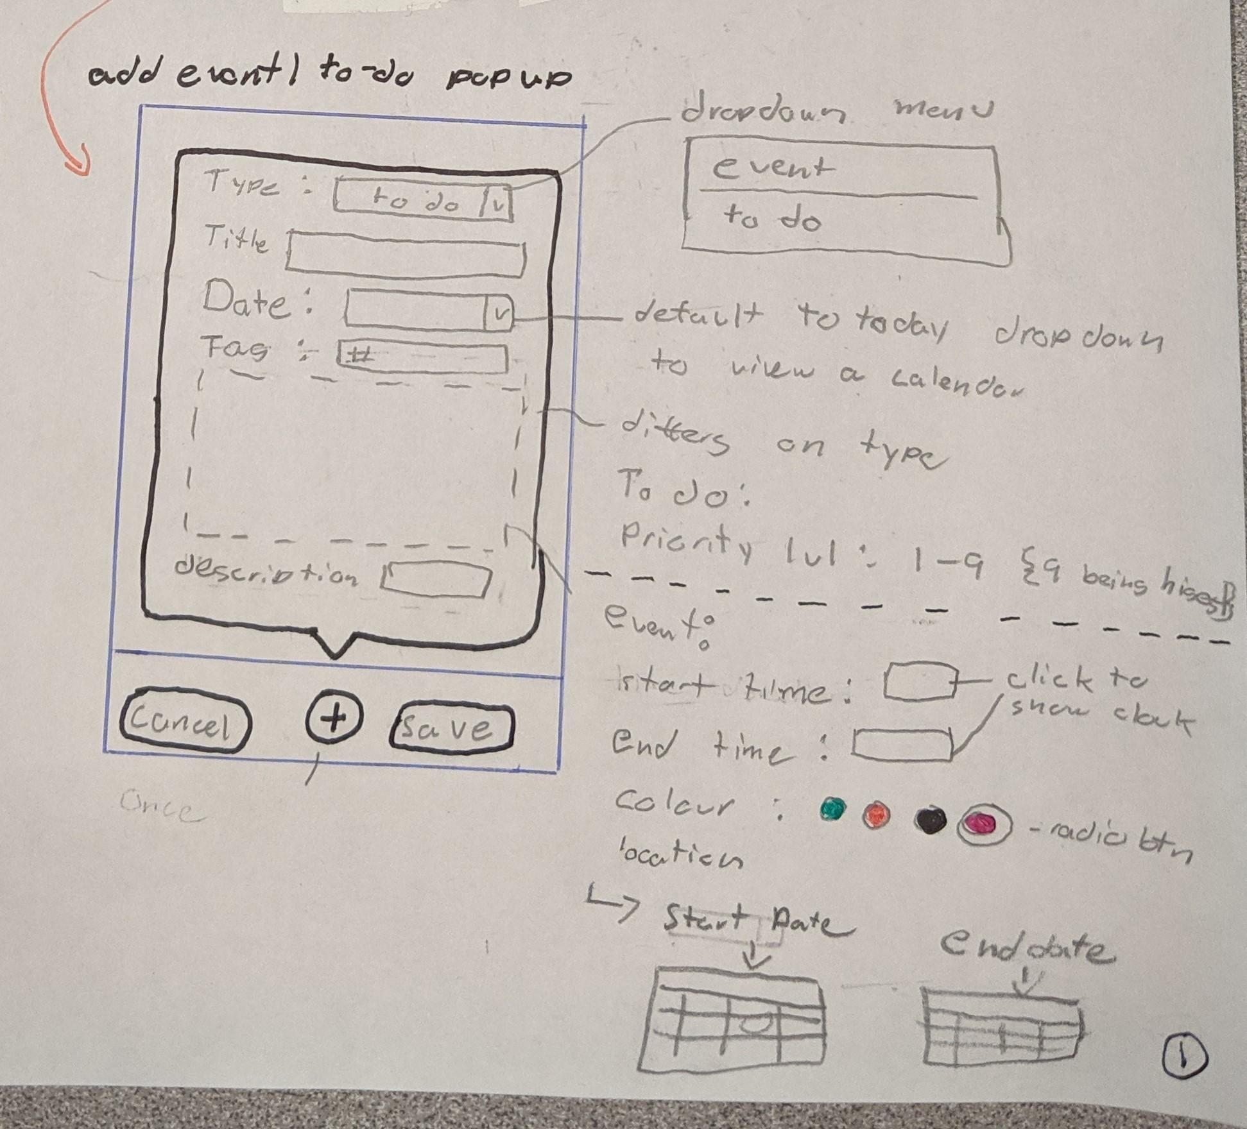
Interface sketches

Slide 7
Updates
https://github.com/Mertric/ENSE-374Project

Slide 8
Group reflection
How did we feel about this milestone?
This milestone was challenging. Creating the data flow from the MVC and UML diagrams. Though it was fun designing the interface.
What did we learn about each other?
We procrastinate a lot , though we are able to collaborate well together which helped us get things finished.
How will you use what you have learned going forward?
Using these diagrams and ideas to help develop the application.
What items related to this milestone would we want help with?
Help with the data flow of this application. A clear description of the different diagrams to include.

Slide 9
Thanks You
Any questions?

