Slide 1
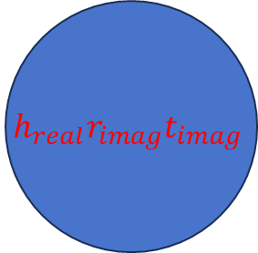
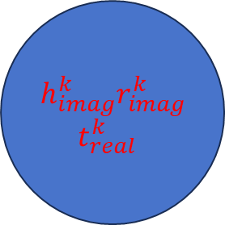
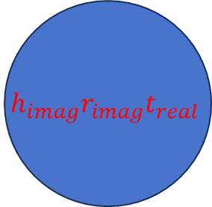
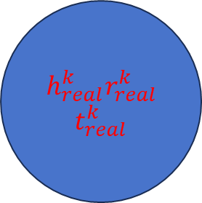
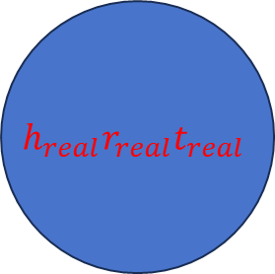
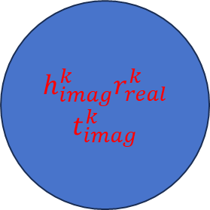
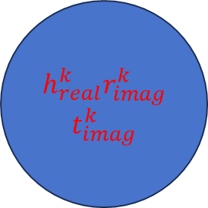
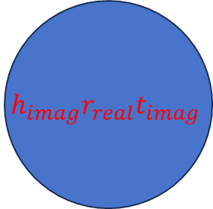
Input knowledge graph
Test set
Training set
implant
implant
h_real
h_imag
R_real
R_imag
T_real
T_imag
h_real
h_imag
R_real
R_imag
T_real
T_imag
$$h_{real}r_{real}t_{real}$$
$$h_{real}r_{imag}t_{imag}$$
$$h_{imag}r_{real}t_{imag}$$
$h_{real}^{k}r_{real}^{k}$ $t_{real}^{k}$
$$h_{imag}r_{imag}t_{real}$$
$h_{real}^{k}r_{imag}^{k}$ $t_{imag}^{k}$
$h_{imag}^{k}r_{real}^{k}$ $t_{imag}^{k}$
$h_{imag}^{k}r_{imag}^{k}$ $t_{real}^{k}$
F(h,r,t)
BCE Loss
gradient function
Complex model
Negative samples
Positive samples
save
correct
Forecast results
ROC curve

Slide 2










Knowledge Graph
(Head noderelationshipTail node)
(Head noderelationshipTail node)
(Head noderelationshipTail node)
……
Random division
80%
20%
Training set
(Head noderelationshipTail node)
(Head noderelationshipTail node)
(Head noderelationshipTail node)
……
(Head noderelationshipTail node)
(Head noderelationshipTail node)
(Head noderelationshipTail node)
……
Test set
Embedding vector
$$h_{real}^{1}$$
$$h_{real}^{2}$$
…
$$h_{real}^{k}$$
$$h_{imag}^{1}$$
$$h_{imag}^{2}$$
…
$$h_{imag}^{k}$$
$$r_{real}^{1}$$
$$r_{real}^{2}$$
…
$$r_{real}^{k}$$
$$r_{imag}^{1}$$
$$r_{imag}^{2}$$
…
$$r_{imag}^{k}$$
$$t_{real}^{1}$$
$$t_{real}^{2}$$
…
$$t_{real}^{k}$$
$$t_{imag}^{1}$$
$$t_{imag}^{2}$$
…
$$t_{imag}^{k}$$
$h_{real}^{1}r_{real}^{1}$ $t_{real}^{1}$
$h_{real}^{2}r_{real}^{2}$ $t_{real}^{2}$
…
$h_{real}^{k}$ $r_{real}^{k}$ $t_{real}^{k}$
$h_{imag}^{1}r_{imag}^{1}$ $t_{real}^{1}$
$h_{imag}^{2}r_{imag}^{2}$ $t_{real}^{2}$
…
$h_{imag}^{k}$ $r_{imag}^{k}$ $t_{real}^{k}$
$h_{real}^{1}r_{imag}^{1}$ $t_{imag}^{1}$
$h_{real}^{2}r_{imag}^{2}$ $t_{imag}^{2}$
…
$h_{real}^{k}$ $r_{imag}^{k}$ $t_{imag}^{k}$
$h_{imag}^{1}r_{real}^{1}$ $t_{imag}^{1}$
$h_{imag}^{2}r_{real}^{2}$ $t_{imag}^{2}$
…
$h_{imag}^{k}$ $r_{real}^{k}$ $t_{imag}^{k}$

Slide 3




















Knowledge Graph
(Head noderelationship Tail)
(Head noderelationship Tail)
(Head noderelationship Tail)
……
Random division
80%
20%
Training set
(Head noderelationship Tail)
(Head noderelationship Tail)
(Head noderelationship Tail)
……
(Head noderelationship Tail)
(Head noderelationship Tail)
(Head noderelationship Tail)
……
Test set
Embedding vector
Embedding vector
$$h_{real}^{1}$$
$$r_{real}^{1}$$
$$t_{real}^{1}$$
$$h_{real}^{1}$$
$$r_{real}^{1}$$
$$t_{real}^{1}$$
$$h_{real}^{1}$$
$$r_{real}^{1}$$
$$t_{real}^{1}$$
$$h_{real}^{1}$$
$$r_{real}^{1}$$
$$t_{real}^{1}$$
$$h_{imag}^{1}$$
$$r_{imag}^{1}$$
$$h_{imag}^{1}$$
$$h_{imag}^{1}$$
$$r_{imag}^{1}$$
$$h_{imag}^{1}$$
$$h_{imag}^{1}$$
$$r_{imag}^{1}$$
$$h_{imag}^{1}$$
$$h_{imag}^{1}$$
$$r_{imag}^{1}$$
$$h_{imag}^{1}$$
Complex Product Layer
Complex model parameter
Compare scores
Scoring Layer
BCE Loss
Save
Positive samples
Negative samples
Save
Correct

Slide 4
Knowledge Graph
(Head noderelationship Tail)
(Head noderelationship Tail)
(Head noderelationship Tail)
……
Random division
80%
20%
Training set
(Head noderelationship Tail)
(Head noderelationship Tail)
(Head noderelationship Tail)
……
(Head noderelationship Tail)
(Head noderelationship Tail)
(Head noderelationship Tail)
……
Test set
Embedding vector
Embedding vector
$$h_{real}^{1}$$
$$r_{real}^{1}$$
$$t_{real}^{1}$$
$$h_{real}^{1}$$
$$r_{real}^{1}$$
$$t_{real}^{1}$$
$$h_{real}^{1}$$
$$r_{real}^{1}$$
$$t_{real}^{1}$$
=
$$h_{real}^{1}$$
$$r_{real}^{1}$$
$$t_{real}^{1}$$
$$h_{imag}^{1}$$
$$r_{imag}^{1}$$
$$h_{imag}^{1}$$
$$h_{imag}^{1}$$
$$r_{imag}^{1}$$
$$h_{imag}^{1}$$
$$h_{imag}^{1}$$
$$r_{imag}^{1}$$
$$h_{imag}^{1}$$
$$h_{imag}^{1}$$
$$r_{imag}^{1}$$
$$h_{imag}^{1}$$
Complex Product Layer
Complex model parameter
Forward propagation
Compare scores
Scoring Layer
BCE Loss
Positive samples
Negative samples
Save
Correct
Back propagation
Gradient calculation
Save

