Slide 1

London bıke stands
MERVE HOROZ
ISTANBUL DATA SCIENCE ACADEMY – SUMMER 2020

Slide 2
Project ınfo
Problem : The problem of not being able to rent or drop a bicycle at the stand during rush hours
Solution : Transfer among the stands where bicycles are the most picked up and dropped
Data : Transportation for London
 | WEEKDAY | WEEKEND
MORNING RUSH HOURS | 7AM - 9 AM | 9-11AM
NOON RUSH HOURS | - | 12 AM – 5PM
EVENING RUSH HOURS | 4PM - 6PM | 6PM - 9PM

Slide 3
methodology
Determine top 15 busiest stations
Determine the most used time intervals by weekdays and weekends
Decide to transfer among the stands where bicycles are the most picked up and dropped

Slide 4
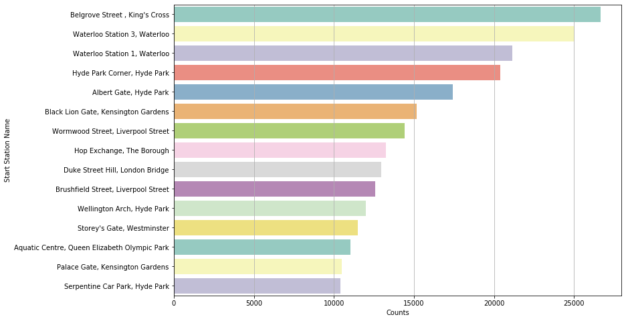
Top 15 start statıons

Slide 5
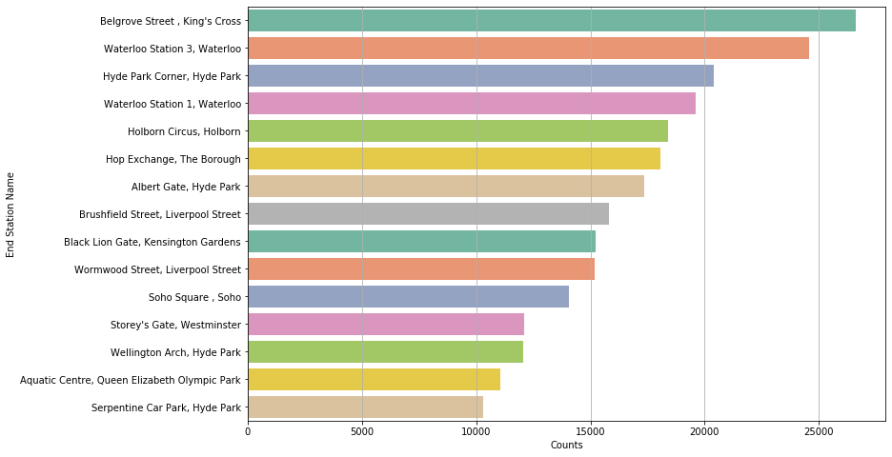
Top 15 end statıons

Slide 6
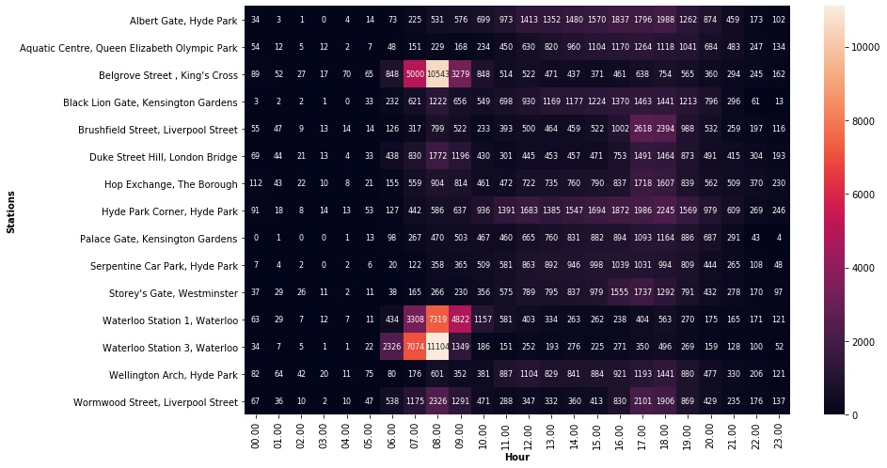
Weekday hours

Slide 7
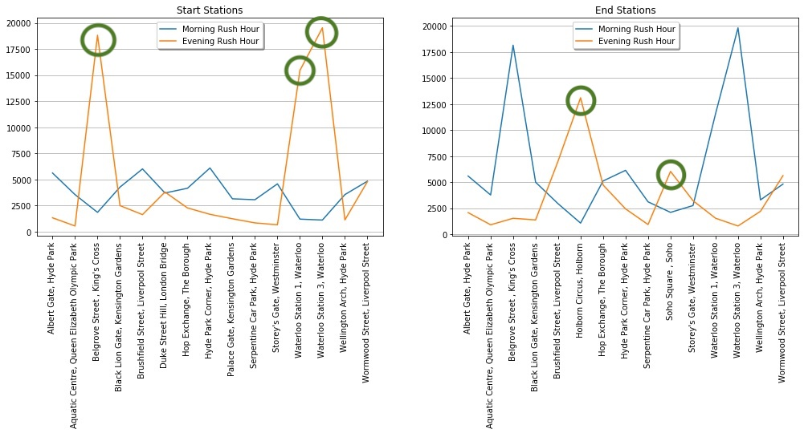
Weekday Recommendatıons (evenıng)

Slide 8
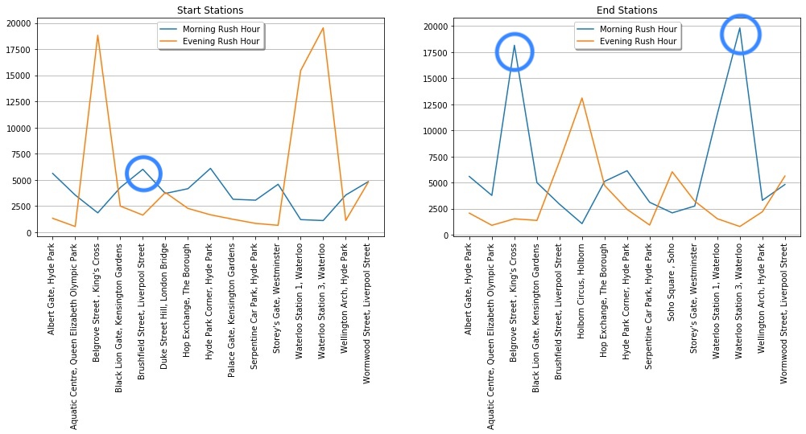
Weekday recommendatıons (mornıng)

Slide 9
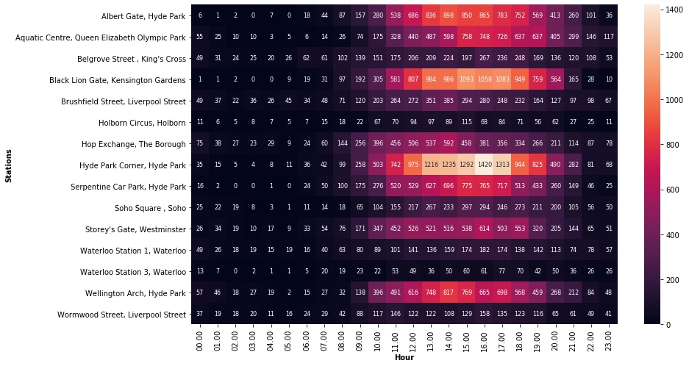
Weekend hours

Slide 10
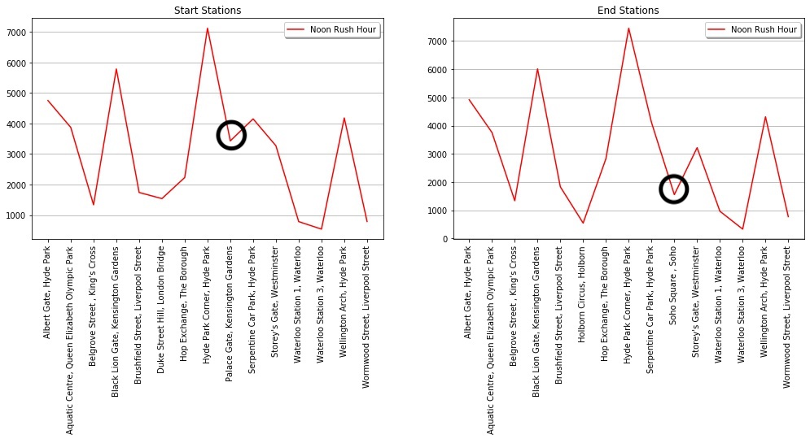
Weekend recommendatıons

Slide 11
Weekday evenıng
Belgrove Street, King’s Cross
Waterloo Station 1, Waterloo
Waterloo Station 3, Waterloo
Holborn Circus, Holborn
Soho Square, Soho
Weekday mornıng
Belgrove Street, King’s Cross
Waterloo Station 3, Waterloo
Brushfield Street, Liverpool Street
weekend
Soho Square, Soho
Palace Gate, Kensington Gardens

Slide 12
FUTURE WORKS
Analyzing the data of the whole year and look at the differences based on season
Showing station densities on London map

