Slide 1
NYC Airbnb Market Analysis (2019)
Supply, pricing and demand across New York City
Final Data Analysis Project | Python (Kaggle notebook) + Power BI dashboard

Slide 2
What is the problem, and what data did we use?
Problem + Data
The problem
48,895 x 16
How is the NYC Airbnb market structured, what drives listing prices, and where is demand strongest?
Raw data: AB_NYC_2019 (only dataset used)
Questions we answer
48,870 x 22
Which listing types and areas are most active?
How do prices differ, and what affects them?
How do price, reviews and stay length relate?
Which areas perform best, and what patterns appear?
After cleaning and feature engineering
No rating column
Reviews are used as a booking-activity proxy
Source: Airbnb New York City 2019 open data. Reviews measure booking activity, not guest satisfaction.

Slide 3
How was the data cleaned? Only 0.05% of rows removed
How was it cleaned?
Issue | Action | Result
reviews_per_month missing (10,052) | Filled with 0 (all had 0 reviews) | Logically correct
name / host_name missing (16 / 21) | Filled "Unknown", columns dropped | No analysis impact
last_review stored as text | Converted to datetime | Time analysis possible
Price = 0 (11), min. nights > 365 (14) | Rows removed | 25 rows (0.05%)
Price > $500 (2.1% of listings) | Flagged, not removed | Luxury listings kept
Duplicates | Checked rows and id | None found
Also added: is_inactive, has_reviews, host_type, stay_type, price_category, log_price (price skew 19.1 to 0.63).

Slide 4
Two boroughs and two room types make up the market
What did you discover?
Manhattan + Brooklyn = 85.4% of listings. Entire homes + private rooms = 98%. Largest area: Williamsburg (3,917).

Slide 5
Location drives price: Manhattan is most expensive in every room type
What did you discover?
Median price (USD) | Entire home | Private room | Shared room
Bronx | $100 | $54 | $40
Brooklyn | $145 | $65 | $36
Manhattan | $191 | $90 | $69
Queens | $120 | $60 | $37
Staten Island | $100 | $50 | $30
What it means
Entire home: $191 in Manhattan vs $100 in the Bronx
The premium holds inside each room type, so it is a real location effect
Price has weak correlation with reviews or availability (|r| ≤ 0.11)
Colour scale: yellow < $60 | orange < $110 | pink < $150 | violet $150+
Median price (listings up to $500): Manhattan $145, Brooklyn $90, Queens and Staten Island $75, Bronx $65.

Slide 6
Demand is higher outside the core and for shorter stays
What did you discover?
Correlation of minimum nights with monthly reviews: -0.25. Listings above $500: only 60% reviewed (82% at $76-150).

Slide 7
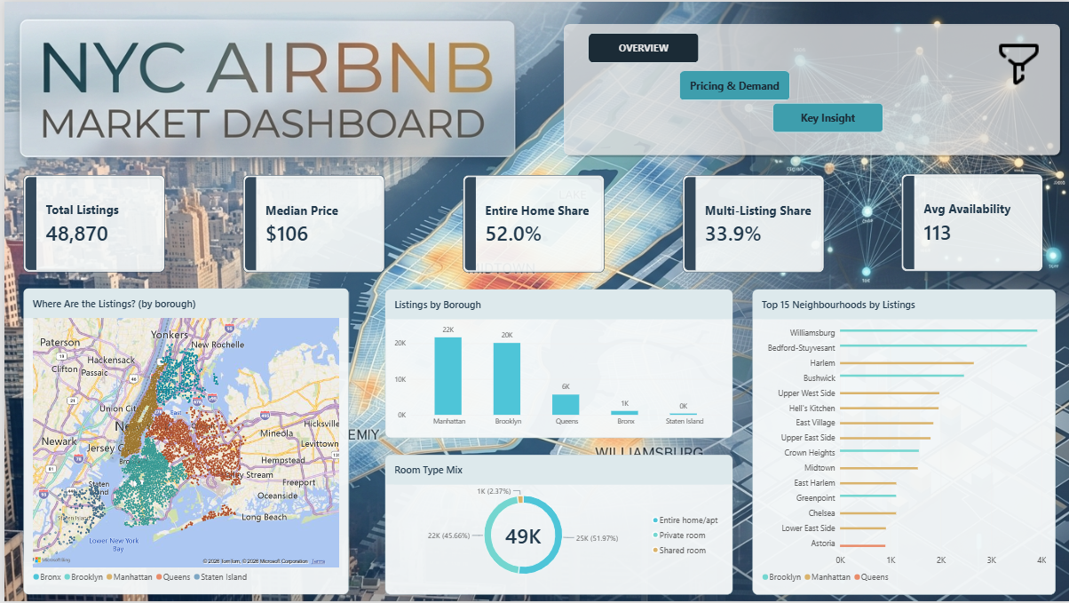
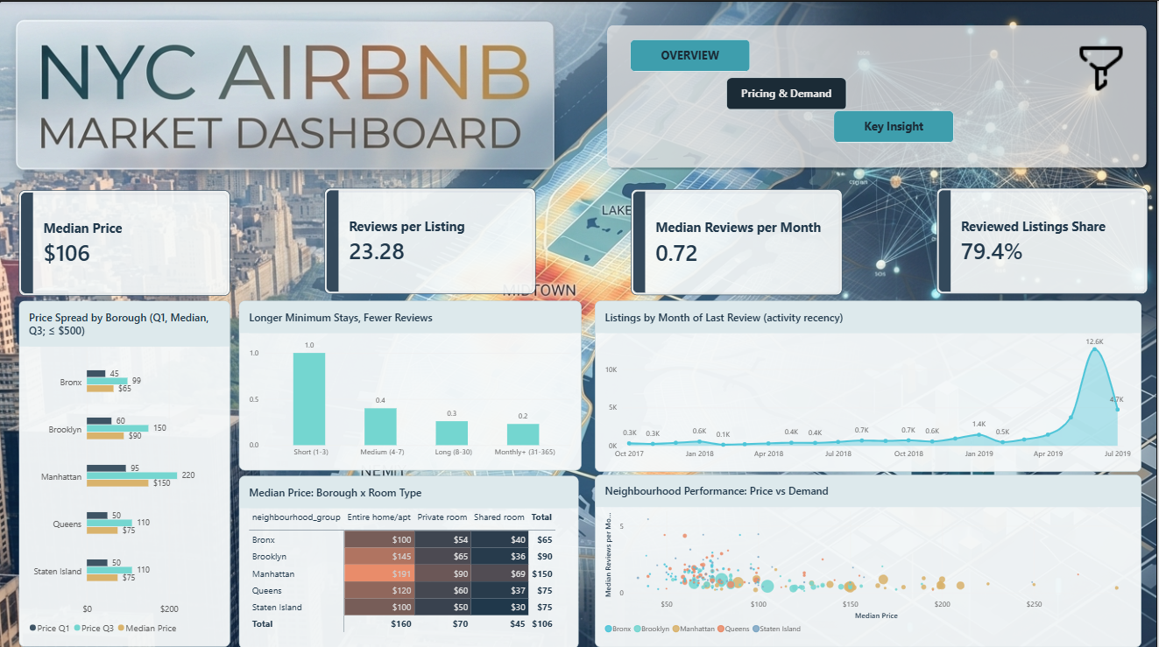
The Power BI dashboard lets anyone explore these findings
Dashboard
Overview: 5 KPIs, map, room-type mix, boroughs, top 15 neighbourhoods
Pricing & Demand: 4 KPIs, price quartiles, heatmap, bubble chart, trend, slide-out filters
3 pages (Overview, Pricing & Demand, Key Insight) | 4 filters: borough, room type, price category, host type | every chart cross-filters.

Slide 8
Six insights and the decisions they support
Insights + Decisions
Insight (what we found) | Recommendation (decision)
Two boroughs hold 85% of supply | Benchmark by borough x room type
Location drives price ($191 vs $100 entire home) | Price from the benchmark, not the citywide average
Outer boroughs: 1.2-1.4 reviews/month vs 0.6 in the core | Explore Queens first for new listings
Above $500, only 60% of listings are reviewed | Keep standard listings at $76-150
1-3 night minimum: 1.00 reviews/month vs 0.23-0.40 | Test shorter minimum stays
35.9% of listings are blocked; 6+ listing hosts stay open 283-319 days | Size the market with active listings only
Each insight is backed by the notebook analysis and visible in the dashboard.

Slide 9
Conclusion: benchmark by location and type, and look beyond the core
Conclusion
Summary
Limitations
The market is concentrated, and price is set mainly by where a listing is and what type it is. Booking activity is higher outside Manhattan and Brooklyn and for cheaper, shorter-stay listings, and a third of listed supply is not bookable.
No rating column: reviews are only a proxy
Single snapshot (July 2019): no seasonality or growth
Bronx and Staten Island: small samples
Associations, not proven causes
Deliverables: clean dataset, Kaggle notebook, Power BI dashboard, final report, insights and recommendations.

