Slide 1

Number Theoretic Transform: A Python-based Speed Enhancement
Merve Karabulut
Advisor: Reza Azarderakhsh

Slide 2
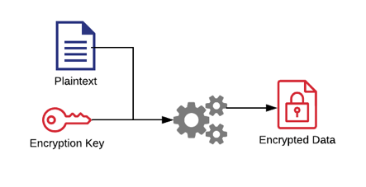
Cryptography
Key of digital world security
Ensures it is kept private and secure from unintended parties
How it should be?
Non-solvable math problem
Efficient
Standardized

Slide 3

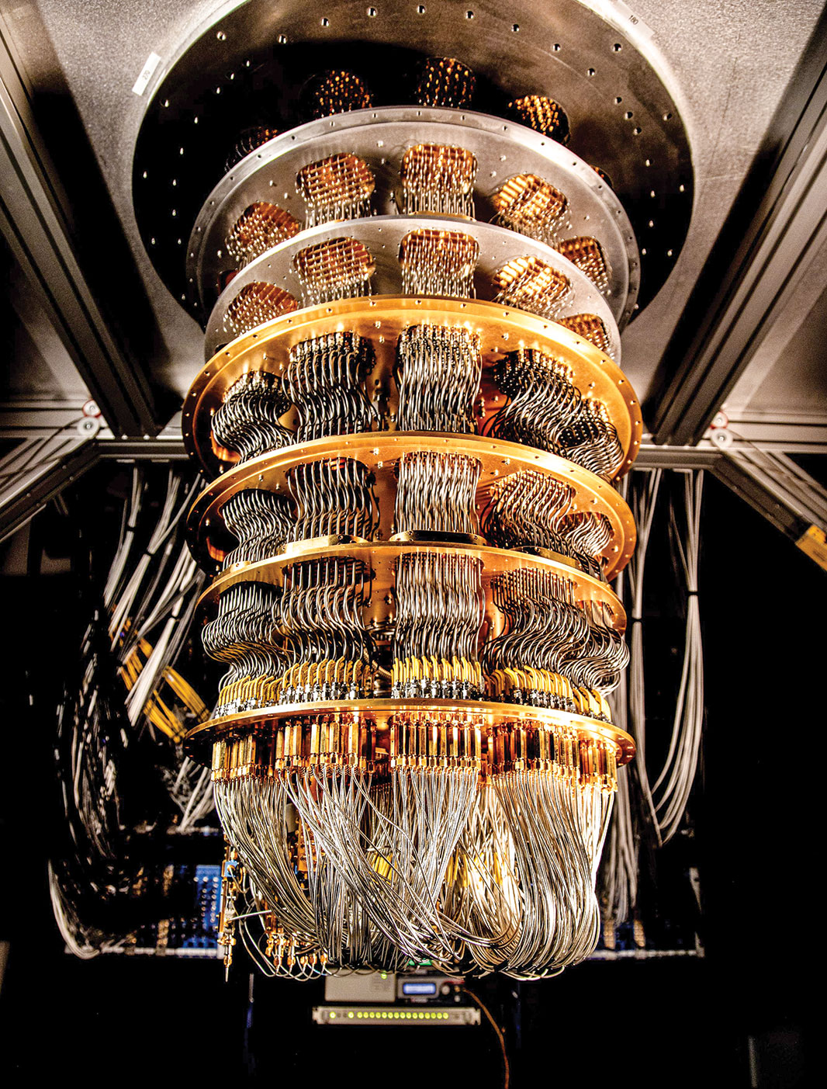
Post Quantum Cryptography
Solves hard math problems
Fast computing power
Because of Shor’s algorithm
RSA
Diffie-Hellman
Eliptic Curve algorithms are defeated

Slide 4

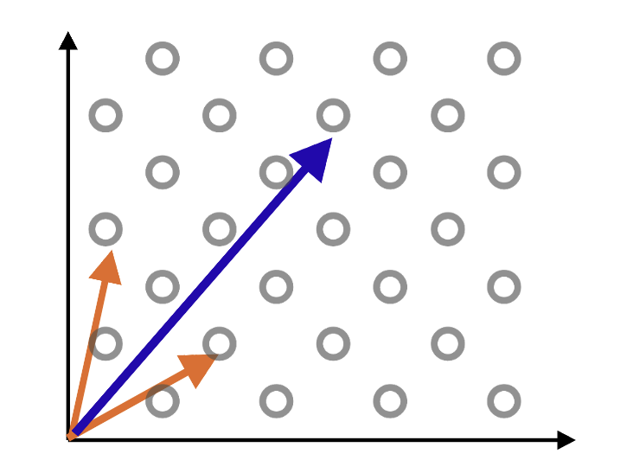


Lattice Based Cryptography
Lattice: set of points in the space
Vector: quantity that has both magnitude (distance) and direction
Basis: set of vector that produce the vector in the lattice
Lattice
Basis

Slide 5
Learning With Error Lattice Based Public Key Encryption
A and B are public, s is a secret and e is a noise vectors in Z^{n}_{p}
Each row represents the co-efficient
Number of rows presents the range of polynomial
B = ( A*s + e mod(q) )
It’s hard to find s, knowing A and B
1
4
0
2
5
2
3
1
0
1
0
1
2
1
-2
439
543
123
968
322
x
+
=
A
s
e
B

Slide 6
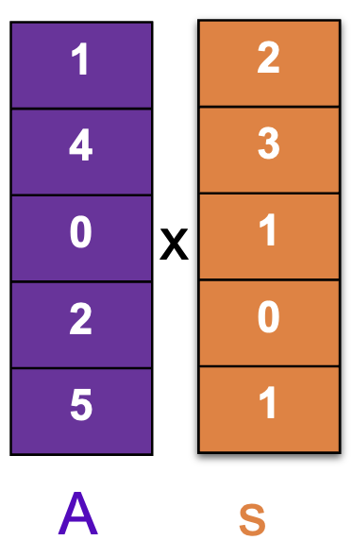
Lattice Based Cryptography
Schoolbook multiplication’s complexity is O(n²)
(q = 6, n = 5), A = x⁴ + 4x³ + 2x + 5 and s = 2x⁴ + 3x³ + x² + 1
1 | 4 | 0 | 2 | 5
x
2 | 3 | 1 | 0 | 1
1 | 4 | 0 | 2 | 5
Reduction with q
2x⁸+5x⁷+x⁶+2x⁵+5x⁴+3x³+5x²+2x+5 / (x⁵ + 1)
0 | 0 | 0 | 0 | 0
1 | 4 | 0 | 2 | 5
3 | 0 | 0 | 0 | 3
+
2 | 2 | 0 | 4 | 4
2 | 5 | 1 | 2 | 5 | 3 | 5 | 2 | 5

Slide 7
Schoolbook Multiplication Number Theoretical Transformation
O (n²)
O(n log n)
x
NTT
NTT
Point wise multiplication
…….
INTT
+

Slide 8
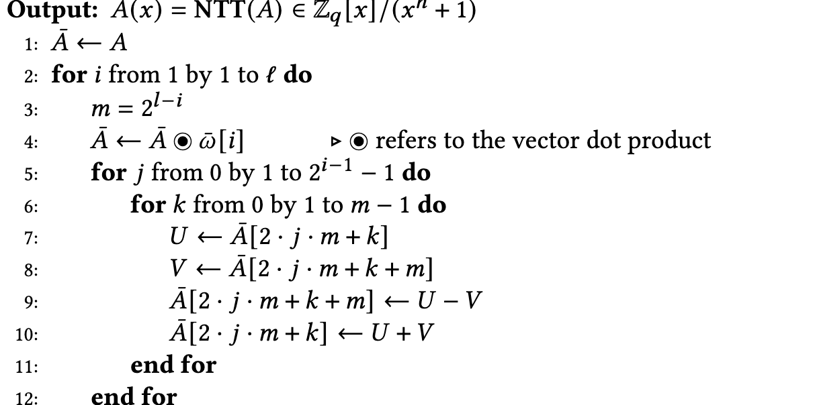
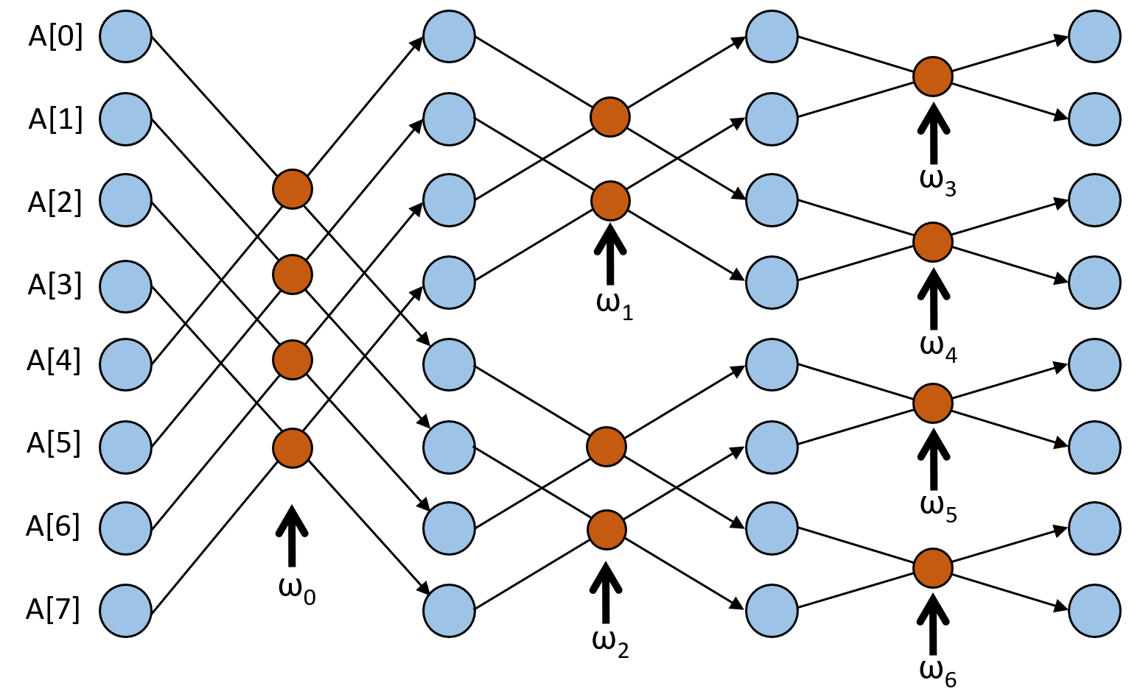
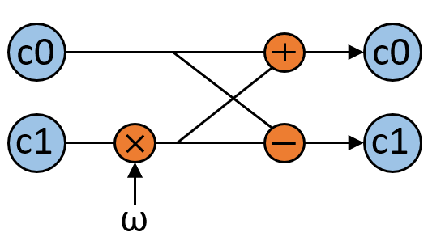
Complexity is O( nlog(n) )
For this example, we need log(n) layer and for each layer n/2 butterfly operation.
Butterfly operation

Slide 9
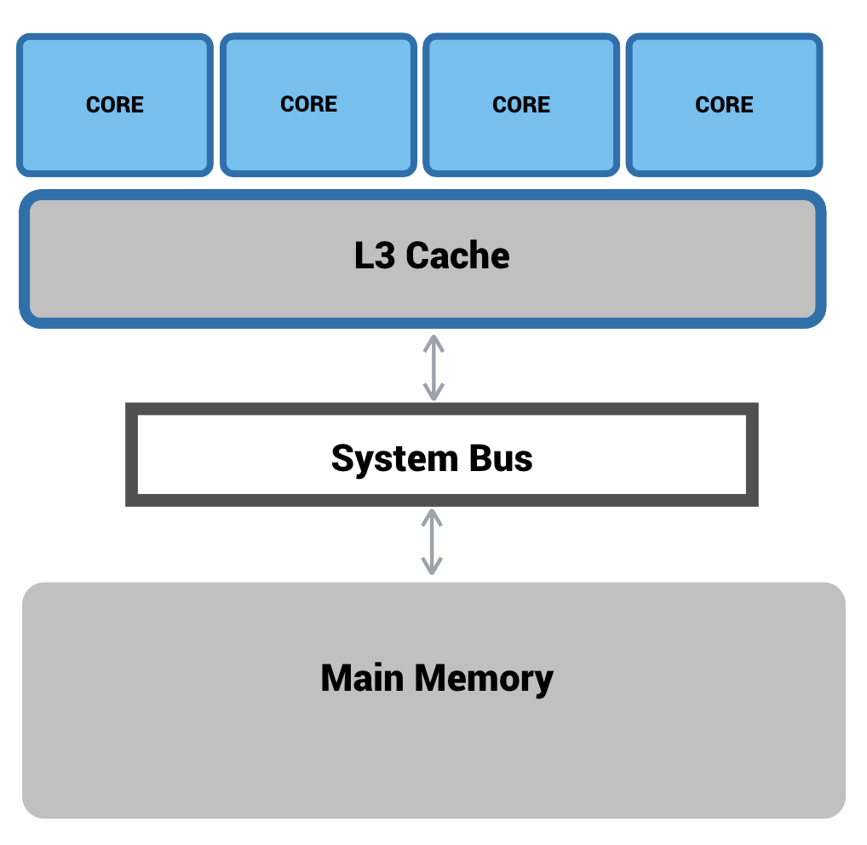
Efficient Implementation of NTT on Modern CPU
Modern computer has multi-core, multi-thread structure
We can execute butterfly operation in parallel using modern CPU

Slide 10
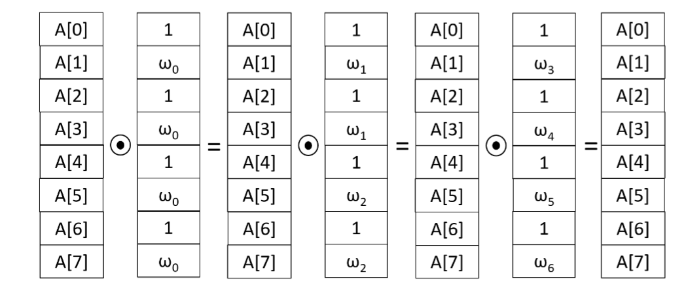
Only values with odd indexes are multiplied by the twiddle value.
We can create a vector array that even indexes contains 1, odd indexes contains corresponding 𝜔 values.
We can perform operations in parallel using python library numba.

Slide 11
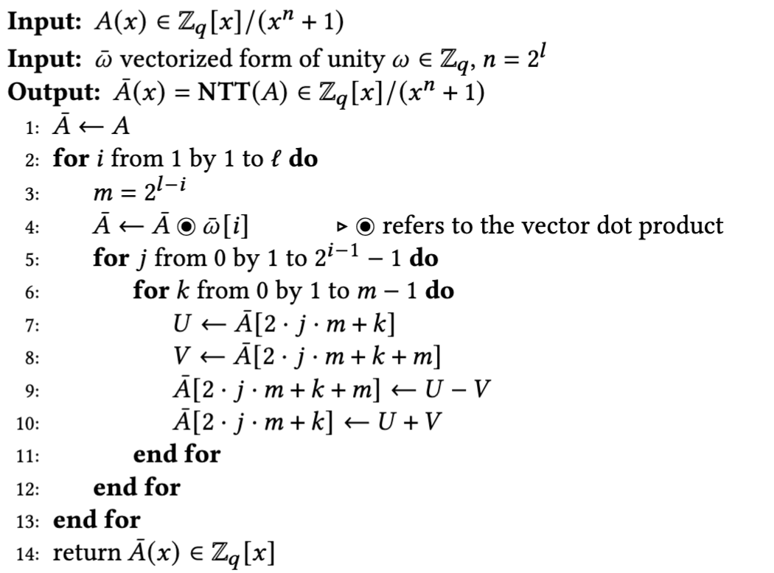
Modification on Control Flow
Less operation in nested loop.
Compatible with parallel execution.
Able to use @njit decorator from Numba package.

Slide 12
Enhancing Parallelism
Is used to accelerate the performance of certain functions using Just-In-Time (JIT) compilation.
The parallel=True option in @njit allows Numba to parallelize certain loops, which can further enhance performance on multi-core processors.

Slide 13
Performance Evaluation
Kyber is well-regarded for having highly optimized parameters and the smallest prime number among the PQC finalists.
We opted to compare our Python- based NTT implementation with the C-based implementation of CRYSTAL-Kyber,. one of the PQC finalists.
1024 co-efficient is used and each of co-efficient can be up to 23 bit.
Implementation | Execution Time
CRYSTAL-Kyber in C | 0.62 ms
Baseline Design in C | 5.97 ms
Python Implementation Using Numba | 0.043 ms

Slide 14
Feedback

