Slide 1
Towards Building More Intelligent Conversational Systems: Semantics, Consistency, &Interactivenss
Dr. Minlie Huang
Associate Professor
Tsinghua University
http://coai.cs.tsinghua.edu.cn/hml

Slide 2
Types of Conversational AI Systems
Limited social
back and forth
Ideal Bot
Virtual
Assistant
Accomplish
Tasks
Limited content
to talk about
execute commands,
answer questions
Chat Bot
chitchat
Social Conversation
From prof. M Ostendorf, with edits

Slide 3
Issues Vary for Different Paradigms
ASSISTANT
Conversational AI
System Components
SOCIALBOT
*Social & info
*Intents
*Grounding
*Task intents
*Slot filling
Speech/language
understanding
*Narrow options
& execute tasks
*Reward = timely
task completion
*Learn about interests
*Make suggestions
*R=user engagement
Dialog management
Constrained domains
Language generation
Open domains
Back-end application
Unstructured
Data & Info
Structured
KB+DB
From prof. M Ostendorf, with edits

Slide 4
Good Examples from DL Models
User：最幸福的人不是拿到了最好的东西，而是学会去珍惜手上已经拥有的人。
The happiest person is not the one who gets the best thing, instead who cherishes what she/he already has.
Machine: 是的，所以我也要珍惜自己的幸福
Agree, I will cherish my happiness too.
User: 时间啊，你这把杀猪刀。。。 Time is a killer…
Machine: 我是被杀的 I am the one who was killed.
User: 怕孤獨，又捨不下自己的小自由。
Afraid to be lonely, but wont’ give up my little freedom.
Machine: 我想去流浪，但没有人陪我去。
I want to wander, but no one accompany me.

Slide 5
Bad Examples are More!
User: 其实，他没有那么爱你。
Ohh, he does not love you that much.
Machine: 幸福的一天开始了。
A happy day starts.
User: 回北京了！很冷很高兴！
Back to Beijing now. So cold so happy!
Machine: 什么时候来北京啊？
When will you come to Beijing?
User: 我来自上海。
I come from Shanghai.
Machine：真巧，我来自海南，老乡啊
So cool, I am from Hainan, the same province!

Slide 6
Controllability of Language Generation
Three fundamental problems in current neural language generation models
Semantics
Consistency
Logic

Slide 7

Bad Examples are More!
Xiaoice by MSRA
语义理解的问题 Semantic understanding
微
软
小
冰
User: 你家多大？ How large is your house?
小冰: 这么快就要爆年龄了？ So soon to reveal my age?
User: 你是素食主义者还是吃肉啊？
Are you vegan or meatatarian?
小冰: 怎么减肥
How can I lose weight?
个性身份一致性问题
Inconsistency in personality
User: 你几岁了？
小冰: 我啊。。。反正是九零后！
User: 那你是几几年出生的？
小冰: 错，75年阳历一月出生。
User: 你是九零后，怎么会75年出生？
小冰: 生在九零后，在深圳只能被当做八零后了。
上下文理解的问题 Context issue
User: 早饭不好吃
小冰: 那明早一起吃
User: 行，你推荐的应该不错
小冰: 是吗？
User: 哈哈，我相信你
小冰: 呃呃

Slide 8
Challenges in Conversational Systems
One-to-many: one input, many many possible responses
Knowledge & Reasoning: real understanding requires various knowledge, world facts, commonsense, etc.
Situational Context
Who are you talking with?
Stranger, or friend?
His mood and emotion?
Shared backgrounds that are only accessible by two acquaintances

Slide 9
Challenges in Conversational Systems
Semantics
Consistency
Interactiveness
Content,
Context,
Scene
Personality,
Personalization,
Language Style
Emotion &
Sentiment
Strategy,
Behavior
Open-domain + Open-topic

Slide 10
Open-domain Conversational Systems
Behaving more interactively:
Perceiving and Expressing Emotions (AAAI 2018)
Proactive Behavior by Asking Good Questions (ACL 2018)
Controlling Sentence Function (ACL 2018)
Topic Change (SIGIR 2018)
Behaving more consistently:
Explicit Personality Assignment (IJCAI-ECAI 2018)
Behaving more intelligently with semantics:
Better Understanding and Generation Using Commonsense Knowledge (IJCAI-ECAI 2018 distinguished paper)
Discourse parsing in multi-party dialogues (AAAI 2019)

Slide 11
Open-domain Conversational Systems
Behaving more interactively:
Perceiving and Expressing Emotions (AAAI 2018)
Proactive Behavior by Asking Good Questions (ACL 2018)
Controlling Sentence Function (ACL 2018)
Topic Change (SIGIR 2018)
Behaving more consistently:
Explicit Personality Assignment (IJCAI-ECAI 2018)
Behaving more intelligently with semantics:
Better Understanding and Generation Using Commonsense Knowledge (IJCAI-ECAI 2018 distinguished paper)
Discourse parsing in multi-party dialogues (AAAI 2019)
Emotional Chatting Machine: Emotional Conversation Generation with Internal and External Memory. AAAI 2018.
Assigning personality/identity to a chatting machine for coherent conversation generation. IJCAI-ECAI 2018.
Commonsense Knowledge Aware Conversation Generation with Graph Attention. IJCAI-ECAI 2018.
Learning to Ask Questions in Open-domain Conversational Systems with Typed Decoders. ACL 2018.
Generating Informative Responses with Controlled Sentence Function. ACL 2018.
Chat more: deepening and widening the chatting topic via a deep model. SIGIR 2018.
A Deep Sequential Model for Discourse Parsing on Multi-Party Dialogues. AAAI 2019.

Slide 12
Interactiveness: Emotion Perception and Expression

Slide 13
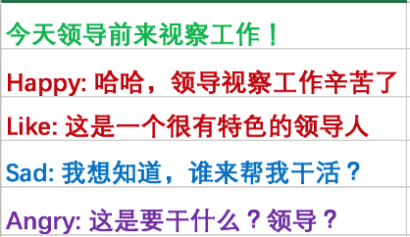



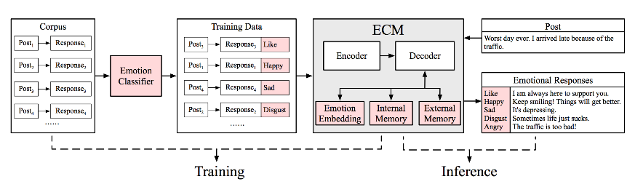
Emotional Chatting Machine
Perceiving and Expressing emotion by machine
Closer to human-level intelligence
Social Interaction Data
Post
Response
Emotion
Tagged
data
Emotion
Classifier
Emotional Chatting
Machine
Post
Response
Post
Response
…
Post
Response
Happy
Angry
Sad
…
Our work was reported by MIT Technology Review, the Guardian, Cankao News, Xinhua News Agency etc.
Prof Björn Schuller: “an important step” towards personal assistants that could read the emotional undercurrent of a conversation and respond with something akin to empathy.
Emotional Chatting Machine: Emotional Conversation Generation with Internal and External Memory. AAAI 2018.
Notes:
如何让计算机感知、表达情绪或情感，一直是AI的长期努力的目标。比如日本软银公司的情感机器人pepper，就曾经在市场上引起了极大的轰动。
我们研究了开放领域闲聊对话场景下如何让聊天机器人表达喜怒哀乐几种情绪化的内容。
首先，我们从社交媒体收集了大量的 用户之间的互动数据；
然后，我们训练了一个情绪分类器，对这些互动数据进行 喜怒哀乐的情绪标注；
最后，这些数据被送入到一个 基于深度学习的情绪化内容生成器，这样对于一个输入内容“今天领导前来视察工作”，可以生成不同情绪的回复，比如高兴的，悲伤的。。。。
我们的工作得到了媒体的关注，认为对于让机器表达情绪这个问题，是一个很重要的尝试。
Prof Schuller 是情感分析领域的顶级大牛，对我们的工作也有很高的评价。

Slide 14
More Examples
情绪emotion | Post:早上的天气不错啊！哈哈哈哈哈哈
Other | 今天是个好天气。
喜欢 Like | 今天的天气不错啊！
悲伤 Sad | 天气好，心情不好。
厌恶 Disgust | 这是哪里啊？求解释
愤怒 Angry | 怎么了？什么情况？
快乐 Happy | 今天的天气真好啊！
情绪 emotion | Post:送一个这样的蛋糕，给你美丽的闺蜜吧！
Other | 这是蛋糕蛋糕吗？
喜欢 Like | 好漂亮的蛋糕啊！
悲伤 Sad | 为什么我觉得很恶心
厌恶 Disgust | 这样的蛋糕你忍心吗？
愤怒 Angry | 有没有想开网店的？
快乐 Happy | 哈哈，好可爱的蛋糕！
情绪emotion | Post:为了解决抄作业的不好习惯，高数老师这回要出绝招了！
Other | 这老师是要逆天吗？
喜欢 Like | 这老师太有才了！
悲伤 Sad | 这样的老师伤不起啊
厌恶 Disgust | 这老师也太狠了点吧
愤怒 Angry | 这老师是要逆天啊！
快乐 Happy | 哈哈，这老师太有才了
情绪 emotion | post:承诺，就是一个骗子说给一个傻子听的。
Other | 承诺就是一个承诺
喜欢 Like | 承诺是一个专一的傻子
悲伤 Sad | 我就是一个悲伤的傻子
厌恶 Disgust | 一个骗子说给一个傻子听
愤怒 Angry | 不管你信不信，反正我信了！
快乐 Happy | 我就是一个开心的傻子
Emotional Chatting Machine: Emotional Conversation Generation with Internal and External Memory. AAAI 2018.

Slide 15
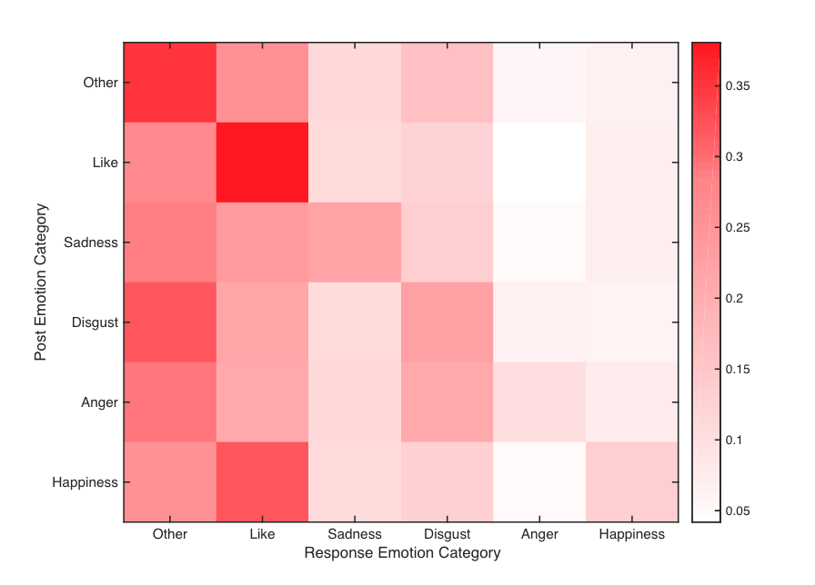
Emotion Interaction Patterns
Like→Like (empathy)
Sadness →Sadness (empathy)
Sadness →Like (comfort)
Disgust → Disgust (empathy)
Disgust → Like (comfort)
Anger → Disgust
Happiness→Like
Emotional Chatting Machine: Emotional Conversation Generation with Internal and External Memory. AAAI 2018.

Slide 16
Interactiveness: Behaving More Proactively by Asking Good Questions

Slide 17
Asking Questions in Conversational Systems
我昨天晚上去聚餐了
I went to dinner yesterday night.
Learning to ask questions in open-domain conversation systems. ACL 2018.

Slide 18
Asking Questions in Conversational Systems
Asking good questions requires scene understanding
Scene: Dining at a restaurant
我昨天晚上去聚餐了
I went to dinner yesterday night.
Friends?
Place?
Food?
…
Persons?
Bill?
WHO
WHERE
HOW-ABOUT
HOW-MANY
WHO
Learning to ask questions in open-domain conversation systems. ACL 2018.

Slide 19
Asking Questions in Conversational Systems
Responding + asking (Li et al., 2016)
Key proactive behaviors (Yu et al., 2016)
Asking good questions are indication of machine understanding
Key differences to traditional question generation (eg., reading comprehension):
Different goals: Information seeking vs. Enhancing interactiveness and persistence of human-machine interactions
Various patterns: YES-NO, WH-, HOW-ABOUT, etc.
Topic transition: from topics in post to topics in response

Slide 20
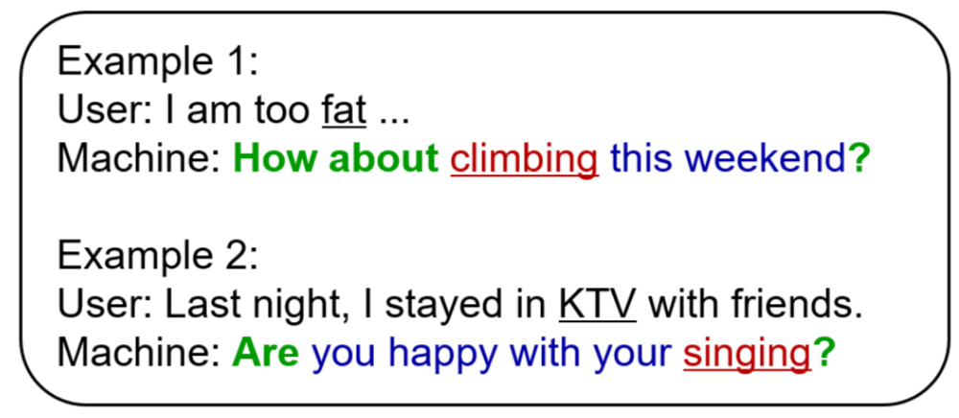
Asking Questions in Conversational Systems
A good question is a natural composition of
Interrogatives for using various questioning patterns
Topic words for addressing interesting yet novel topics
Ordinary words for playing grammar or syntactic roles

Slide 21
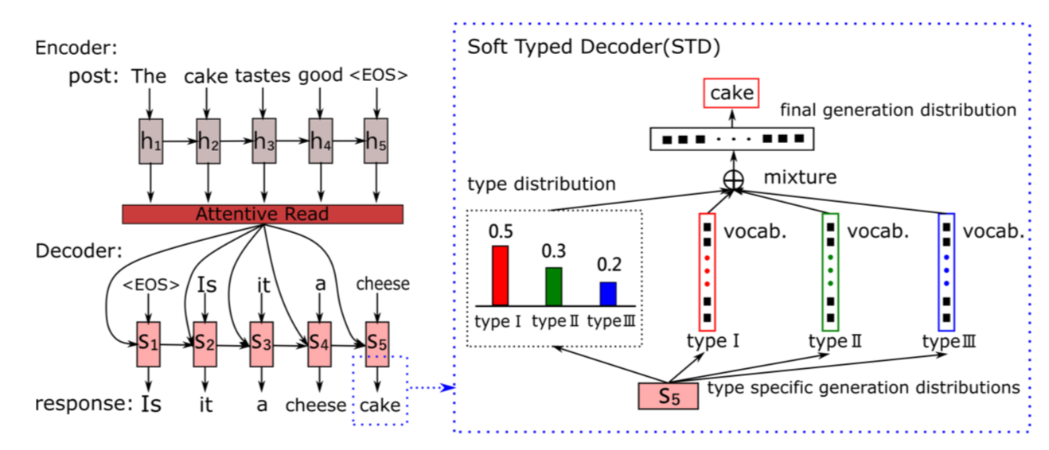
Asking Questions in Conversational Systems
Typed decoders: soft typed decoder

Slide 22
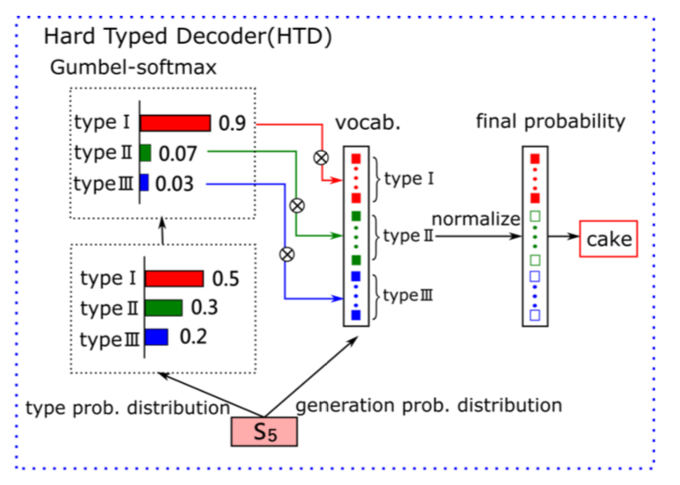
Asking Questions in Conversational Systems
Typed decoders: hard typed decoder
For each post:
A set of interrogatives
A list of topic words
Others for ordinary words
Topic words:
Training -- nouns, verbs
Test – predicted by PMI

Slide 23
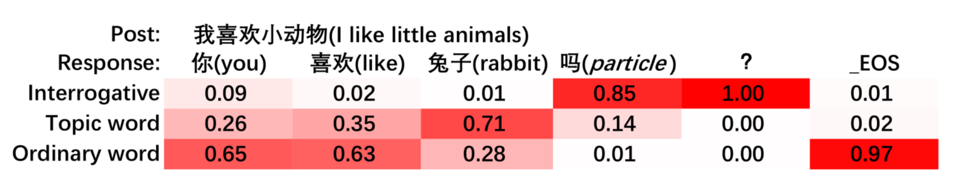
Asking Questions in Conversational Systems
Type prediction at each decoding position
Decoding steps
1
2
3
4
5
6

Slide 24
Interactiveness: Achieving Different Speaking Purposes by Controlling Sentence Function

Slide 25
Controlling Sentence Function
Sentence function indicates different conversational purposes.
Interrogative
Acquire further information from users
(e.g. WHY, WHAT, …)
User: I’m really hungry now.
Imperative
Make requests, instructions or invitations
(e.g. LET’S, PLEASE, …)
Declarative
Make statements to state or explain
(e.g. AND, BUT, …)
Generating Informative Responses with Controlled Sentence Function. ACL 2018.

Slide 26
Controlling Sentence Function
Response with controlled sentence function requires a global plan of function-related, topic and ordinary words.
Interrogative
What did you have at breakfast?
(Acquire further information from users)
User: I’m really hungry now.
Imperative
Let’s have dinner together !
(Make requests, instructions or invitations)
Declarative
Me, too. But you ate too much at lunch.
(Make statements to state or explain)
Function-related words
Topic words
Ordinary words

Slide 27
Controlling Sentence Function
Key differences to other controllable text generation tasks:
Global Control: adjust the global structure of the entire text, including changing word order and word patterns
Compatibility: controllable sentence function + informative content
Solutions:
Continuous Latent Variable: project different sentence functions into different regions in a latent space + capture word patterns within a sentence function
Type Controller: arrange different types of words at proper decoding positions by estimating a distribution over three word types

Slide 28
Semantics: Better Understanding and Generation with Commonsense Knowledge

Slide 29
Commonsense Knowledge
Commonsense knowledge consists of facts about the everyday world, that all humans are expected to know. (Wikipedia)
Lemons are sour
Tree has leafs
Dog has four legs
Commonsense Reasoning ~ Winograd Schema Challenge:
The trophy would not fit in the brown suitcase because it was too big. What was too big?
The trophy would not fit in the brown suitcase because it was too small. What was too small?
Notes:
The main focus of the Paul Allen Institute for Artificial Intelligence ($125 million in 2018)

Slide 30
Commonsense Knowledge in Chatbots
respiratory disease
lung disease
IsA
IsA
asthma
air pollution
Prevented_by
Caused_by
avoiding triggers
Caused_by
chest tightness
Notes:
asthma英 ['æsmə] 美 ['æzmə]
n. [内科][中医] 哮喘，气喘

Slide 31
Commonsense Knowledge in Chatbots
lung disease
respiratory disease
IsA
IsA
asthma
air pollution
Caused_by
Prevented_by
avoiding triggers
Caused_by
chest tightness
Notes:
asthma英 ['æsmə] 美 ['æzmə]
n. [内科][中医] 哮喘，气喘

Slide 32
Commonsense Knowledge in Chatbots
Post: I have an asthma since three years old.
Triples in knowledge graph:
(lung disease, IsA, asthma )
(asthma, Prevented_by, avoiding triggers)
respiratory disease
lung disease
IsA
IsA
asthma
air pollution
Prevented_by
Caused_by
avoiding triggers
Caused_by
From ConceptNet
chest tightness
Notes:
asthma英 ['æsmə] 美 ['æzmə]
n. [内科][中医] 哮喘，气喘

Slide 33
Commonsense Knowledge in Chatbots
Post: I have an asthma since three years old.
Triples in knowledge graph:
(lung disease, IsA, asthma )
(asthma, Prevented_by, avoiding triggers)
Response: I am sorry to hear that. Maybe avoiding
triggers can prevent asthma attacks.
respiratory disease
lung disease
IsA
IsA
asthma
air pollution
Prevented_by
Caused_by
avoiding triggers
Caused_by
From ConceptNet
chest tightness
Notes:
asthma英 ['æsmə] 美 ['æzmə]
n. [内科][中医] 哮喘，气喘

Slide 34
Commonsense Knowledge in Chatbots
Post: I have an asthma since three years old.
Triples in knowledge graph:
(lung disease, IsA, asthma )
(asthma, Prevented_by, avoiding triggers)
Response: I am sorry to hear that. Maybe avoiding
triggers can prevent asthma attacks.
respiratory disease
lung disease
IsA
IsA
asthma
air pollution
Prevented_by
Caused_by
avoiding triggers
Caused_by
From ConceptNet
chest tightness
Notes:
asthma英 ['æsmə] 美 ['æzmə]
n. [内科][中医] 哮喘，气喘

Slide 35
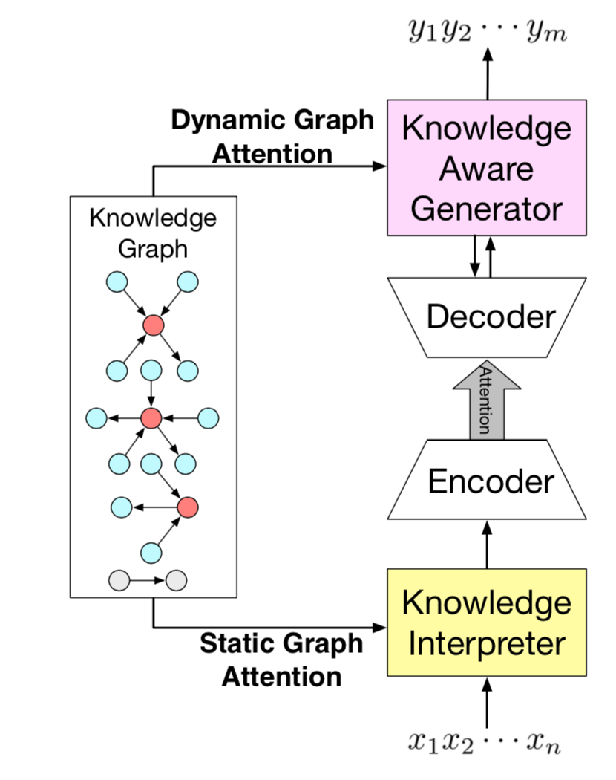
Commonsense Knowledge in Chatbots
Output: Because I’m a brittle man.
Decoding words by attending to knowledge graphs and then to triples
Encoding the retrieved knowledge graphs for each word
Input: why are you so breakable?

Slide 36
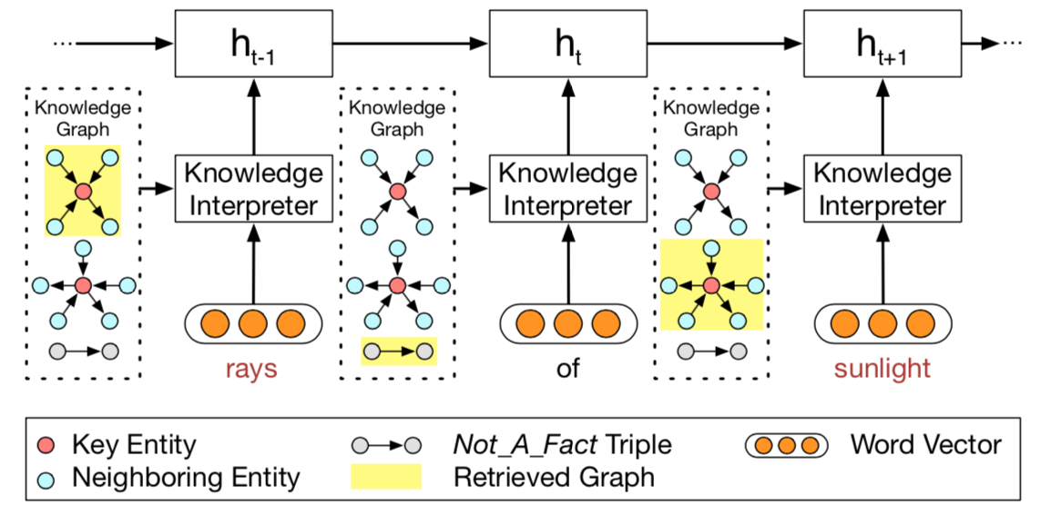
Commonsense Knowledge in Chatbots
Static graph attention: encoding semantics in graph,
Feeding knowledge-enhanced info. into the encoder

Slide 37
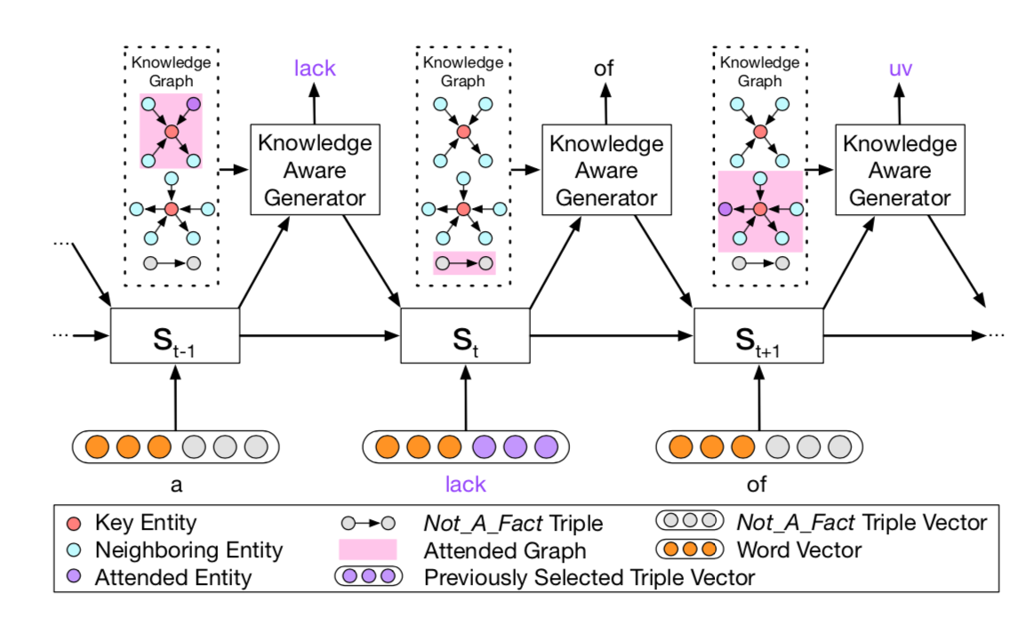
Commonsense Knowledge in Chatbots
Dynamic graph attention: first attend a graph, then to a triple
within that graph, finally generate with the words in a graph

Slide 38
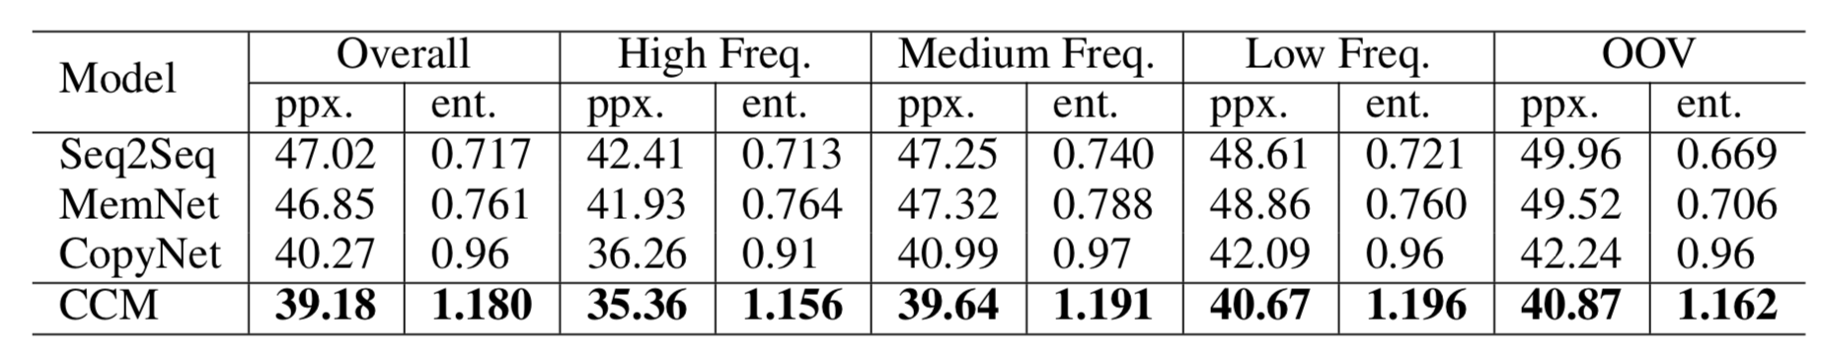
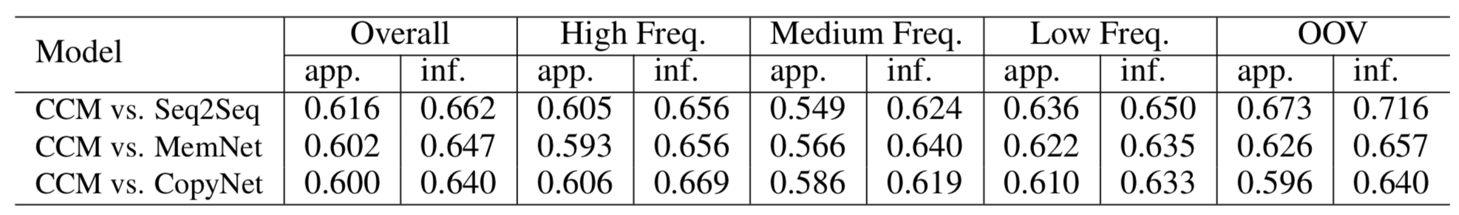
Commonsense Knowledge in Chatbots
Automatic evaluation
Manual evaluation
(Sign-test, p-value<0.005)
Commonsense Knowledge Aware Conversation Generation with Graph Attention. IJCAI-ECAI 2018, Stockholm, Sweden.

Slide 39
Generation Examples 1
Post: He proposed March 5th. We will be married October 10th. So 7 months
Knowledge: (engaged, RelatedTo, married), (wedding, RelatedTo, married), (miss, DistinctFrom, married), (March, RelatedTo, months)
Seq2Seq: I'm not sure how to answer that. I'm not sure how to make a date.
MemNet: I'm assuming he's married to a gay marriage?
CopyNet: I'm sorry, I'm not sure what you mean by that.
CCM: I'm pretty sure he's going to be engaged in the next 6 months.

Slide 40
Logic: Story Ending Generation

Slide 41
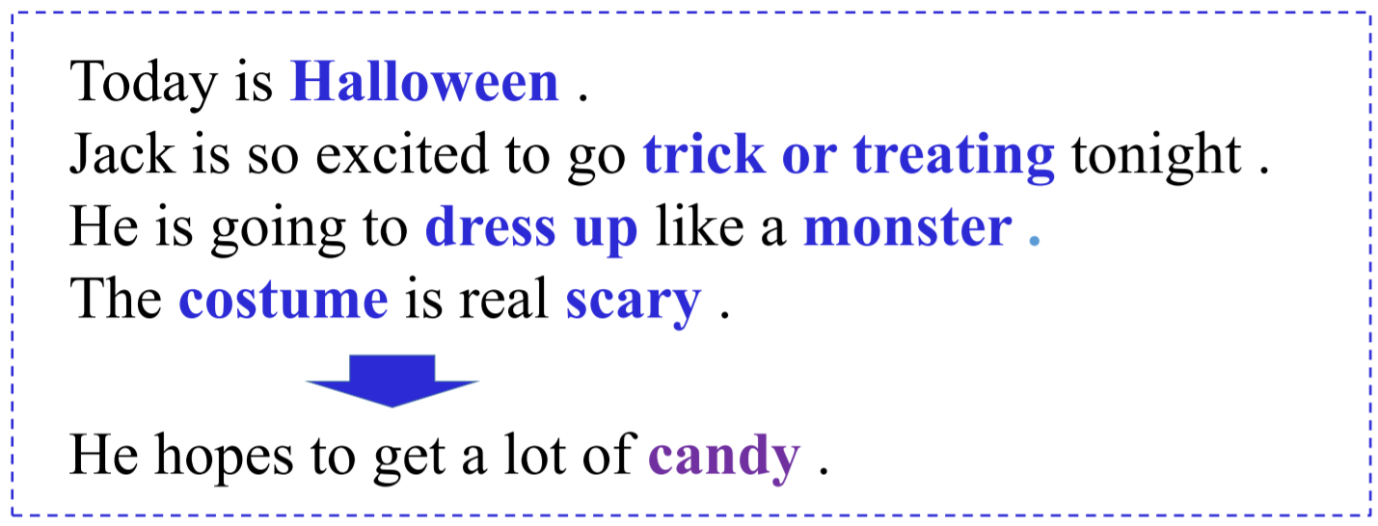
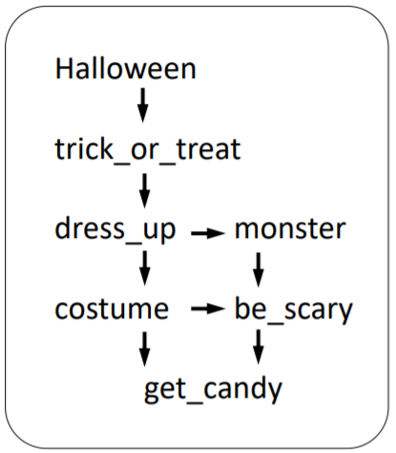
Logic: Story Ending Generation
Find context clues: plan the order of events and entities.
Story Ending Generation with Incremental Encoding and Commonsense Knowledge AAAI 2019
Reported by TechXplore
Notes:
捕获文章逻辑信息的重要两个部分：发掘原文中的逻辑信息，从外部知识库中获取信息。
上：例文，蓝色和紫色分别代表原文和生成结局中的events和entities
左下：常识信息中各个实体间的关系
右下：context clues，各个事件以及实体在文中的出现顺序

Slide 42
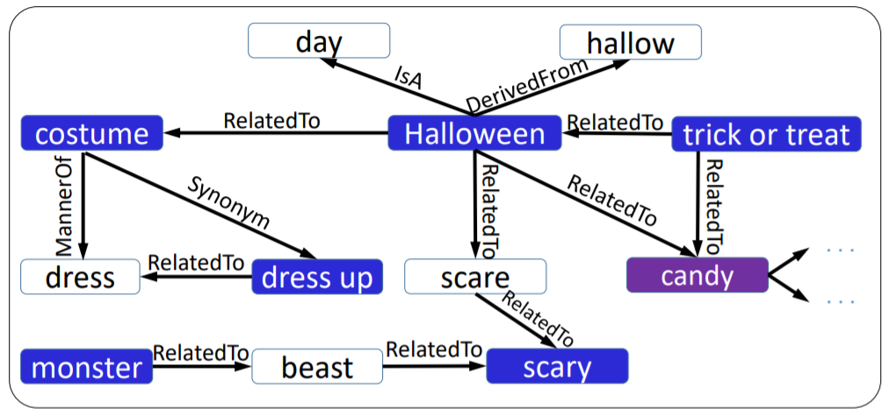
Logic: Story Ending Generation
Commonsense knowledge
Notes:
捕获文章逻辑信息的重要两个部分：发掘原文中的逻辑信息，从外部知识库中获取信息。
上：例文，蓝色和紫色分别代表原文和生成结局中的events和entities
左下：常识信息中各个实体间的关系
右下：context clues，各个事件以及实体在文中的出现顺序

Slide 43
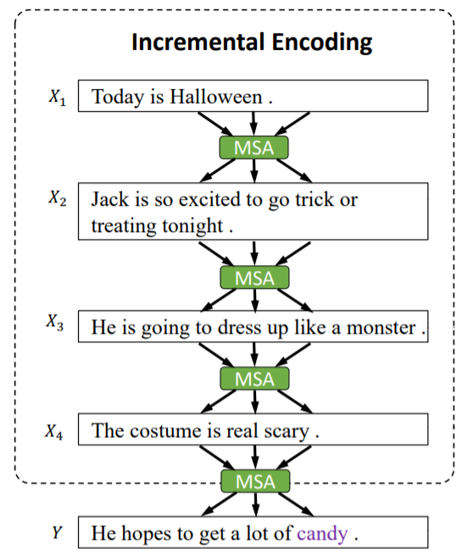
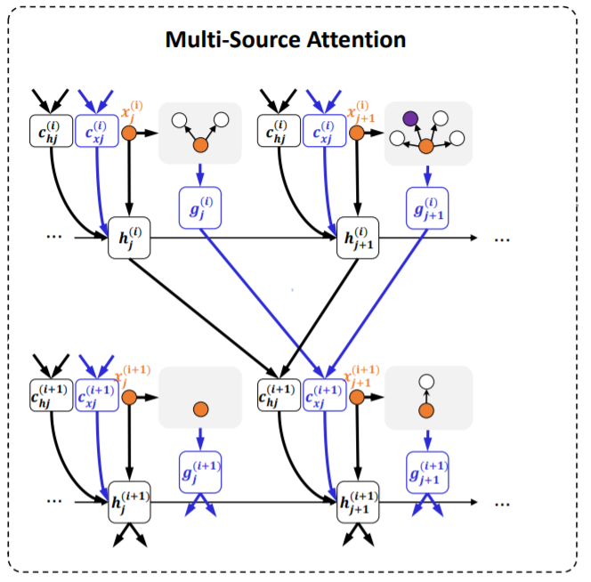
Logic: Story Ending Generation
Incremental Encoding
Multi-Source Attention
Notes:
MSA: multi-source attention, 可以从上文中计算与当前编码的句子相关的部分，以及从知识库中获取信息
亮点在于在故事编码的过程中利用attention传递逻辑信息，在每一个时刻得到当前时刻的context clue，最终在解码的时候使用这个context clue预测正确的event和entity

Slide 44
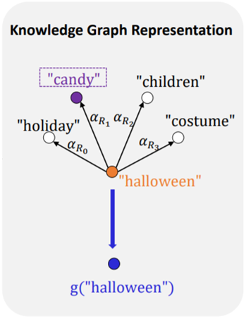
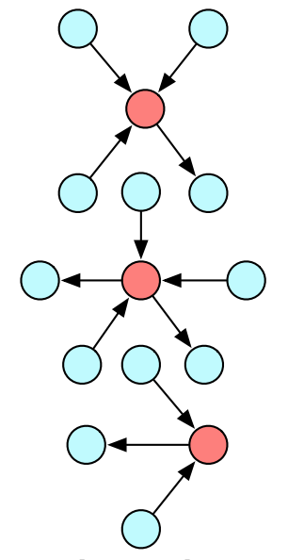
Logic: Story Ending Generation
Attention to the knowledge base: static graph attention
Graph attention
Notes:
这里利用知识库信息的方式，可以使用前面提到的static graph attention，获取文中每个词的一个knowledge representation

Slide 45
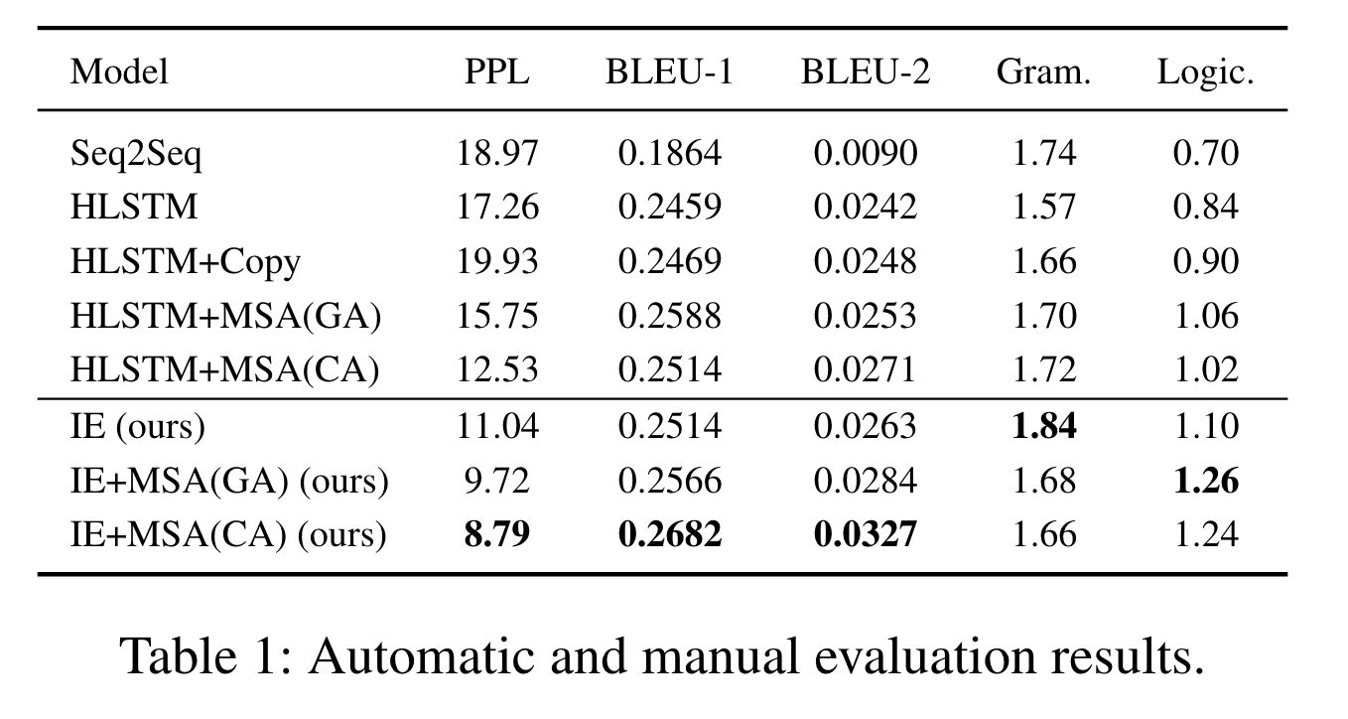
Experiment
ROCStories, 90,000 for training, 8912 for test

Slide 46
Logic: Story Ending Generation
Story 1:
Context:
Taj has never drank an espresso drink.
He ordered one while out with his friends.
The shot of espresso tasted terrible to him.
Taj found that he couldn't stop talking or moving.
Generated Ending:
He decided to never drink again.
Story 2:
Context:
Martha is cooking a special meal for her family.
She wants everything to be just right for when they eat.
Martha perfects everything and puts her dinner into the oven.
Martha goes to lay down for a quick nap.
Generated Ending:
When she gets back to the kitchen, she sees a burning light on the stove.
Notes:
两个例子，蓝色和紫色的是文中表示逻辑的事件

Slide 47
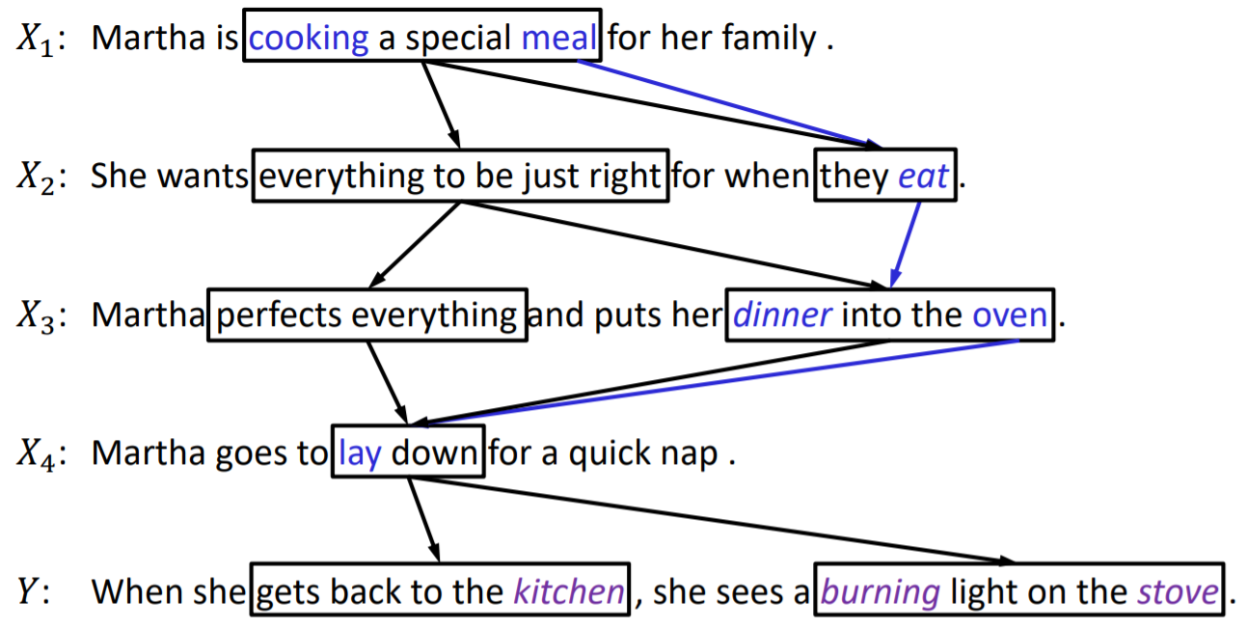
Logic: Story Ending Generation
Building context clues incrementally
Notes:
我们模型对于逻辑事件的捕获能力，箭头表示attention，黑色的是context vector（表示上下文线索），蓝色的是knowledge vector（表示knowledge base中的逻辑线索）

Slide 48
Summary
Semantics, consistency, interactiveness
Emotion, behaviors, personality, and knowledge
Still a long way to go: existing conversational systems are still far from human-like

Slide 49
Future Research Problems
Multi-modality emotion perception and expression (voice, vision, text)
Personality, identity, style→ “human-like robot”
Introvert or extrovert
Personalized (style, or profile)
Learning to learn (lifelong learning)
Grow up from interactions with human partners and environment

Slide 50
Thanks for Your Attention
http://coai.cs.tsinghua.edu.cn/ds/ 对话系统技术平台
Contact:
Minlie Huang, Tsinghua University
aihuang@tsinghua.edu.cn
http://coai.cs.tsinghua.edu.cn/hml

