Slide 1
SLT 2018 Special Session – Microsoft Dialogue Challenge: Building E2E Task-Completion Dialogue Systems.
Agenda
1:00 - 1:10PM | Opening, Jianfeng Gao (MSR)
1:10 – 1:40PM | “Past, Present, and Future of Conversational AI”, Gokhan Tur (Uber)
1:40 – 2:10PM | “Towards Building More Intelligent Conversational System: Semantics, Consistency & Interactiveness”, Minlie Huang (Tsinghua)
2:10 – 2:40PM | “Towards Open-Domain Conversational AI”, Vivian Chen (NTU)
2:40 – 3:00PM | Break
3:00 – 3:20PM | “MS dialogue challenge: result and outlook”, Sungjin Lee (MSR)
3:20 – 3:35PM | “Universe Model: A Human-like User Simulator Based on Dialogue Context”, Sihong Liu (Beijing University of Posts and Telecommunications)
3:35 – 3:50PM | “Double dueling Agent for Dialogue Policy Learning”, Yu-An Wang (NTU)
3:50 – 4:30PM | Panel discussion - Alex Acero (Apple), Vivian Chen (NTU), Minlie Huang (Tsinghua), Sungjin Lee (MSR), Spyros Matsoukas (Amazon), Gokhan Tur (Uber)

Slide 2
Topics we’d like to discuss…
- E2E system evaluation: simulated users, paid users and unpaid users.
- A unified modeling framework for dialogues: rule-based, SL, RL; fully data-driven vs. hybrid.
- Scalable training for task-oriented dialogues
- Dealing with heterogeneous data: chitchat, goal-oriented, non-conversational data
- Incorporating EQ (or empathy) into dialogue: recognize user emotion, generate empathetic responses
- Towards human-level intelligence: understand humans and their surrounding physical world
- Towards an ethical AI bot.
- …
Gao, Galley, Li. 2018. Neural Approaches to Conversational AI. arxiv.org/pdf/1809.08267.pdf

Slide 3
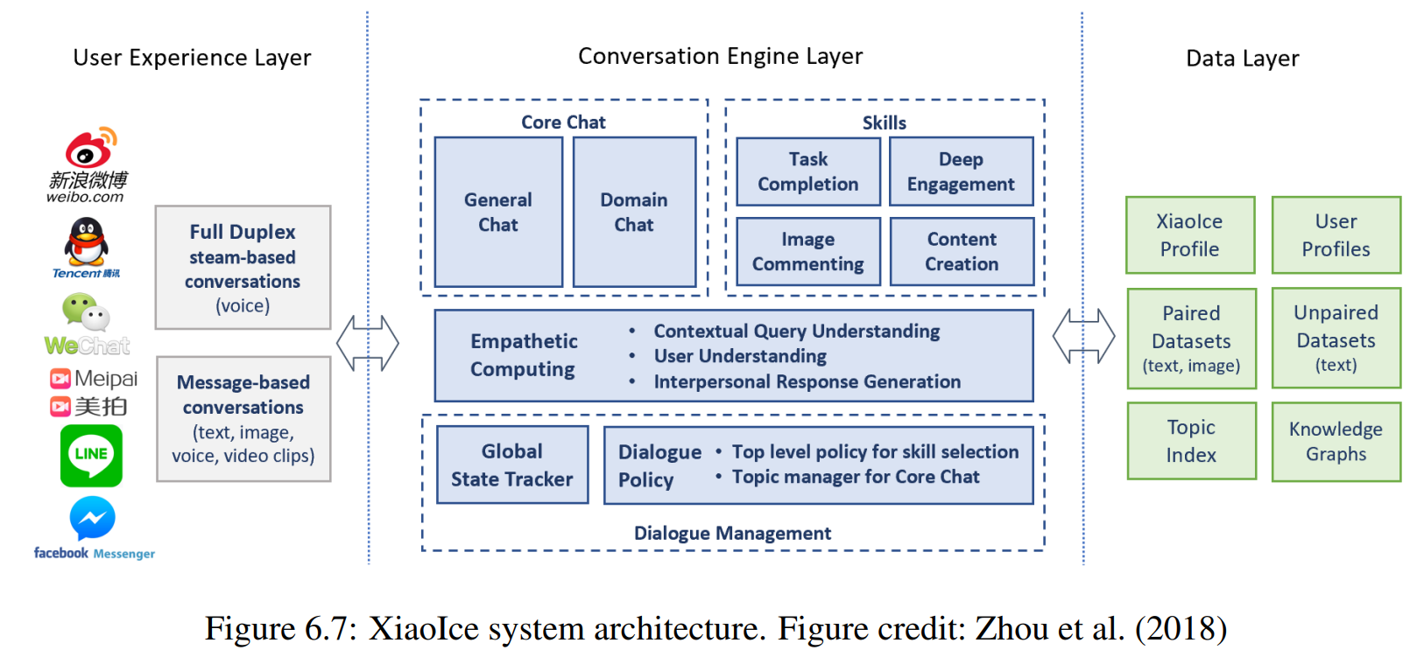
Gao, Galley, Li. 2018. Neural Approaches to Conversational AI. arxiv.org/pdf/1809.08267.pdf

Slide 4


MS Dialogue Challenge
Sungjin Lee, Jianfeng Gao, Xiujun Li, JJ Liu, Sarah Panda

Slide 5
MS Dialogue Challenge
Challenges help the dialogue research community evaluate on common testbeds and advance the technology together.
Previous challenges were largely focused on particular components, trained and tested on static datasets
MS Dialogue Challenge is unique in aiming for end-to-end system evaluation.
User Simulator
Dialog System
User
Model
NLG
NLU
StateTracker
Backend
NLU
NLG
Policy

Slide 6







Real User Evaluation
Real users are vastly different from simulated users.
Unpaid users are again significantly different from paid users (from The Spoken Dialog Challenge).
Paid Users
Dialog System
Unpaid Users

Slide 7

Learning Resources
MS Dialogue Challenge provides different types of learning resources to allow for training various approaches.
State-of-the-art components are available.
Dialog System
Dialog System
Dialog System
NLU
E2E
Neural
Network
StateTracker
StateTracker
Policy
Policy
Pre-train
NLG
NLG

Slide 8
First Challenge Domains
Domains: Movie, Restaurant, Taxi
Human-human dialogs using Amazon Mechanical Turk.
Fully annotated with intents and slot-values
user | Please find me a Japanese restaurant that is open until at least midnight tonight in downtown seattle.
agent | I'm sorry - this is a movie booking service, I am not able to search for restaurants.
user | Oh, show me theaters in southeast portland oregon that are showing star wars the force awakens tonight
agent | You could still catch Star Wars tonight at Regal Lloyd Center, Century Eastport 16, Or Regal Movies on TV Stadium 16. Would you like to book tickets at any of those?
user | That's odd. Someone another person got crossed with me. But sure. Is there a very late showing I could still catch at any of those?
agent | How many tickets would you like?
user | Well, I think it's a little late for tonight. How about 4 tickets, to Regal Lloyd, anytime after 7pm tomorrow night.
agent | Great, I was able to purchase 4 tickets to Star Wars for 3/8 at 9:50 pm at REGAL LLOYD CENTER 10 & IMAX MOVIE TIMES + TICKETS 1510 N.E. Multnomah St., Portland, OR 97232.
user | Perfect. Thank you so much.
Task | #Ints | #Slots | #Dials | #Utters | #Turns
Movie | 11 | 29 | 2890 | 21656 | 7.5
Rest. | 11 | 30 | 4103 | 29720 | 7.3
Taxi | 11 | 19 | 3094 | 23312 | 7.6
Downloadable at https://github.com/xiul-msr/e2e_dialog_challenge/tree/master/data

Slide 9
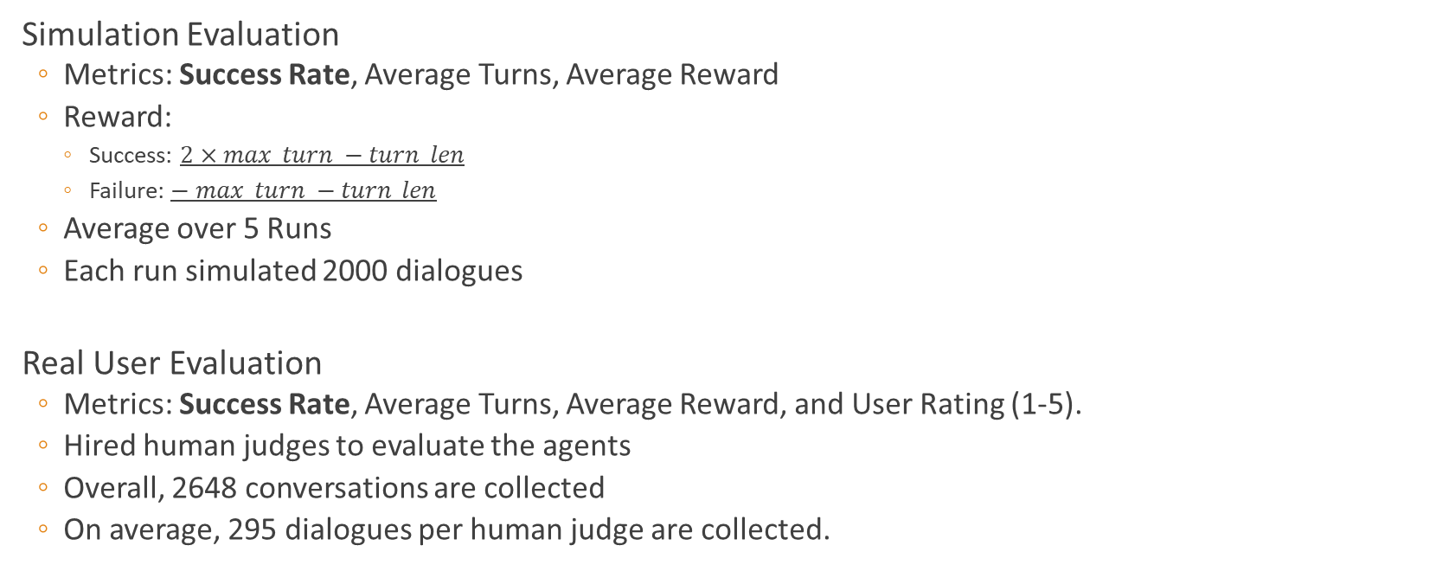
Evaluation
Simulation Evaluation
Metrics: Success Rate, Average Turns, Average Reward
Reward:
Success: $2×max_turn −turn_len$
Failure: $− max_turn −turn_len$
Average over 5 Runs
Each run simulated 2000 dialogues
Real User Evaluation
Metrics: Success Rate, Average Turns, Average Reward, and User Rating (1-5).
Hired human judges to evaluate the agents
Overall, 2648 conversations are collected
On average, 295 dialogues per human judge are collected.

Slide 10
First Challenge Result
Movie Domain Entry | Automatic Success Rate | Human Success Rate | Human Rating
NTU-Double-Q | 41.8% | 31.1% | 2.65
DQN | 44.1% | 30.8% | 2.62
NTU-HDQN | 33.3% | 27.3% | 2.49*
BUPT-Transfer-DDQ | 11.5% | 9.66% | 2.24*
Rule | 6.13% | 6.42% | 1.78*
4 reinforcement learning-based agents and 1 rule-based agent.
Overall, RL-based agents outperform rule-based agent.
The first and second systems in automatic evaluation switch positions in human evaluation.
More details available from participants’ presentation.
No entries for Restaurant and Taxi domain.
*Statistically significant with p<0.05

Slide 11
Next Challenge with Tsinghua University

Slide 12



Movie Bot Interacting with Real Users
Unpaid users are again significantly different from paid users.
Evaluate top-performing movie bots with unpaid real users
Screening
Dialog System
Dialog System

Slide 13
Multi-domain E2E Dialogue System
Multi-domain user simulator based on MultiWOZ extended with uncooperative behavior.
Baseline system based on hierarchical reinforcement learning.
Human evaluation with crowdsourced users.
User Simulator
Dialog System
Hotel
...
Hotel
...
Rest.
Taxi
Rest.
Taxi

Slide 14
Cross-lingual Settings
Chinese as low resource language in the Movie domain.
Build a Chinese bot with a small amount of Chinese dialog data by leveraging all the resources available for English bot.
Human evaluation with crowdsourced users.
Chinese
Data
English
Chinese

Slide 15



Post-Challenge
Data will remain publicly available.
Keep codebase updated with state-of-the-art models
Maintain a leaderboard and continuously evaluate top systems with real users.

Slide 16

Logistics
Jul. 2019
Challenge overview and resource release (ACL/Sigdial)
Nov. 2019
Evaluation, paper submission
Dec 2019
Workshop (ASRU/NeurIPS)

Slide 17

Special thanks to…
SLT for hosting this special session
Our advisory board
Challenge participants

Slide 18
Evaluation
Domain | Agent | Simulation Evaluation |  |  | Human Evaluation
 |  | Success | Reward | Turn | Success | Reward | Turn | Rating
Movie | Double Q | 41.8% | -2.73 | 19.59 | 31.1% | -18.15 | 31.31 | 2.65
 | DQN | 44.1% | 0.93 | 18.85 | 30.8% | -18.08 | 26.09 | 2.62
 | HDQN | 33.3% | -15.60 | 32.39 | 27.3% | -23.47 | 32.39 | 2.49
 | Transfer-DDQ | 11.5% | -35.75 | 16.18 | 9.66% | -36.51 | 16.13 | 2.24
 | Rule | 6.13% | -42.38 | 20.0 | 6.42% | -41.29 | 18.0 | 1.78
Restaurant | DQN | 30.18% | 0.70 | 22.32 | 22.9% | -22.53 | 26.67 | 2.35
 | Rule | 7.22% | -24.50 | 18.00 | 6.85% | -32.02 | 16.02 | 1.94
Taxi | DQN | 43.5% | 0.26 | 22.60 | 25.2% | -19.88 | 25.09 | 2.38
 | Rule | 12.2% | -31.00 | 22.00 | 8.70% | -32.21 | 19.98 | 1.71

