Slide 1
Universe Model: A Human-like User Simulator Based on Dialogue Context
Sihong Liu, Keqing He, Weiran Xu
Beijing University of Posts and Telecommunications
Dec 18, SLT 2018

Slide 2
Outline
Introduction
Model
Experiments
Conculsion and future work

Slide 3
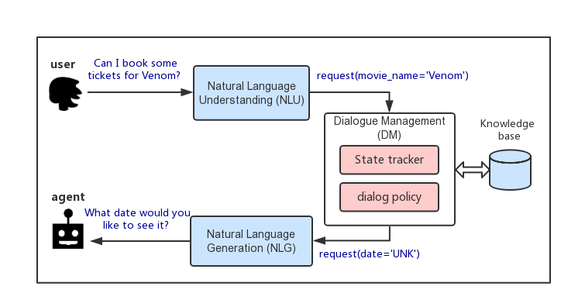
Task-oriented dialogue system

Slide 4
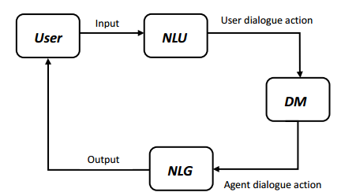
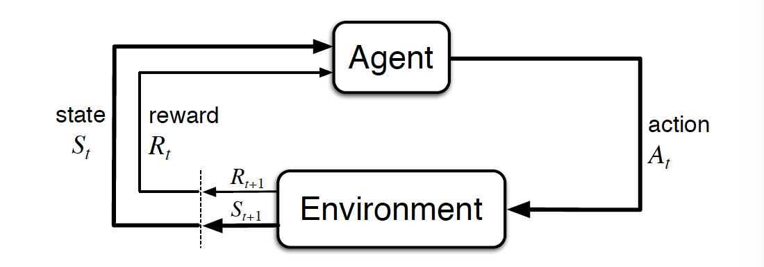
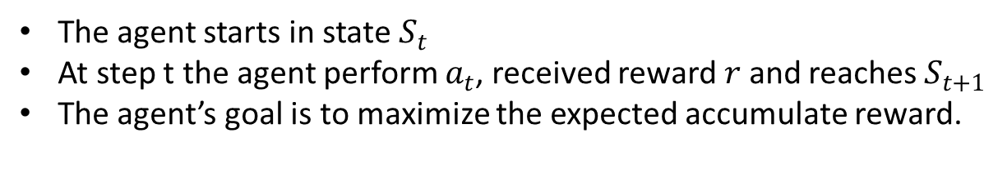
RL in dialog system
RL process : state, action, reward
The agent starts in state $S_{t}$
At step t the agent perform $a_{t}$, received reward $r$ and reaches $S_{t+1}$
The agent’s goal is to maximize the expected accumulate reward.

Slide 5
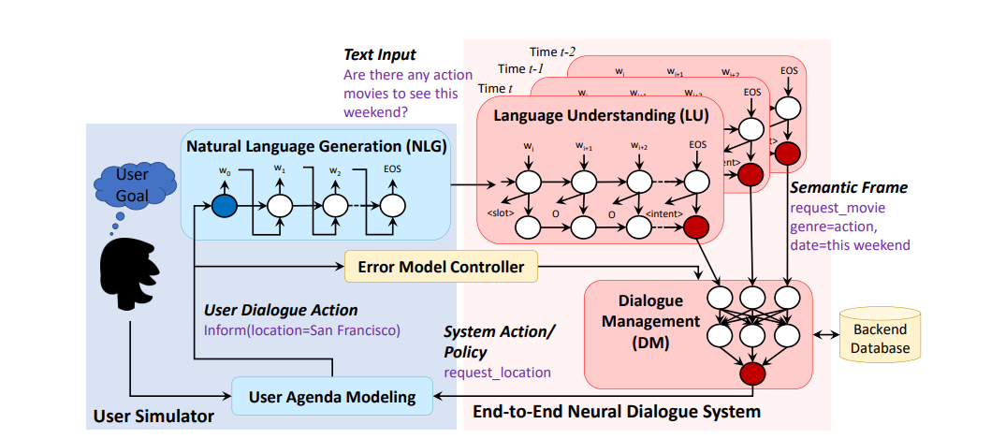
User simulator
Challenge:
RL require interaction with the environment.
The collecting of real experience is expensive and time consuming.
Solution:
User simulator [Schatzmann et al., 2007]
Mimic what a real user does in a conversation
Provide environment for RL agent
Figure 1 End-to-end neural dialogue system with a user simulator [Li+ 17]

Slide 6
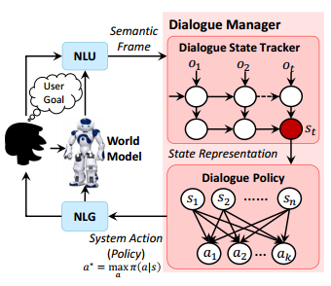
User simulator: exsiting methods
Rule based
Pros
Unlimited amount of training data for RL agent without any cost.
Cons
Rough approximation of real users
Real conversation is more complex
Model based
Learn from the limited real experience:
DDQ - world model [Peng et al.,2017 ]
Insufficient context informations
Figure 2: Illustration of the task-completion DDQ dialogue agent. [Peng et al.,2017 ]

Slide 7
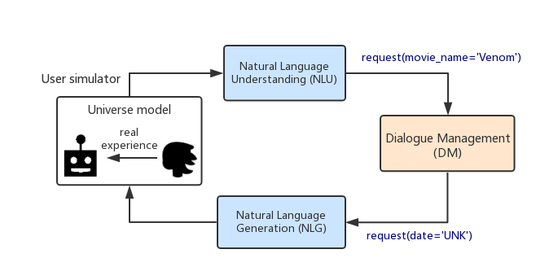
Our proposed model : Universe model

Slide 8
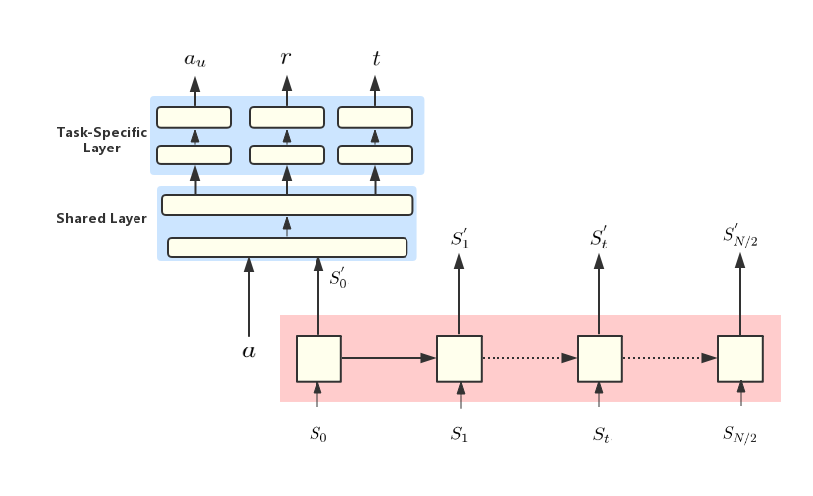
The universe model architecture
RNN + Multi task learning
Input :
Current and previous state
Output :
User action, reward, terminate signal

Slide 9




Universe model
User: | Can I book some tickets for Venom?
Agent: | What date would you like to see it?
User: | I want to set it up tomorrow.
Agent: | Which theater would you like?
User: | I want to watch at regal meridian 16.
Agent: | What time would you like to see it?
User: | 9:25 pm.
Agent: | How many tickets do you need?
User: | 2 tickets please!
Agent: | Great - I was able to purchase 2 tickets for you to see Venom tomorrow at regal meridian 16 theater at 9:25 pm.
.
.
.
Context information learning
Multi task learning
Input: $a, {S′}_{t}$
Output:${ a}_{u}, r,t$
$$S_{t−1}$$
$S_{0}$,${ S}_{1}, …S_{t−1},S_{t}…, S_{N/2}$
$$S_{t}$$
.
.
.

Slide 10
Experimental results
The simulating performance of different user simulators
User simulators | Reward acc | Term acc | User action acc
Original world model from DDQ(5) | 0.419 | 0.984 | 0.736
Transferred world model | 0.934 | 0.983 | 0.891
Universe model | 0.951 | 0.991 | 0.95
The performance of different simulators on the same dialogue system
User simulator | Dialog avg reward | Dialog avg turns | Dialog success acc
Original world model from DDQ(5) | 45.11 | 19.94 | 0.784
Transferred world model | 53.93 | 11.73 | 0.823
Universe model | 55.26 | 11.85 | 0.851

Slide 11
Conclusion and Future work
Universe model :
Provide a more human-like environment and generate unlimited training data for RL-based dialogue system to interact with.
Future work:
Narrow the gap between the human and user simulator to improve the human evaluation.
And It’s still a challenge for universe model to predict more complex dialogues.

Slide 12
Thank you!

