Slide 1

Double Dueling Agent
for Dialogue Policy Learning
Yu-An Wang
https://github.com/MiuLab/E2EDialog

Slide 2
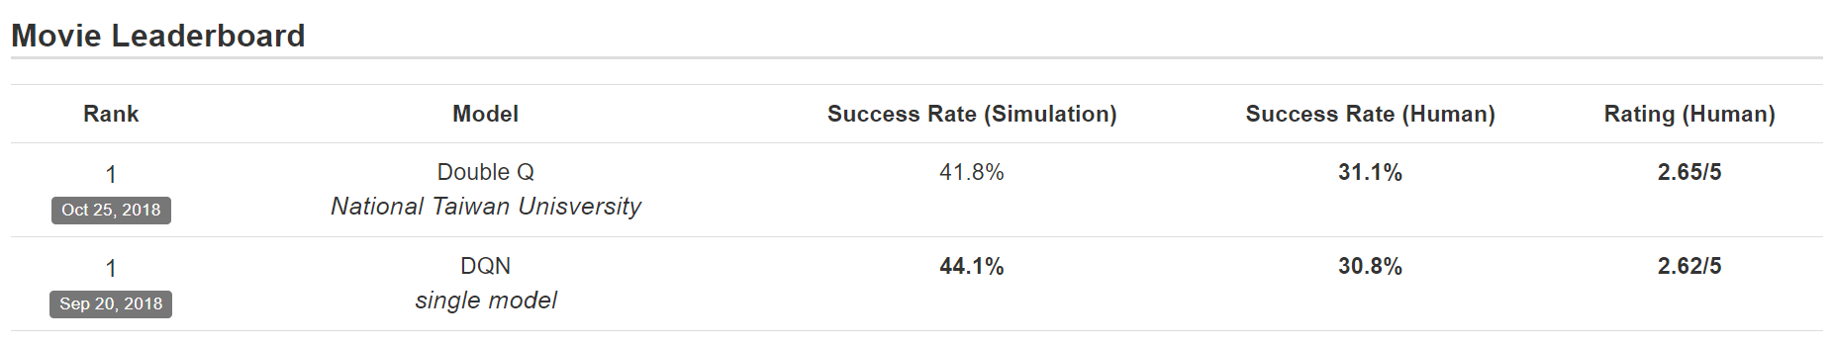
Microsoft Dialogue Challenge
Double Dueling DQN

Slide 3
Outline
Variants of DQN
DQN
Double DQN
Dueling DQN
Prioritized DQN
Distributional DQN
Exploration Strategies
Noisy DQN
Curiosity-based Exploration
Experiments On Task-completion Dialogue Policy

Slide 4
What is the BEST RL Algorithm
for Dialogue Policy?
There are too many RL algorithms: Policy Gradient, Actor-Critic, DDPG, PPO, DQN, DDQN, Distributional DQN…...etc

Slide 5
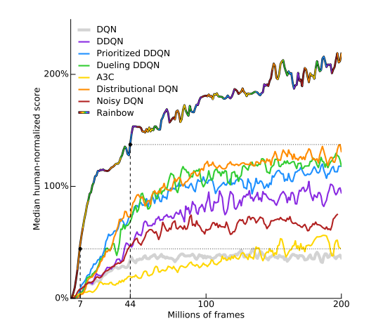
Rainbow
Combine 5 variants of DQN and test on Atari 2600
https://arxiv.org/pdf/1710.02298.pdf

Slide 6
Deep Q-Networks (DQN)
Value-based RL algorithm
Learn a Q-Value function obeys a Bellman Equation
Loss Function

Slide 7

Double DQN and Dueling DQN
Double DQN: Decouple selection and evaluation
Dueling DQN: Split Q-value into advantage function and value function

Slide 8

Distributional DQN (Categorical DQN)
Learn the distribution of value function
Use a set of atoms to model a discrete distribution
Project the target distribution on the support vector, then minimize KL-divergence

Slide 9


Prioritized DQN
Assign every transition a priority in replay buffer
Sample transitions with probability according to priorities

Slide 10
Exploration Strategies
Noisy Network
Curiosity-based Exploration

Slide 11
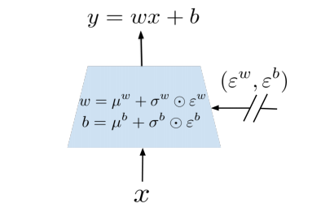
Noisy DQN
Add noise in linear layer to induce stochastic exploration

Slide 12
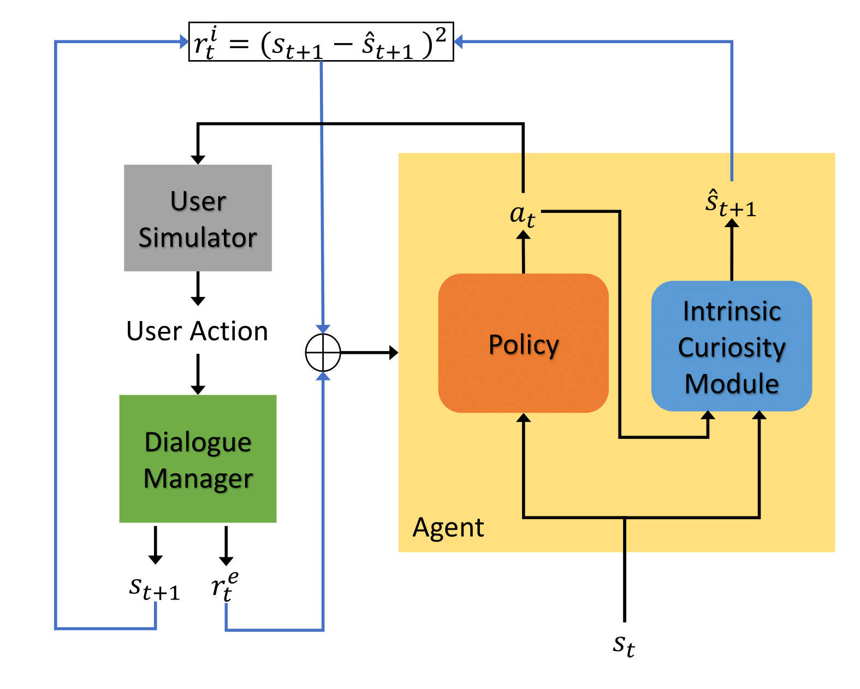
Curiosity-based Exploration
Use error of next state’s prediction as intrinsic reward
High error -> the state is novel for the agent

Slide 13
Experiments
Variants of DQN
Exploration strategies

Slide 14
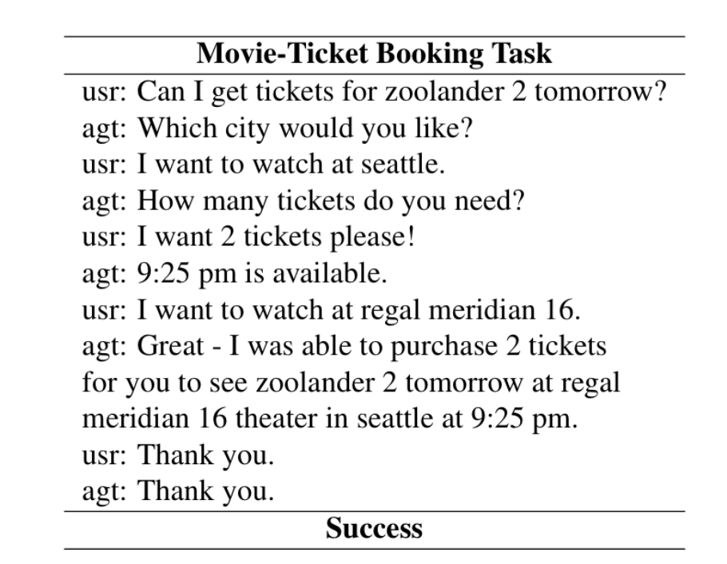
Setup
Task: Movie-Ticket Booking
Each model trained 5 times with different random seeds

Slide 15
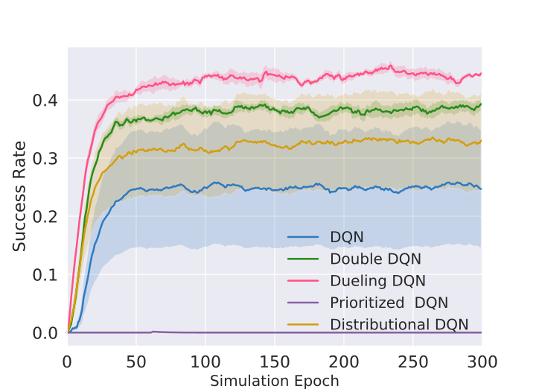
Variants of DQN
Dueling DQN performs best
DQN and Distributional DQN sometimes fail
Prioritized DQN always fails
Final choice: Double + Dueling

Slide 16
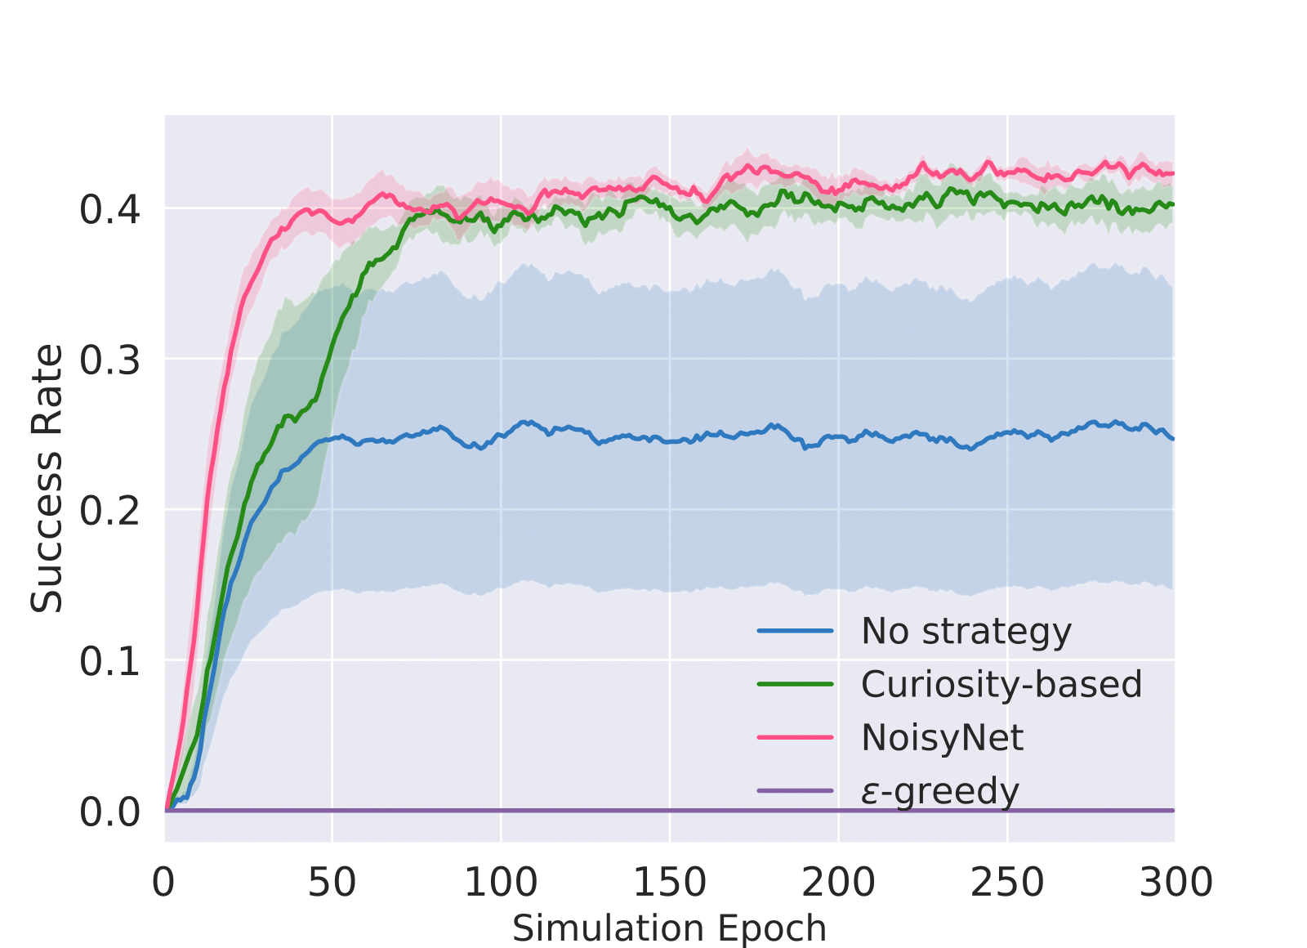
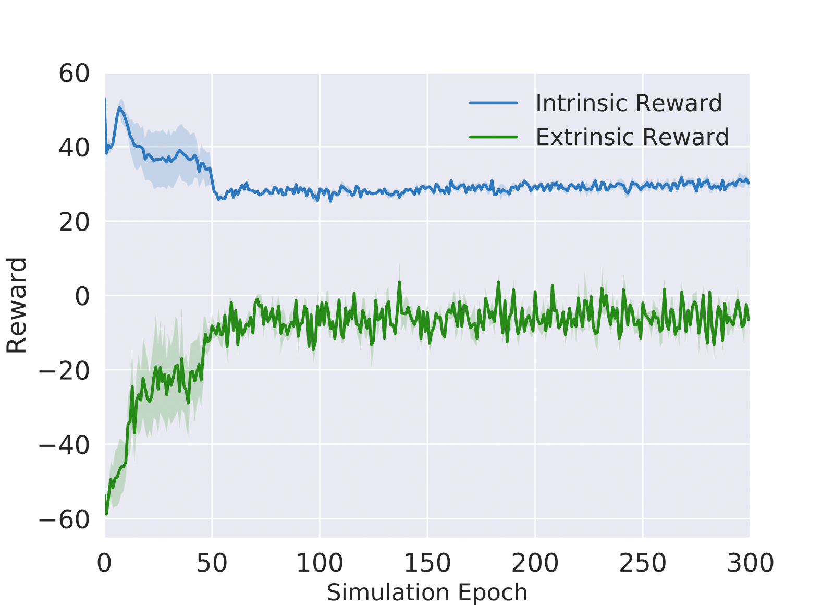
Exploration Strategies
Choosing a suitable exploration strategy can make training more stable

Slide 17
Conclusions
Dueling DQN performs best in this task
Suitable exploration strategies can make training more stable

Slide 18

Thanks for Listening
The code is available here: https://github.com/MiuLab/E2EDialog
The paper with more details Investigating Variants of Deep Q-Networks for Task-Completion Dialogue Policy will be available on arxiv soon.

Slide 19
References
Hessel, Matteo, et al. "Rainbow: Combining improvements in deep reinforcement learning." arXiv preprint arXiv:1710.02298 (2017).
Van Hasselt, Hado, Arthur Guez, and David Silver. "Deep Reinforcement Learning with Double Q-Learning." AAAI. Vol. 2. 2016.
Wang, Ziyu, et al. "Dueling network architectures for deep reinforcement learning." arXiv preprint arXiv:1511.06581 (2015).
Schaul, Tom, et al. "Prioritized experience replay." arXiv preprint arXiv:1511.05952 (2015).
Bellemare, Marc G., Will Dabney, and Rémi Munos. "A distributional perspective on reinforcement learning." arXiv preprint arXiv:1707.06887 (2017).
Fortunato, Meire, et al. "Noisy networks for exploration." arXiv preprint arXiv:1706.10295 (2017).
Pathak, Deepak, et al. "Curiosity-driven exploration by self-supervised prediction." International Conference on Machine Learning (ICML). Vol. 2017. 2017.

