Slide 1

Design and Analysis of Algorithms
Dinesh Singh
Department of Computer Science & Engineering

Slide 2
DESIGN AND ANALYSIS OF ALGORITHMS
Heaps and Heap sort
Dinesh Singh
Department of Computer Science & Engineering

Slide 3
Design and Analysis of Algorithms
Heap and Heap Sort
Heaps and Heapsort
Heap: a partially ordered data structure
• Efficient for implementing priority queues
• Priority queue: multiset of elements with priorities
• Main operations:
  Find item with highest priority
  Delete item with highest priority
  Insert a new item

Slide 4
Design and Analysis of Algorithms
Heap and Heap Sort
Applications of Priority Queues and Heaps
Used in operating system scheduling
• Used in network traffic management
• Important algorithms using heaps:
  Prim’s Algorithm
  Dijkstra’s Algorithm
  Huffman Coding
Heaps are also used in Heapsort

Slide 5
Design and Analysis of Algorithms
Heap and Heap Sort
Definition of a Heap
A heap is a binary tree with one key per node satisfying:
1. Shape Property
• The binary tree is essentially complete
• All levels are full except possibly the last
• The last level is filled from left to right
2. Heap Property
  • The key in each node is ≥ the keys in its children
  • Root always contains the largest key
  • Keys decrease along any root-to-leaf path
  • No left-to-right ordering between nodes at the same level

Slide 6
Design and Analysis of Algorithms
Heap and Heap Sort
Important Properties of Heaps
Exactly one essentially complete binary tree exists with n nodes
• Height of heap = ⌊log₂ n⌋
• Root contains the largest element
• Any subtree of a heap is also a heap
Array Representation of a Heap
Heap elements can be stored in an array
• Stored in top-down, left-to-right order
• Array positions: 1 to n
• Parents occupy first ⌊n/2⌋ positions
• Leaves occupy the last ⌈n/2⌉ positions

Slide 7
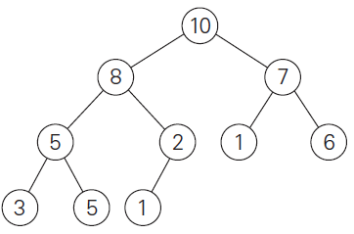
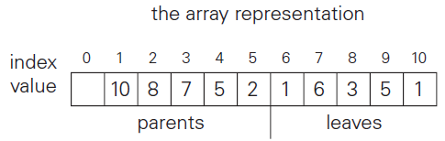
Design and Analysis of Algorithms
Heap and Heap Sort

Slide 8
Design and Analysis of Algorithms
Heap and Heap Sort
Parent–Child Relationships in Array
For a node at position i:
  • Left child → 2i
  • Right child → 2i + 1
  • Parent → ⌊i/2⌋
Heap condition:
H[i] ≥ max(H[2i], H[2i+1]) for i = 1 … ⌊n/2⌋

Slide 9
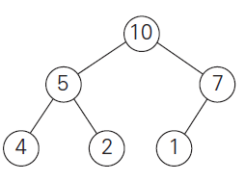
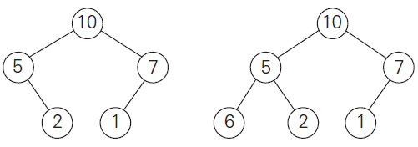
Design and Analysis of Algorithms
Heap and Heap Sort
Which of the following are heaps?

Slide 10
Design and Analysis of Algorithms
Heap and Heap Sort
Heap Construction (Bottom‑Up Method)
Two main ways to construct a heap:
• Top‑down construction
• Bottom‑up construction
Bottom‑up heap construction starts with an unordered complete binary tree and converts it into a heap by applying heapify from the last internal node up to the root.

Slide 11
Design and Analysis of Algorithms
Heap and Heap Sort
Idea of Bottom‑Up Heap Construction
Treat the input array as a complete binary tree.
• Start with the last parent node.
• Apply heapify to enforce heap property.
• Move upward level by level.
• Repeat until the root node is processed.
This ensures the entire structure satisfies the heap property

Slide 12
Design and Analysis of Algorithms
Heap and Heap Sort
Heapify Process
For a node k:
• Compare the node with its children.
• Identify the larger child (for max‑heap).
• If the child is larger, Move the child up to position of parent.
• Continue this process until the node reaches a position where the heap property is satisfied.

Slide 13
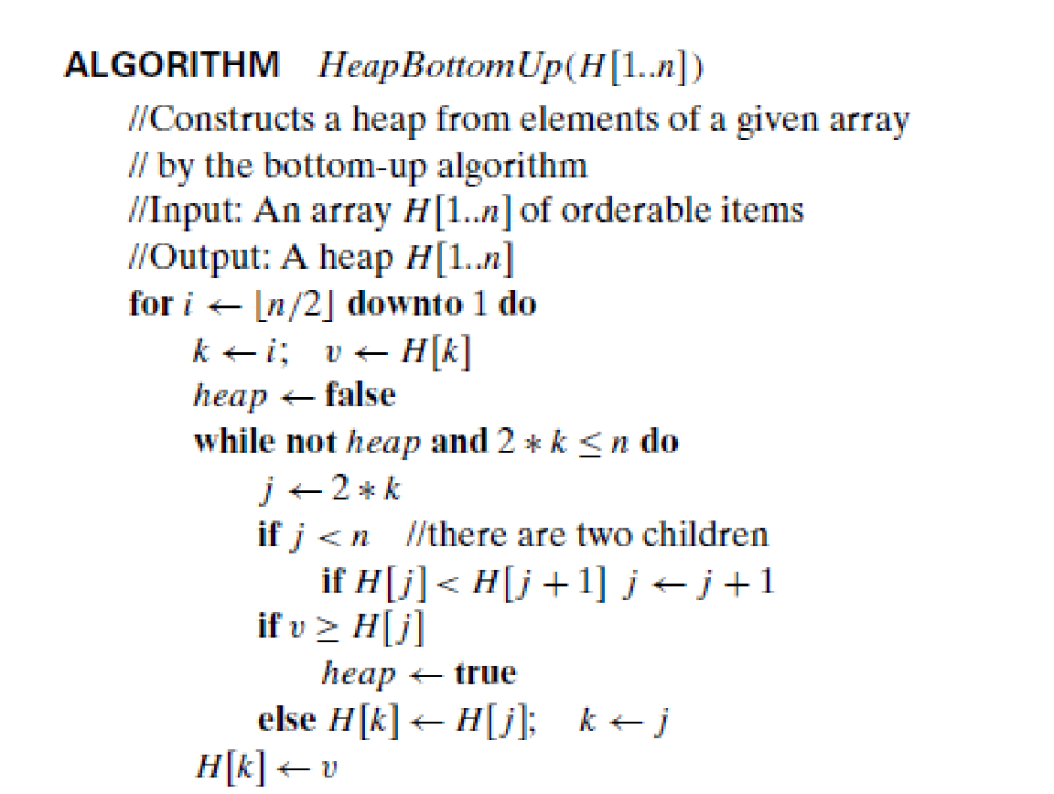
Design and Analysis of Algorithms
Heap and Heap Sort
Bottom‑Up Heap Construction Algorithm

Slide 14
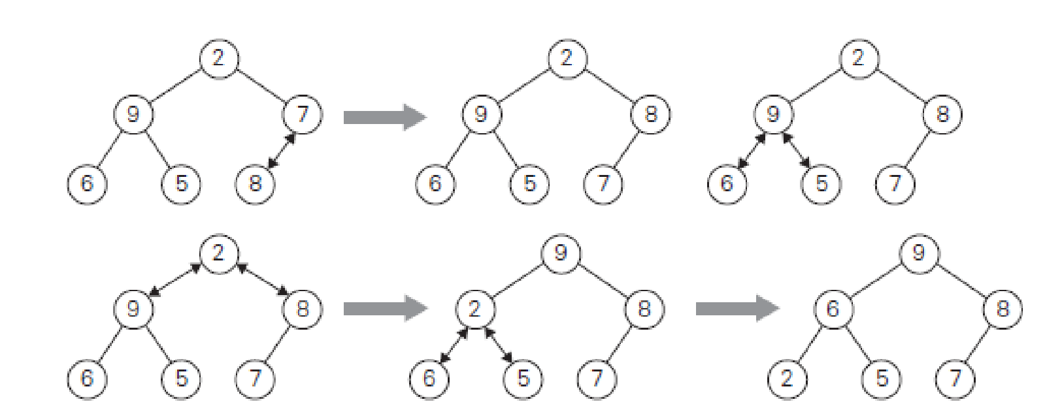
Design and Analysis of Algorithms
Heap and Heap Sort
Example of Bottom‑Up Heap Construction
Example list: 2, 9, 7, 6, 5, 8

Slide 15
Design and Analysis of Algorithms
Heap and Heap Sort
Efficiency
Assume the heap is a complete binary tree.
Number of nodes: n = 2^{(h+1)} − 1
Height of heap:
h = log₂(n + 1) − 1

Slide 16
Design and Analysis of Algorithms
Heap and Heap Sort
In the worst case, a node may travel from its level to the leaf level.
At each level:
• One comparison to find the larger child
• One comparison to check heap condition
Total Number of key comparisons for a node at level i: 2(h − i)

Slide 17
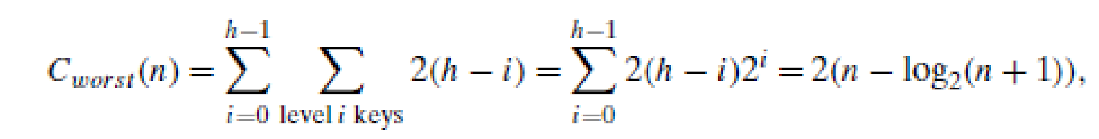
Design and Analysis of Algorithms
Heap and Heap Sort
Total number of key comparisons in worst case:
Efficiency of Bottom‑Up Heap Construction
Worst‑case comparisons < 2n
• Time complexity: Θ(n)

Slide 18
Design and Analysis of Algorithms
Heap and Heap Sort
Top-Down Heap Construction
An alternative way to build a heap is by inserting elements one by one.
This method is called the Top-Down Heap Construction algorithm.
It constructs the heap by successive insertions into an existing heap
Start with an empty heap.
• Insert elements sequentially.
• Each new element is inserted at the last leaf position.
• Restore the heap property by moving the element upward.
This upward movement is called 'sift-up' or 'bubble-up

Slide 19
Design and Analysis of Algorithms
Heap and Heap Sort
Insertion Procedure
Step 1: Insert the new key K at the next available leaf position.
Step 2: Compare K with its parent.
Step 3: If parent ≥ K, stop (heap property satisfied).
Step 4: Otherwise swap K with its parent.
Step 5: Continue until K reaches correct position or root.

Slide 20
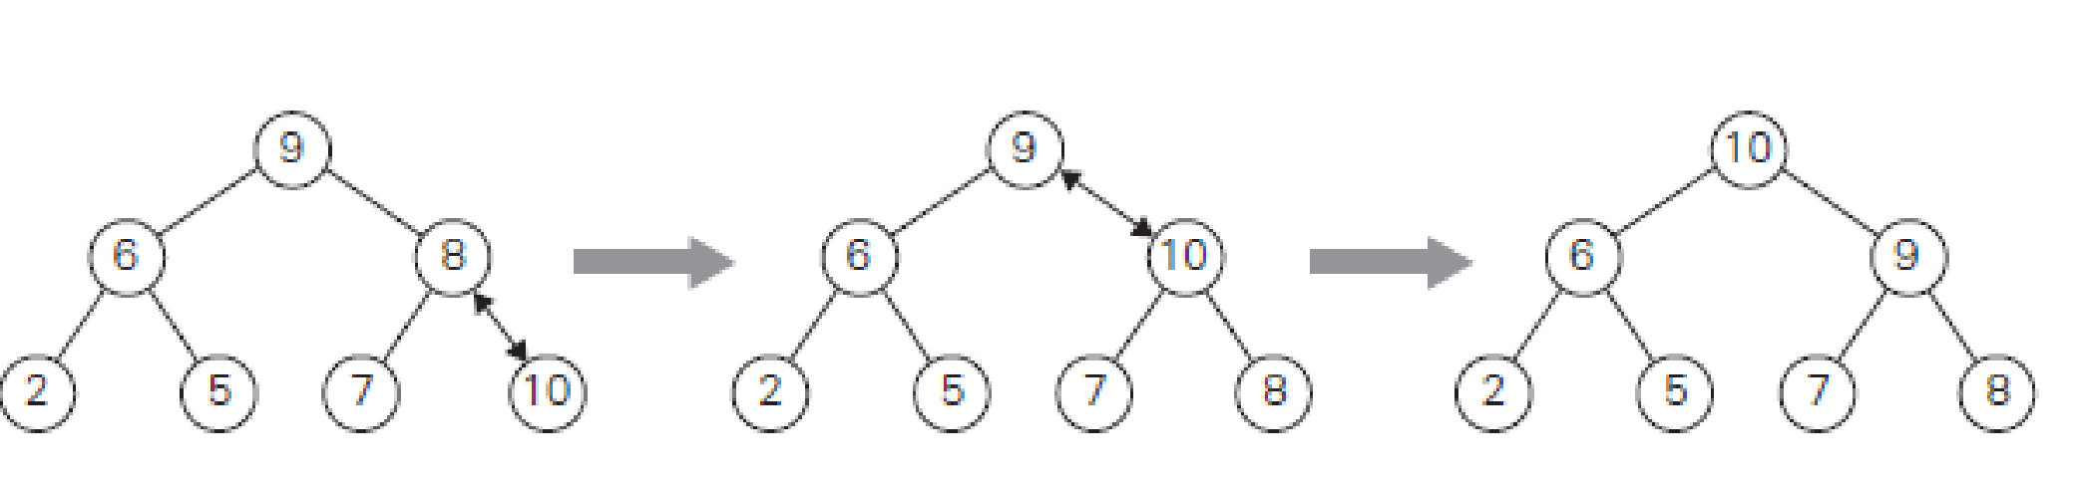
Design and Analysis of Algorithms
Heap and Heap Sort
Suppose we insert elements one by one into a heap.
For each insertion:
• Element is placed at the leaf.
• It moves upward until heap property holds.
This gradually builds the heap from top to bottom.
Example inserting 10

Slide 21
Design and Analysis of Algorithms
Heap and Heap Sort
Time Complexity :
For each insertion:
• In worst case, element moves from leaf to root.
• Height of heap = log₂ n.
Therefore:
Worst case per insertion = ϴ(log n)

Slide 22
Design and Analysis of Algorithms
Heap and Heap Sort
Deletion in a Heap
Deleting an element from a heap usually refers to deleting the root element.
This is the most common operation because the root stores the maximum (in a max-heap) or minimum (in a min-heap) element.
The deletion process maintains the heap property after removing the root

Slide 23
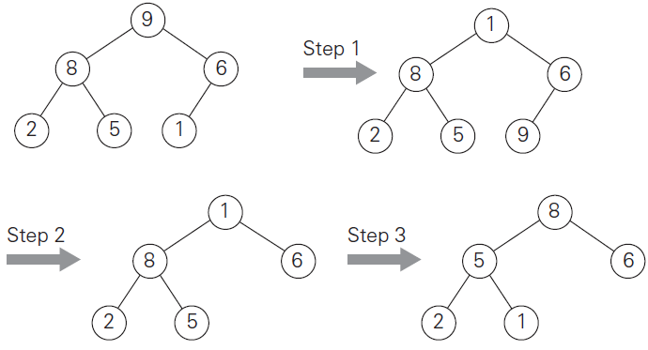
Design and Analysis of Algorithms
Heap and Heap Sort
Maximum Key Deletion from a Heap
Step 1: Exchange the root key with the last key of the heap.
Step 2: Decrease the heap size by 1.
Step 3: Restore the heap property by performing heapify (sifting the element down the tree).

Slide 24
Design and Analysis of Algorithms
Heap and Heap Sort
Heapify after Deletion
After swapping the root with the last element:
• Check the parent dominance condition.
• If the heap property holds, stop.
• Otherwise, swap the element with the larger of its children.
• Continue until the heap property is satisfied.

Slide 25
Design and Analysis of Algorithms
Heap and Heap Sort
Heapify(H[1..n])
{
k=1; v=H[k]
heap=false
while not heap and 2*k<=n do
{
j=2*k
if j<n
if(H[j] < H[j+1]) j=j+1;
if (v >H[j])
heap=true
else
H[k]=H[j]; k=j;
}
H[k]=v
}

Slide 26
Design and Analysis of Algorithms
Heap and Heap Sort
Time Complexity of Deletion
The efficiency of deletion depends on the number of comparisons needed during heapify.
In the worst case, the element travels from the root to a leaf.
Height of heap = log₂ n.
Therefore, deletion takes ϴ(log n) time.

Slide 27
Design and Analysis of Algorithms
Heap and Heap Sort
Heapsort
Heapsort is a sorting algorithm discovered by J. W. Williams.
It works in two main stages:
1. Heap construction
2. Repeated deletion of the maximum element.
Stage 1: Heap Construction
Construct a heap for the given array.
This step can be done using the bottom-up heap construction algorithm.
Time complexity of heap construction = ϴ (n).

Slide 28
Design and Analysis of Algorithms
Heap and Heap Sort
Stage 2: Maximum Deletions.
Apply the root deletion operation repeatedly.
Delete the maximum element n − 1 times.
Each deletion places the removed element at the end of the array.
Because the deleted elements are placed at the end of the array, the final array becomes sorted in increasing order.
Heapsort is an in-place sorting algorithm and does not require extra storage.

Slide 29
Design and Analysis of Algorithms
Heap and Heap Sort
HeapSort(H[1..n])
{
HeapBottomUp(H[1..n]) //Construct heap
for i ← n downto 2 do
H[1] ↔ H[i] //H[1] has the max element.
Heapify(H[1..i-1]) //Shift down H[1]
}
Time Complexity of Heapsort.
Stage 1: Heap Construction = ϴ (n)
Stage 2: Repeated deletions = ϴ(n log n)

Slide 30
Design and Analysis of Algorithms
Heap and Heap Sort
Key Comparisons During Root Deletions
Let C(n) be the number of comparisons required to eliminate the root keys from heaps of sizes n, n−1, n−2, ..., 2.
For a heap of size k, the height of the heap is approximately log₂k. Heapify requires at most about 2 log₂k comparisons.
Expression for Total Comparisons
The total number of comparisons satisfies the inequality:
C(n) ≤ 2⌊log₂(n−1)⌋ + 2⌊log₂(n−2)⌋ + ... + 2⌊log₂2⌋
This can be bounded as:
C(n) ≤ 2 Σ (from i=1 to n−1) log₂i

Slide 31
Design and Analysis of Algorithms
Heap and Heap Sort
Upper Bound Simplification
Since log₂ i ≤ log₂(n−1), we obtain:
C(n) ≤ 2 Σ (from i=1 to n−1) log₂(n−1)
C(n) = 2(n−1) log₂(n−1)
Final Complexity Result
Because (n−1)log₂(n−1) ≤ n log₂ n, we get:
C(n) ≤ 2n log₂ n
Therefore:
C(n) ∈ ϴ(n log n)

Slide 32
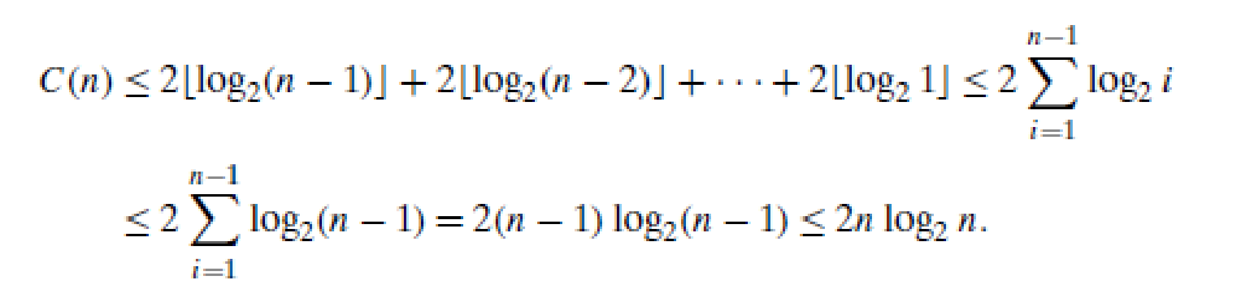
Design and Analysis of Algorithms
Heap and Heap Sort
Total Time Complexity:
ϴ(n) + ϴ(n log n) = ϴ(n log n)
Worst-case complexity = ϴ(n log n)
• Average-case complexity = ϴ(n log n)
• In-place sorting algorithm
• No extra memory required
Heapsort can be competitive with mergesort but is usually slower than quicksort in practice.

Slide 33
Design and Analysis of Algorithms
Multiple choice questions
Let a heap be constructed using the bottom-up heap construction algorithm for n=2^{h+1}−1 (a full binary tree). The maximum number of comparisons involving nodes at level i is:
2^{i}(h−i)
2^{i+1}(h−i)
2^{h−i}(i)
2^{i}(h+i)
Answer B 2^{i+1}(h−i)

Slide 34
Design and Analysis of Algorithms
Multiple choice questions
The worst-case total number of comparisons in bottom-up heap construction for n elements is:
A. n log⁡n
B. n²
C. 2(n−log⁡2(n+1))
D. log⁡n
Answer C. 2(n−log⁡2(n+1))

Slide 35
Design and Analysis of Algorithms
Multiple choice questions
Suppose a heap is built by successive insertions (top-down method). If the input array is already arranged in decreasing order, the time complexity of building the heap will be:
ϴ(n)
ϴ(nlog⁡n)
ϴ(log⁡n)
ϴ(n²)
Answer A : ϴ(n)

Slide 36
Design and Analysis of Algorithms
Multiple choice questions
In a heap with n elements, deleting the maximum element requires at most how many key comparisons during heapify?
A. log⁡₂n
B. 2log⁡₂n
C. n
D. n log⁡n
Answer B: 2log⁡₂n

Slide 37
Design and Analysis of Algorithms
Multiple choice questions
The number of comparisons required in the second stage of heapsort satisfies the inequality:
C(n) ≤ 2 ∑ i=1 to n−1 log⁡₂i Which of the following is the tightest asymptotic bound?
A. ϴ(n)
B. ϴ(nlog⁡n)
C. ϴ(n²)
D. ϴ(log⁡n)
Answer B: O(nlog⁡n)

Slide 38
THANK YOU
Dinesh Singh
Department of Computer Science & Engineering

