Slide 1

Design and Analysis of Algorithms
Dinesh Singh
Department of Computer Science & Engineering

Slide 2
DESIGN AND ANALYSIS OF ALGORITHMS
RED BLACK TREES
Dinesh Singh
Department of Computer Science & Engineering

Slide 3
Design and Analysis of Algorithms
Red Black Trees
A Red-Black tree is a kind of self-balancing binary search tree where each node has an extra bit, and that bit is often interpreted as the colour (red or black).
Although the balance of the tree is not perfect, it is good enough to reduce the searching time and maintain it around ϴ(log n) time, where n is the total number of elements in the tree

Slide 4
Design and Analysis of Algorithms
Red Black Trees
Properties of Red Black Tree
Every node has a colour either red or black.
The root of the tree is always black.
There are no two adjacent red nodes (A red node cannot have a red parent or red child).
Null Node is considered as BLACK
Every path from a node (including root) to any of its descendant’s NULL nodes has the same number of black nodes.

Slide 5
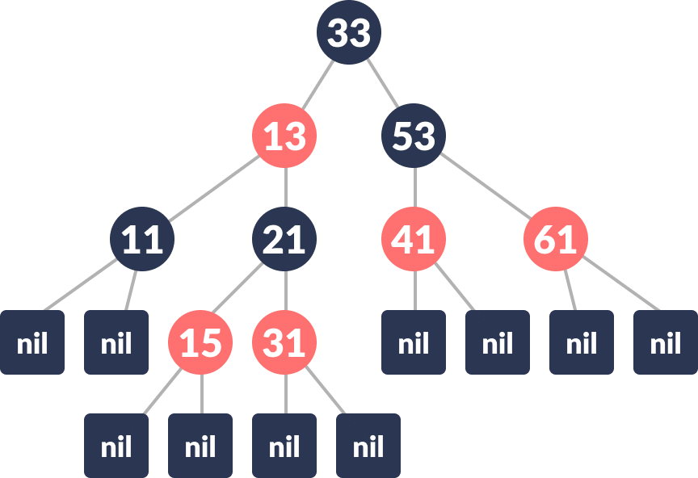
Design and Analysis of Algorithms
Red Black Trees

Slide 6
Design and Analysis of Algorithms
Red Black Trees
Interesting points about Red-Black Tree:
Black height of the red-black tree is the number of black nodes on a path from the root node to a leaf(NIL) node. All NIL nodes are also counted as black nodes. So, a red-black tree of height h has black height >= h/2. The longest Path from a node to a leaf is at most twice the length of the shortest path
Height of a red-black tree with n nodes is h<= 2 log₂(n + 1).
All leaves (NIL) are black.
Black depth = number of black nodes from root to the node
Every red-black tree is a special case of a binary tree.

Slide 7
Design and Analysis of Algorithms
Red Black Trees
Insertion into a Red Black Tree
Algorithm:
Let x be the newly inserted node.
1. Perform Standard BST Insertion and make the colour of newly inserted node as RED.
2. If x is the root, change the colour of x as BLACK.
3. Do the following if the color of x’s parent is not BLACK and x is not the root.
a) If x’s uncle is RED
(i) Change the colour of parent and uncle as BLACK.
(ii) Colour of a grandparent as RED.
(iii) Change x = x’s grandparent, repeat steps 2 and 3 for new x.

Slide 8
Design and Analysis of Algorithms
Red Black Trees
b) If x’s uncle is BLACK, then there can be four configurations for x, x’s parent (p)
and x’s grandparent (g)
(i) Left Left Case (p is left child of g and x is left child of p)
(ii) Left Right Case (p is left child of g and x is the right child of p)
(iii) Right Right Case (Mirror of case i)
(iv) Right Left Case (Mirror of case ii)

Slide 9
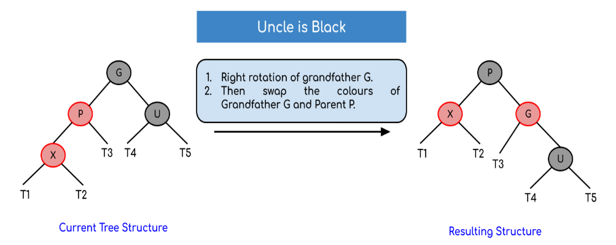
Design and Analysis of Algorithms
Red Black Trees
Left Left Case (R rotation):

Slide 10
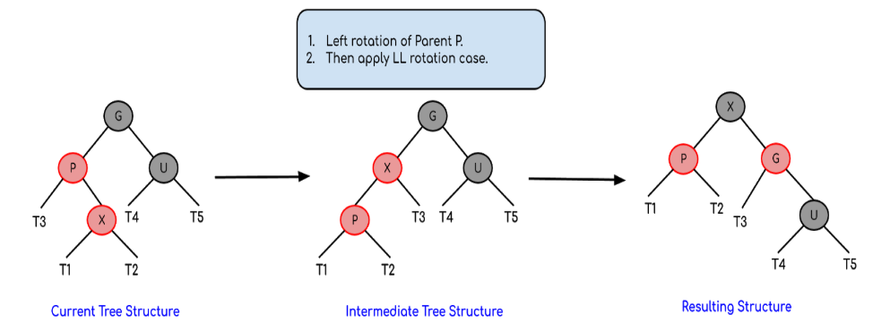
Design and Analysis of Algorithms
Red Black Trees
Left Right Case (LR rotation):

Slide 11
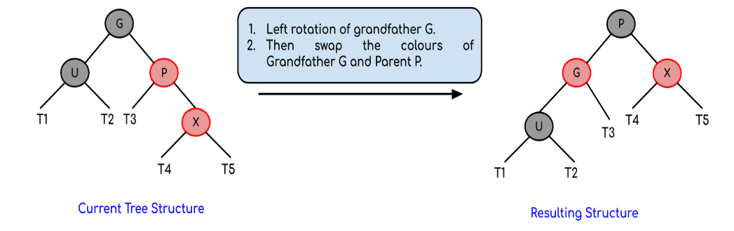
Design and Analysis of Algorithms
Red Black Trees
Right Right Case (L rotation):

Slide 12
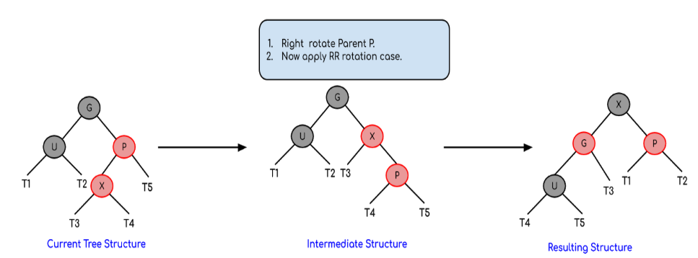
Design and Analysis of Algorithms
Red Black Trees
Right Left Case (RL rotation):

Slide 13
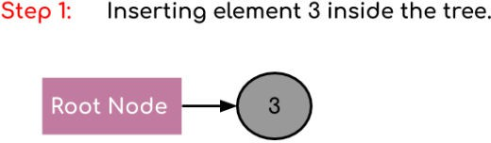
Design and Analysis of Algorithms
Red Black Trees
Create a red-black tree with elements 3, 21, 32 and 15.

Slide 14
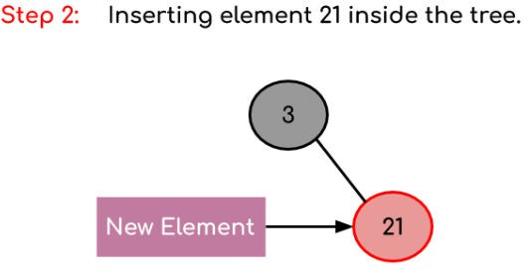
Design and Analysis of Algorithms
Red Black Trees
Create a red-black tree with elements 3, 21, 32 and 15.

Slide 15
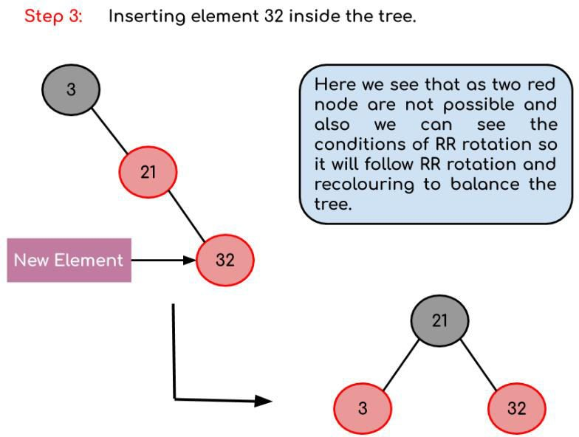
Design and Analysis of Algorithms
Red Black Trees
Create a red-black tree with elements 3, 21, 32 and 15.

Slide 16
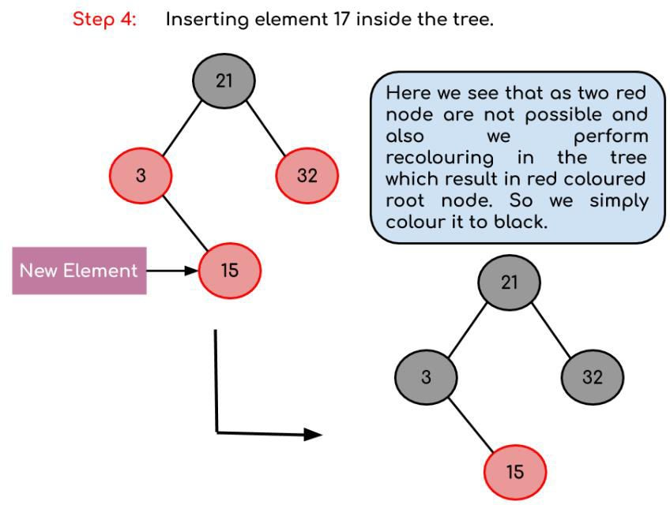
Design and Analysis of Algorithms
Red Black Trees
Create a red-black tree with elements 3, 21, 32 and 15.

Slide 17
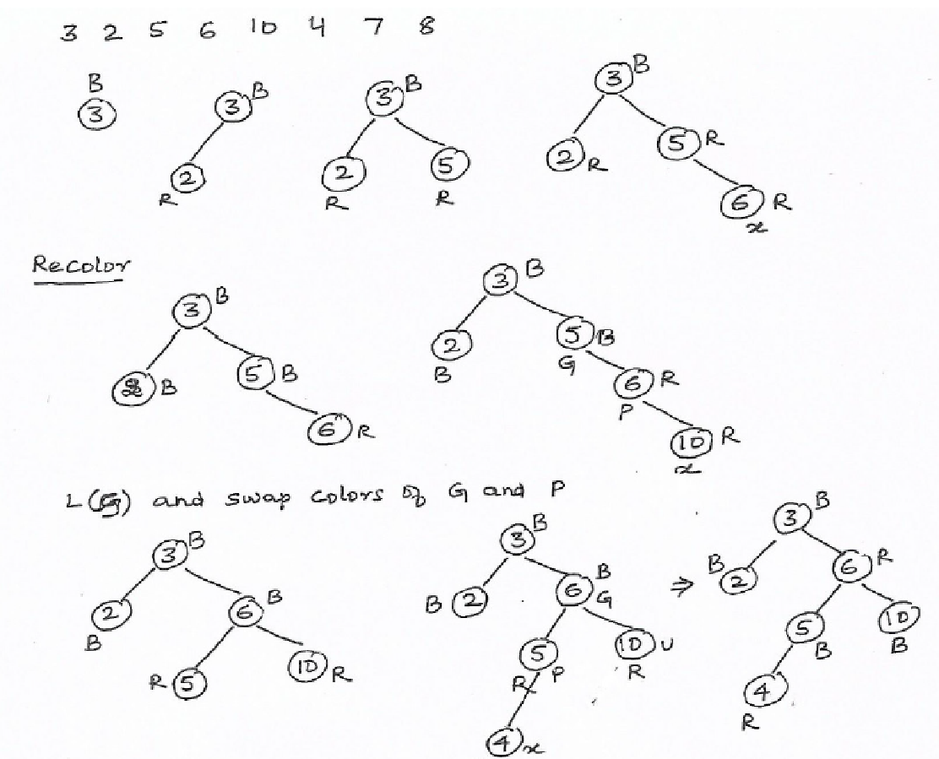
Design and Analysis of Algorithms
Red Black Trees
Create a Red Black Tree for the following numbers 3, 2, 5, 6, 10, 4 , 7, 8

Slide 18
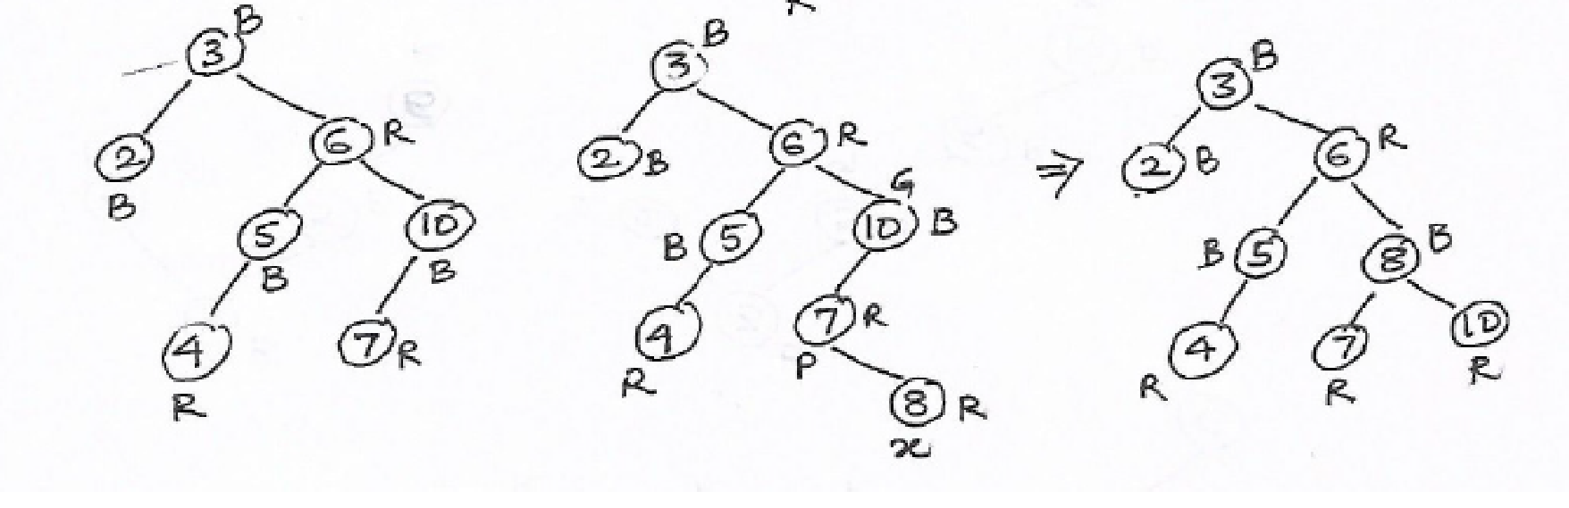
Design and Analysis of Algorithms
Red Black Trees
Create a Red Black Tree for the following numbers 3, 2, 5, 6, 10, 4 , 7, 8

Slide 19
Design and Analysis of Algorithms
Multiple choice Questions
During the insertion of a node in a Red-Black Tree, suppose:
The new node is red
Its parent is red
The uncle is also red
Which of the following operations is performed?
A. Single rotation followed by recoloring
B. Recolor parent and uncle to black, grandparent to red
C. Double rotation followed by recoloring
D. Recolor only the inserted node
Answer B: Recolor parent and uncle to black, grandparent to red

Slide 20
Design and Analysis of Algorithms
Multiple choice Questions
During Red-Black Tree insertion, suppose:
Parent of inserted node is red
Uncle is black
The inserted node is the right child of a left child
Which sequence of operations will restore the Red-Black properties?
A. Left rotation at parent
B. Right rotation at grandparent
C. Left rotation at parent followed by right rotation at grandparent
D. Right rotation at parent followed by left rotation at grandparent
Answer C: Left rotation at parent followed by right rotation at grandparent

Slide 21
Design and Analysis of Algorithms
Multiple choice Questions
During Red-Black Tree insertion, suppose the parent and uncle of the inserted node are both red. After recoloring:
Parent becomes black
Uncle becomes black
Grandparent becomes red
What condition may still violate the Red-Black properties?
A. Root becomes red
B. Two consecutive red nodes may appear
C. Black-height becomes unequal
D. A node may have three children
Answer B : Two consecutive red nodes may appear

Slide 22
THANK YOU
Dinesh Singh
Department of Computer Science & Engineering

