Slide 1
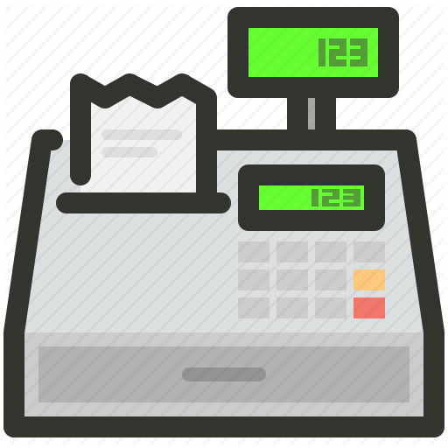
remaining swipes: 100
Notes:
Raise your hand if you’re on a meal plan? If you have meal swipes wasted?
Hundreds of swipes are wasted while some students skip meals
A platform to allow students to give extra swipes & make friends

Slide 2

limit: <= 6 donations
registered students only
Notes:
what about swipe share? Most students find themselves able to give more
We propose alternative that is more widely accessible

Slide 3
SwipeBuddies
Team Mac n’ Cheese
Nov 6, 2019

Slide 4
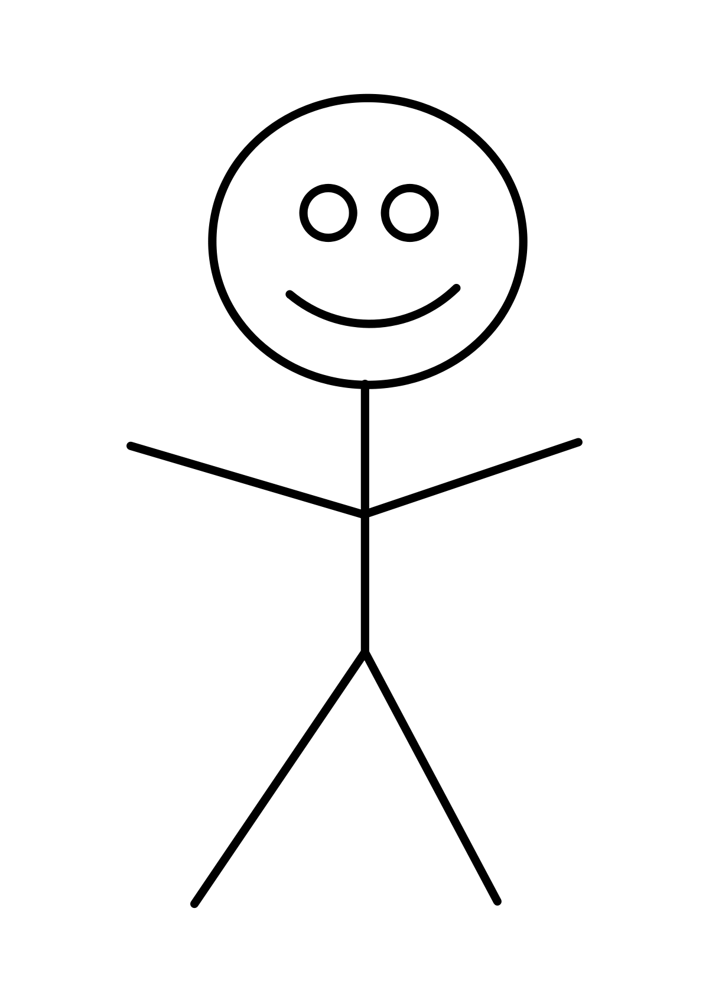
"Donate tomorrow 6-8pm at Maseeh"
"Receive tomorrow anytime at Maseeh/McCormick/Next"
Alice
"Donate weekly on Mondays 6-8pm at Maseeh"
Notes:
Times: 5p, 5:30p, 6p, 6:30p, 7p, 7:30p, 8p
Locations: Maseeh, McC, Baker, Next, Simmons

Slide 5


2 Swipes
Bob
Alice
8 - 9 AM
7 - 8 PM
8 - 9 AM
5 - 7 PM
Carlos
8 - 9 AM
5 - 7 PM
Notes:
https://www.geeksforgeeks.org/maximum-bipartite-matching/

