Slide 1
Allocator & PMR
By Mes
(The contain is modified from 礦坑系列 ── Allocator & PMR)

Slide 2
Allocator & PMR
Brief History
Allocator usage
What is allocator?
Custom allocator
PMR
What & why PMR
PMR usage
Custom 'memory_resource'
Allocator/PMR for user defined class
std::use_allocator_v
Uses-allocator construction

Slide 3
What we will NOT cover (but you may wanna know)
Low-level memory management
Object layout
Empty Base (Class) Optimization (EBO/EBCO)
Standard layout
Layout compatible & common initial sequence
Alignment ('alignas'/alignof usage)
False sharing ('std::hardware_destructive_interference_size' usage)
Operator new/delete detail
Sized-delete
Aligned new/delete
You can check Modern-Cpp-Basics for this part
The strategy of memory allocation algorithm
Include too detailed information in PMR memory resource

Slide 4
Aside
MISRA C/C++ spec prohibit heap allocation (heard from my friend)
Due to historical issues, things are a bit messy.
Allocator & PMR is typically used with STL containers.
To eliminate the overhead of heap allocation.
Hard to ensure that people will use the correct type in large repo.
For “global memory pool”
You typically want 3rd-party lib to be managed by your pool.
Allocator & PMR can't really solve the problem in this scenarios.
Thus you still need to replace functions like malloc, alloc, or realloc.
Like jemalloc just override it

Slide 5
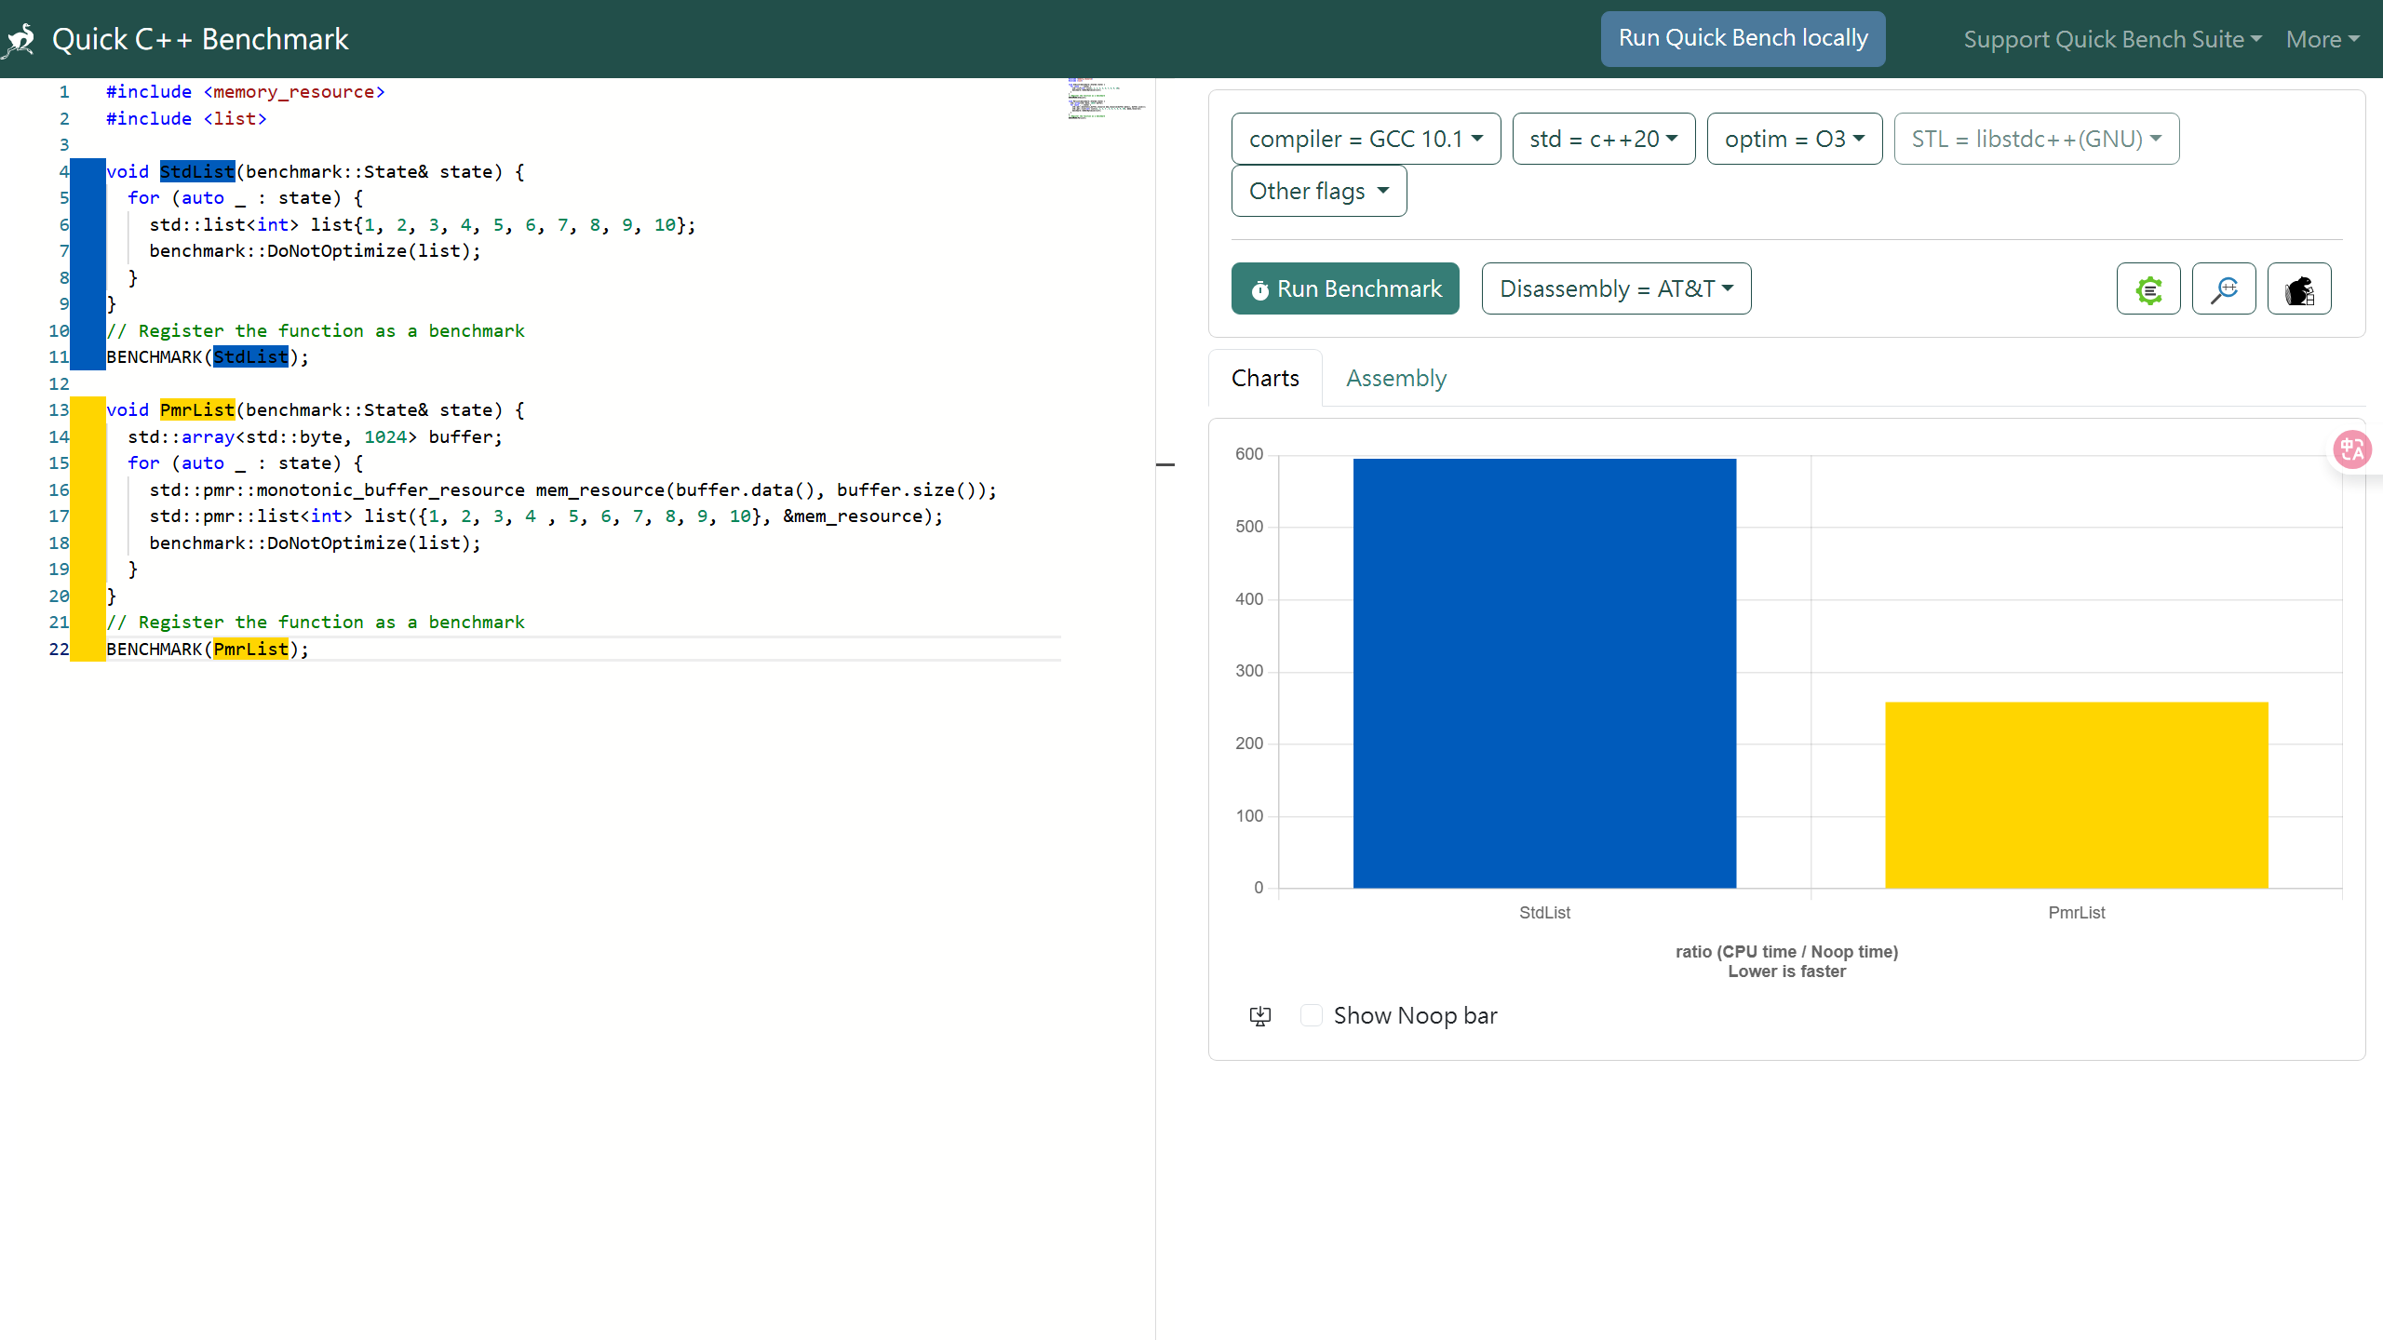
A simple example from Jason Turner

Slide 6
Aside
MISRA C/C++ spec prohibit heap allocation (heard from my friend)
Due to historical issues, things are a bit messy.
Allocator & PMR is typically used with STL containers.
To eliminate the overhead of heap allocation.
Hard to ensure that people will use the correct type in large repo.
For “global memory pool”
You typically want 3rd-party lib to be managed by your pool.
Allocator & PMR can't really solve the problem in this scenarios.
Thus you still need to replace functions like malloc, alloc, or realloc.
Like jemalloc just override it

Slide 7
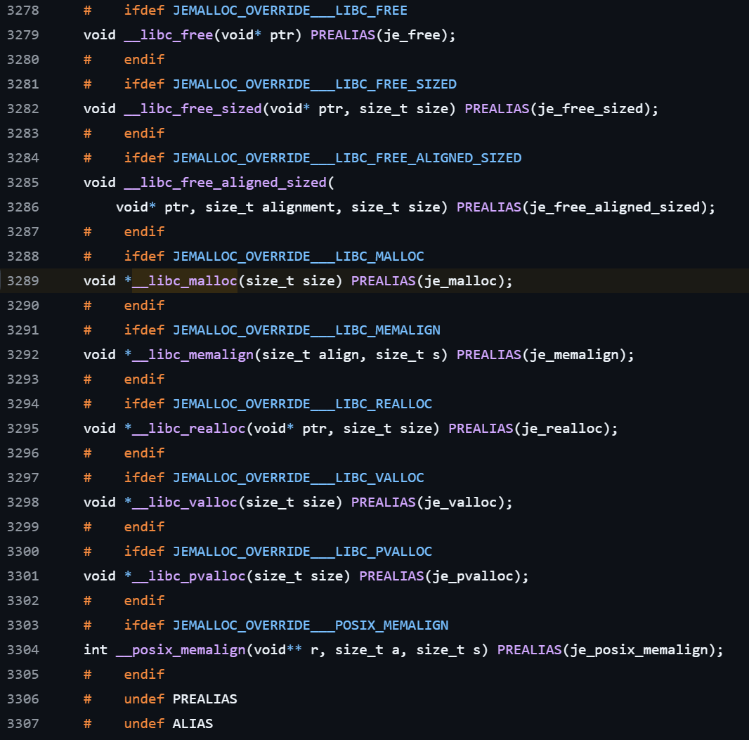
Aside
MISRA C/C++ spec prohibit heap allocation (heard from my friend)
Due to historical issues, things are a bit messy
Allocator & PMR is typically used with STL containers.
To eliminate the overhead of heap allocation.
Hard to ensure that people will use the correct type in large repo.
For “global memory pool”
You typically want 3rd-party lib to be managed by your pool.
Allocator & PMR can't really solve the problem in this scenarios.
Thus you still need to replace functions like malloc, alloc, or realloc.
Like jemalloc just override it

Slide 8
Allocator & PMR
Brief History
Allocator usage
What is allocator?
Custom allocator
PMR
What & why PMR
PMR usage
Custom 'memory_resource'
Allocator/PMR for user defined class
std::use_allocator_v
Uses-allocator construction

Slide 9
Brief History: placement new
For some simple structure(like POD type), we can use placement new
Several issues:
Inconvenient to use with STL containers.
Can't separate memory allocation and object construction.
Need to manual handling issues like alignment.
godbolt example

Slide 10
Brief History: Allocator
From Alexander Stepanov:
People wanted the library to provide some mechanism for abstracting memory models.
Make STL containers independent with memory model.
Tried to make Allocator to fully encapsulate the memory model.
But failed due to efficiency.
Interview with Al Stevens translated by 侯捷

Slide 11
Allocator & PMR
Brief History
Allocator usage
What is allocator?
Custom allocator
PMR
What & why PMR
PMR usage
Custom 'memory_resource'
Allocator/PMR for user defined class
std::use_allocator_v
Uses-allocator construction

Slide 12
Allocator: what & why?
STL container use allocator to allocate memory
N4950（24.2.2.2-64）：Unless otherwise specified, all containers defined in this Clause obtain memory using an allocator
N4950（24.2.2.5-2）：A container calls 'allocator_traits<A>​::​construct(m, p, args)' to construct an element at 'p' using 'args', with 'm == get_allocator()'
The standard provides very detailed procedural specifications for this part.
We will see it later
Can split memory allocation and object construct.

Slide 13
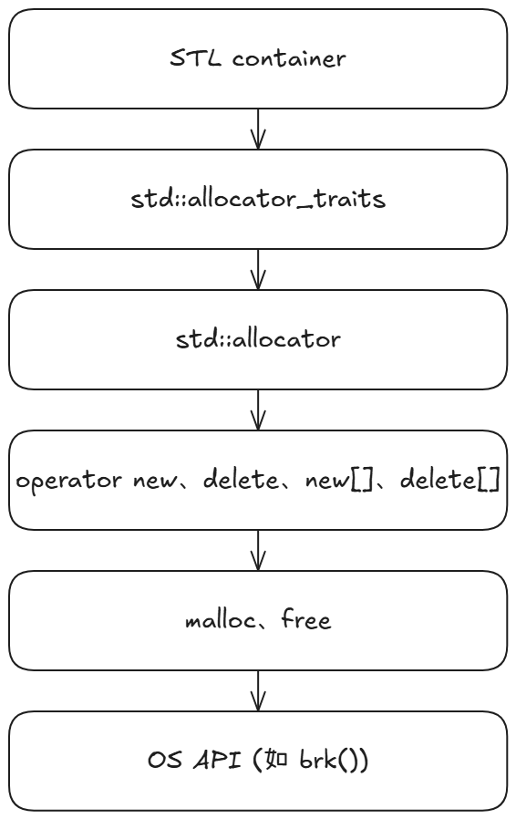
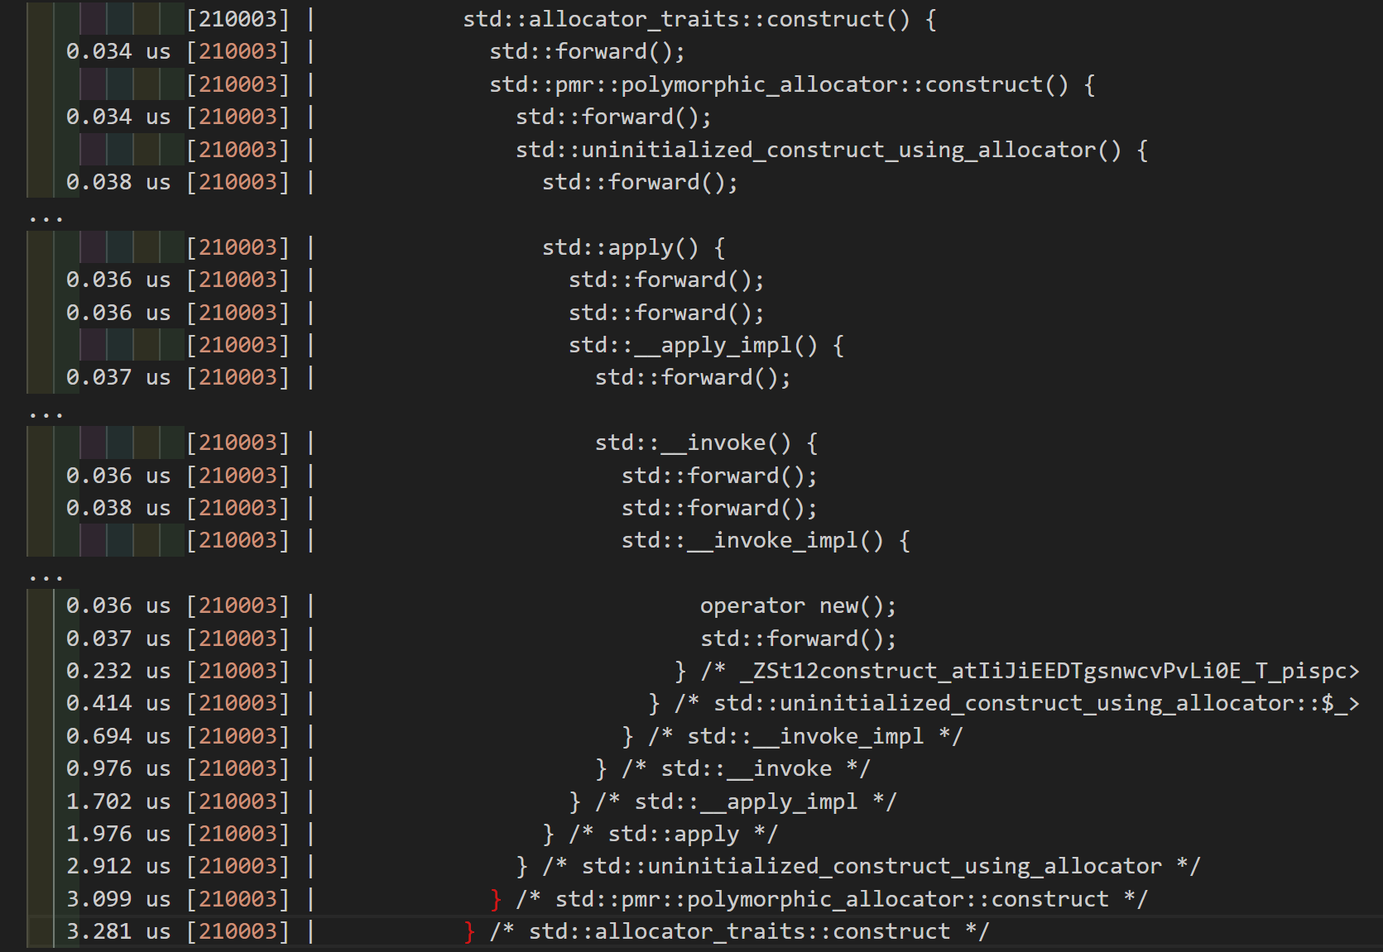
General case
Up to template argument call 'Alloc::allocate'
Default allocator (but rarely used in practice)
uftrace log

Slide 14
Allocator: what & why?
STL container use allocator to allocate memory
N4950（24.2.2.2-64）：Unless otherwise specified, all containers defined in this Clause obtain memory using an allocator
N4950（24.2.2.5-2）：A container calls 'allocator_traits<A>​::​construct(m, p, args)' to construct an element at 'p' using 'args', with 'm == get_allocator()'
The standard provides very detailed procedural specifications for this part.
We will see it later
Can split memory allocation and object construct.

Slide 15
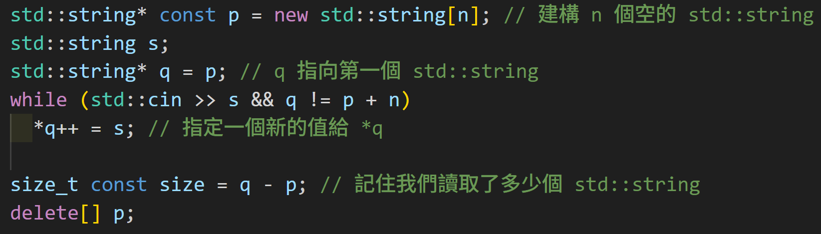
Allocator: split memory allocation and object construct
Use 'std::allocator<T>' to specify which STL container you wanna use.
Operator the allocator via 'std::allocator_traits'
You can manually use 'std::allocator'
But typically you'll want to use the interfaces provided by the standard
Use 'std::allocator_traits' to allocate memory and construct object.
Godbolt link

Slide 16
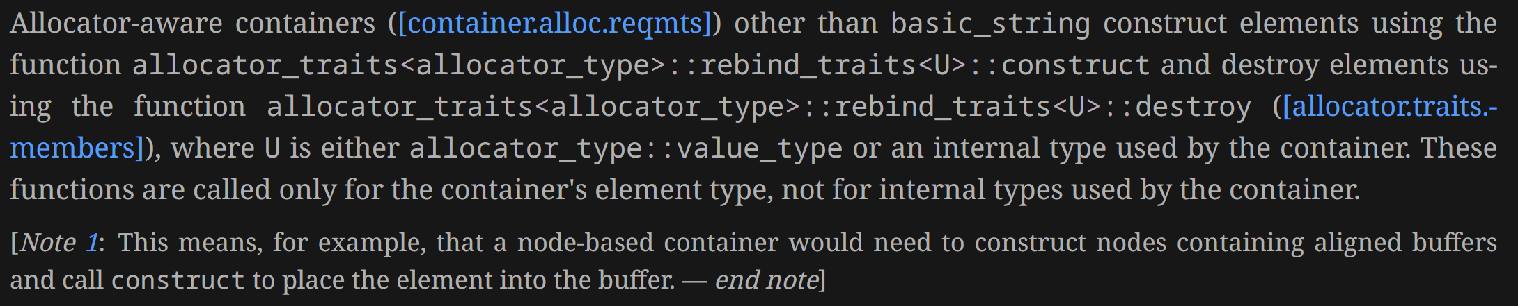
Allocator: custom allocator
AllocatorAwareContainers
Containers that can use custom allocator
Essentially, except for 'std::array' fall into this category
Indirectly utilize it through the 'std::allocator_trait' interface
Except 'std::string' (due to SSO)
N4950（24.2.1）:

Slide 17
Allocator: custom allocator
The requirement for Allocator is very complex (cppreference)
std::allocator_trait
Provides a default implementation for most requirements
Check cppreference for the list
Allows us to customize only the operations we care about
Howard Hinnant gave an template of custom Allocator on his blog

Slide 18
Allocator: custom allocator
Essentially, you need implement
value_type
allocate()
deallocate()
Default constructors and copy constructors are “recommended” to include.
Simplest custom allocator (Godbolt link)
Simple stack string allocator (Godbolt link)

Slide 19
Allocator & PMR
Brief History
Allocator usage
What is allocator?
Custom allocator
PMR
What & why PMR
PMR usage
Custom 'memory_resource'
Allocator/PMR for user defined class
std::use_allocator_v
Uses-allocator construction

Slide 20
PMR: why?
N3916:
The allocator used to construct a container should also be used to construct the elements within that container.
An object’s type should be independent of the allocator it uses to obtain memory.
The first problem occurred in sth like 'std::vector<std::string>'
Can be solved by 'std::scoped_allocator_adaptor'
For the second problem
Each use of an Allocator adds another static type.
The memory allocation strategy can't be changed

Slide 21
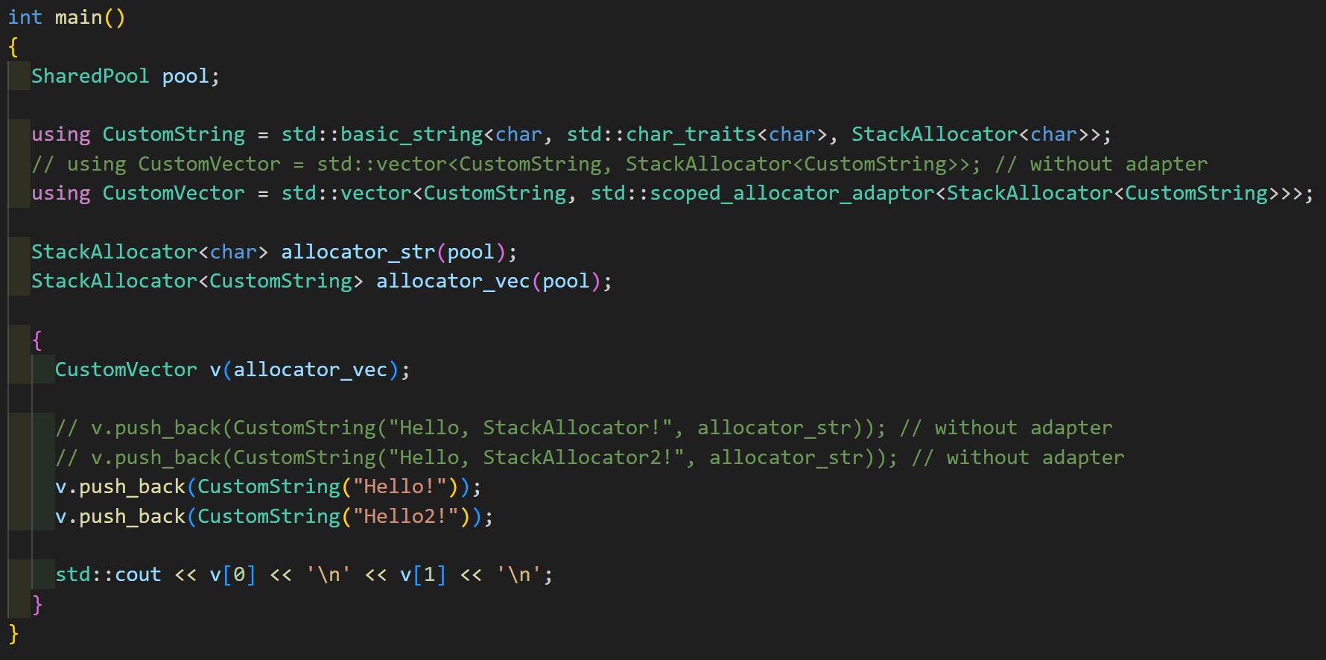
PMR: why?

Slide 22
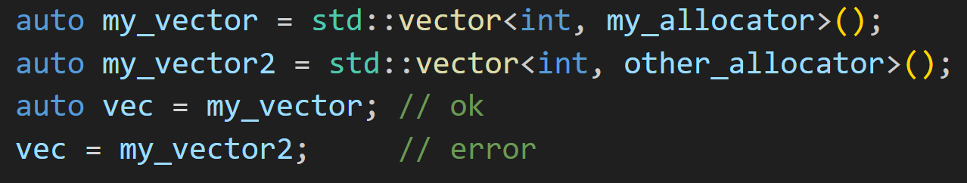
PMR: why?
The two vectors have different static types

Slide 23
PMR: why?
Also, this two parameters must have element type information
This example is not correct.
Don’t forget allocator can apply on different container with different element type.
This is an common mistake that ppl make an allocator for a specific type
The issue here is that the type is hardcoded (maybe very implicit)
Not that he forgot to specify the type, this kind of mistake can pass compile.
Should be sth like 'my_allocator<int>'

Slide 24
PMR: what?
Use runtime polymorphism to achieve same static type
Can change memory allocation strategy at runtime
'std::pmr::polymorphic_allocator<T>'
An allocator provided by PMR
Totally conforms to the requirements of Allocator
Template parameter represents element type
Contain a pointer that point to 'std::pmr::memory_resource'
STL container still use the 'std::allocator_traits' interface
'std::pmr::memory_resource'
The place apply runtime polymorphism.
The place that allocate the memory.

Slide 25
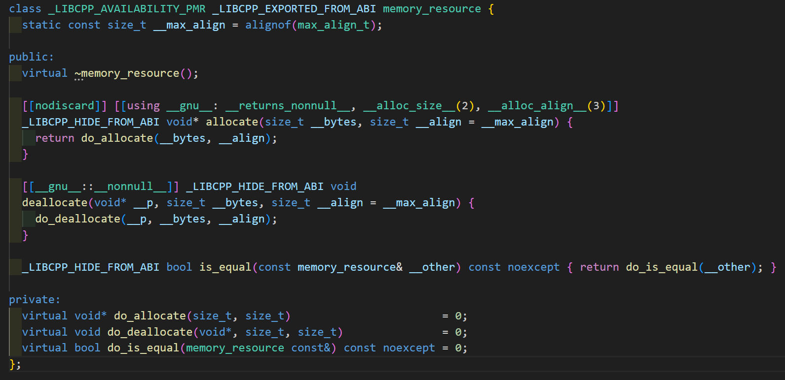
PMR: 'std::pmr::memory_resource' in llvm frontend

Slide 26
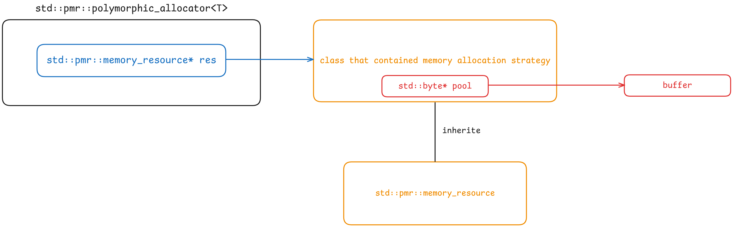
PMR: 'std::pmr::polymorphic_allocator<T>' intro
Architectural Diagram
(This diagram has been simplified. The actual internal names will be different.)

Slide 27
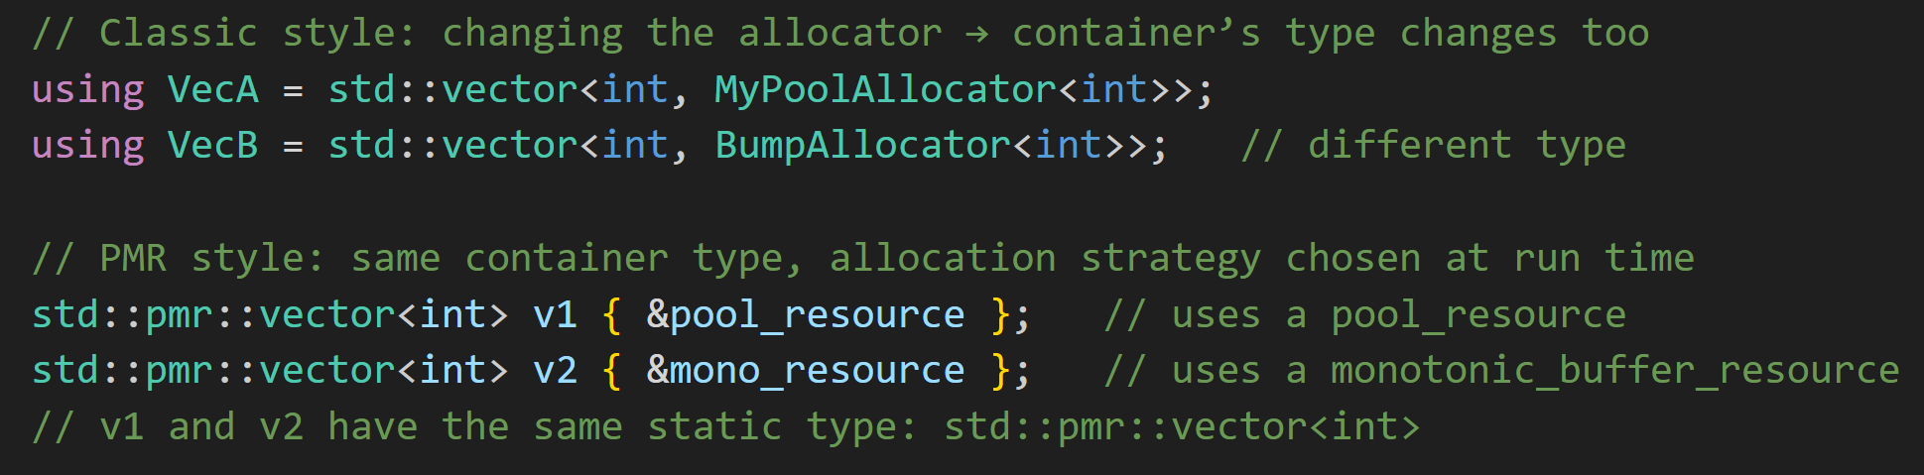
PMR: 'std::pmr::polymorphic_allocator<T>' intro
VecA and VecB are different types, but v1 and v2 are the same type.
('std::pmr::vector' is an abbreviation for 'std::vector<int, std::pmr::polymorphic_allocator<int>')

Slide 28
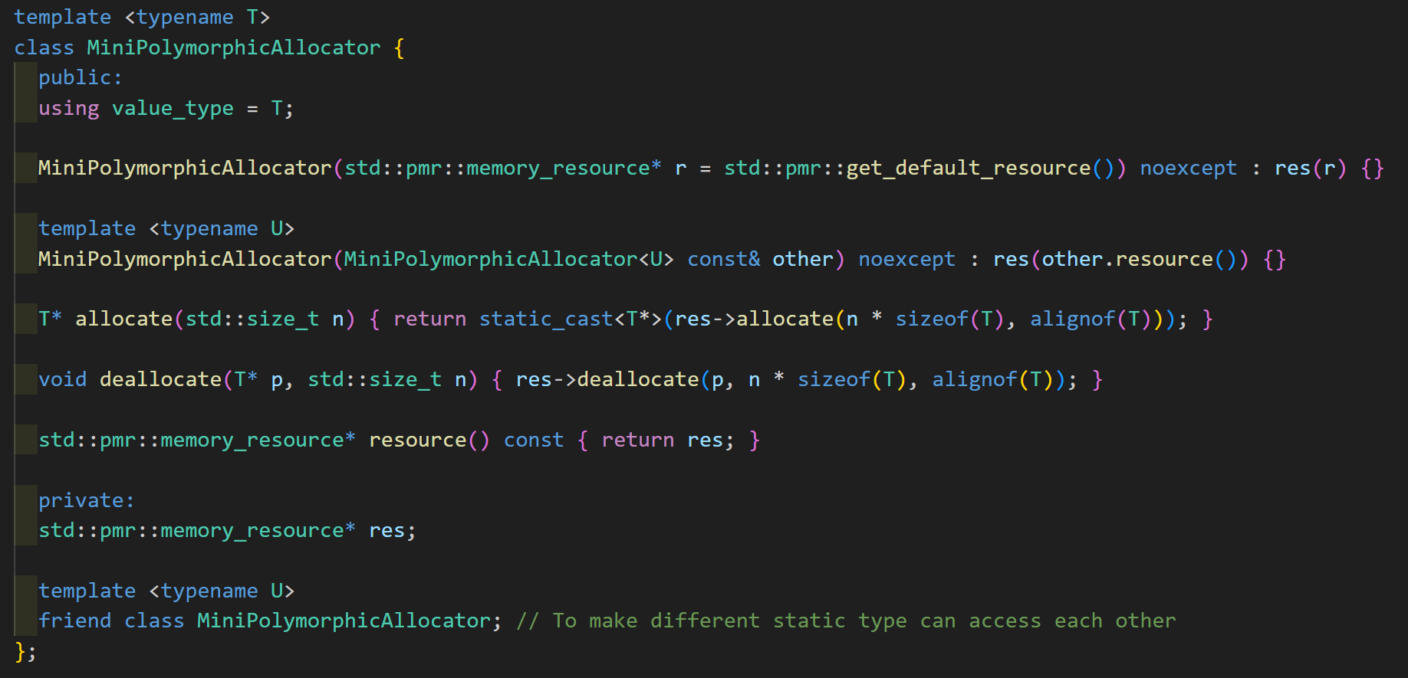
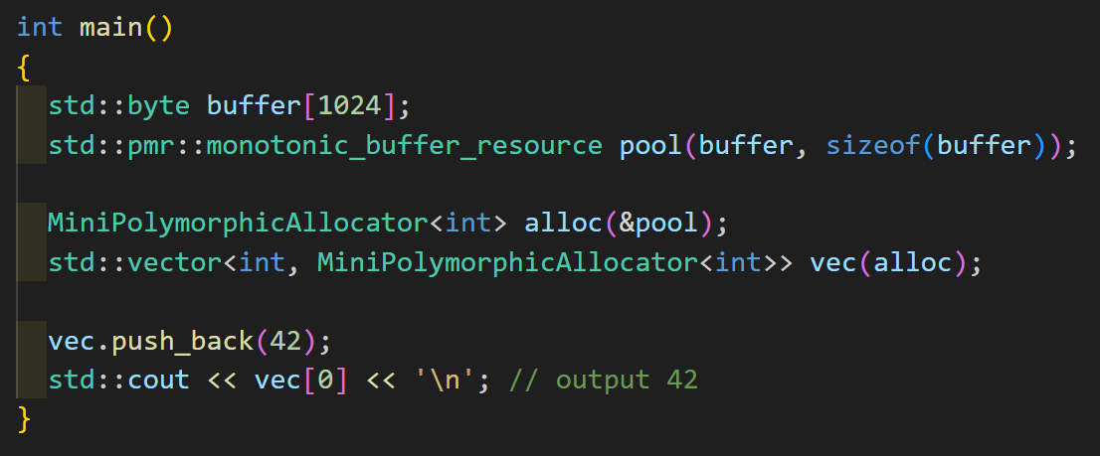
PMR: 'std::pmr::polymorphic_allocator<T>' intro
Make our own polymorphic_allocator (Godbolt link)

Slide 29
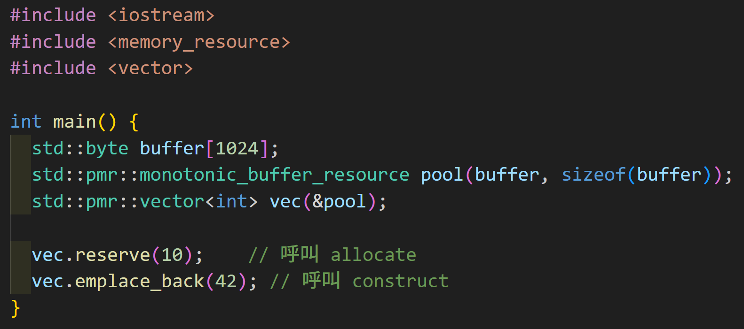
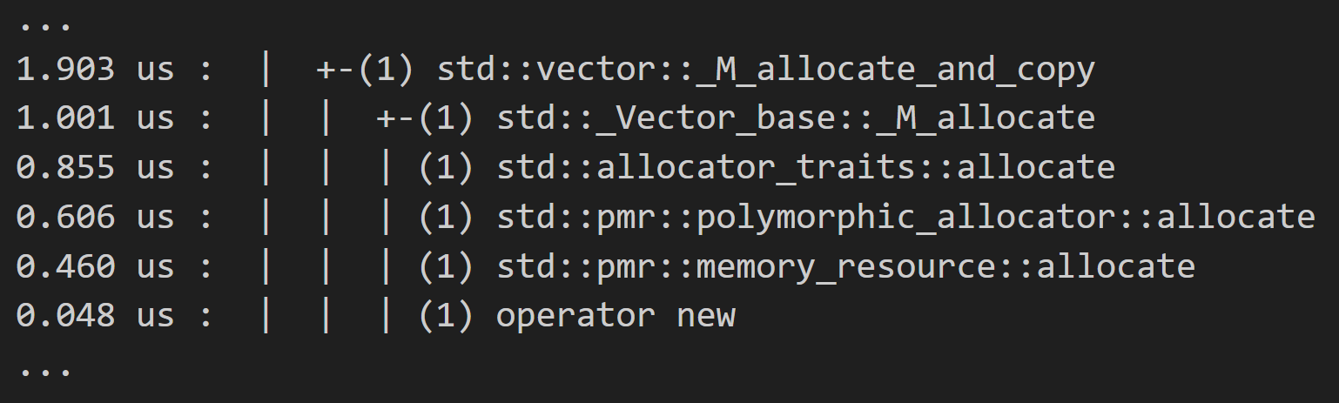
PMR: 'std::pmr::polymorphic_allocator<T>' intro
uftrace log

Slide 30
PMR: memory resource usage
Standard provides five types of memory resources.
'new_delete_resource()'
'synchronized_pool_resource'
'unsynchronized_pool_resource'
'monotonic_buffer_resource'
'null_memory_resource()'
Use 'get_default_resource()' to get the default memory resource
Use 'set_default_resource()' to set the default memory resource
Care about the lifecycle of your memory pool instance

Slide 31
PMR: 'new_delete_resource()'
Default memory resource
'allocate()' use '::operator new'
'deallocate()' use '::operator delete'

Slide 32
PMR: 'null_memory_resource()'
Throw a 'bad_alloc' exception when allocation
Use to ensure no memory is unexpectedly allocated on heap.

Slide 33
PMR: 'monotonic_buffer_resource'
A buffer can be passed in as its memory pool
Bump Allocator
Allocate memory using a monotonically increasing approach
Deallocate actually does nothing.
Very quickly
Can request additional memory from upstream
Thread unsafe

Slide 34
PMR: '(un)synchronized_pool_resource'
The '(un)' mean the thread-unsafe version
Apart from this, they are identical.
Abbreviate to "pool resource"
Requires another memory resource as an upstream resource
Trying to reduce fragmentation
Dividing memory into multiple fixed-size pools
Standard does not specify how buffers should be allocated.

Slide 35
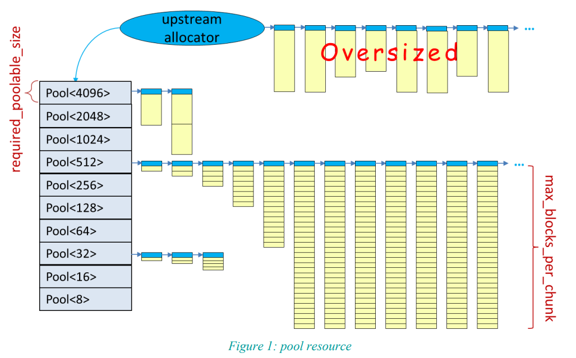

Slide 36
PMR: custom memory resource
No longer implement various allocator.
Now we create our own memory resource
Then pass it to 'std::pmr::polymorphic_allocator'
2 steps:
Inherit from 'std::pmr::memory_resource'
Implement the following three private member functions:
'void* do_allocate(size_t, size_t)'
'void do_deallocate(void*, size_t, size_t)'
'bool do_is_equal(memory_resource const&) const noexcept'

Slide 37
PMR: custom memory resource
'void* do_allocate(size_t, size_t)'
Used to allocate memory
'void do_deallocate(void*, size_t, size_t)'
Used to deallocate memory
'bool do_is_equal(memory_resource const&) const noexcept'
Used to determine whether allocated memory can be swapped
Example: simple stack memory resource (Godbolt link)

Slide 38
Allocator & PMR
Brief History
Allocator usage
What is allocator?
Custom allocator
PMR
What & why PMR
PMR usage
Custom 'memory_resource'
Allocator/PMR for user defined class
std::use_allocator_v
Uses-allocator construction

Slide 39
Allocator/PMR for user defined class
We know how to manage memory for sth like 'std::vector<int>' now
Via old-style allocator or PMR with memory resource
But the element is not user defined class
Or said, not POD type.
We want 'std::vector<Data>' also not using heap
This need to make 'Data' use allocator too.

Slide 40
Details of the allocation process
N4950（24.2.2.2-64）：
Unless otherwise specified, all containers defined in this Clause obtain memory using an allocator. ... A copy of this allocator is used for any memory allocation and element construction performed, by these constructors and by all member functions, during the lifetime of each container object or until the allocator is replaced.
N4950（24.2.2.5-2）:
A container calls 'allocator_traits<A>​::​construct(m, p, args)' to construct an element at 'p' using 'args', with 'm == get_allocator()'.
The default construct in allocator will call '​::​new((void*)p) T(args)', but specialized allocators can choose a different definition.

Slide 41
Details of the allocation process
STL container use 'allocator_traits::construct(m, p, args) to construct element
'allocator_traits::construct' always use the same copy of the allocator
Of course, with the premise that the allocator didn’t be changed.
Also, the container instance need to be alive.
'allocator_traits::construct' will call
'alloc.construct(p, std​::​forward<Args>(args)...)' if that call is well-formed
otherwise, invokes 'construct_at(p, std​::​forward<Args>(args)...)'
Said at N4950（20.2.9.3-6）.

Slide 42
'std::uses_allocator<T, Alloc>'
It's an trait class defined in 'type_traits'.
Used to determine whether the 'T' can use the 'Alloc'.
2 value: 'true_type' and 'false_type'
'true_type' if
T contains a qualified-id 'allocator_type', and 'T::allocator_type' is compatible with 'Alloc' (can be cast).
Manually specialize the target type of 'std::uses_allocator' to 'true_type'.
The first parameter type of constructor must be 'allocator_arg_t'. And the second parameter need to be 'Alloc'.
Or the last parameter type of constructor must be 'Alloc'.

Slide 43
Uses-allocator construction
First proposed in N2982
Trying to pass allocator to element/subcontainers
Trying to unify the allocation process within AllocatorAwareContainer
It's a convention of how to pass allocator to a constructor
The standard (N4950) ensure PMR allocator will follow this convention
There is no guarantee that STL containers will use it.
But most implementations follow it for all container allocation.

Slide 44
Uses-allocator construction
There are three conventions:
If T does not use a compatible allocator ('std::uses_allocator_v<T, Alloc>' is false), then 'alloc' is ignored.
Otherwise, 'std::uses_allocator_v<T, Alloc>' is true, and
If the format of constructor is 'T(std::allocator_arg, alloc, args...)', uses this form.
It's called leading-allocator.
Or, if the format of constructor is 'T(args..., alloc)', uses this form.
It's called trailing-allocator.
Otherwise, the program is ill-formed
This means 'std::uses_allocator_v<T, Alloc>' is true, but T can't actually use the allocator

Slide 45
Details of the allocation process
Remark: 'allocator_traits::construct' will call
'alloc.construct(p, std​::​forward<Args>(args)...)' if that call is well-formed
otherwise, invokes 'construct_at(p, std​::​forward<Args>(args)...)'
So the default procedure for the whole allocation is:
Called 'alloc.construct' or 'construct_at' (link)
If the allocator didn’t be specified, generally the default is 'std::allocator'.
But due to 'std::allocator::construct' is removed in C++20, so the SFINAE would failed.
Check this answer for more detail.
Thus it will fall in the 'std::construct_at'.
Check 'uses_allocator_v' (link)
A little tricky here, check the article for explanation.
Choose leading / trailing / no-alloc (link)
Uses-allocator construction
Not guarantee by standard, but most implementation use it
Or said, there is only PMR allocator would get here.

Slide 46
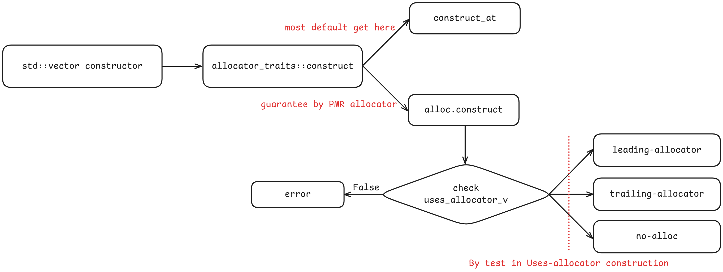
Details of the allocation process

Slide 47
Allocator/PMR for user defined class
To make custom class work with STL container that specify allocator.
You need to let container know your class can use allocator.
Jason Turner called these class "Allocator-aware type".
Colloquial term, not specified in spec.
Different with AllocatorAwareContainer
2 requirement:
'std::uses_allocator<MyClass, Alloc>' need to be 'true_type'
Uses-allocator construction requires the ability to use your constructor.

Slide 48
Allocator/PMR for user defined class
The format below is "user-defined class + STL container"
There are four options.
Traditional Allocator + Traditional Allocator
Pass the Allocator to the internal custom class using 'std::scoped_allocator_adaptor'
Traditional Allocator + PMR Allocator
Uses-allocator construction is guaranteed.
User defined class must be Allocator-aware type.
PMR Allocator + Traditional Allocator
Hard to implement since (new feature apply on old feature). But it's possible.
PMR Allocator + PMR Allocator
Uses-allocator construction is guaranteed.
User defined class must be Allocator-aware type.
Godbolt link (All four examples are included.)

Slide 49
Thank you!

