Slide 1
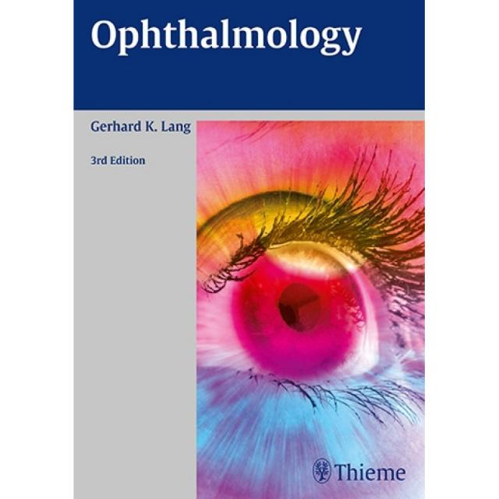
KERATOCONUS AND ROLE OF PHARMACISTS
OPHTHALMOLOGY PHARMACISTS OF NIGERIA (OPON)
PHARM. MESAGAN ELIJAH

Slide 2
OUTLINES
INTRODUCTION
EPIDEMOLOGY
ETIOLOGY
PATHOPHYSIOLOGY
CLINICAL PRESENTATION
DIAGNOSIS
TREATMENT
PHARMACIST’S INTERVENTION

Slide 3
INTRODUCTION
Keratoconus (kera: horn; conus: cone)
progressive corneal ectasia characterized by thinning and weakening of the cornea that leads to irregular astigmatism, refractive myopia, and decreased vision due to corneal scarring and cone-like appearance of the cornea.
Alteration of the cornea’s shape. The cornea is the transparent outer layer of the eye from which the iris and pupil are visible.

Slide 4
INTRODUCTION CONTD
The cornea’s middle layer is thickest layer, is primarily made of collagen, which helps maintain its normal, rounded shape and makes it robust and flexible.
In keratoconus, the cornea thins and bulges into an atypical cone form and this can heavily impair vision.

Slide 5
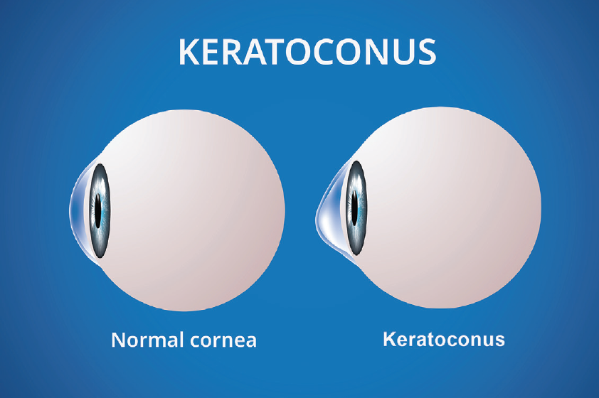
INTRODUCTION CONTD

Slide 6

INTRODUCTION CONTD

Slide 7
EPIDEMIOLOGY
Relatively common disorder.
Reported prevalence ranges from 50 to 230 per 100,000 cases.
Affect all races, and both sexes. Its onset is around puberty and worsens until the mid-30s.
Impossible to forecast whether or how quickly the disease will advance.
Typically, keratoconus affects both eyes, with one being affected worse than the other.

Slide 8
ETIOLOGY
Unknown and possibly multifactorial.
Several research shows a strong relationship between eye rubbing and development of keratconus.
This relationship may be due to the activation of wound healing processes and signaling pathways secondary to mechanical epithelial trauma and also direct rubbing-related mechanical trauma to the keratocytes and increased hydrostatic pressure in the eye.
Contact lens wear is another form of corneal microtrauma associated with keratoconus.

Slide 9
ETIOLOGY CONTD
The hereditary pattern is not predictable although the strongest evidence of genetic involvement.
Various studies have identified altered cytokine (interleukin [IL]-1, IL-6, tumor necrosis factor-α, IL-17, and transforming growth factor-ß2) and immune mediator levels in patients with keratoconus.
The altered cytokine and immune mediator levels may be the genetic basis of keratoconus etiology.

Slide 10
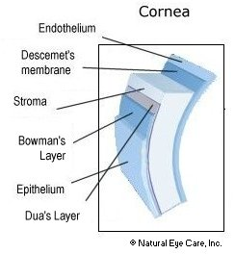
PATHOPHYSIOLOGY

Slide 11
PATHOPHYSIOLOGY CONTD
The cornea of made up of five distinctive layer
Epithelium: Protect the eye from foreign objects like bacteria, dust and water. It has thousands of tiny nerve endings, which is why rubbing or scratching your eye causes pain.
Bowman’s Membrane: The second layer, behind the basement membrane, a transparent film made up of protein fibers known as collagen. Scarring of the Bowman’s membrane, can result in vision loss.
Stroma: Thickest layer within the corneal structure. made of collagen and water. The collagen helps the cornea keep its form, elasticity and strength. The stroma’s unique arrangement, shape and spacing of collagen proteins produce the light-conducting ability of your cornea.

Slide 12
PATHOPHYSIOLOGY CONTD
Dua’s layer, pre-descement’s membrance, discover 2013, extremely thin but very strong and impervious to air
Descemet’s Membrane: Located below the stroma, provide a protective barrier against injury and infection. Composed of a different type of collagen fibers, this membrane heals well after injury.
Endothelium: The innermost layer of your cornea, maintains a fluid balance. If the endothelium didn’t perform this function, the stroma would become cloudy. Endothelial cells damaged are irreversible.

Slide 13
PATHOPHYSIOLOGY CONTD
Keratoconus can involve each layer of the cornea.
The corneal epithelial cells may be enlarged and elongated.
Early degeneration of basal epithelial cells can be followed by disruption of the basement membrane.
This disruption results in the growth of epithelium posterior to the Bowman's layer and collagen anterior to the epithelium, forming typical Z-shaped interruptions or breaks in the Bowman's layer.

Slide 14
PATHOPHYSIOLOGY CONTD
Scarring of the Bowman's layer and the anterior stroma are common and present histopathologically with collagen fragmentation, fibrillation and fibroblastic activity.
The stroma has normal-sized collagen fibers but low numbers of collagen lamellae, which results in stromal thinning.
Endothelial cell pleomorphism and polymegathism may also be manifested.
With increasing severity and duration increase, greater change and damage occurs at the base of the cone than at the apex.

Slide 15
CLINICAL PRESENTATION
complain of progressive visual blur and distortion secondary to myopia and high astigmatism.
Photophobia, glare and monocular diplopia are also presenting symptoms.
A scissors reflex during retinoscopy is a very early sign.
Rizzutti's sign, a conical reflection on the nasal cornea when light is shone temporally, is another early sign.
A Fleischer ring, or iron deposits within the epithelial layer, might be found near the base of the cone.

Slide 16
CLINICAL PRESENTATION CONTD
Fine, and roughly parallel striations (Vogt lines) or stress lines of the stroma might be present.
In advanced keratoconus, the corneal protrusion may cause angulation of the lower lid on downgaze, called Munson's sign.
Spontaneous tears in the Descemet's membrane can result in hydrops.

Slide 17
DIAGNOSIS
Eye refraction.
Slit-lamp examination: The shape of your cornea is evaluated and looks for other potential problems in your eye.
Keratometry: A circle of light on your cornea and measures the reflection to determine the basic shape of your cornea.
Computerized corneal mapping. Special photographic tests, such as corneal tomography and corneal topography, record images to create a detailed shape map of your cornea. Corneal tomography can also measure the thickness of your cornea. Corneal tomography can often detect early signs of keratoconus before the disease is visible by slit-lamp examination.

Slide 18
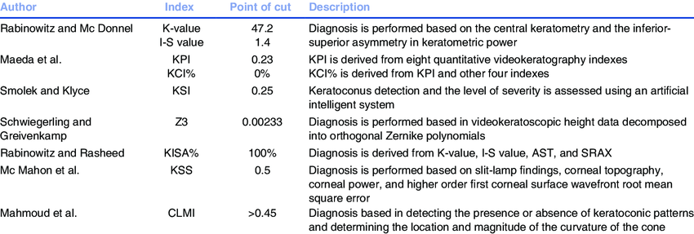
DIAGNOSIS

Slide 19
TREATMENT
Treatment goal: correct vision to the possible maximum.
In early stages spectacle correction is usually satisfactory.
In mild or moderate stages presenting with irregular astigmatism, the treatment of choice are contact lenses, especially rigid gas permeable ones. If contact lenses are not tolerated Intra Corneal Rings (ICR, different brands available) could be a solution to enable spectacle correction.
Since the late nineties collagen cross-linking (CXL) has been proven to be successful in “stiffening” the cornea thereby arresting progression and flattening the cornea by preventing enzymatic degradation of stromal collagen.

Slide 20
TREATMENT
Advanced and severe Keratoconus that cannot tolerate or improve their vision sufficiently with contact lenses, ICRs or CXL and will eventually need surgery.
The traditional surgical intervention has been penetrating keratoplasty, now mostly replaced by deep lamellar keratoplasty (DLK).

Slide 21
PHARMACIST’S INTERVENTION
Collaborate with other health care provider to counsel the patients on risk factors such as
Eye rubbing: causes microtrauma that can further progresses to apoptosis of the keratocytes thereby destroying the cornea layers.
Allergy : lead to itching of the eye. This should be prevented as much as possible
Ultraviolet light: Excessive exposure to sunlight leads to oxidative damage of cornea in patient with keratoconus. There is need to wear 100%UVA and UVB protecting wraparound sunglasses.
Supplementation with nutrients and eyedrops found helpful to protect vision such as N-Acetyl Cysteine and Vitamin c.

Slide 22
References
“See How to Treat and Prevent Keratoconus | Eyes Now.” Eyes Now | Eye Exams & Contact Lens Fittings in the Dallas, 6 July 2022, eyesnow.us/see-how-to-treat-and-prevent-keratoconus-eyes-now/.
Zhao, Fangkun, et al. “Trends in Research Related to Keratoconus from 2009 to 2018: A Bibliometric and Knowledge Mapping Analysis.” Cornea, vol. 38, no. 7, 25 Apr. 2019, pp. 847–854, www.ncbi.nlm.nih.gov/pmc/articles/PMC6571177/, 10.1097/ico.0000000000001984.
Ladan Espandar, and Jay Meyer. “Keratoconus: Overview and Update on Treatment.” Middle East African Journal of Ophthalmology, vol. 17, no. 1, 2010, p. 15, www.meajo.org/article.asp?issn=0974-9233;year=2010;volume=17;issue=1;spage=15;epage=20;aulast=Espandar#ref1, 10.4103/0974-9233.61212.
“Keratoconus - Symptoms and Causes.” Mayo Clinic, 2021, www.mayoclinic.org/diseases-conditions/keratoconus/symptoms-causes/syc-20351352.
“NCRM Ophthalmology Corneal Limbal Stem Cells Tissue Culture Feeder Free Technology Endothelial Damage and Retina Diseases Research.” Ncrm.org, 2022, www.ncrm.org/projects/corendo.htm.
“Dr. Natalya Fazylova.” Manhattan Eye Doctors & Best Rated Specialists in NYC, 2016, www.eyedoctorophthalmologistnyc.com/treatment/corneal-disease-dystrophy/.

Slide 23
THANK YOU

