Slide 1



code_basics_pbi
View in Power BI
Last data refresh:
4/14/2023 10:15:06 AM UTC
Downloaded at:
4/14/2023 10:49:51 AM UTC

Slide 2
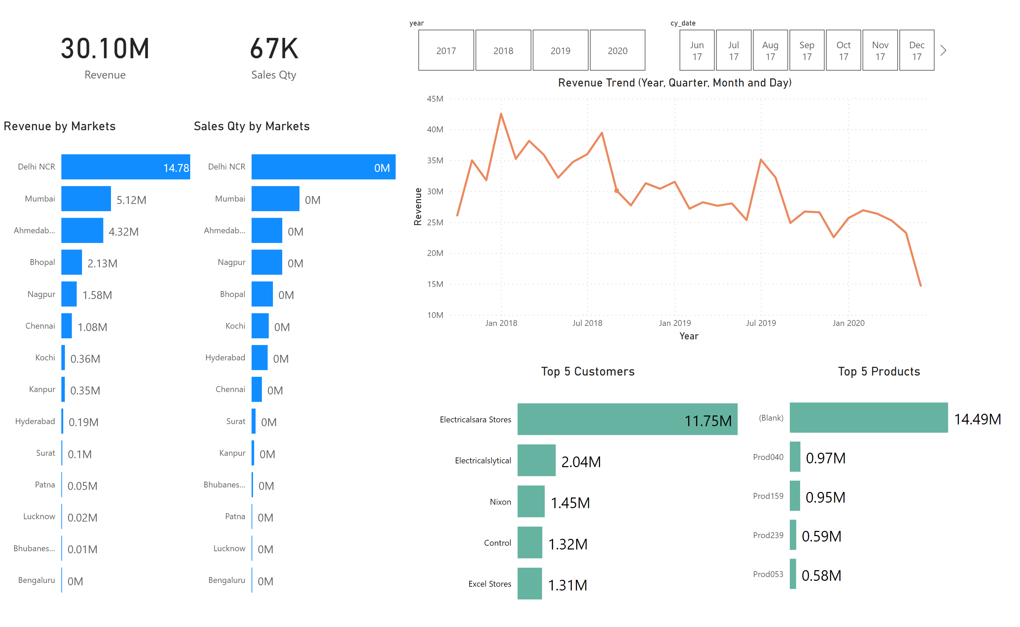
Page 1
Notes:
card
No alt text provided
card
No alt text provided
Revenue by Markets
No alt text provided
Sales Qty by Markets
No alt text provided
Top 5 Customers
No alt text provided
slicer
No alt text provided
Top 5 Products
No alt text provided
slicer
No alt text provided
Revenue Trend (Year, Quarter, Month and Day)
No alt text provided

