Slide 1
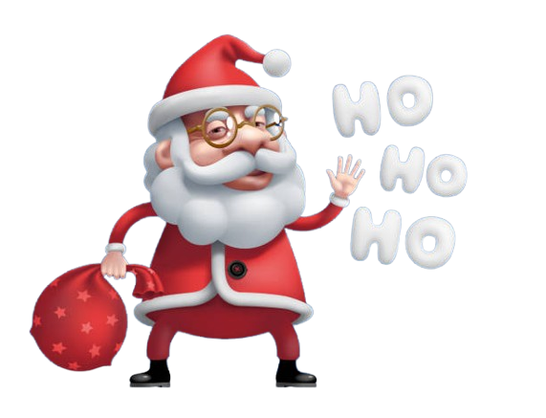
MERRY CHRISTMAS
IT’S CHRISTMAS!! KINDLY SUBSCRIBE.

Slide 2
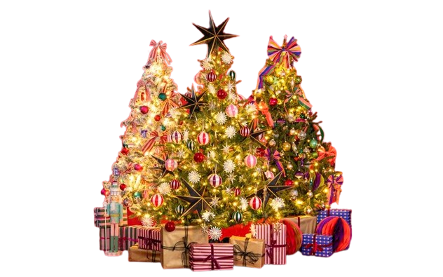
MERRY CHRISTMAS
IT’S CHRISTMAS!! KINDLY SUBSCRIBE.

