Slide 1

GitHub Copilot Hackathon
Team Name- Experience
Team Leader Name- Meshach Opoku Boadi
Team Leader Email Address-meshachboadi230@gmail.com

Slide 2

Brief Summary of Project:
Personal Finance Tracker called
Myfinance Tracker
The application should allow users to add, edit, and delete income and expense transactions and display the current balance.

Slide 3
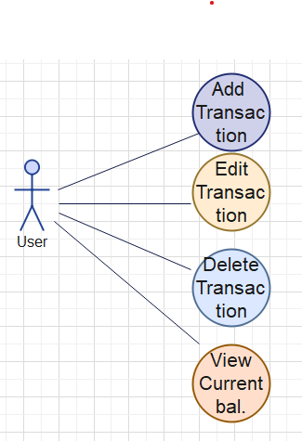
Business Challenge /Use Cases

Slide 4
Proposed Solution
Myfinance tracker : keep one in check as how is finance is going.

Slide 5
Technology/Tool Stack Used:
Languages used are:
1.HTML
2.CSS
3.Javascript

Slide 6
Mention of usage of Github Copilot

Slide 7
Source code in zip file / Github link :
Gihtub Link https://github.com/MeshachOpoku/Myfinance_Tracker.git

Slide 8
Execution Demo(Video/Screenshots) showing usage of the GitHub Copilot Platform :

Slide 9
Additional comments (optional):

Slide 10
THANK YOU

