Slide 1

Chapter 5
Selection Statements
Animated Version

Slide 2
Objectives
After you have read and studied this chapter, you should be able to
    Implement a selection control using if statements
    Implement a selection control using switch statements
    Write boolean expressions using relational and boolean expressions
    Evaluate given boolean expressions correctly
    Nest an if statement inside another if statement
    Describe how objects are compared
    Choose the appropriate selection control statement for a given task
Notes:
We will study two forms of if statements in this lesson. They are called if-then-else and if-then. Although the compiler does not care how we format the if statements, we will present the recommended style.

Slide 3
The if Statement
int testScore;
testScore = //get test score input
if (testScore < 70)
JOptionPane.showMessageDialog(null,
"You did not pass" );
else
JOptionPane.showMessageDialog(null,
"You did pass" );
This statement is executed if the testScore is less than 70.
This statement is executed if the testScore is 70 or higher.
Notes:
We assume there’s some kind of input routine to input test score value and assign it to ‘testScore’.
This sample shows how to make a decision on the input value by using an if test.

Slide 4
Syntax for the if Statement
if ( <boolean expression> )
<then block>
else
<else block>
Boolean Expression
if ( testScore < 70 )
JOptionPane.showMessageDialog(null,
"You did not pass" );
else
JOptionPane.showMessageDialog(null,
"You did pass " );
Then Block
Else Block

Slide 5
Control Flow
false
true
testScore < 70 ?
JOptionPane.
showMessageDialog
(null, "You did pass");
JOptionPane.
showMessageDialog
(null, "You did not pass");
Notes:
This shows how the control logic flows. When the test is true, the true block is executed. When the test is false, the else block is executed.

Slide 6
Relational Operators
< //less than
<= //less than or equal to
== //equal to
!= //not equal to
> //greater than
>= //greater than or equal to
testScore < 80
testScore * 2 >= 350
30 < w / (h * h)
x + y != 2 * (a + b)
2 * Math.PI * radius <= 359.99
Notes:
The list shows six relational operators for comparing values. The result is a boolean value, i.e., either true or false.
One very common error in writing programs is mixing up the assignment and equality operators. We frequently make a mistake of writing
if (x = 5) ...
when we actually wanted to say
if (x == 5) ...

Slide 7
Compound Statements
Use braces if the <then> or <else> block has multiple statements.
if (testScore < 70)
{
JOptionPane.showMessageDialog(null,
"You did not pass“ );
JOptionPane.showMessageDialog(null,
“Try harder next time“ );
}
else
{
JOptionPane.showMessageDialog(null,
“You did pass“ );
JOptionPane.showMessageDialog(null,
“Keep up the good work“ );
}
Then Block
Else Block
Notes:
When there are more than one statement in the then or else block, then we put the braces as this example illustrates.
Rules for writing the then and else blocks:
- Left and right braces are necessary to surround the statements if the then or else block contains multiple statements.
- Braces are not necessary if the then or else block contains only one statement.
- A semicolon is not necessary after a right brace.

Slide 8
Style Guide
if ( <boolean expression> ) {
…
}
else {
…
}
Style 1
if ( <boolean expression> )
{
…
}
else
{
…
}
Style 2
Notes:
Here are two most common format styles. In this course, we will use Style 1, mainly because this style is more common among programmers, and it follows the recommended style guide for Java. If you prefer Style 2, then go ahead and use it. Whichever style you choose, be consistent, because consistent look and feel are very important to make your code readable.

Slide 9
The if-then Statement
if ( <boolean expression> )
<then block>
Boolean Expression
if ( testScore >= 95 )
JOptionPane.showMessageDialog(null,
"You are an honor student");
Then Block
Notes:
Here's the second form of the if statement. We call this form if-then.
Notice that the if–then statement is not necessary, because we can write any if–then statement using if–then–else by including no statement in the else block. For instance, the sample if–then statement can be written as
if (testScore >= 95) {
messageBox.show("You are an honor student");
}
else { }
In this book, we use if-then statements whenever appropriate.

Slide 10
Control Flow of if-then
true
testScore >= 95?
JOptionPane.
showMessageDialog (null,
"You are an honor student");
false
Notes:
This shows how the control logic of the if-then statement flows. When the test is true, the true block is executed. When the test is false, the statement that follows this if-then statement is executed.

Slide 11
The Nested-if Statement
The then and else block of an if statement can contain any valid statements, including other if statements. An if statement containing another if statement is called a nested-if statement.
if (testScore >= 70) {
if (studentAge < 10) {
System.out.println("You did a great job");
} else {
System.out.println("You did pass"); //test score >= 70
} //and age >= 10
} else { //test score < 70
System.out.println("You did not pass");
}
Notes:
It is possible to write if tests in different ways to achieve the same result. For example, the above code can also be expressed as
if (testScore >= 70 && studentAge < 10) {
messageBox.show("You did a great job");
} else {
//either testScore < 70 OR studentAge >= 10
if (testScore >= 70) {
messageBox.show("You did pass");
} else {
messageBox.show("You did not pass");
}
}

Slide 12
Control Flow of Nested-if Statement
inner if
false
true
testScore >= 70 ?
false
studentAge < 10 ?
true
messageBox.show
("You did not pass");
messageBox.show
("You did pass");
messageBox.show
("You did a great job");
Notes:
This diagram shows the control flow of the example nested-if statement.

Slide 13
Writing a Proper if Control
if (num1 < 0)
if (num2 < 0)
if (num3 < 0)
negativeCount = 3;
else
negativeCount = 2;
else
if (num3 < 0)
negativeCount = 2;
else
negativeCount = 1;
else
if (num2 < 0)
if (num3 < 0)
negativeCount = 2;
else
negativeCount = 1;
else
if (num3 < 0)
negativeCount = 1;
else
negativeCount = 0;
negativeCount = 0;
if (num1 < 0)
negativeCount++;
if (num2 < 0)
negativeCount++;
if (num3 < 0)
negativeCount++;
The statement
negativeCount++;
increments the variable by one
Notes:
The two sample if statements illustrate how the same task can be implemented in very different ways. The task is to find out how many of the three numbers are negative. Which one is the better one? The one on the right is the way to do it.
The statement
negativeCount++;
increments the variable by one and, therefore, is equivalent to
negativeCount = negativeCount + 1;
The double plus operator (++) is called the increment operator, and the double minus operator (--) is the decrement operator (which decrements the variable by one).

Slide 14
if – else if Control
if (score >= 90)
System.out.print("Your grade is A");
else if (score >= 80)
System.out.print("Your grade is B");
else if (score >= 70)
System.out.print("Your grade is C");
else if (score >= 60)
System.out.print("Your grade is D");
else
System.out.print("Your grade is F");
Test Score | Grade
90 ≤ score | A
80 ≤ score < 90 | B
70 ≤ score < 80 | C
60 ≤ score < 70 | D
score < 60 | F
Notes:
This is the style we format the nested-if statement that has empty then blocks. We will call such nested-if statements if-else if.
If we follow the general rule , the above if-else if will be written as below, but the style shown in the slide is the standard notation.
if (score >= 90)
System.out.print("Your grade is A");
else
if (score >= 80)
System.out.print("Your grade is B");
else
if (score >= 70)
System.out.print("Your grade is C");
else
if (score >= 60)
System.out.print("Your grade is D");
else
messageBox.show("Your grade is F");

Slide 15
Matching else
Are and different?
A
B
Both and means…
A
A
B
if (x < y)
if (x < z)
System.out.print("Hello");
else
System.out.print("Good bye");
if (x < y) {
if (x < z) {
System.out.print("Hello");
} else {
System.out.print("Good bye");
}
}
B
if (x < y)
if (x < z)
System.out.print("Hello");
else
System.out.print("Good bye");
Notes:
It is important to realize that the indentation alone is not sufficient to determine the nesting of if statements. The compiler will always match the else with the nearest if as this illustration shows. If you want the else to match with the first if, then you have to write
if (x < y) {
if (x < z)
messageBox.show("Hello");
}
else
messageBox.show("Good bye");

Slide 16
Boolean Operators
A boolean operator takes boolean values as its operands and returns a boolean value.
The three boolean operators are
  and: &&
  or: ||
  not !
if (temperature >= 65 && distanceToDestination < 2) {
System.out.println("Let's walk");
} else {
System.out.println("Let's drive");
}
Notes:
The result of relational comparison such as score > 80 is a boolean value. Relational comparisons can be connected by boolean operators &&, ||, or !. The sample boolean expression is true if BOTH relational comparisons are true.

Slide 17
Semantics of Boolean Operators
Boolean operators and their meanings:
P | Q | P && Q | P || Q | !P
false | false | false | false | true
false | true | false | true | true
true | false | false | true | false
true | true | true | true | false
Notes:
Here's the table that lists the semantics of three boolean operators.

Slide 18
De Morgan's Law
De Morgan's Law allows us to rewrite boolean expressions in different ways
Rule 1: !(P && Q) ⬅➔ !P || !Q
Rule 2: !(P || Q) ⬅➔ !P && !Q
!(temp >= 65 && dist < 2)
⬅➔ !(temp >=65) || !(dist < 2) by Rule 1
⬅➔ (temp < 65 || dist >= 2)
Notes:
Following the De Morgan's Law help us rewrite a boolean expression is a more logically easier-to-follow syntax.

Slide 19
Short-Circuit Evaluation
Consider the following boolean expression:
x > y || x > z
The expression is evaluated left to right. If x > y is true, then there’s no need to evaluate x > z because the whole expression will be true whether x > z is true or not.
To stop the evaluation once the result of the whole expression is known is called short-circuit evaluation.
What would happen if the short-circuit evaluation is not done for the following expression?
z == 0 || x / z > 20
Notes:
The Java interpreter does not always evaluate the complete boolean expression. When the result of a given boolean expression is determined before fully evaluating the complete expression, the interpreter stops the evaluation.
If the expression z == 0 || x / z > 20 is fully evaluated, it will result in a divide-by-zero error when the value of z is equal to 0.

Slide 20
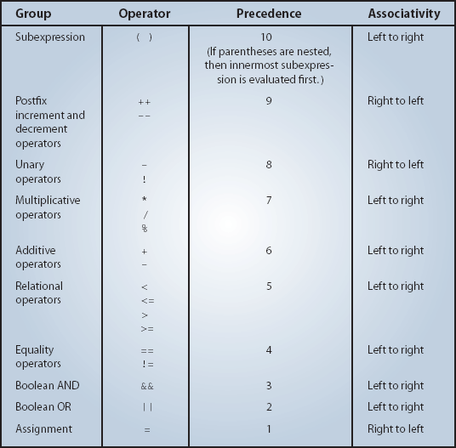
Operator Precedence Rules
Notes:
The precedence table shows the order of operator evaluation. Instead of memorizing this table, it is more convenient and the code more readable if you use the parentheses judiciously.

Slide 21
Boolean Variables
The result of a boolean expression is either true or false. These are the two values of data type boolean.
We can declare a variable of data type boolean and assign a boolean value to it.
boolean pass, done;
pass = 70 < x;
done = true;
if (pass) {
…
} else {
…
}
Notes:
The result of a boolean expression is one of the values of data type boolean. As we can assign an int value to an int variable, we can assign a boolean value to a boolean variable.

Slide 22
Boolean Methods
A method that returns a boolean value, such as
private boolean isValid(int value) {
if (value < MAX_ALLOWED)
return true;
} else {
return false;
}
}
if (isValid(30)) {
…
} else {
…
}
Can be used as
Notes:
This example shows an effective use of a boolean method. We will be seeing this style of using boolean methods frequently, so make sure you are comfortable with this.

Slide 23
Comparing Objects
With primitive data types, we have only one way to compare them, but with objects (reference data type), we have two ways to compare them.
  We can test whether two variables point to the same object (use ==), or
  We can test whether two distinct objects have the same contents.
Notes:
Comparing primitive data types is straightforward because there's only one way to compare them. Comparing objects is a little trickier because we can compare them in two different ways.

Slide 24
Using == With Objects (Sample 1)
String str1 = new String("Java");
String str2 = new String("Java");
if (str1 == str2) {
System.out.println("They are equal");
} else {
System.out.println("They are not equal");
}
They are not equal
Not equal because str1 and str2 point to different String objects.
Notes:
When we use the equality operator (==), we can comparing the contents of the variables str1 and str2. So str1 == str2 being true means the contents are the same, which in turn, means they are pointing to the same object because the content of a reference data type is an address. Therefore, if there are two distinct objects, even the values hold by these objects are the same, the equality testing by the equality operator will always result in false.

Slide 25
Using == With Objects (Sample 2)
String str1 = new String("Java");
String str2 = str1;
if (str1 == str2) {
System.out.println("They are equal");
} else {
System.out.println("They are not equal");
}
They are equal
It's equal here because str1 and str2 point to the same object.

Slide 26
Using equals with String
String str1 = new String("Java");
String str2 = new String("Java");
if (str1.equals(str2)) {
System.out.println("They are equal");
} else {
System.out.println("They are not equal");
}
They are equal
It's equal here because str1 and str2 have the same sequence of characters.
Notes:
To compare whether two String objects have the same sequence of characters, we use the equals method. This method checks for the case. If we want to compare String objects case-insensitively, then we use the equalsIgnoreCase method.

Slide 27
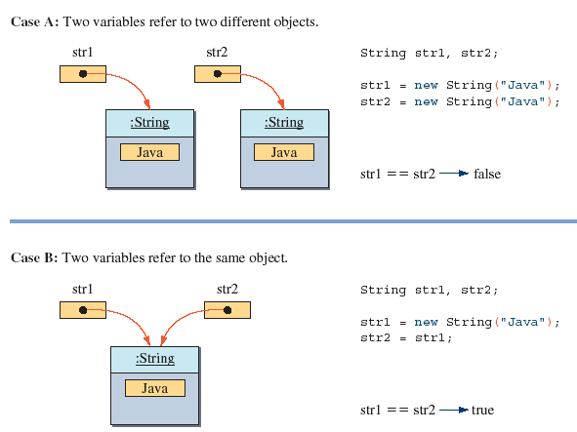
The Semantics of ==

Slide 28
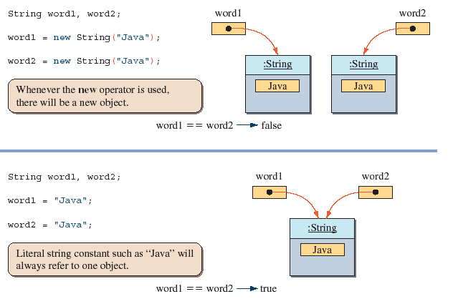
In Creating String Objects

Slide 29
The switch Statement
int gradeLevel;
gradeLevel = JOptionPane.showInputDialog("Grade (Frosh-1,Soph-2,...):" );
switch (gradeLevel) {
case 1: System.out.print("Go to the Gymnasium");
break;
case 2: System.out.print("Go to the Science Auditorium");
break;
case 3: System.out.print("Go to Harris Hall Rm A3");
break;
case 4: System.out.print("Go to Bolt Hall Rm 101");
break;
}
This statement is executed if the gradeLevel is equal to 1.
This statement is executed if the gradeLevel is equal to 4.
Notes:
This is an example of a switch statement. The variable gradeLevel is called a switch control. The data type for a switch control must be one of the integer data types or a char.

Slide 30
Syntax for the switch Statement
switch ( <arithmetic expression> ) {
<case label 1> : <case body 1>
…
<case label n> : <case body n>
}
Arithmetic Expression
switch ( gradeLevel ) {
case 1: System.out.print( "Go to the Gymnasium" );
break;
case 2: System.out.print( "Go to the Science Auditorium" );
break;
case 3: System.out.print( "Go to Harris Hall Rm A3" );
break;
case 4: System.out.print( "Go to Bolt Hall Rm 101" );
break;
}
Case Label
Case Body
Notes:
This is the general syntax rule for a switch statement. The case body may contain zero or more statements.

Slide 31
switch With No break Statements
true
N == 1 ?
x = 10;
switch ( N ) {
case 1: x = 10;
case 2: x = 20;
case 3: x = 30;
}
false
true
N == 2 ?
x = 20;
false
true
N == 3 ?
x = 30;
false
Notes:
This flowchart shows the control flow of a switch statement when case bodies do not include the break statement. The flow will first start from the matching case body and then proceed to the subsequent case bodies.

Slide 32
switch With break Statements
true
N == 1 ?
x = 10;
switch ( N ) {
case 1: x = 10;
break;
case 2: x = 20;
break;
case 3: x = 30;
break;
}
false
break;
true
N == 2 ?
x = 20;
false
break;
true
N == 3 ?
x = 30;
false
break;
Notes:
By placing a break statement at the end of a case body, the control flow will jump to the next statement that follows this switch statement. By placing a break statement at the end of each case body, the case bodies become mutually exclusive, i.e., at most one case body will be executed.

Slide 33
switch With the default Block
switch (ranking) {
case 10:
case 9:
case 8: System.out.print("Master");
break;
case 7:
case 6: System.out.print("Journeyman");
break;
case 5:
case 4: System.out.print("Apprentice");
break;
default: System.out.print("Input error: Invalid Data");
break;
}
Notes:
If the ranking is 10, 9, or 8, then the text “Master” is displayed. If the ranking is 7 or 6, “Journeyman” is displayed. If the ranking is 5 or 4, “Apprentice” is displayed. If there’s no matching case, the default case is executed and an error message is displayed. If a default case is included, then it is executed when there are no matching cases. You can define at most one default case.
A default case is often used to detect an erroneous value in the control variable.
Although not required, it is a standard to place the default case at the end.

Slide 34
Drawing Graphics
Chapter 5 introduces four standard classes related to drawing geometric shapes. They are
  java.awt.Graphics
  java.awt.Color
  java.awt.Point
  java.awt.Dimension
These classes are used in the Sample Development section
Please refer to Java API for details
Notes:
A Graphics object keeps track of necessary information about the system to draw geometric shapes. A Color object represents a color in RGB (red, green, blue) format. A Point object represents a point in a coordinate system. A Dimension object represents the dimension of a rectangular shape. Section 5.6 of the textbook explains these four standard classes.

Slide 35
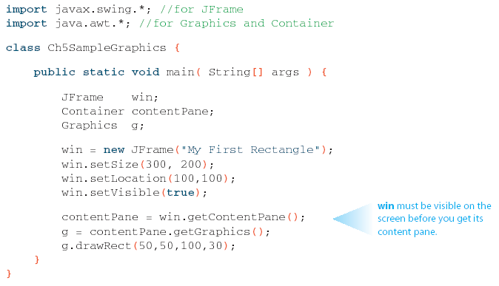
Sample Drawing
Notes:
This program draws a rectangle of size 100 pixels wide by 30 pixels high at location (50, 50) in a frame window. We are actually drawing the rectangle on the content pane of the frame window.

Slide 36
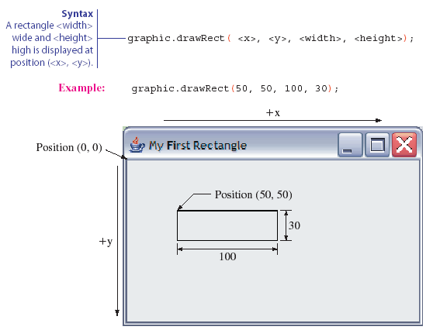
The Effect of drawRect

Slide 37
Problem Statement
Write an application that simulates a screensaver by drawing various geometric shapes in different colors. The user has an option of choosing a type (ellipse or rectangle), color, and movement (stationary, smooth, or random).

Slide 38
Overall Plan
Tasks:
  Get the shape the user wants to draw.
  Get the color of the chosen shape.
  Get the type of movement the user wants to use.
  Start the drawing.
Notes:
As a part of the overall plan, we begin by identifying the main tasks for the program. Notice this program follows the universal pattern of computer programs, namely, the pattern of input, computation, and output. The drawing of a specified object constitutes the computation and output aspects of the program pattern.

Slide 39
Required Classes
Ch5DrawShape
JOptionPane
standard class
DrawingBoard
DrawableShape
class we implement
helper class given to us
Notes:
Given the tasks identified in the overall program flow, we need to find suitable classes and objects to carry out the tasks. For this program, we will use one helper class that provides a service of drawing and moving geometric shapes. The actual shape to be drawn is determined by the code programmed in the DrawableShape class. We specify the shapes we want to draw by implementing the DrawableShape class accordingly. In addition to this class, we will implement the main class Ch5DrawShape.

Slide 40
Development Steps
We will develop this program in six steps:
  Start with a program skeleton. Explore the DrawingBoard class.
  Define an experimental DrawableShape class that draws a dummy shape.
  Add code to allow the user to select a shape. Extend the DrawableShape and other classes as necessary.
  Add code to allow the user to specify the color. Extend the DrawableShape and other classes as necessary.
  Add code to allow the user to specify the motion type. Extend the DrawableShape and other classes as necessary.
  Finalize the code by tying up loose ends.

Slide 41
Step 1 Design
The methods of the DrawingBoard class
  public void addShape(DrawableShape shape)
    Adds a shape to the DrawingBoard. No limit to the number shapes you can add
  public void setBackground(java.awt.Color color)
    Sets the background color of a window to the designated color
  public void setDelayTime(double delay)
    Sets the delay time between drawings to delay seconds
  public void setMovement(int type)
    Sets the movement type to STATIONARY, RANDOM, or SMOOTH
  public void setVisible(boolean state)
    Sets the background color of a window to the designated color
  public void start( )
    Starts the drawing of added shapes using the designated movement type and delay time.
Notes:
In the first step, we explore the given DrawingBoard class. There are six public methods. Fuller explanation can be found on page 268 of the textbook.

Slide 42
Step 1 Code
    Directory: Chapter5/Step1
    Source Files: Ch5DrawShape.java
Program source file is too big to list here. From now on, we ask
you to view the source files using your Java IDE.
Notes:
Please use your Java IDE to view the source files and run the program.

Slide 43
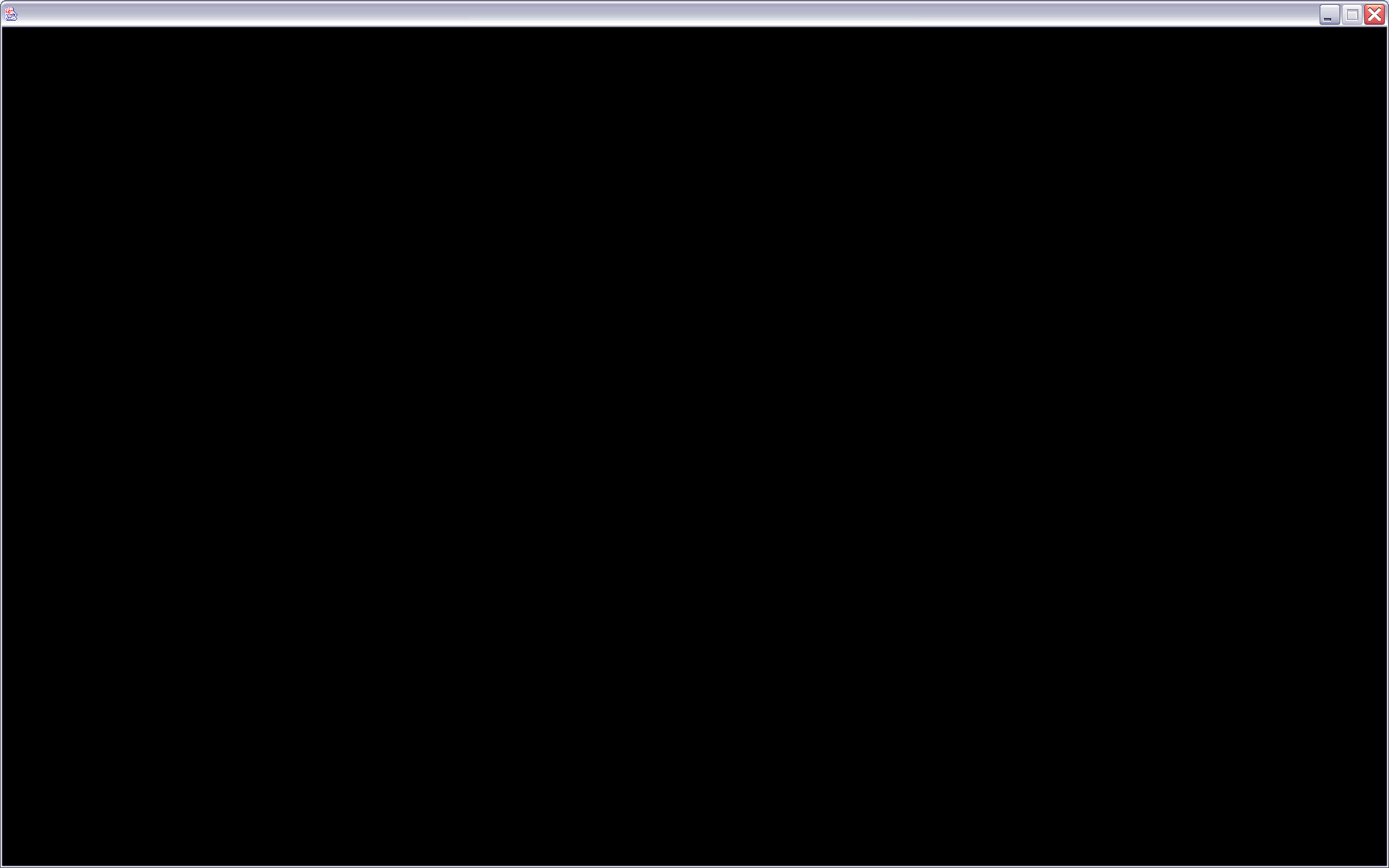
Step 1 Test
In the testing phase, we run the program and verify that a DrawingBoard window with black background appears on the screen and fills the whole screen.
Notes:
Run the program and verify that you get the same result.

Slide 44
Step 2 Design
Define a preliminary DrawableShape class
The required methods of this class are
  public void draw(java.awt.Graphics g)
    Draws a shape on Graphics object g.
  public java.awt.Point getCenterPoint( )
    Returns the center point of this shape
  public java.awt.Dimension getDimension( )
    Returns the bounding rectangle of this shape
  public void setCenterPoint(java.awt.Point pt)
    Sets the center point of this shape to pt.
Notes:
We are now ready to test the actual drawing of some geometric shape. The DrawingBoard class controls a collection of shapes by drawing and moving them on a frame window. The actual drawing of a shape is delegated to the draw method of DrawableShape. So by defining this method ourselves, we can draw any shape we want to draw. In addition to calling to the draw method, a DrawingBoard object will be calling three additional public methods of the DrawableShape class. We need to define them also. In this step we will draw a fix-sized circle whose radius is set to 100 pixels and dimension to 200 by 200 pixels. We will improve the methods as we progress through the development steps.

Slide 45
Step 2 Code
    Directory: Chapter5/Step2
    Source Files: Ch5DrawShape.java
    DrawableShape.java
Notes:
We extended the start method of the Ch5DrawShape class to add three DrawableShape objects with different center points.

Slide 46
Step 2 Test
We compile and run the program numerous times
We confirm the movement types STATIONARY, RANDOM, and SMOOTH.
We experiment with different delay times
We try out different background colors
Notes:
Our key purpose of Step 2 testing is to confirm the connection between the DrawingBoard and DrawableShape classes. We need to try out all three movement types and confirm how they affect the movement of geometric shapes. We will also experiment with the delay times and background colors.

Slide 47
Step 3 Design
We extend the main class to allow the user to select a shape information.
We will give three choices of shapes to the user: Ellipse, Rectangle, and Rounded Rectangle
We also need input routines for the user to enter the dimension and center point. The center point determines where the shape will appear on the DrawingBoard.
Three input methods are
  private int inputShapeType( )
  private Dimension inputDimension( )
  private Point inputCenterPoint( )
Notes:
The input methods for shape type, dimension, and center point will include input validation tests. For example, the width of a shape is restricted within the range of 100 and 500 pixels. Any invalid input will be replaced by a minimum valid value of 100.
The DrawableShape class is updated accordingly to handle the drawing of different shapes. In the previous step, a fix-sized circle was drawn. The drawShape method is updated to draw three different types of shapes.

Slide 48
Step 3 Code
    Directory: Chapter5/Step3
    Source Files: Ch5DrawShape.java
    DrawableShape.java
Notes:
Both classes include substantial additions to the code.

Slide 49
Step 3 Test
We run the program numerous times with different input values and check the results.
Try both valid and invalid input values and confirm the response is appropriate
Notes:
We need to try out as many variations as possible for the input values, trying out all three possible shape types, different dimensions, and different center points.

Slide 50
Step 4 Design
We extend the main class to allow the user to select a color.
We follow the input pattern of Step 3.
We will allow the user to select one of the five colors.
The color input method is
  private Color inputColor( )
Notes:
We follow the pattern of inputting the shape type for the color input routine.

Slide 51
Step 4 Code
    Directory: Chapter5/Step4
    Source Files: Ch5DrawShape.java
    DrawableShape.java
Notes:
We make intermediate extensions to both classes to handle the color input and drawing.

Slide 52
Step 4 Test
We run the program numerous times with different color input.
Try both valid and invalid input values and confirm the response is appropriate
Notes:
We need to try out as many variations as possible to test the color input routine and verify the color selected is used in the actual drawing of shapes.

Slide 53
Step 5 Design
We extend the main class to allow the user to select a movement type.
We follow the input pattern of Step 3.
We will allow the user to select one of the three movement types.
The movement input method is
  private int inputMotionType( )
Notes:
We follow the pattern of inputting the shape type for the movement input routine.

Slide 54
Step 5 Code
    Directory: Chapter5/Step5
    Source Files: Ch5DrawShape.java
    DrawableShape.java
Notes:
We make minor extensions to both classes to handle the movement input routine.

Slide 55
Step 5 Test
We run the program numerous times with different movement input.
Try both valid and invalid input values and confirm the response is appropriate
Notes:
We need to try out as many variations as possible to test the movement input routine and verify the movement selected is used in the actual drawing of shapes.

Slide 56
Step 6: Finalize
Possible Extensions
  Morphing the object shape
  Changing the object color
  Drawing multiple objects
  Drawing scrolling text
Notes:
There are a number of very interesting extensions we can make to the program.

