Slide 1
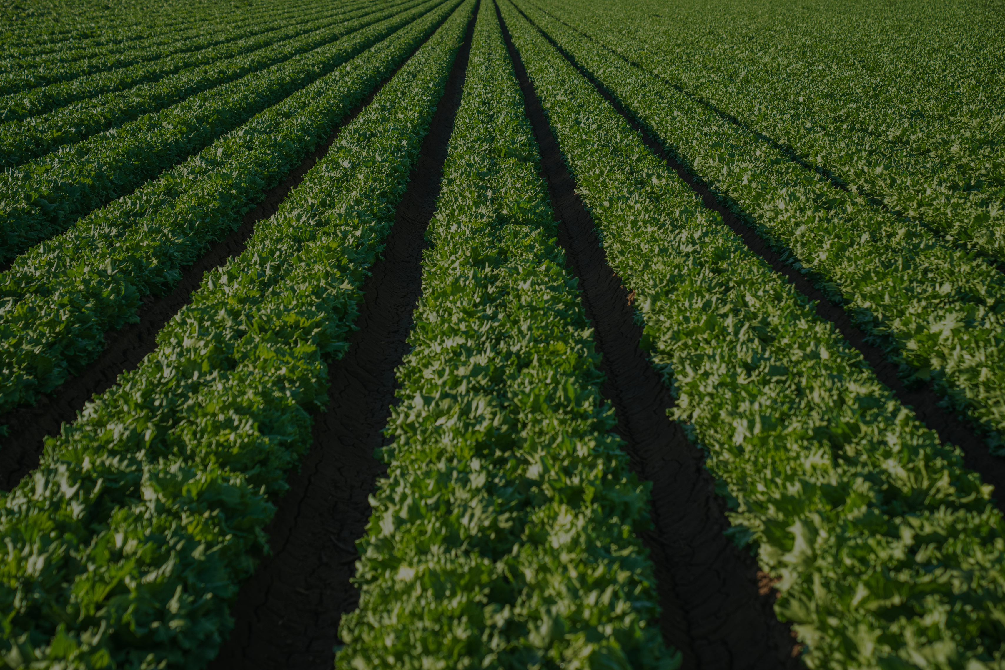

FarmBotika
Your Farming Ally, from Ground to Growth

Slide 2
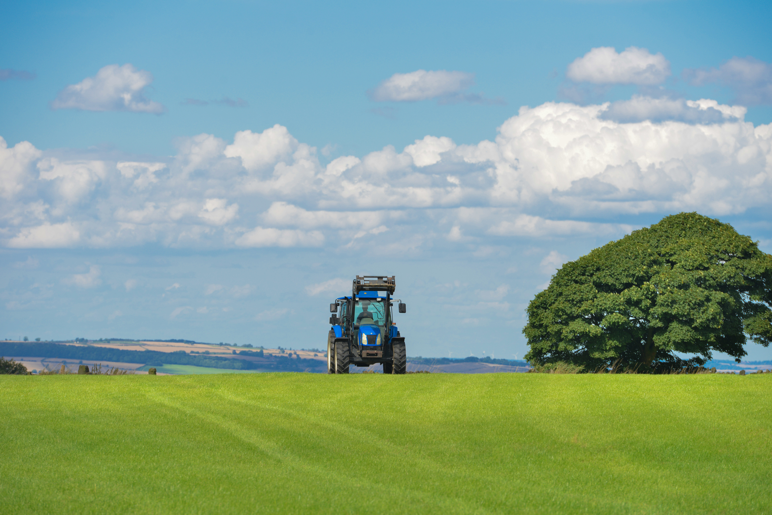


Team Members
1. Meshack Ochieng’ – Team Lead
2. Philip Simiyu – UX/UI Designer
3. Elsie Wanjiku - UX/UI Designer
4. Nicholas Mwangi – ML Engineer
5. Brian Kipkirui – Backend Engineer
6. Ian Mandila – IoT Expert
7. Maureen Nkatha – Data Scientist
8. Emmanuel – IoT Engineer

Slide 3
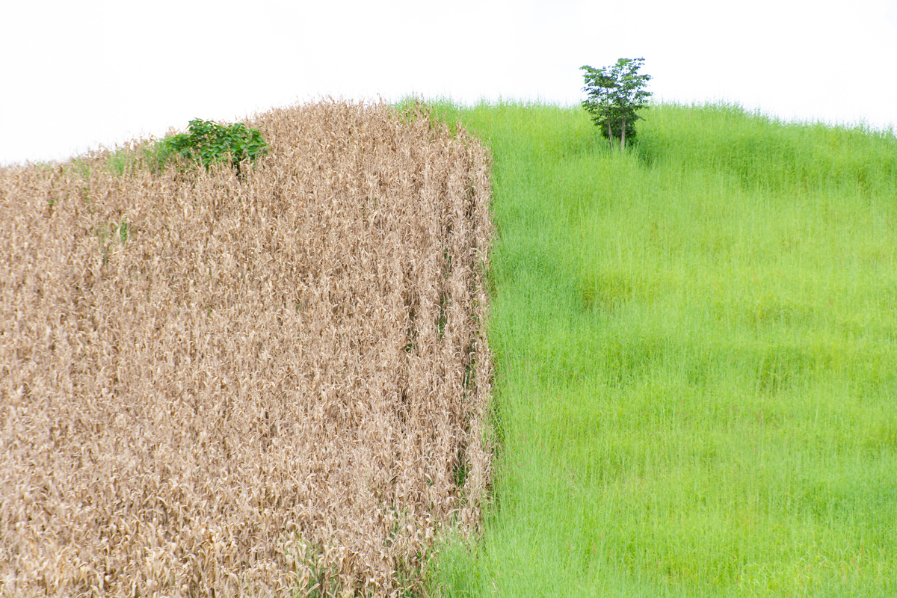
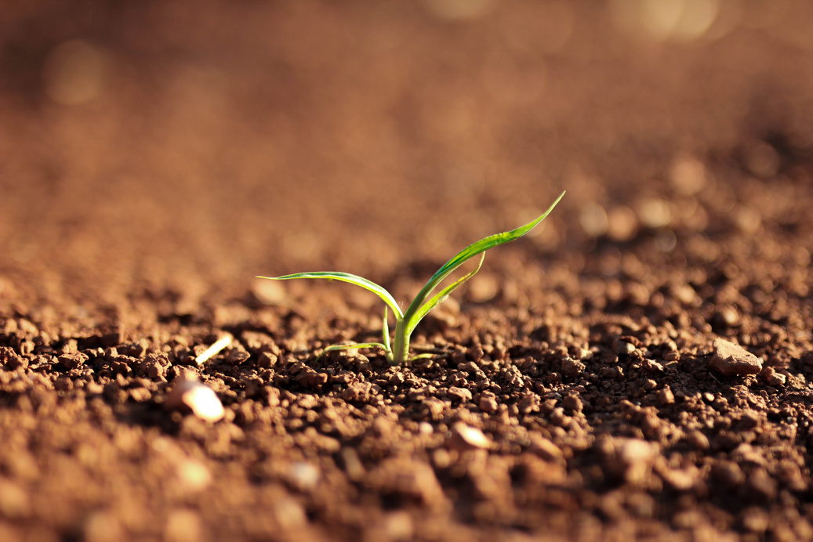
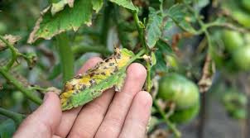
Problem Statement
Smallholder farmers in rural areas face persistent, interconnected challenges—from unpredictable weather and degraded soil health to delayed pest detection—each limiting productivity, driving up costs, and threatening food security.
Climate Change
Soil Degradation
Pests and Diseases
Unpredictable weather reduces crop yield.
Lack of real-time soil data.
Delayed pest detection harms crops.

Slide 4
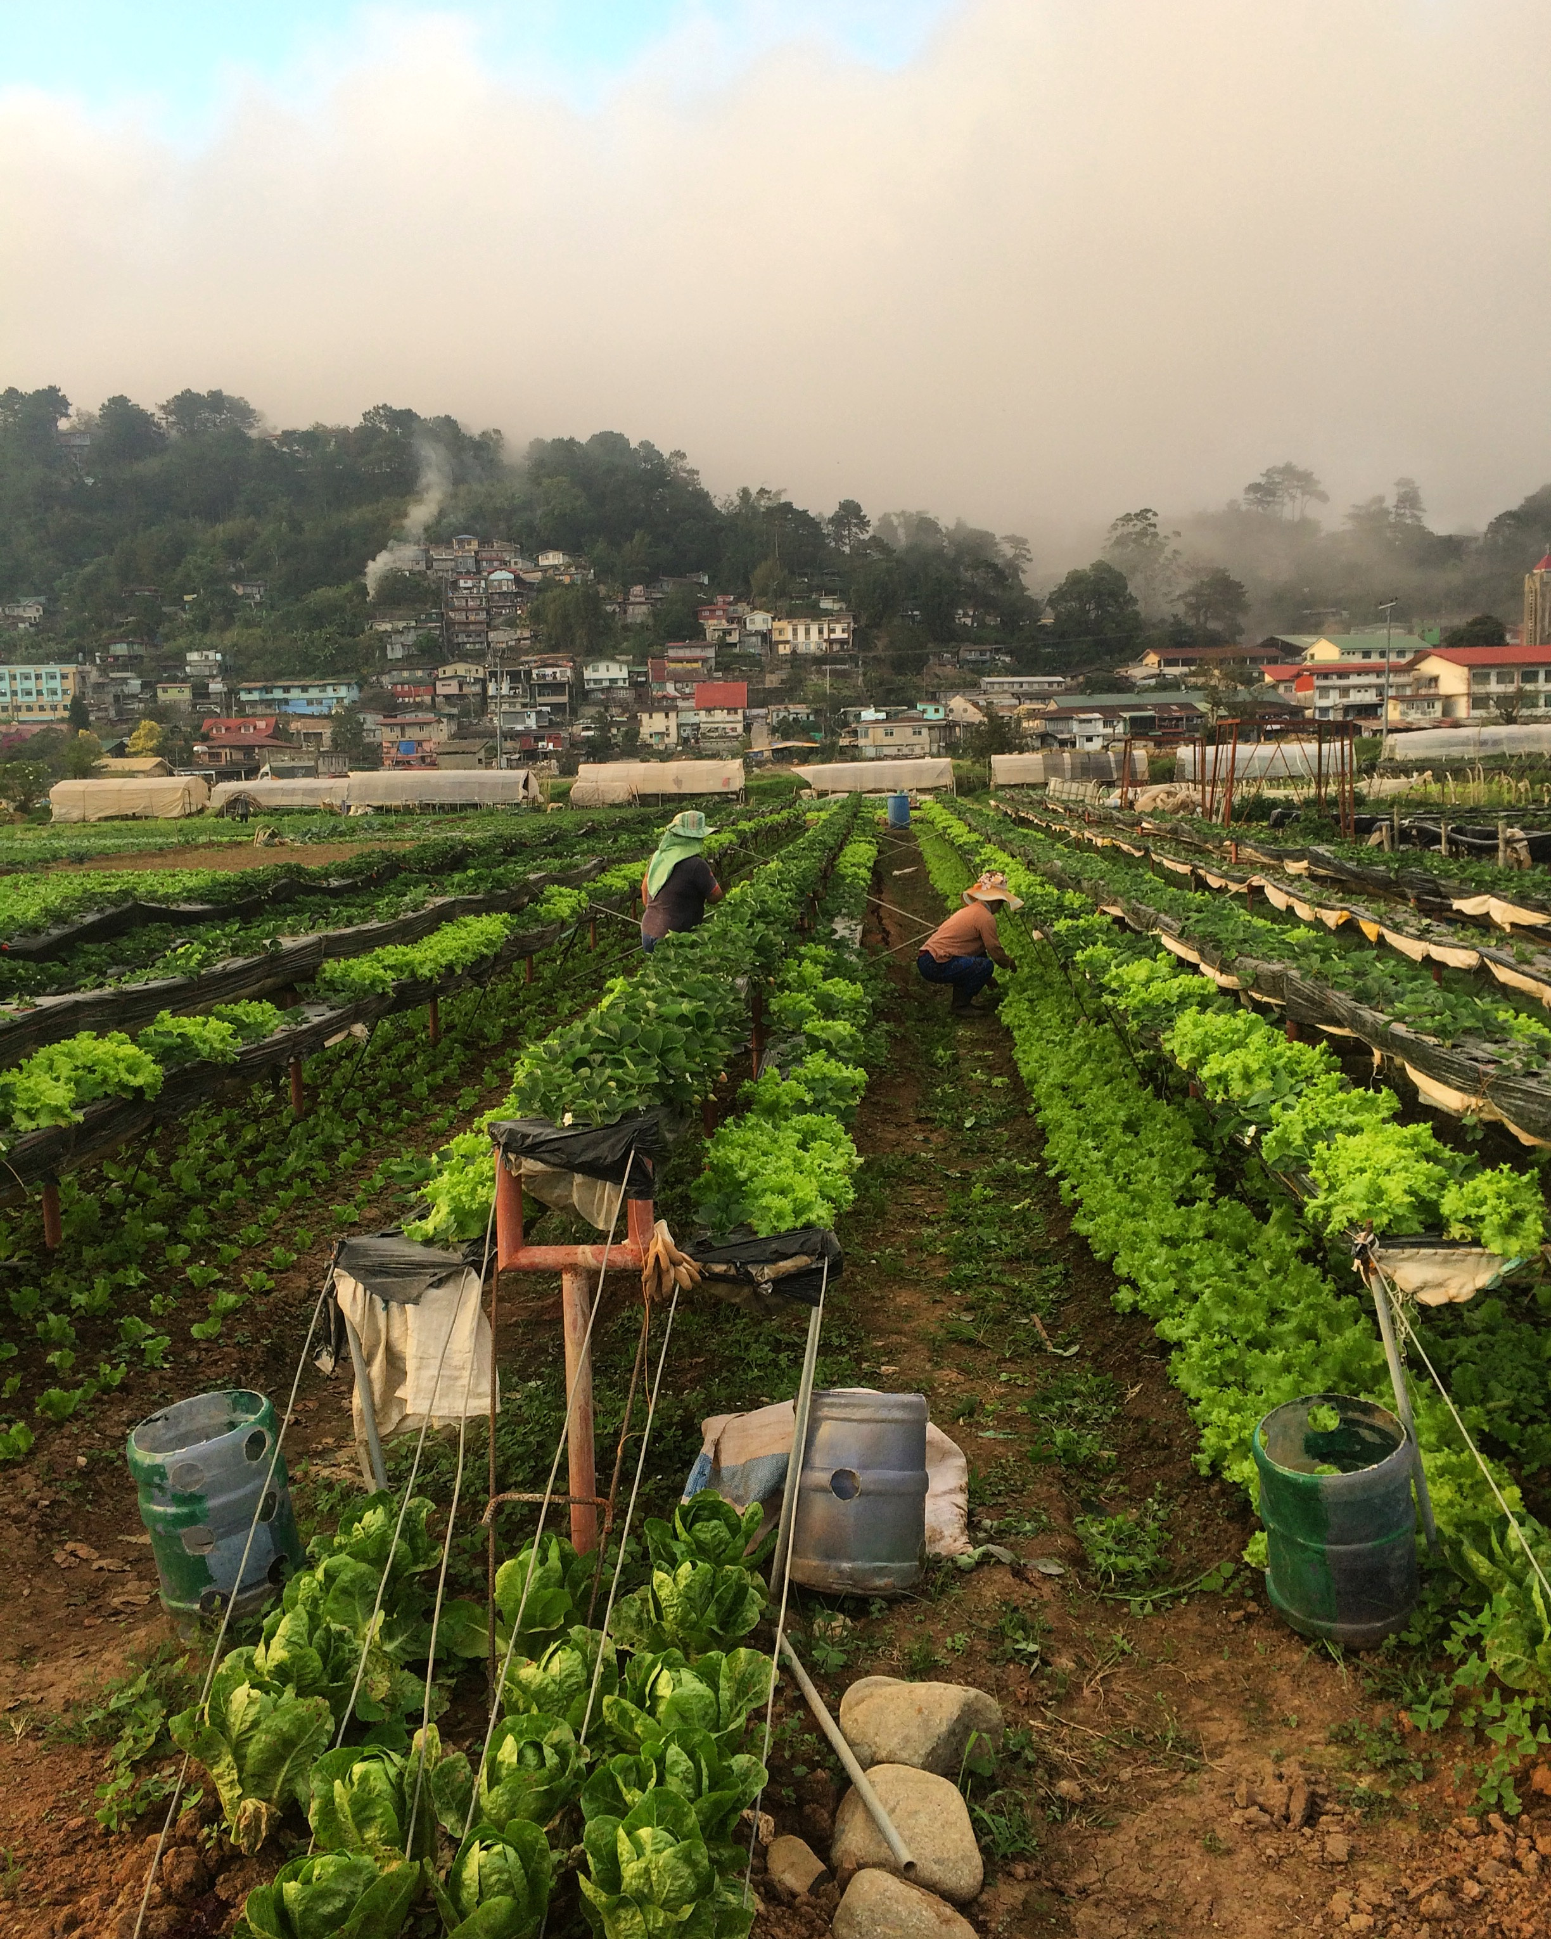
Solution
FarmBotika delivers AI-powered, localized crop, soil, and weather insights directly to farmers via SMS and USSD.
AI-Driven Weather Forecasting
AI-Driven weather forecasting for precise predictions.

Slide 5
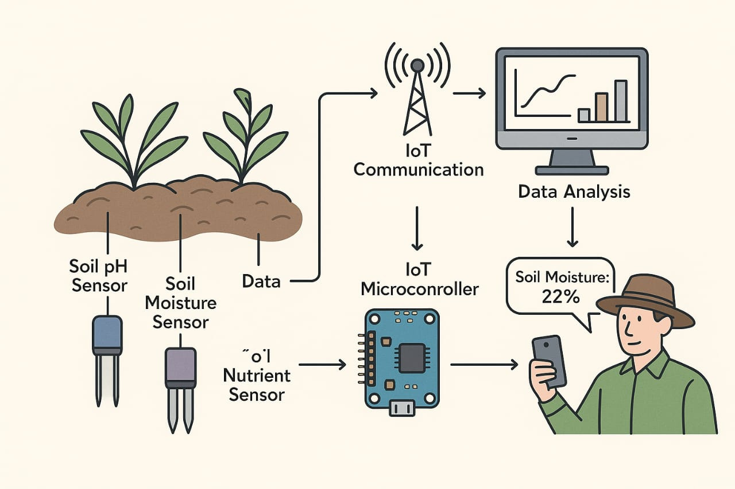
2. IoT-Driven Soil Health

Slide 6
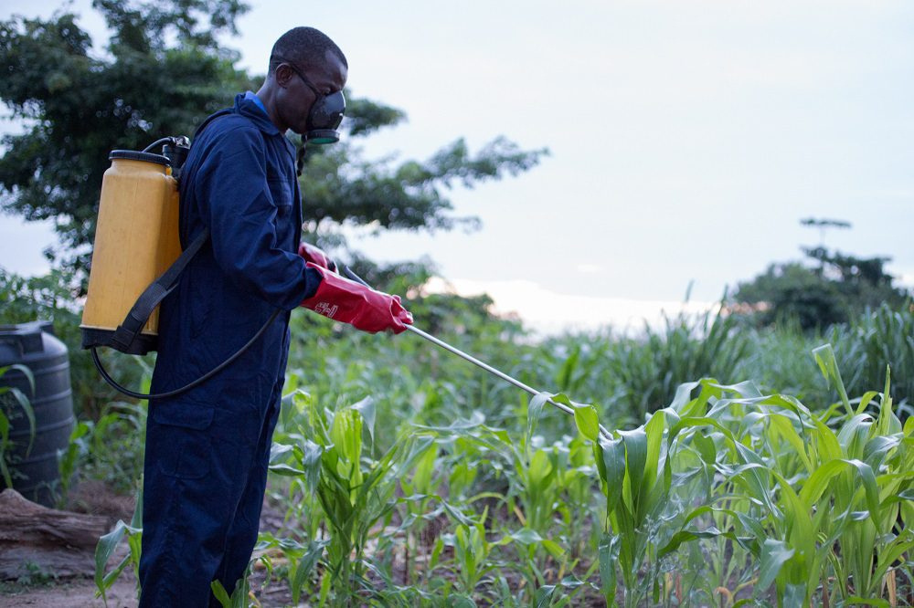
3. AI-Driven Pests and Diseases control
ML vision detect pest and diseases in fields.

Slide 7




Journey through the farming process
No Internet connectivity needed
Why FarmBotika is Unique
Supports diverse local languages
Small-local farmer customization

Slide 8
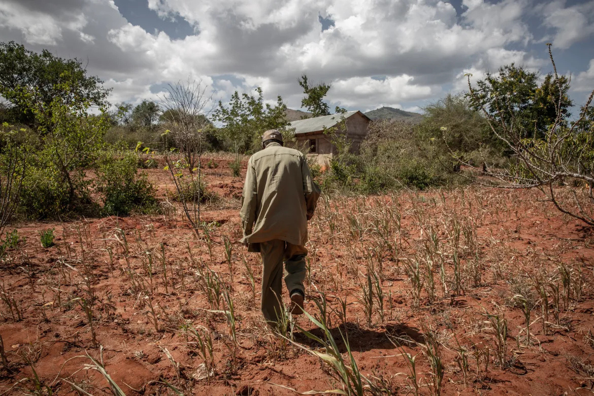
FarmBotika Target Users
01.
Smallholder Farmers in Low-Connectivity Areas.
02.
Local Extension Agents / Agro-Dealers
03.
Non-Governmental Organizations (NGOs)

Slide 9
FarmBotika
Technical Feasibility
02
01
03
UX/UI
Backend
React
Tailwind CSS
JavaScript
Machine Learning
Python(Django)
Node JS
USSD/SMS(Africa Talking)
04
Python
Open-source Data sets
IoT
Sensor data coding

Slide 10



Kenya Vision 2030
Directly support the agriculture into profitable and competitive sector and nutrition security.
Kenya National Climate Change Action Plan
Alignment with
Development Goals
Integrates climate-smart agriculture practices and strengthens early warning systems for climate resilience.
UN Sustainable Development Goal: Zero Hunger
Which calls for sustainable food production resilience and best agricultural practices.

Slide 11
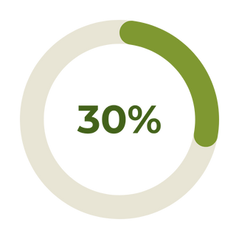
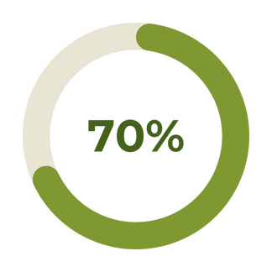
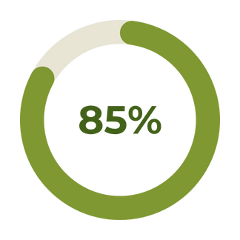
Potential Impact and Scalability
FarmBotika promises a successful, significant and quantifiable boost yields, incomes and resilience for target farmers. For example:
Increased Yields and Income.
Behavior Change Rate
Message Reach and Engagement
.

Slide 12
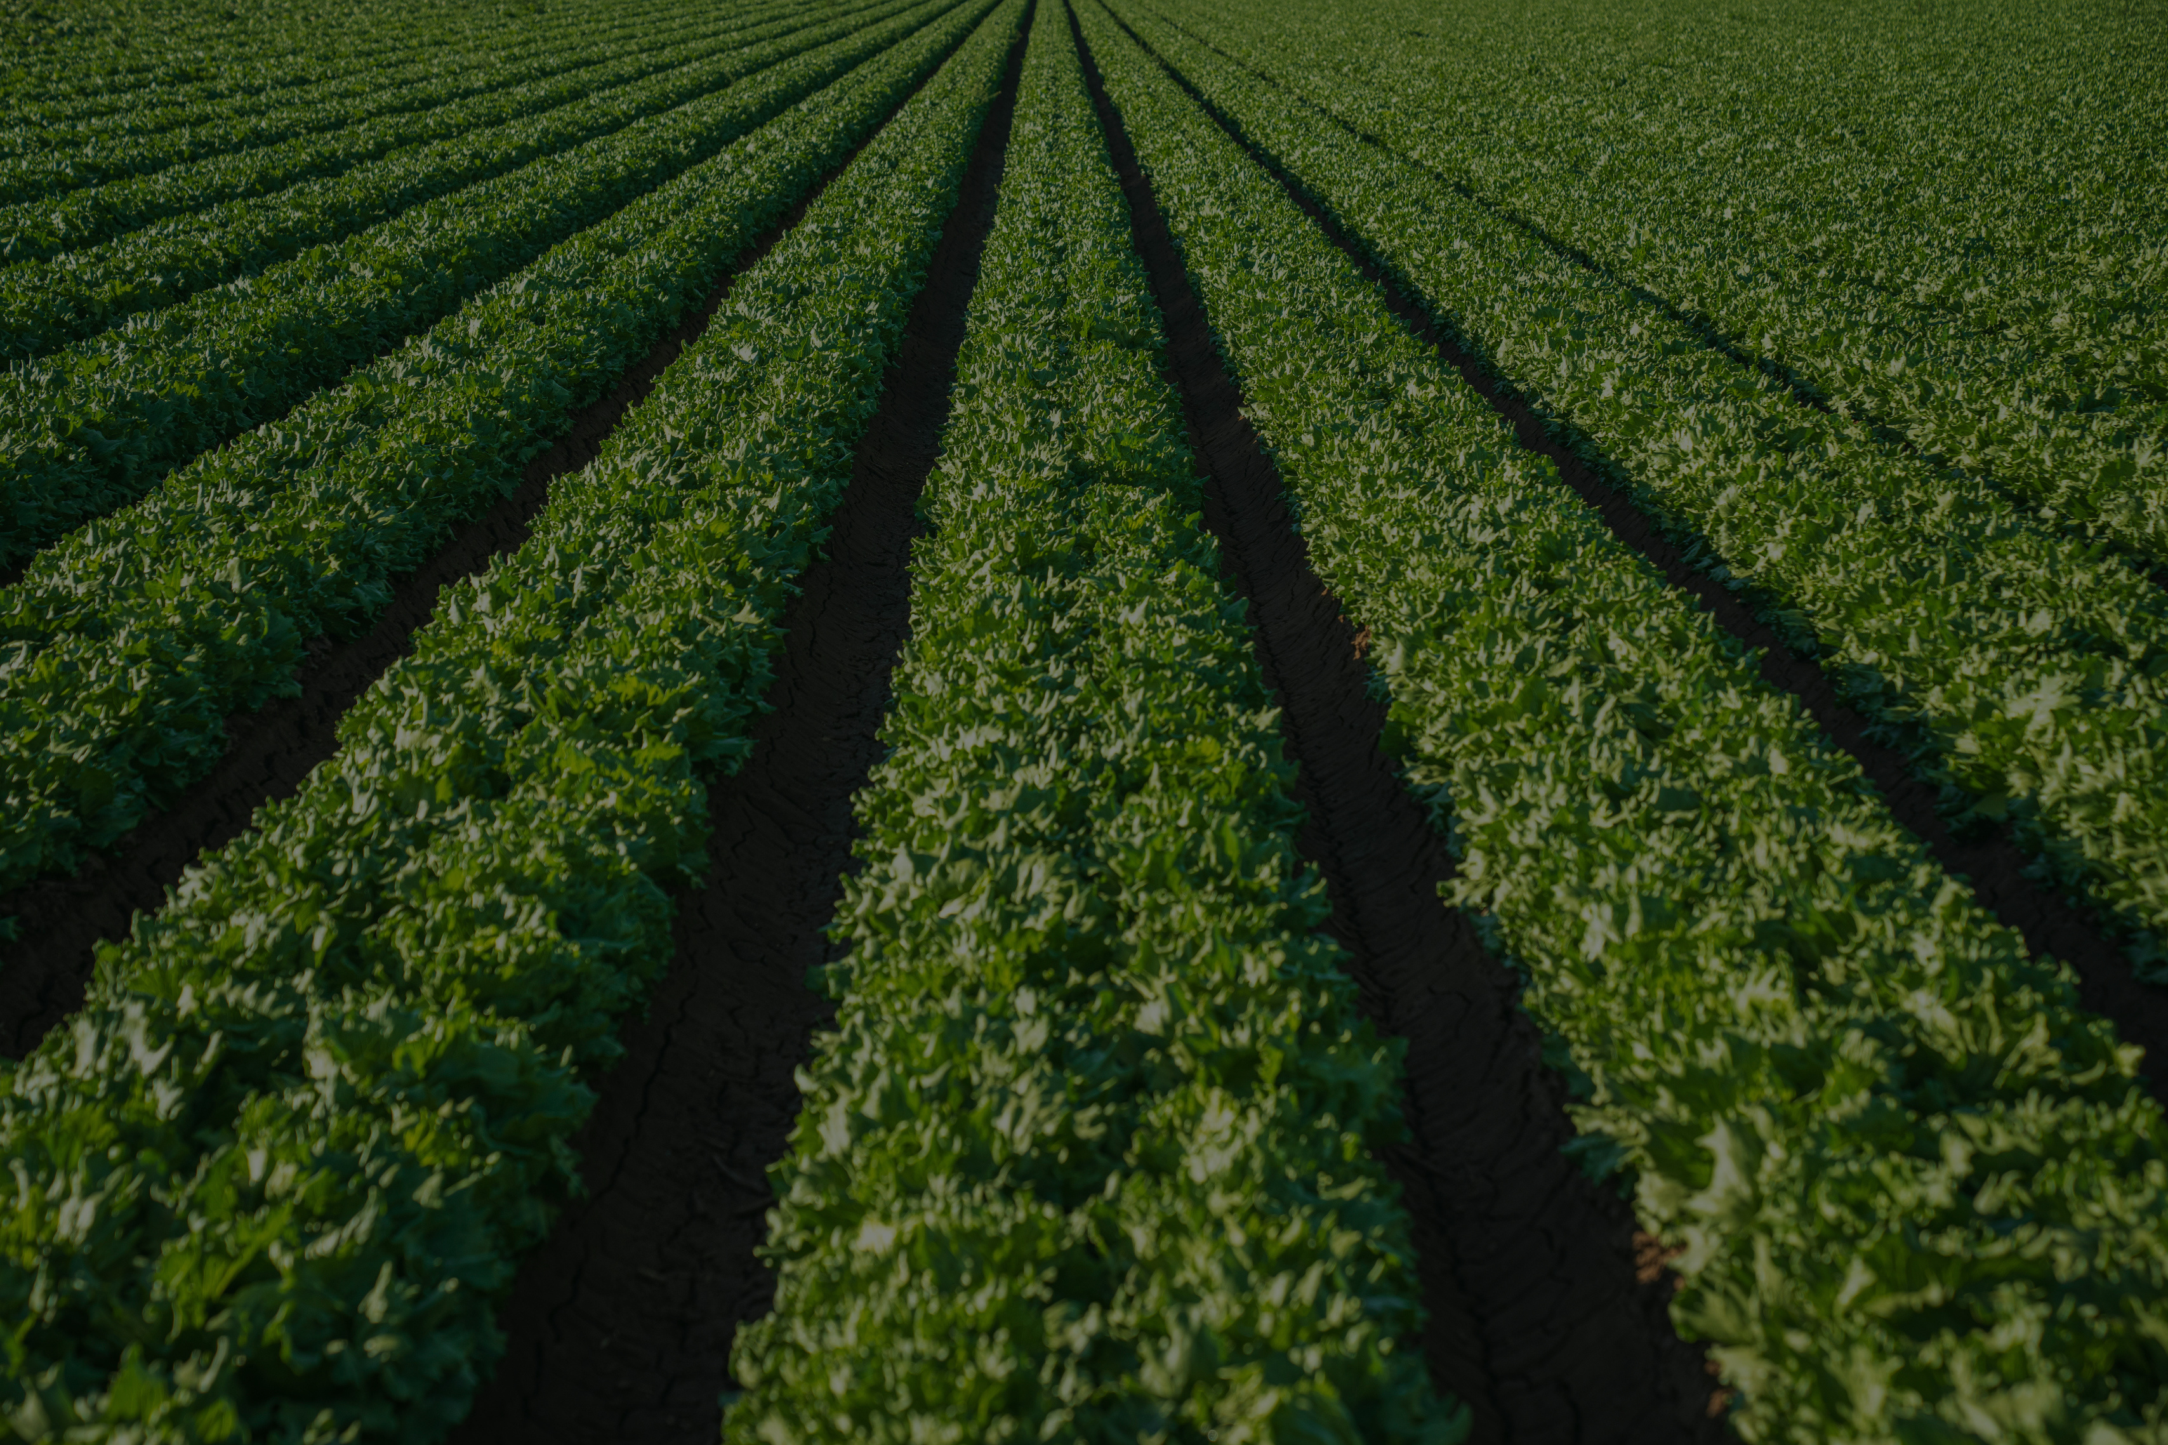
Thank You.

