Slide 1




NDIZIAI
Banana Ripeness Detection and Value Addition Recommendation System

Slide 2


PROBLEM STATEMENT
Lack of value addition in Kenyan agriculture.
Farmers sell bananas immediately due to insufficient knowledge and resources.
High post-harvest losses due to rapid ripening and waste.

Slide 3
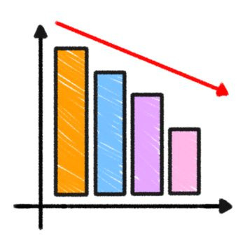
Current Scenario
Kenya produces 1.9 million metric tons of bananas annually
Post-harvest losses for bananas reach up to 50%.
Farmers lack the knowledge and skills for value addition.

Slide 4

Objectives
•Automate detection of banana ripeness levels.
•Provide recommendations on value addition to minimize waste
•Improve farmers' return on investment (ROI) by ensuring minimal crop loss.

Slide 5
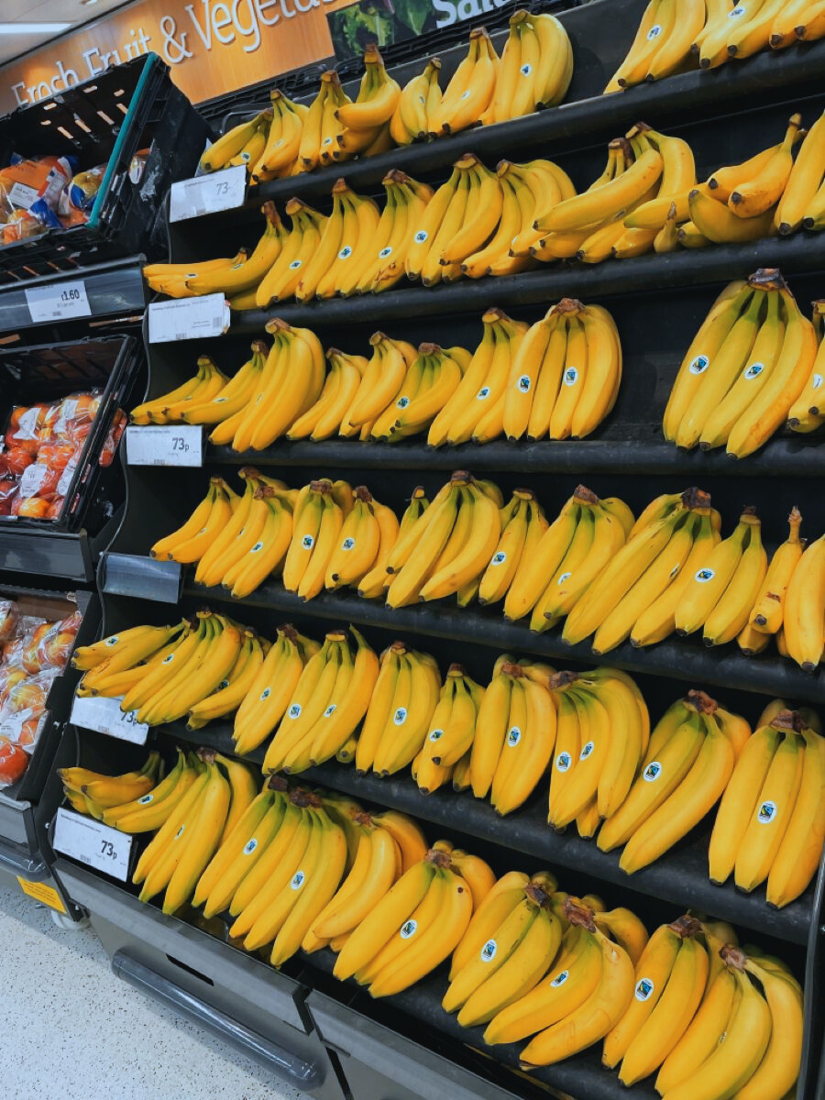
TARGET MARKET
1. Farmers & Banana Growers
2. Fruit Vendors & Market Sellers
3. Supermarkets & Retailers
4. Food Processing Companies
5. Restaurants, Bakeries & Food Businesses
6. Home Users & Consumers

Slide 6


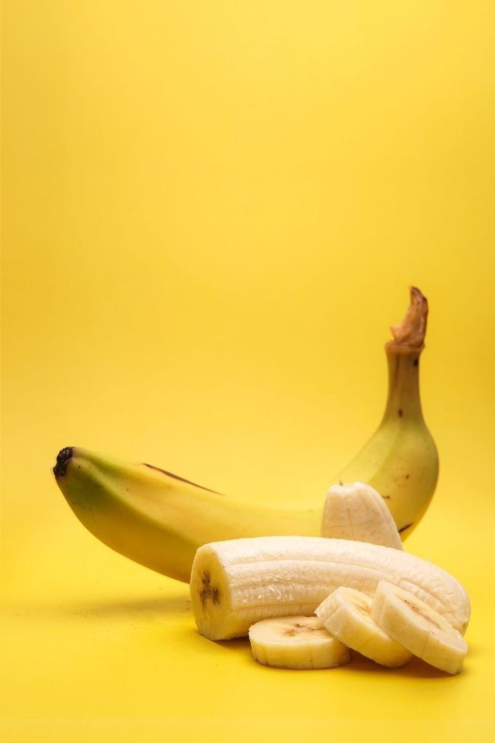
Implementation Plan
• Data collection and preprocessing.
• Model training and optimization.
• Development of the application interface
• System testing and deployment.

Slide 7



Possible Challenges
Model Accuracy:
Affected by lighting and quality variations.
Adoption Barriers:
Farmers hesitant to use new technology.
Technical Issues:
Compatibility with diverse devices and networks.

Slide 8
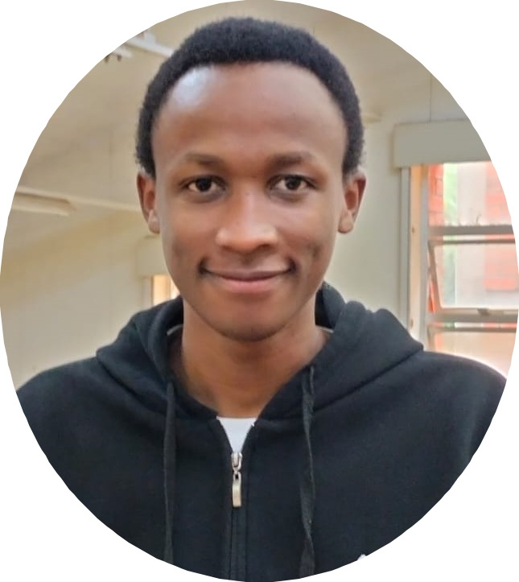
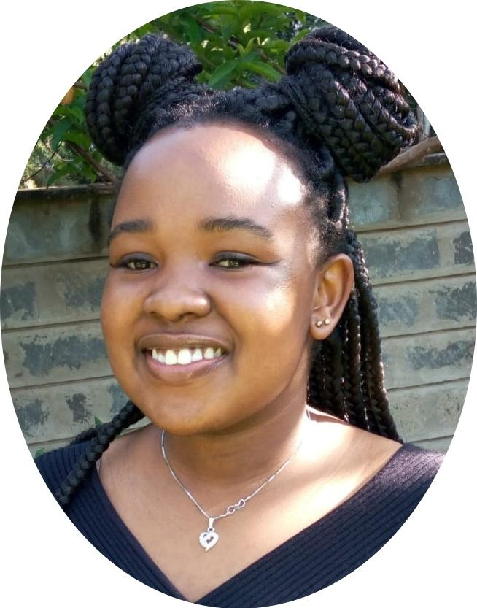


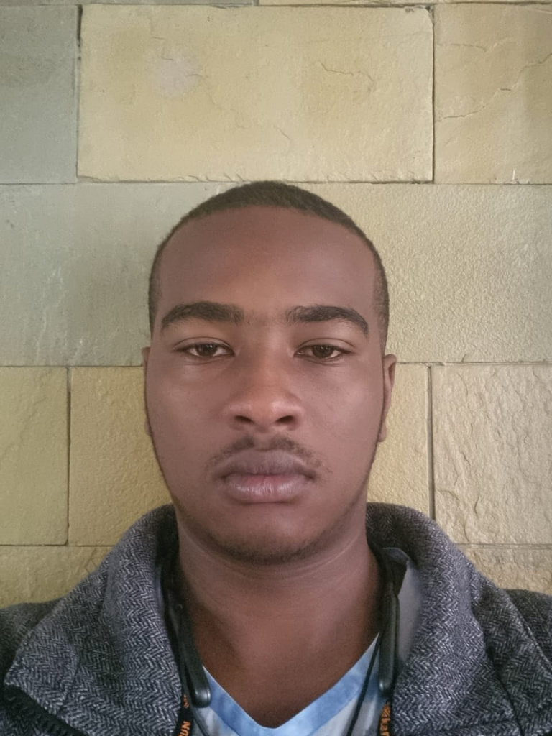
Project Team
Kevin Mwirigi
UI/UX Designer
Christine Nyaga
Frontend Dev
Rotich Kibet
Project Lead
Rotich Kibet
Project Lead
Chrispin Maina
Frontend Dev

