Slide 1
E-Commerce Shipping Data

Slide 2
Into the online Data Science Bootcamps for SDAIA Academy, my project will review the dataset for E-Commerce Shipping Data .it will be cleaning and analysing with visualization data by python libraries

Slide 3
The data contains the following information:
ID: ID Number of Customers.
Warehouse block: The Company have big Warehouse, which is divided in to block such as A, B, C, D, E.
Mode of shipment: The Company Ships the products in multiple way such as Ship, Flight and Road.
Customer care calls: The number of calls made from enquiry for enquiry of the shipment.
Customer rating: The company has rated from every customer. 1 is the lowest (Worst), 5 is the highest (Best).
Cost of the product: Cost of the Product in US Dollars.
Prior purchases: The Number of Prior Purchase.
Product importance: The company has categorized the product in the various parameter such as low, medium, high.
Gender: Male and Female.
Discount offered: Discount offered on that specific product.
Weight: It is the weight in grams.
Reached on time: It is the target variable, where 1 Indicates that the product has NOT reached on time and 0 indicates it has reached on time.

Slide 4
The Work Flow
Import libraries and Loading the data
Cleaning and visualization the data
EDA and Modelling of the date

Slide 5
Cleaning and visualization the data
10999 rows × 12 columns
Libraries
Pandas
Numpy
Visualization
Matplotlib
Seaborn
Modelling
Sklearn

Slide 6
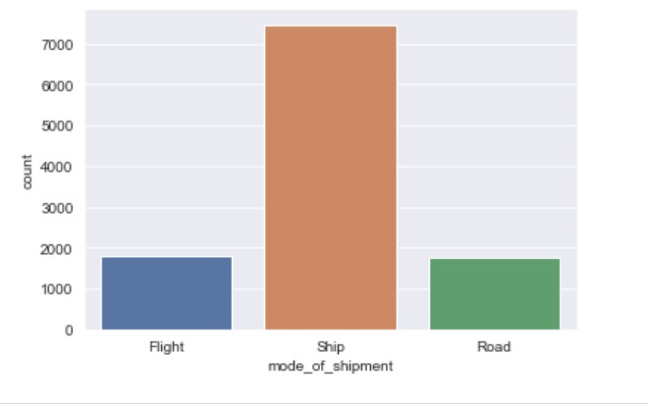
The chart review which way the most used to transfer the shipment

Slide 7
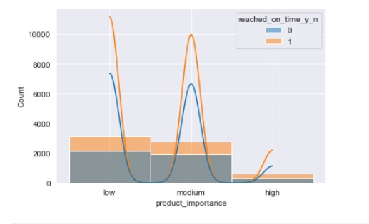
The relation between the product important and the time of received the shipment

Slide 8
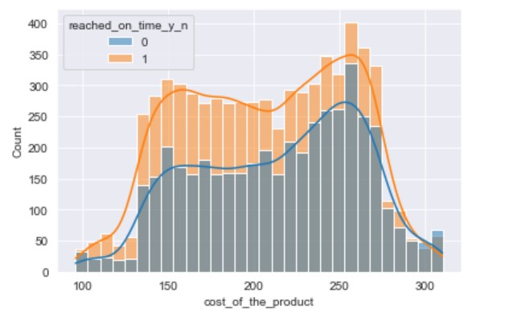
The relation between the cost of the product and the time of received the shipment

Slide 9
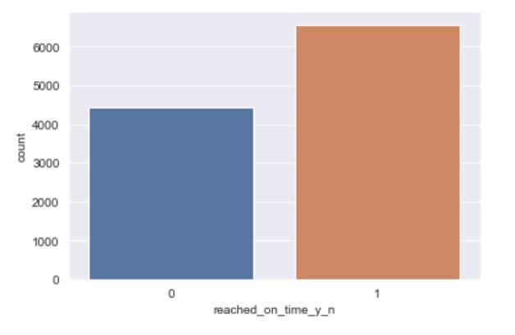
# EDA Reached on time: It is the target variable, where 1 Indicates that the product has NOT reached on time and 0 indicates it has reached on time. # Target #where 1 Indicates that the product has NOT reached on time and 0 indicates it has reached on time.

Slide 10
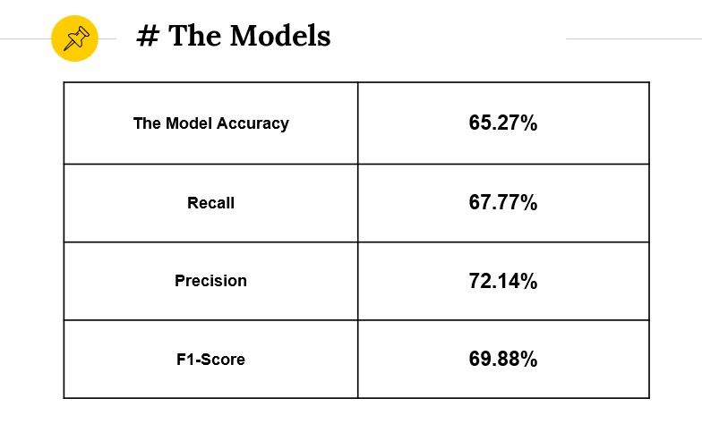

Slide 11
The Models
The Decision Tree model accuracy score was 65% on test dataset
The Random Forest model accuracy score was 66% on test dataset
The Random Forest model accuracy score was 69% on test dataset

Slide 12
Conclusion
From the dataset
the most way used to transfer the shipment by the ship
the product has NOT reached on time more than the product it has reached on time.
The decision Tree model accuracy score was 65% on test dataset
The Random Forest model accuracy score was 69% on test dataset
The advice from the dataset
The customers not happy with all these delay shipment and the company should improve the distribution to be sure to arrive the shipment on the time

Slide 13
Thanks!
Any questions ?
Prepared by
Meshari alshahrani

