Slide 1
Sentiment Analysis of Arabic Tweets

Slide 2
The group of project
Students
Meshary Abdullah Alyami
Abdullah Rashed Alqahtani
Youssef Mohamed Abdelhamid
Supervisor
Dr. Bandar Almaslukh
Prince Sattam Bin Abdulaziz University
College of Computer Engineering and sciences Dep Computer Sciences
May 2022

Slide 3
Introduction
1

Slide 4
Description of the problem
Given an Arabic tweet T, the problem statement can be formulated as developing an effective model M to classify this Arabic tweet into positive or negative using supervised machine learning methods L.
The challenges of sentiment analysis in Arabic words:
Formatting.
Different meanings.
Many dialects.

Slide 5
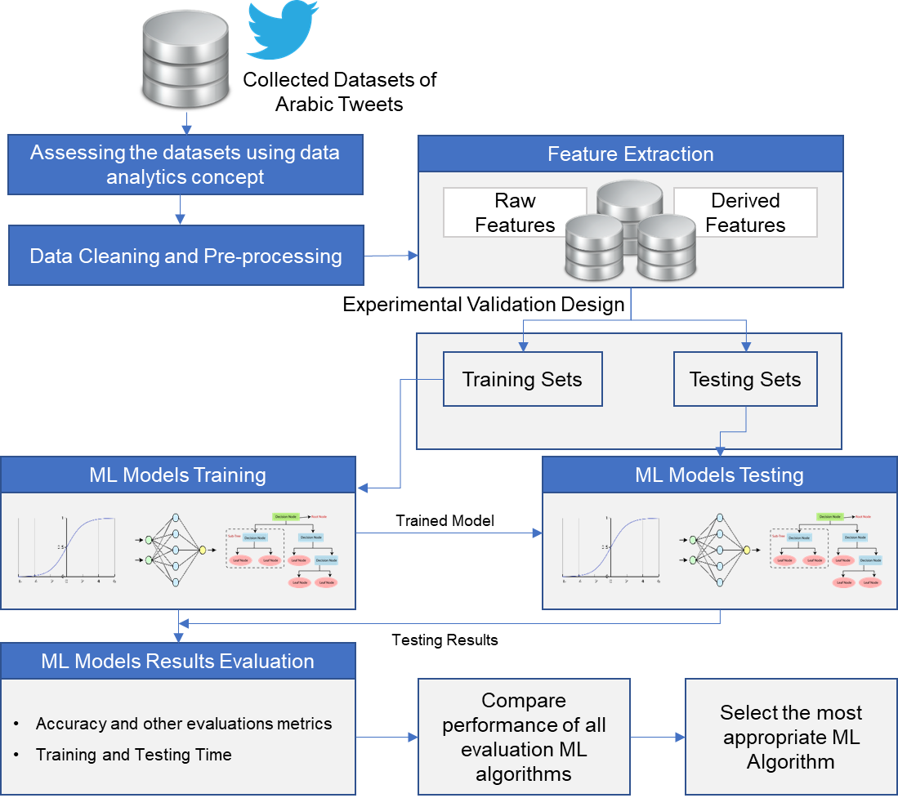
Workflow

Slide 6
Algorithms
2

Slide 7
Naïve Bayse
Naive bayes classifier is a text classification algorithm that is based on bayes probability theorem that is widely used for seminal analysis and filtering spam mail Most popular types of naive bayes algorithm:
Gaussian Naive Bayes.
Multinomial Naive Bayes.
Bernoulli Naive Bayes.

Slide 8
Ridge Classifier
The Ridge Classifier, based on Ridge regression method, converts the label data into [-1,1] and solves the problem with regression method. The highest value in prediction is accepted as a target class and for multiclass data multi output regression is applied.

Slide 9
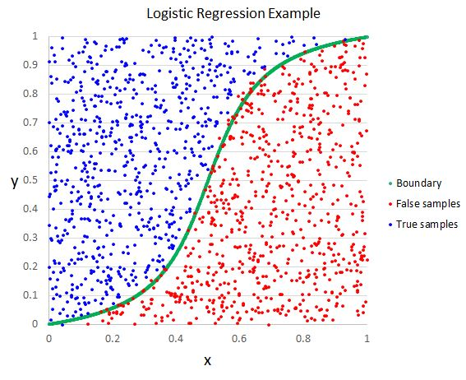
Logistic Regression
Logistic regression AKA Generalized Linear Model is another method to find relations in data based on logistic functions. used usually with binary classifications like true, false or positive, negative by a given set of independent variables to consider it binary class.

Slide 10
Random Forest
It is an improvement over decision trees and as its name suggests, it consists of a large number of individual decision trees that work as a group to obtain more accurate and stable predictions.

Slide 11
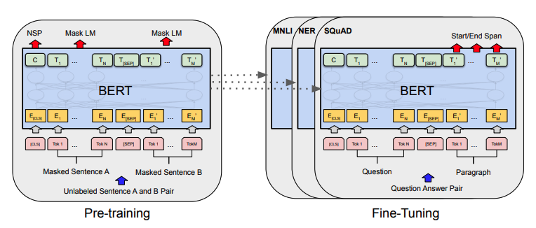
Bidirectional Encoder Representations Transformers (BERT)
BERT is a transformer-based machine learning technique for natural language processing (NLP) pre-training developed by Google. BERT was created and published in 2018 by Jacob Devlin and his colleagues from Google in 2019, Google announced that it had begun leveraging BERT in its search engine

Slide 12
Datasets
3

Slide 13
Datasets:
Availability | References | Collection date | # of tweets | Class | Data set name
Public under CC License | Kaggle | Collect data from twitter API in 2021 | 47,000 | -Positive -Negative | 1- Arabic Sentiment Twitter Corpus
Data not available | https://2u.pw/i12G5 | Collect data from tweepy in 2018 | 151,548 | -Positive -Negative | 2- Twitter Benchmark Dataset for Arabic Sentiment Analysis
Data not available | https://cutt.us/SnLVJ | Collect data from twitter API in January 2016 | 6,341,135 | -positive -negative -neutral -mixed | 3- AraSenTi-Tweet: A Corpus for Arabic Sentiment Analysis of Saudi Tweets
Data not available | https://cutt.us/zWR0J | Collect data from twitter API in March 2020 | 10,000 | -positive -negative -neutral | 4- Arabic Tweets Sentiment Analysis about Online Learning during COVID-19 in Saudi Arabia
Public under GPL 2.0 License | https://cutt.us/SXE2v | Collect data from twitter API in Aug 7, 2015 | 10,000 | -positive -negative -mixed -Objective | 5- ASTD: Arabic Sentiment Tweets Dataset
Public ,the published didn't mention the license | GitHub | Collect data from twitter API in Mar 17, 2018 | 16,702 | -positive -negative -neural | 6- Arabic-Sentiment-Analysis
Public, the published didn't mention the license | https://2u.pw/Lm0nA | Collect data from twitter API in 2019 | 148,328 | -positive -negative | 7- Arabic Language: Twitter Sentiment Analysis
Public, the published didn't mention the license | https://2u.pw/GDnoU | Collect data from twitter API in Mar 17, 2019 | 156,407 | -positive -negative | 8- Arabic Twitter Data for sentiment

Slide 14
Datasets (cont.)
We select two datasets number 7 and number 8 for the following reasons:
Publish datasets.
Modern datasets.
Containing Sufficient data for training.

Slide 15
Datasets (cont.)
After we select dataset 7 and dataset 8, we choose to combine this two datasets to get third dataset containing data from both datasets to test quality from accuracy and other measured to data after combined.

Slide 16
Implementation and Result
4

Slide 17
Data Preprocessing
Remove punctuation signs (''`÷×؛<>_()*&^%][ـ،/:"؟.,'{}~¦+|!”…“–ـ'‘’).
Remove emoji and special character.
Normalize tweets ("[إأآا ]", "ا").
Remove consecutive characters from a string ('شكرا','شكراااااا’).
Remove Arabic stop words.
Remove # character #meshary'-->'meshary’.
Remove mentions (@meshary).

Slide 18
Feature Extraction
We using two way for convert text to number one way for traditional machine learning algorithms and another for deep learning algorithm (BERT), the two way is :
TF-IDF.
Transformer.

Slide 19
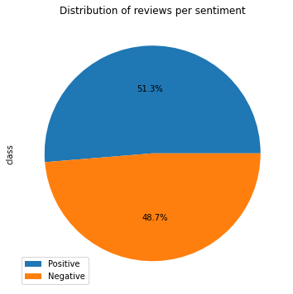

Dataset 7
Dataset containing 76,094 positive and 72,234 negative, is balance dataset and the percentage distribution was as follows:
We display the 150 most frequent words in tweets:

Slide 20
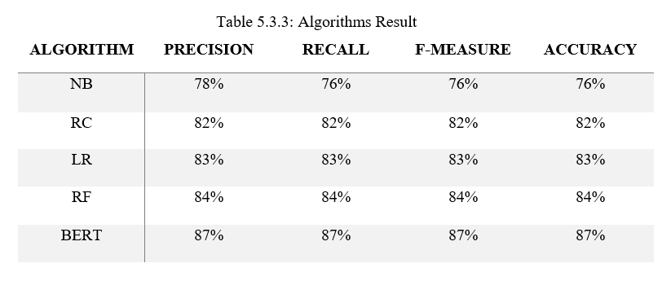
Dataset 7 (cont.)
We start in training our model using tweets and split data to 80% training and 20% testing and the distribution became like this: 118,662 training tweets and 29,666 testing tweets and results as follow:

Slide 21

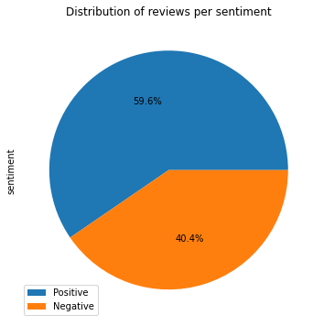
Dataset 8
Dataset containing 93,141 positive and 63,263 negative, is unbalance dataset and the percentage distribution was as follows:
We display the 150 most frequent words in tweets:

Slide 22
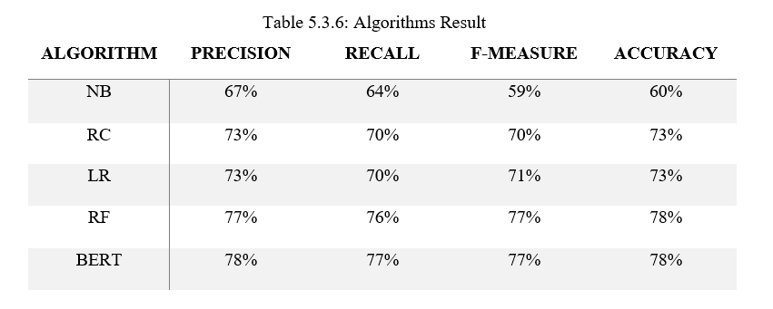
Dataset 8 (cont.)
We start in training our model using tweets and split data to 80% training and 20% testing and the distribution became like this: 125,125 training tweets and 31,282 testing tweets and results as follow:

Slide 23

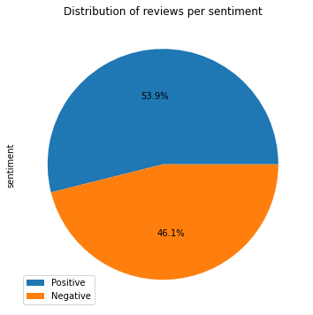
Combined Dataset
It is containing 304,735 Arabic tweets, but after remove duplicate it became 163,498 Arabic tweets, 83,523 positive and 79,975 negative and the distribution was as follows:
We display the 150 most frequent words in tweets:

Slide 24
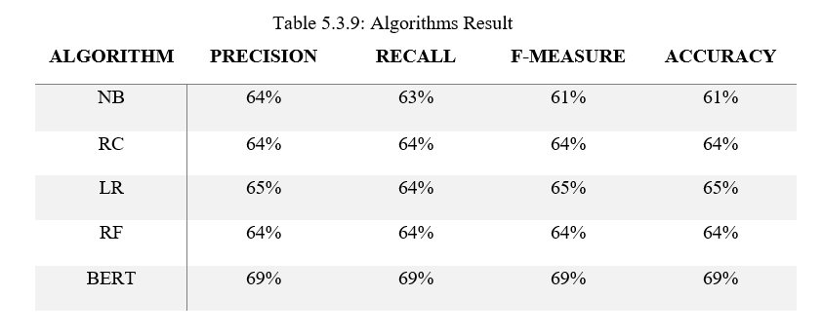
Combined Dataset (cont.)
We start in training our model using tweets and split data to 80% training and 20% testing and the distribution became like this: 144,961 training tweets and 36,241 testing tweets and results as follow:

Slide 25
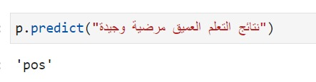
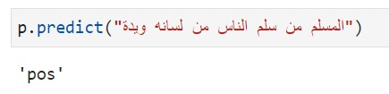
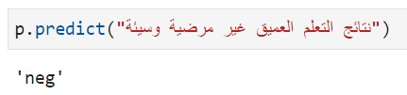
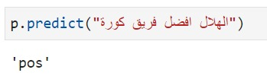
Model Classification Examples

Slide 26
Conclusion
5

Slide 27
Conclusion
Finally, After we worked on this project we discovered the big differences in accuracy other measures if the dataset is balance or unbalance or if a dataset is combined on another. We experienced a range of difficulties in this project, such as having some algorithms that needed a super computer because it took us days to work.

Slide 28
Thanks!
Any questions ?

