Slide 1
Telco Customer ChurnRate Analysis
Assisted by Softarex Team & Meshcharakou Egor

Slide 2
Greetings, TelCo management team!
Our team has carefully reviewed and prepared a comprehensive report on the available data. In this presentation, we will share the results of our work with you.

Slide 3
В данной презентации будут слайды 2х видов: ~ на русском для вас ~ на английском для условного заказчика

Slide 4
Part 1 : Data analysis
During the analysis of the database, we found some trends that may be of interest to you. Lets discuss it!

Slide 5
Первой частью было необходимо изучить задачу и подготовить данные.
Когда контекст задачи был и вид данных был изучен, было проведено математическое описание данных

Slide 6
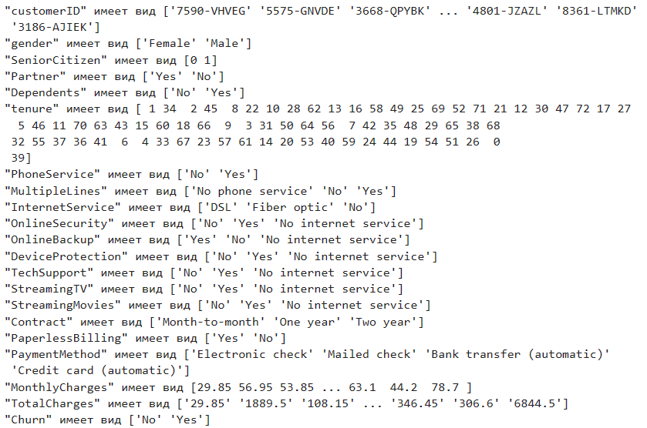
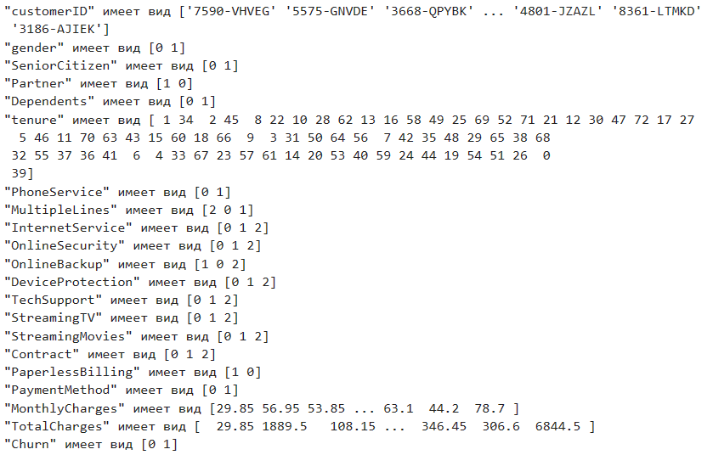
Преобразовано из --- в

Slide 7
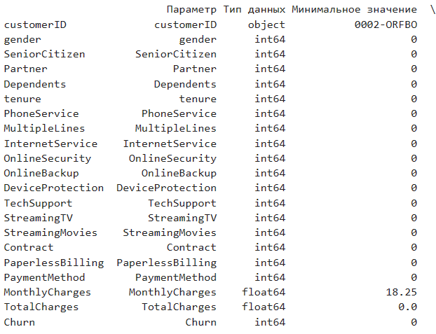
Trouble shooting
Смысловых ошибок в данных не было найдено, Однако есть подозрительный момент что TotalCharges может быть 0, когда mounthly charges положительного значения Предполагаем что компания не ошиблась и Просто изменят TotakCharges по прошествию месяца, а mountly charges в течении месяца

Slide 8
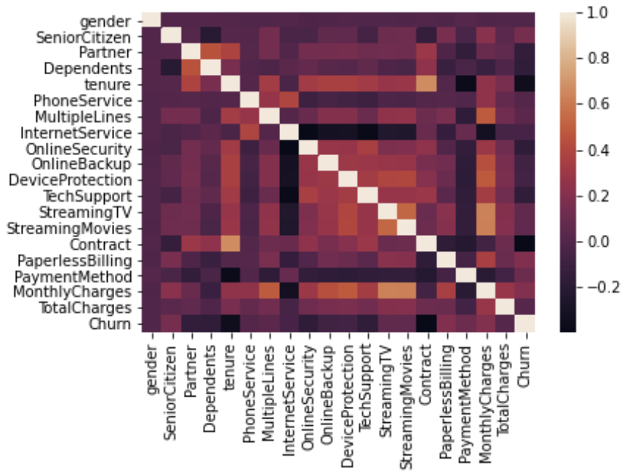
1.1 Correlation
From the heatmap, we could see that the features ‘Contract’ and ‘Tenure’ have a high correlation. It makes sense because these features measure the loyalty of the customer.
“StreamingTV”, “StreamingMovie”, “Multiple Lines” and “Monthly Charges” have a high correlation with one another. We think that this is because customers who stream movies are more likely to stream TV as well.

Slide 9
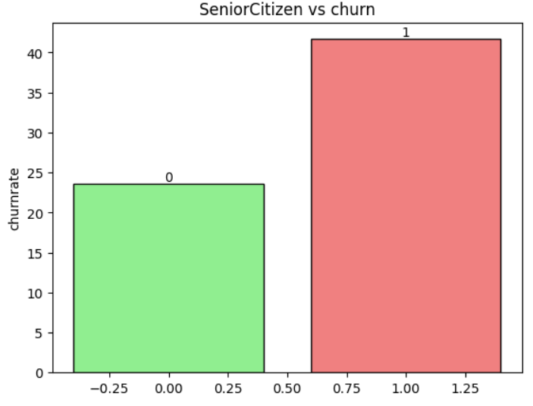
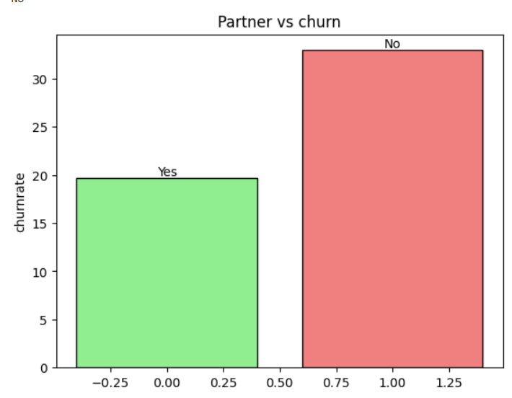
2.2 Categorical Data Analysis
the customers who are a senior citizens will be more likely to churn for the Telco service.
customers who doesn’t have a partner will be more likely to churn for the Telco service.

Slide 10
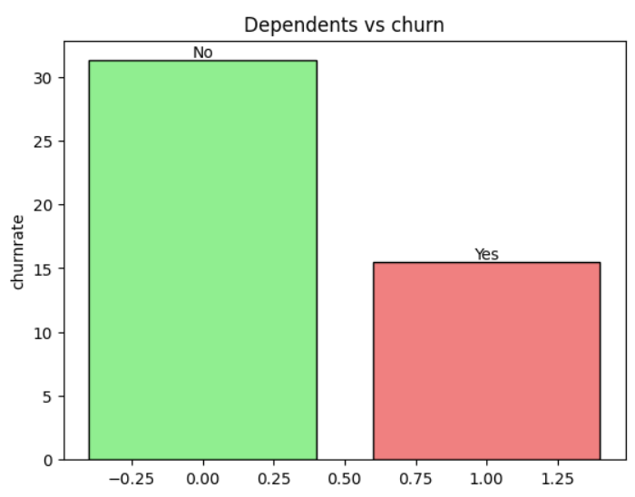
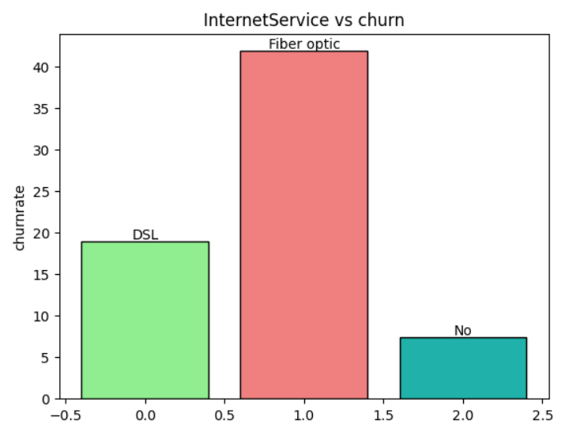
2.2 Categorical Data Analysis
the customers who doesn’t have Dependents will be more likely to churn for the Telco service.
it looks like most people are using Fiber internet and the customers who subscribe to Fiber internet are more likely to Churn.

Slide 11
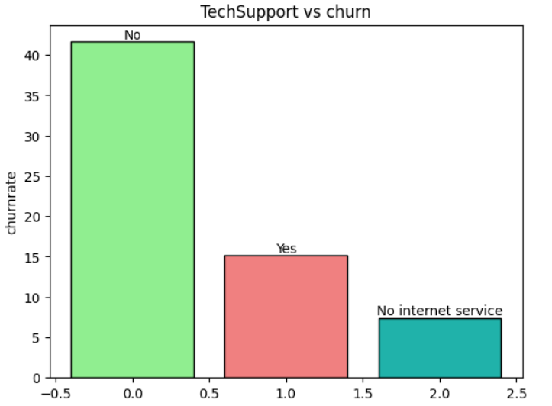
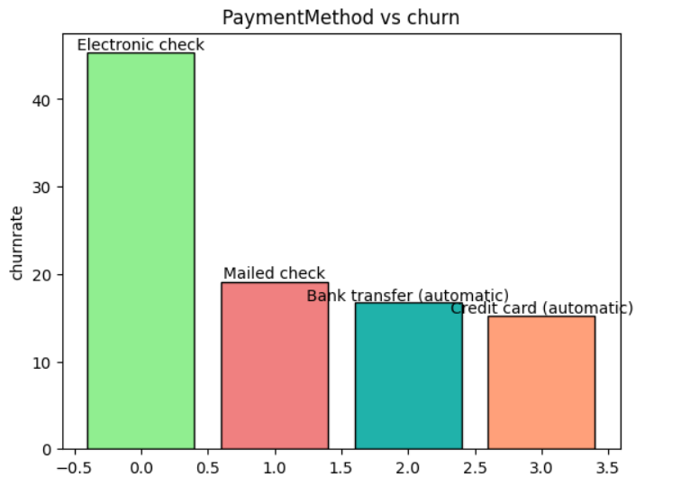
2.2 Categorical Data Analysis
Looks like your tech support works very well and helps to keep customers. But still customers prefer having internet at other service
Transfering users from Electronic check can help to keep your customers. Also its easy to notice – automatic payment is good way to keep your customers

Slide 12
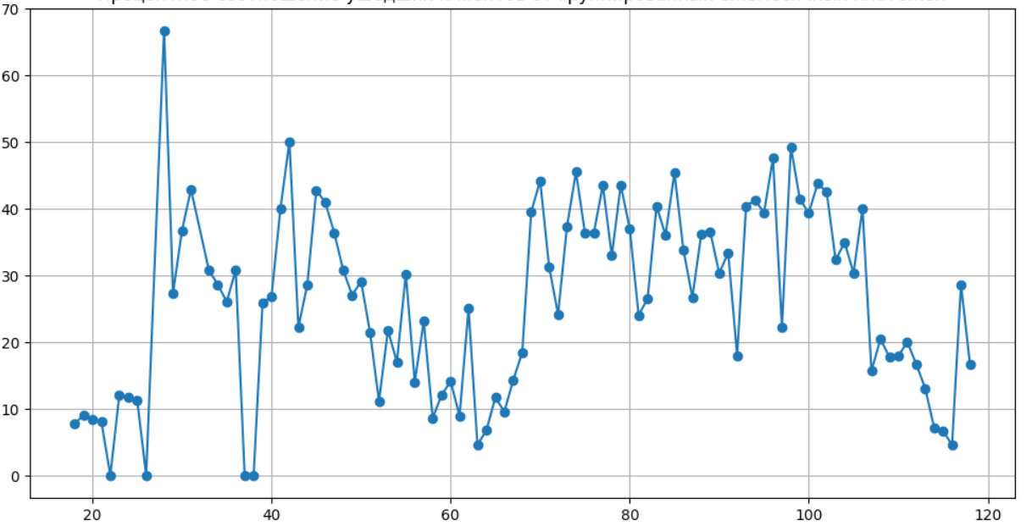
2.3 Monthly charges velocity
According to the chart, customers who pay between 110 and 120 euros per month, as well as those who pay between 50 and 70 euros per month, have the lowest churn rate. This means that these customers are the most loyal to the company.
To understand why these customers are the most loyal, it is necessary to study the service packages they use. It is possible that these service packages offer better value for customers, or they meet the needs of customers to a greater extent than the service packages of other competitors.
Studying the service packages used by these customers, as well as taking into account the data from previous slides, can also help the company to identify its strengths

Slide 13
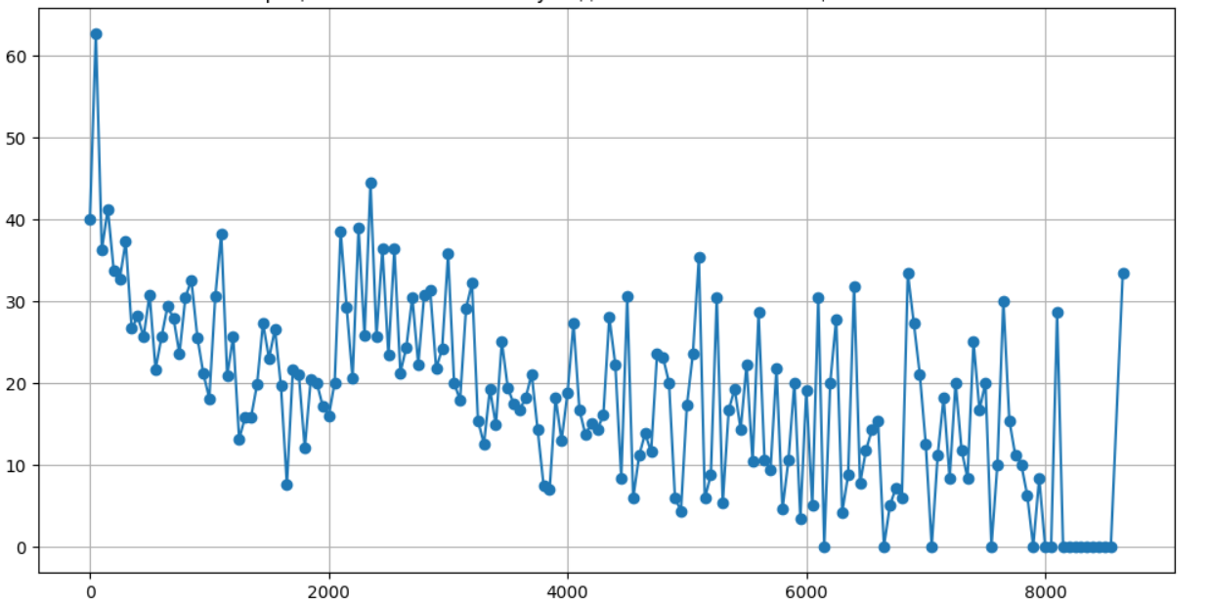
2.4 Total charges velocity
The graph shows that new customers have a particularly high churn rate. This suggests that your company's offerings for new customers are likely inferior to those of your competitors, which is something you should work on.
It is important to remember that new customers are generally more likely to churn quickly, but our churn rate for new customers is too high, which suggests that the conditions for new customers are poor.

Slide 14
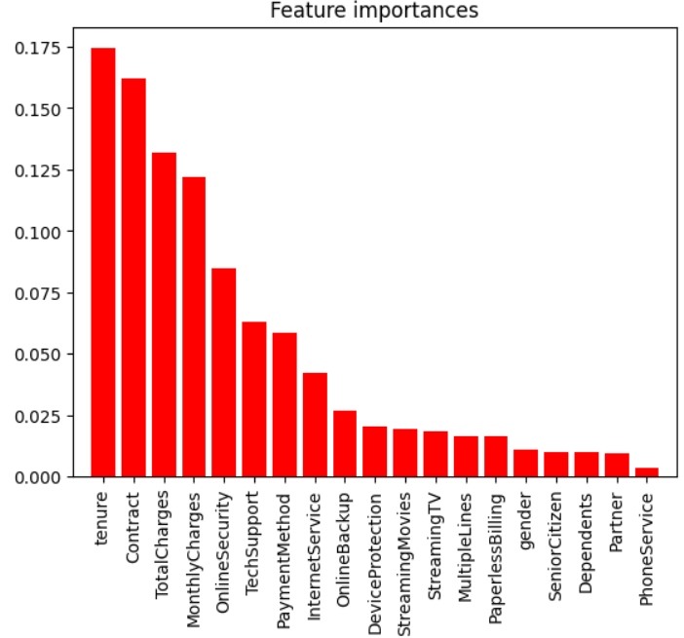
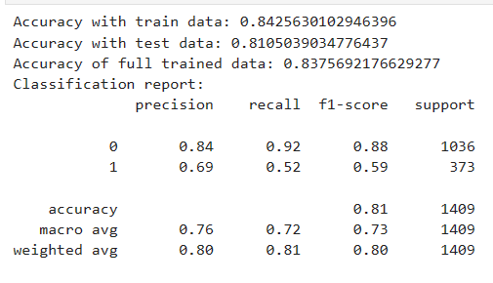
3. accurate ML model
Our team has identified the most accurate model for predicting customer behavior - Random Forest.
Random Forest is a machine learning method that combines multiple trees for better predictions.
With its help, you will be able to simulate a different scenario and forecast the future number of clients when implementing reforms in your customer management system.
Here we provide important metrics of our trained and optimized model:

Slide 15
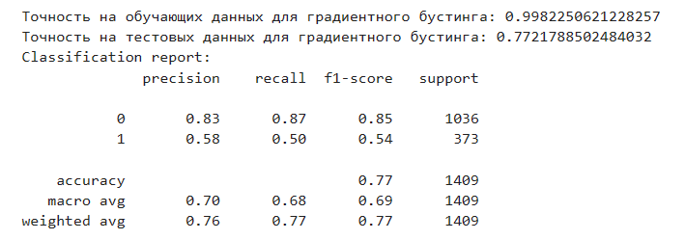
Выбор пал на дерево, тк это наиболее по простому трактуемый алгоритм машинного обучения, что подойдет для трактования результатов
Так же были испробованы другие алгоритмы, такие как logistic regression, simple tree и GradientBoostingClassifier
logistic regression дал результаты ниже представленного
simple tree так же
GradientBoostingClassifier дал точность 99 процентов на обучаемой выборке, однако на тестовых данных показывает себя значительно хуже

Slide 16
Thank you for attention !

