Slide 1
CAMPUSFIND
One campus.
Three challenges.
Connecting Campus Communities Through One Platform.
UEAB ISC DIGITAL BUILD-OFF 2026
TEAM / CAMPUSFIND
Meshack Oduor
Tumaini Kiplimo
Team Leader
Team Member
LOST ITEMS NOTICES MENTORSHIP
UEAB ISC DIGITAL BUILD-OFF 2026 / CAMPUSFIND
01
Notes:
Tumaini opens: CampusFind brings three everyday campus services into one place—lost-item reporting and claims, campus notices, and mentorship. Introduce the team and frame the pitch as one connected platform, not three separate apps.

Slide 2
CAMPUSFIND
01 / THE NEED
Small campus frictions add up
01
02
03
Lost items
Unclear notices
Weak mentorship
A missing item can be hard to report, match to the right details, and safely return.
Important updates can be easy to miss when people cannot quickly find the right information.
Students can struggle to discover a suitable mentor and start a structured connection.
Belongings stay unresolved.
Students may miss what matters.
Guidance is harder to reach.
Three familiar moments. One opportunity to make campus life easier to navigate.
UEAB ISC DIGITAL BUILD-OFF 2026 / CAMPUSFIND
02
Notes:
Meshack: Describe the three pain points as everyday campus experiences, not quantified claims. A lost item is difficult to trace, a useful notice is not useful if people cannot find it, and mentorship often begins with the hard part—finding the right person and making first contact.

Slide 3
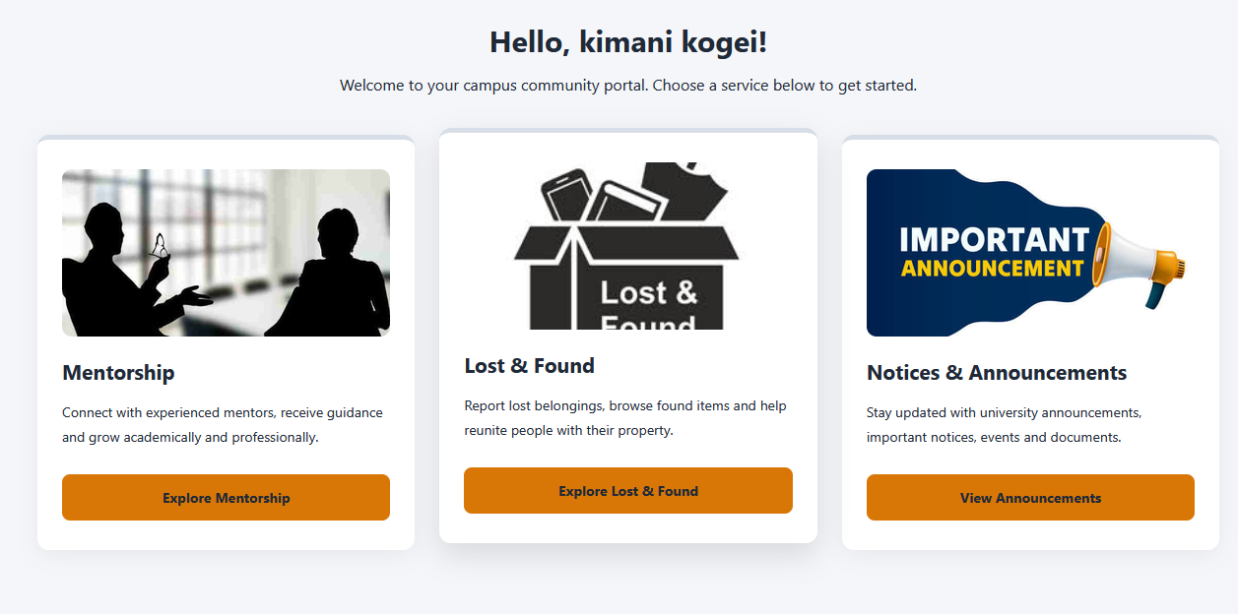
CAMPUSFIND
02 / THE SOLUTION
One account. Three campus services.
A shared home for finding, staying informed, and growing.
LOST ITEMS
Report and follow lost-item claims.
NOTICES
Find campus announcements.
MENTORSHIP
Discover mentors and connect.
Shared account / shared notifications
Actual CampusFind dashboard capture
UEAB ISC DIGITAL BUILD-OFF 2026 / CAMPUSFIND
03
Notes:
Tumaini: CampusFind connects the three services through one signed-in dashboard, a consistent interface, and common account and notification infrastructure. The screenshot is an actual dashboard capture from the project; point out how the three services are presented side by side.

Slide 4
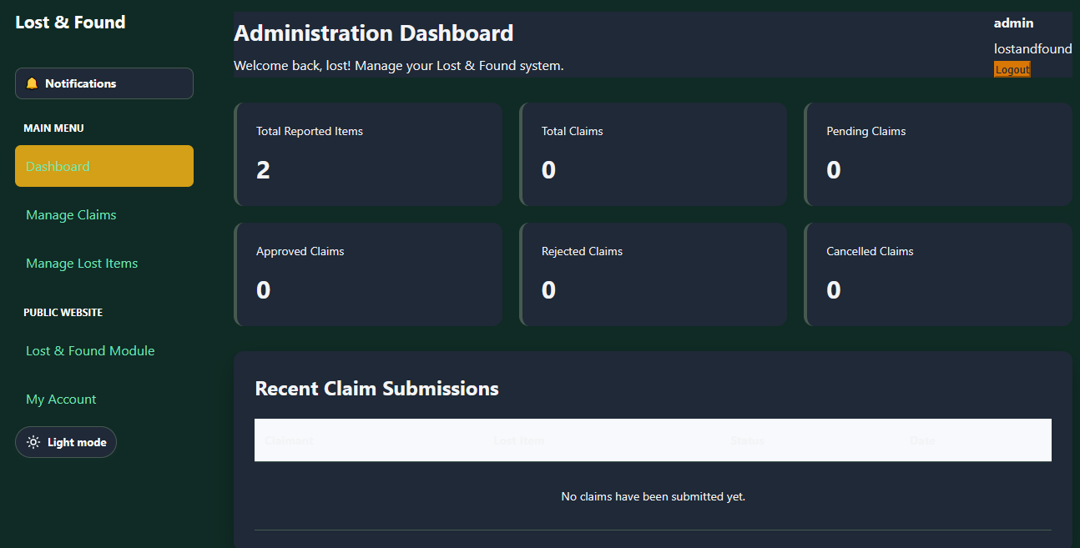
CAMPUSFIND
03 / MODULE ONE
Lost Items: from report to review
01
Report a lost item
Add details, location, date, and a photo.
02
Administrator review
Reports are checked before appearing in the gallery.
03
Browse and claim
Users find approved reports and submit ownership evidence.
04
Decision and recovery
Admins review claims and can record a returned item.
Actual Lost & Found administrator dashboard
CURRENT SCOPE: LOST-ITEM REPORTING
A user-facing found-item submission flow is a future improvement.
UEAB ISC DIGITAL BUILD-OFF 2026 / CAMPUSFIND
04
Notes:
Meshack: Walk through the actual flow: a signed-in user submits a lost-item report with details and a photo; an administrator reviews it; approved reports can be browsed and claimed with evidence; an administrator reviews the claim and records a return. Be explicit that the current user-facing flow is for lost reports, not found-item submissions.

Slide 5
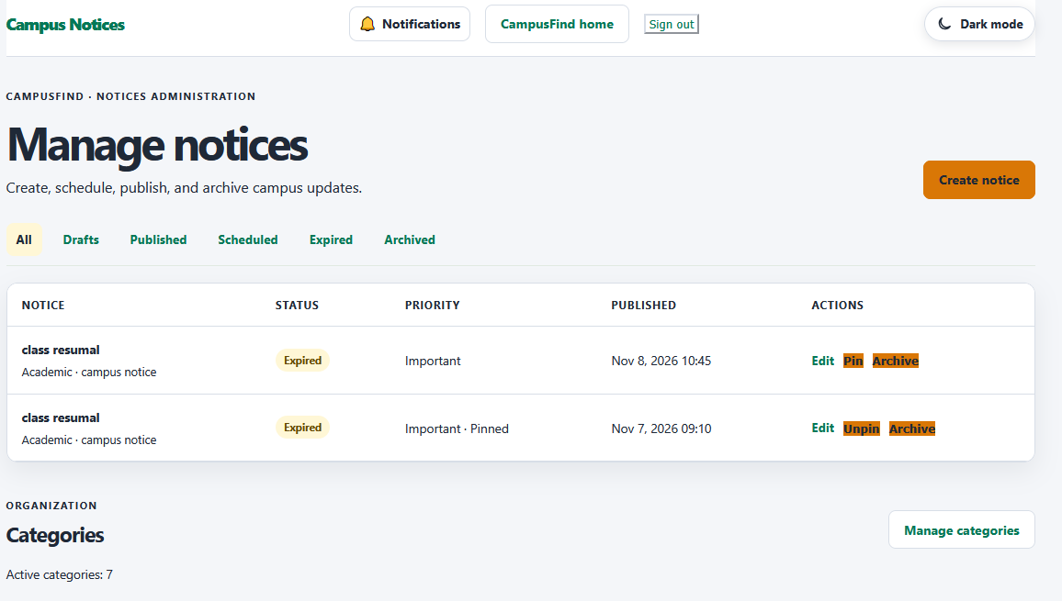
CAMPUSFIND
04 / MODULE TWO
Notices: campus updates in one place
Make the right information easier to find—and easier to manage.
One notice feed
Signed-in students and staff can browse published notices.
Useful context
Categories, urgency, dates, attachments, and read tracking.
Targeted publishing
Admins can choose audience and school or department targeting.
Admin controls
Create drafts, publish, schedule, edit, pin, and archive.
Actual Notices administration capture
UEAB ISC DIGITAL BUILD-OFF 2026 / CAMPUSFIND
05
Notes:
Cyprian: Notices are centralized in a signed-in feed. Administrators can draft, publish or schedule, prioritize, target, attach documents, and manage categories; readers can browse and open published notices. The screenshot shows the real administration interface, not a mock-up.

Slide 6
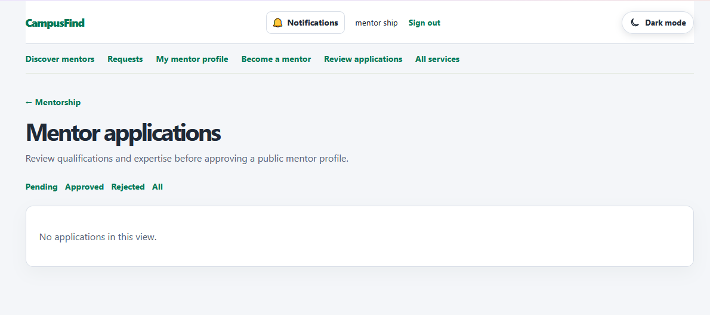
CAMPUSFIND
05 / MODULE THREE
Mentorship: make the first connection
Discovery becomes a structured path to guidance.
Discover
Search active mentors by name or expertise.
Apply
Prospective mentors submit a profile for admin review.
Request
Students send a mentorship request to an available mentor.
Continue
Accepted connections support conversations and sessions.
Actual mentor-application review capture
REVIEW BEFORE PUBLIC PROFILE
UEAB ISC DIGITAL BUILD-OFF 2026 / CAMPUSFIND
06
Notes:
Donovan: Mentorship is more than a directory: students can search active mentors by name or expertise, mentors can apply for an administrator-reviewed profile, and students can request a connection. Accepted connections support participant conversations and session scheduling. The image is the real mentor-application review screen.

Slide 7
CAMPUSFIND
06 / THE EXPERIENCE
A clear path from sign-in to action
01
02
03
04
05
Register or
sign in
Open your
home
Choose a
module
Complete an
action
Check
updates
Student or staff account
Authenticated dashboard
Lost Items · Notices · Mentorship
Report · read · request
In-app notifications
One notification center surfaces relevant updates across the modules.
The dashboard is the signed-in home; there is no separate public marketing landing page today.
UEAB ISC DIGITAL BUILD-OFF 2026 / CAMPUSFIND
07
Notes:
Tumaini: Explain the real route: registration or login leads to the authenticated dashboard, where users choose a service and complete a workflow. Relevant events can surface in the shared in-app notification center. Administrator accounts route to their administration home rather than the student/staff dashboard.

Slide 8
CAMPUSFIND
07 / HOW IT FITS TOGETHER
Three modules, one shared foundation
PHP APPLICATION / APACHE
BROWSER
MYSQL
Lost Items
Notices
Mentorship
HTML
CSS · JavaScript
PDO connection
InnoDB tables
CampusFind interface
Shared authentication + CSRF
Shared notifications
A single database backs shared user accounts, module workflows, and notifications.
Server-rendered PHP pages · shared helpers · relational data with foreign keys
UEAB ISC DIGITAL BUILD-OFF 2026 / CAMPUSFIND
08
Notes:
Cyprian: The architecture is a server-rendered PHP application served through Apache, with HTML/CSS/JavaScript in the browser. Shared helpers cover authentication, CSRF, and notifications; module workflows use a PDO connection to one MySQL database with InnoDB tables and foreign keys.

Slide 9
CAMPUSFIND
08 / TECHNOLOGY
Built with a focused, conventional stack
01
02
03
04
Interface
Application
Data
Runtime
HTML · CSS · browser JavaScript
PHP 8.1+
MySQL · PDO
Apache
Server-rendered pages; shared design tokens
Module workflows and shared helpers
InnoDB tables, relationships, and migrations
Local development commonly uses XAMPP
A practical, dependency-light foundation for a connected campus service.
Confirmed in the repository: no Composer or npm dependency manifest.
UEAB ISC DIGITAL BUILD-OFF 2026 / CAMPUSFIND
09
Notes:
Cyprian: Name only what is in the repository: PHP 8.1 or later, MySQL via PDO, server-rendered HTML, CSS and browser JavaScript, and Apache; XAMPP is a common local setup. The project has no Composer or npm dependency manifest.

Slide 10
CAMPUSFIND
09 / TRUST AND OVERSIGHT
Access is tied to accounts and roles
IMPLEMENTED CONTROLS
ADMINISTRATION
Session-based sign-in; passwords are hashed.
Module assignments and super-admin oversight are part of the current platform.
Student, staff, admin, and super-admin roles.
Role and active-account checks on protected pages.
Notices admin routes enforce module assignment. Enforcement is not yet uniform across every Lost Items and Mentorship admin route.
CSRF tokens on state-changing forms.
Credible access controls today—with a clearly identified authorization gap to close.
UEAB ISC DIGITAL BUILD-OFF 2026 / CAMPUSFIND
10
Notes:
Meshack: Describe the implemented controls narrowly: session-based sign-in, hashed passwords, role and active-account checks, CSRF tokens, module assignments, and super-admin oversight. Do not claim uniform module-level authorization: the project documentation identifies that enforcement is not yet consistent across all Lost Items and Mentorship admin routes.

Slide 11
CAMPUSFIND
10 / EXPECTED VALUE
Less friction. More connection.
The value we expect to create across everyday campus life
FIND
A clearer route from lost-item report to reviewed claim.
KNOW
One place to browse notices and their important details.
GROW
An easier first step toward mentor guidance.
CONNECT
One campus platform instead of isolated workflows.
Expected impact—not measured outcomes. Campus-wide results have not been established.
UEAB ISC DIGITAL BUILD-OFF 2026 / CAMPUSFIND
11
Notes:
Donovan: These are intended outcomes, not measured results. Explain how each module reduces a practical barrier: a more structured recovery workflow, more accessible notices, and a path from mentor discovery to an ongoing connection. We have not established campus-wide adoption or impact metrics.

Slide 12
CAMPUSFIND
11 / WHAT COMES NEXT
A focused roadmap—not a feature claim
FUTURE OPPORTUNITIES
01
Complete the found-item flow
02
Refine mobile workflows
Expose a user-facing path for found-item reports and recovery.
Keep key tasks comfortable on smaller screens.
03
Improve discovery
04
Add notification preferences
Make cross-module and item search more useful.
Let people choose which updates they receive.
05
Build insight and integrations
Build on what is already working
Explore reporting and university-system connections.
Prioritize reliability, usability, and responsible integration.
Every item above is proposed future development—not an implemented feature.
UEAB ISC DIGITAL BUILD-OFF 2026 / CAMPUSFIND
12
Notes:
Donovan: These opportunities are explicitly future work: a complete found-item user flow, continued mobile refinements, better discovery, notification preferences, analytics/reporting, and possible university integrations. Do not imply any of these are already implemented.

Slide 13
CAMPUSFIND
12 / LIVE DEMONSTRATION
See the workflows in action
01
02
03
LOST ITEMS
NOTICES
MENTORSHIP
Report → review → claim
Publish → browse → read
Discover → request → connect
Focus: the recovery workflow
Focus: targeted campus updates
Focus: the guided first step
Sign in → choose a module → complete one real workflow → check notifications
UEAB ISC DIGITAL BUILD-OFF 2026 / CAMPUSFIND
13
Notes:
Tumaini: Transition into the live demo. Suggested sequence: sign in and show the dashboard; demonstrate a Lost Items workflow, browse a notice, discover a mentor and show the request path; finish with the shared notifications. If time is tight, choose one end-to-end interaction per module.

Slide 14
CAMPUSFIND
13 / AI ACKNOWLEDGEMENT
AI Tools & Development Assistance Acknowledgement
A transparent account of where AI assisted and where accountability stays.
TOOLS USED
HOW AI SUPPORTED THE WORK
GitHub Copilot
1
Brainstorming and refining ideas
AI coding assistant
2
Technical research and problem analysis
3
Code suggestions and debugging assistance
ChatGPT / OpenAI
4
UI/UX design suggestions
Conversational AI assistant
5
Documentation and presentation preparation
DEVELOPMENT ASSISTANT: NOT A REPLACEMENT FOR OUR WORK
Our team made the technical decisions, reviewed implementations, tested functionality, integrated modules, and remains responsible for the final product.
AI accelerated our development process, but the vision, decisions, implementation, integration, testing, and responsibility for CampusFind remain with our team.
UEAB ISC DIGITAL BUILD-OFF 2026 / CAMPUSFIND
14

Slide 15
CAMPUSFIND
One Campus. Three Challenges.
One Connected Solution.
Thank you.
QUESTIONS & ANSWERS
Tumaini Kiplimo · Meshack Oduor
UEAB ISC DIGITAL BUILD-OFF HACKATHON 2026
UEAB ISC DIGITAL BUILD-OFF 2026 / CAMPUSFIND
15
Notes:
All: Thank the judges, restate the one-campus promise, and invite questions. Tumaini can close and the rest of the team can answer module-specific questions.

