Slide 1

Payroll Management Database
Carmeshia Lazzana

Slide 2
Agenda
Create
Create a Database Diagram showing tables relations
Create
Create Relational Database
Set
Set Primary and Foreign Keys constraints to create relations between tables
Prepare
Prepare example query using GROUP BY and HAVING
Prepare
Prepare an example query with a Subquery
Use
Use Joins to create a view using multiple tables
Create
Create a View using 3-4 tables and prepare a query
Create
Create a Stored Function
Create
Create a Stored Procedure and demonstrate how it works
Create
Create a Trigger and demonstrate how it runs

Slide 3
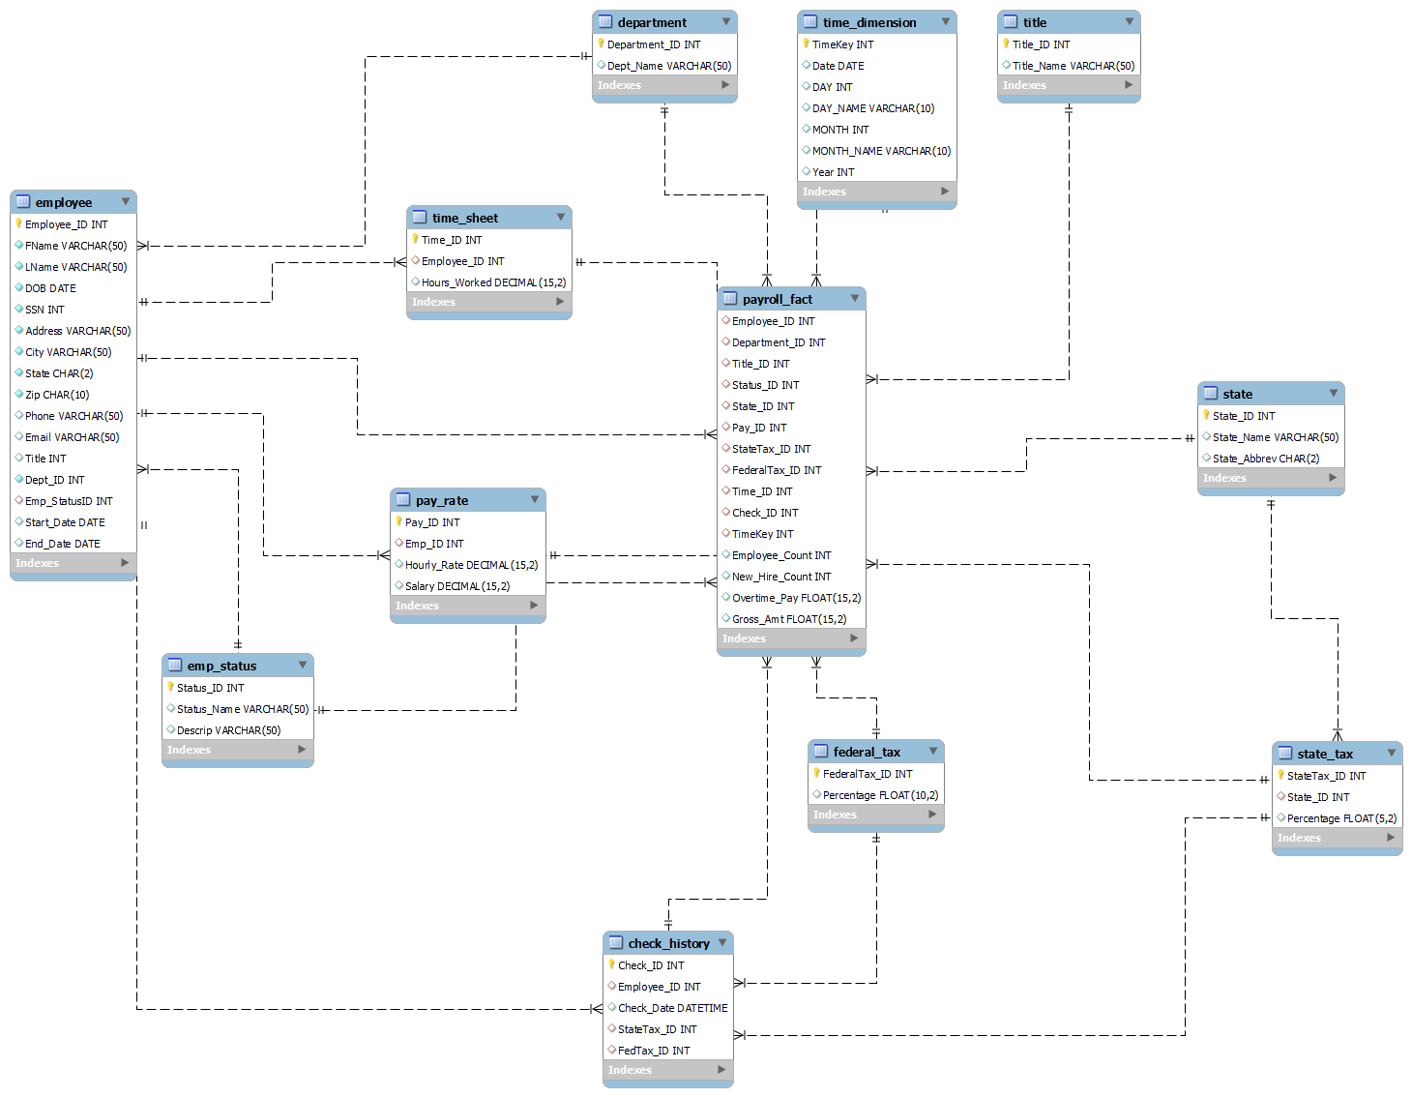
Relational Diagram
Snowflake Schema

Slide 4
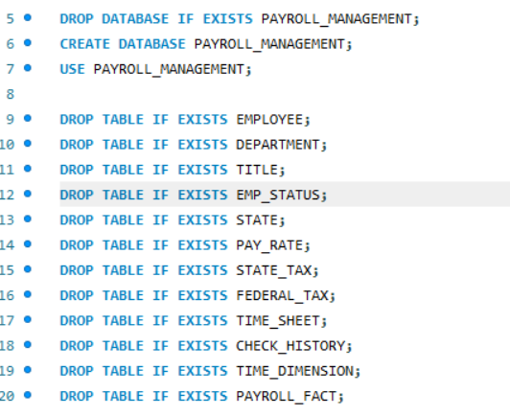
Create Database
Creating of Database and Tables within

Slide 5
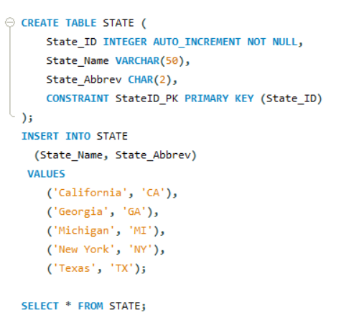
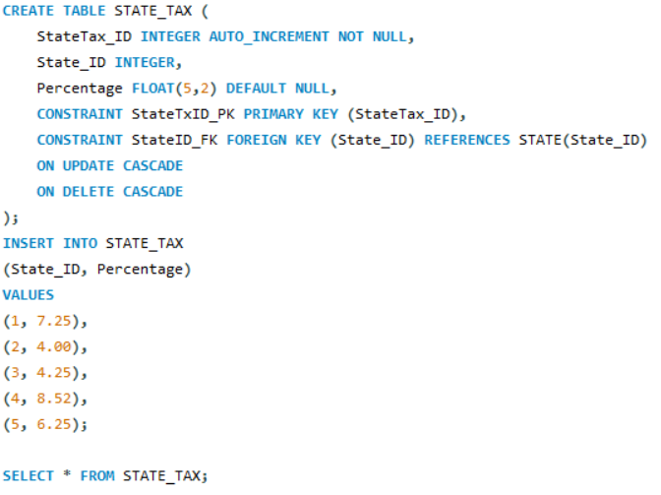
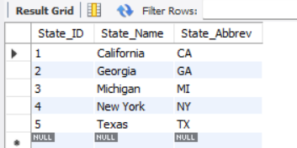
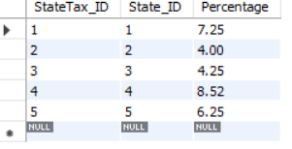
Set Primary Key and Foreign Key Constraints
Create Tables
State table PK (State_ID) is FK on State_Tax table

Slide 6
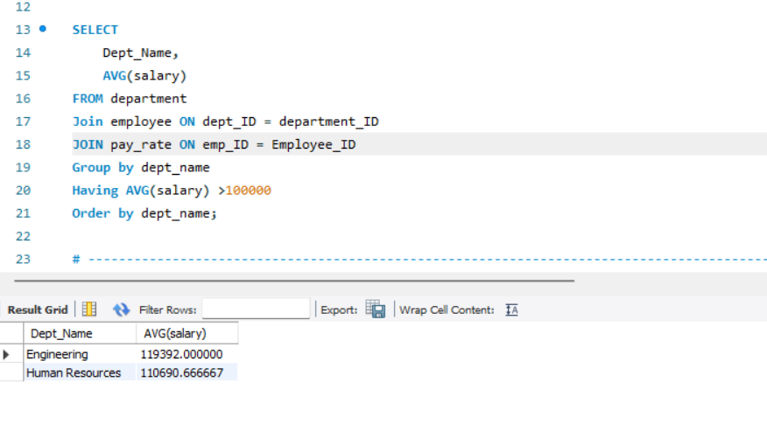
Group By And Having
Query: Find which department pays their employees more than $100,000 on average

Slide 7
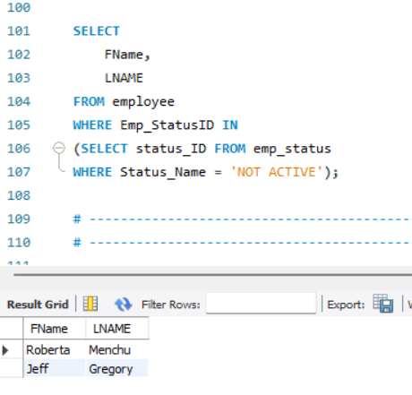
Subquery
Query: Find the employees that are no longer active with the company.

Slide 8
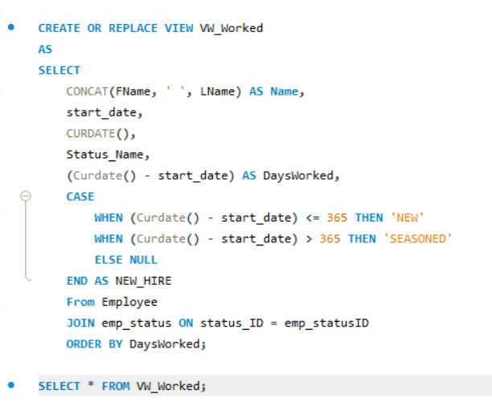
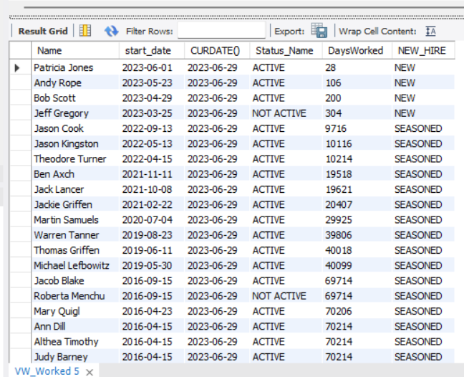
Use Joins to Create View
Create a view that combines multiple tables in a logical way
Query: Find all employees who are considered as new hires. Employees are considered new if they have worked a year or less.

Slide 9
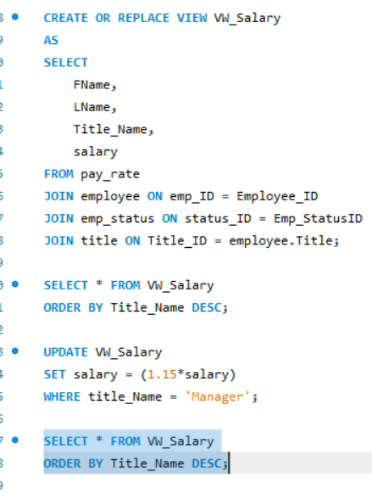
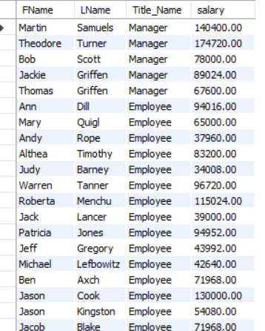
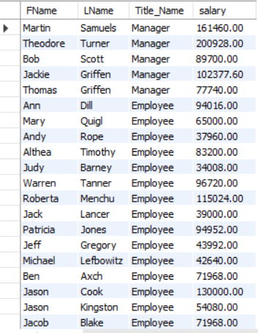
Create View Using 3-4 Base Tables
Query: Create a view of the employee's name, title and salary. Update the view by giving the managers a %15 raise.

Slide 10
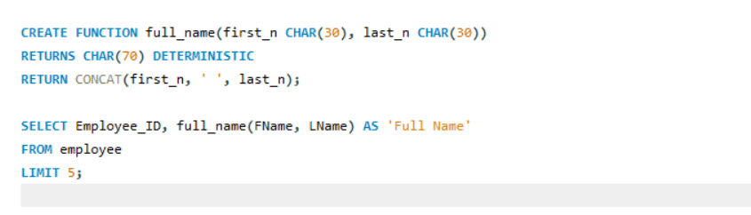
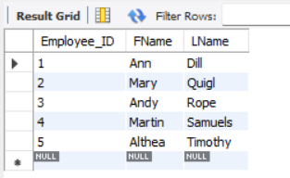
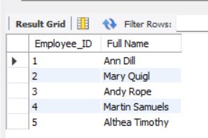
Stored Function
Query: Create a stored function that will combine the employee’s first and last name

Slide 11
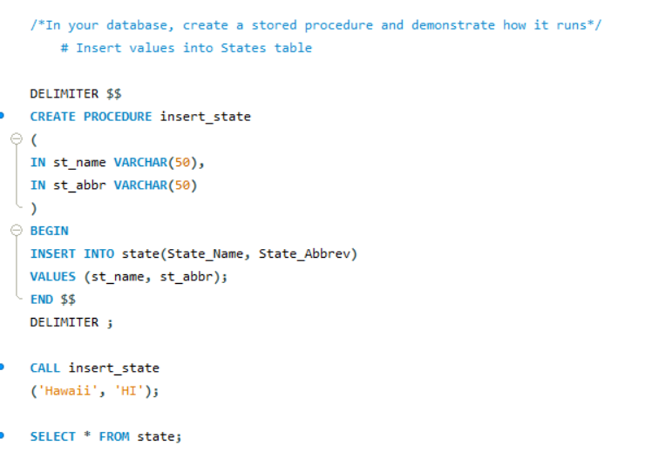
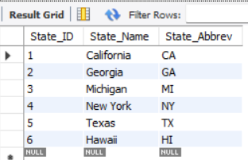
Stored Procedure
Query: Create a stored procedure for the state table and insert values into the table

Slide 12
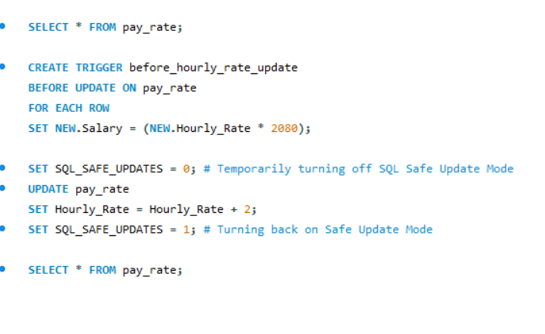
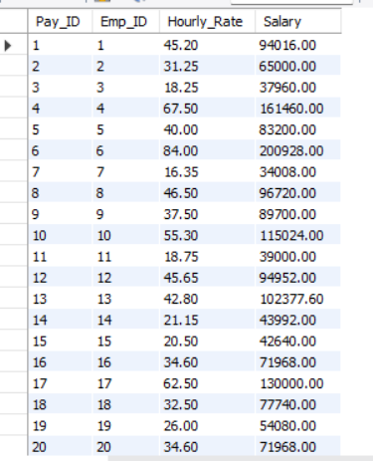
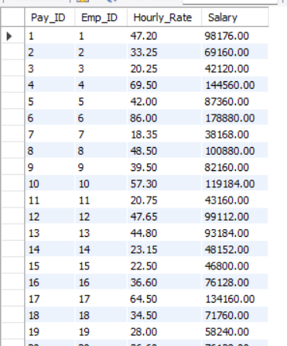
Trigger
Query: Create a trigger that will calculate a salary from the hourly rate, increase the hourly rate by $2
2080 is the average hours worked in a year

Slide 13

Summary
This project is a demonstration of SQL and Data skills learned within the Code First Girls program.

Slide 14

Thank you
Author: Carmeshia Lazzana
LinkedIn: Carmeshia.Lazzana
GitHub: Carmeshia.Lazzana

