Slide 1
Nextflow Overview
J.Smith
6/14/2022

Slide 2
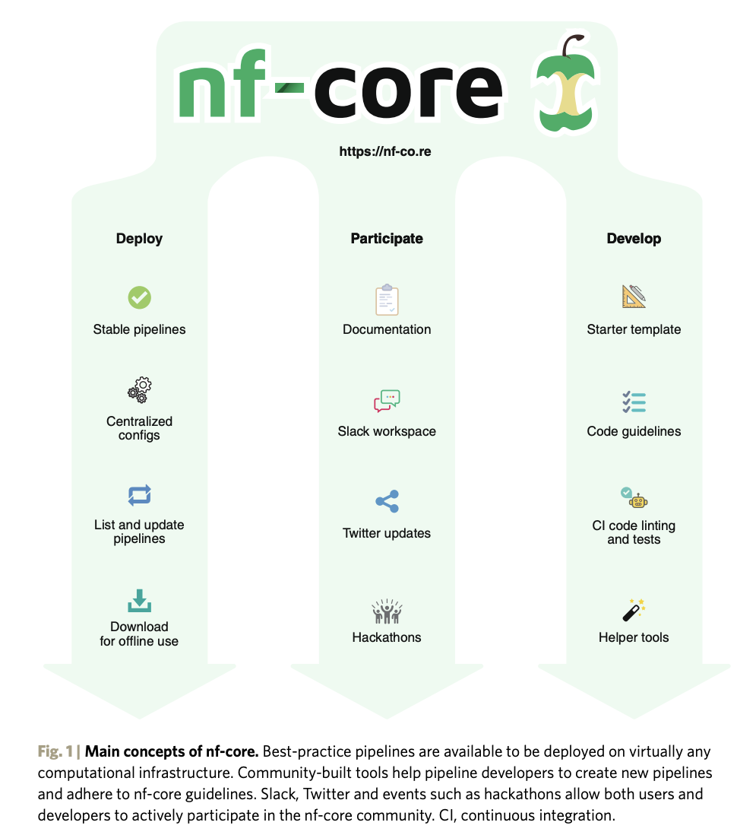
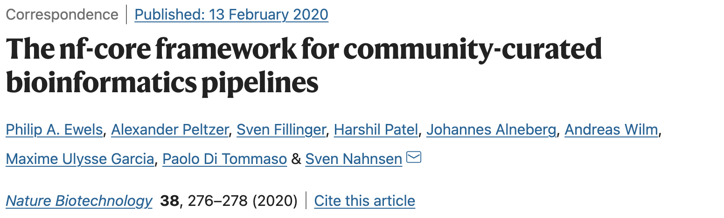
Background
https://nf-co.re/join
https://nf-co.re/usage/introduction
https://www.nextflow.io/docs/latest/dsl2.html

Slide 3
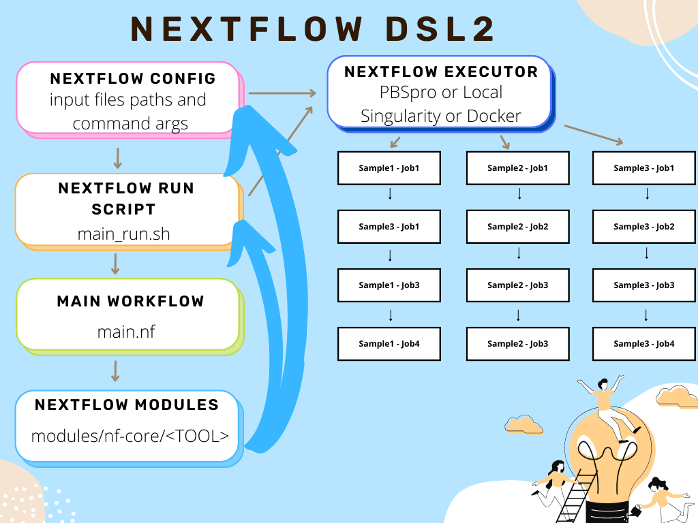
DSL2 Concepts
Modular workflows
Can include subworkflows

Slide 4
RNA-seq count pipeline
Based on nf-core modules
https://github.com/nf-core/modules
https://childrens-atlassian/bitbucket/projects/RPDEV/repos/rnaseq_count_nf
Directions to run the pipeline:
`workflow_run.Rmd`

Slide 5
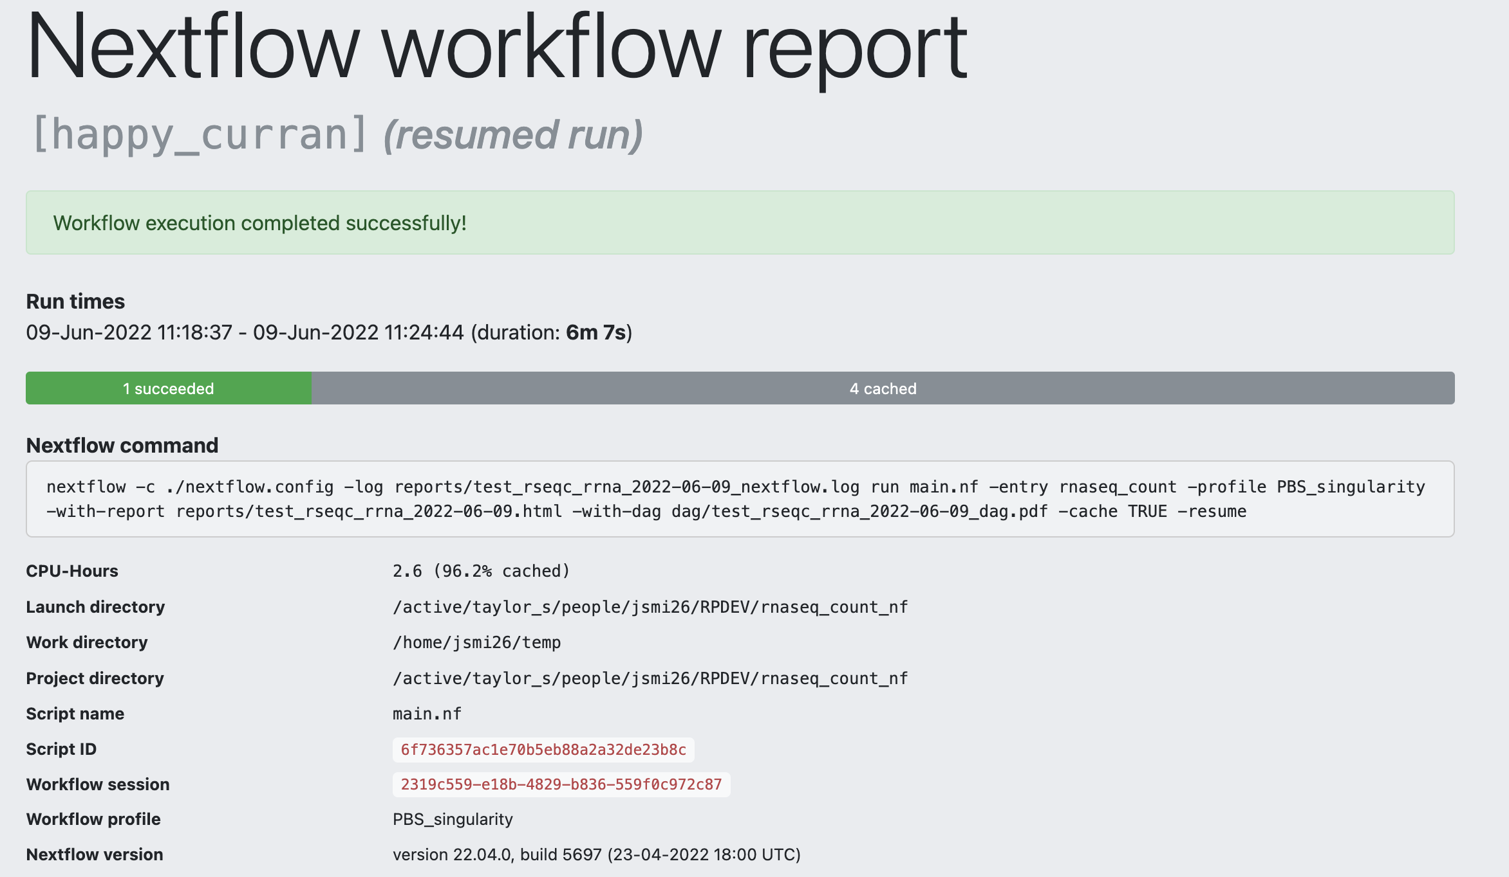
RNA-seq count pipeline

Slide 6
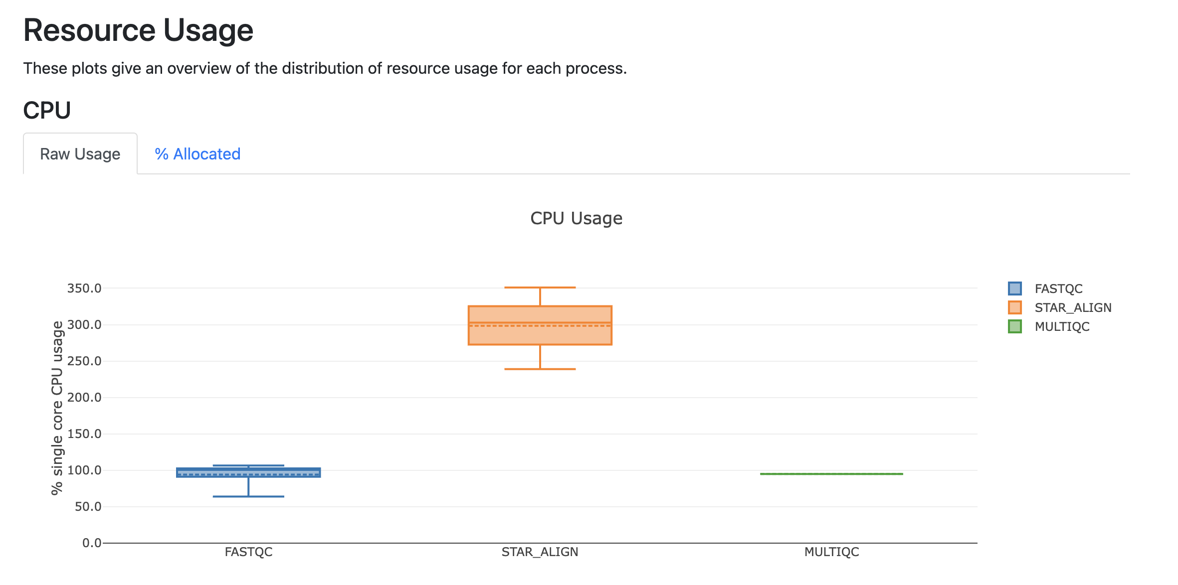
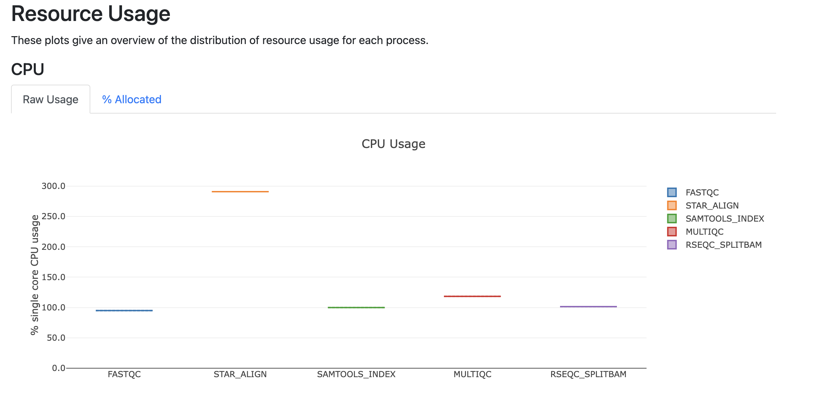
RNA-seq count pipeline

Slide 7
Learning Materials
https://learn.gencore.bio.nyu.edu/intro-to-nextflow/
https://carpentries-incubator.github.io/workflows-nextflow/

